Slide 1
Car Rental System Implementation Plan
Justin Verrick
INFO-C 451
Midterm Project
March 2026

Slide 2
Car Rental System Implementaion
Replace outdated manual rental process
Introduce centralized digital system
Manage reservations, vehicles, customers, and payments
Improve efficiency and reduce human error

Slide 3
System Implementation within SDLC
Planning: Define scope and goals
Analysis: Gather system requirements
Design: System Architecture and database
Development: Build system features
Testing: Verify system performance
Implementation: Deploy system
Maintenance: Updates and improvements

Slide 4
Hybrid Development Approach
Combines Waterfall and Agile
Waterfall: Planning, requirements, and high-level design
Agile: Development, testing, and improvements
Using a combination of both methods will provide structure while allowing flexibility.

Slide 5
Risk Assessment
Implementation Risks:
Data migration errors
System downtime during deployment
Employee resistance to change
Integration issues with payment systems
Mitigation Strategies:
Data cleansing before migration
Deploy system during off-hours
Provide employee training
Perform system testing

Slide 6
Project Timeline
Weeks 1-2: Planning
Weeks 3-4: Requirements Analysis
Weeks 5-6: System Design
Weeks 7-10: Development
Weeks 11-12: Testing
Weeks 13: Data Migration
Weeks 14: Deployment
Weeks 15-16: Post-Implementation Support

Slide 7
Data Migration Plan
Data will be transferred using ETL
Extract: Collect data from spreadsheets, paper records, and old databases.
Transform: Clean duplicates, fix formatting, and standardize data fields.
Load: Import cleaned data into new system database.

Slide 8
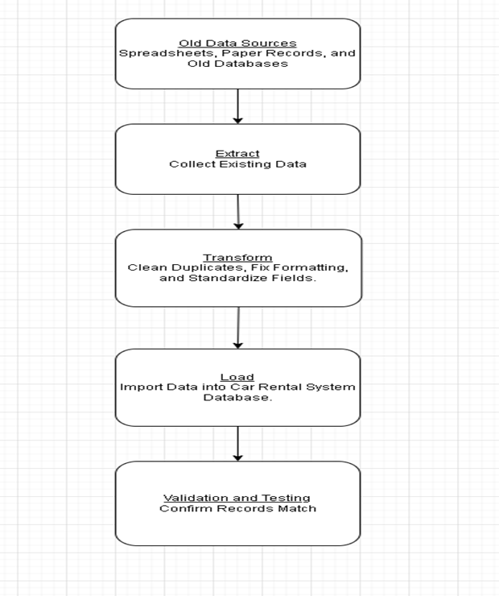
ETL Diagram

Slide 9
System Testing Plan
Testing Types: Unit Testing, Integration Testing, System Testing, and User Acceptance Testing.
Testing Tools: Selenium, Junit, and Postman.

Slide 10
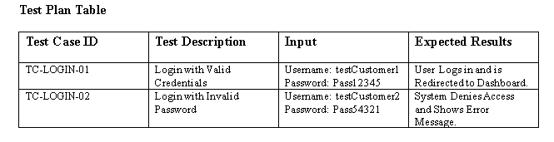
Test Cases

Slide 11
Successful Implementation Depends On
Proper project planning
Accurate data migration
Employee training and support
Testing before deployment
Post-Implementation Monitoring

Slide 12
Lessons Learned
Planning reduces system implementation risks
Data validation is critical for migration success
Testing helps detect issues early
Continuous improvements help maintain system performance

