Slide 1


From Sensor to GeoJSON:
Building an Open Source IoT Geo-Pipeline

Slide 2


About me
MSc. Geology, Utrecht University
Python & data during thesis
Python/GIS dev at an engineering company
Now teacher at Geo-ICT
Notes:
Volgende keren andere docenten, ik heb de installatie etc. met ze afgestemd

Slide 3
Planning
Geo-ICT
Workshop intro: IoT & components
First Project
More components & connecting to Wifi etc.
Self paced: help yourself and each other
Break at around 16.00h
Notes:
Eerst alles los van elkaar, dan samenvoegen.
Eerst werken aan de basis voor de integratie

Slide 4
This Workshop
Ask your questions when you have them
Try to fix your bugs
Read the instructions
Help each other

Slide 5
Courses
QGIS, Python, Remote Sensing, Deep Learning, PostGIS, Geoserver, Docker, Openlayers, Web-GIS, Field surveying, Drones, and 200+ more
Blended learning, On-site, Online
IT/GIS staffing/seconding
Europe
Remote

Slide 6
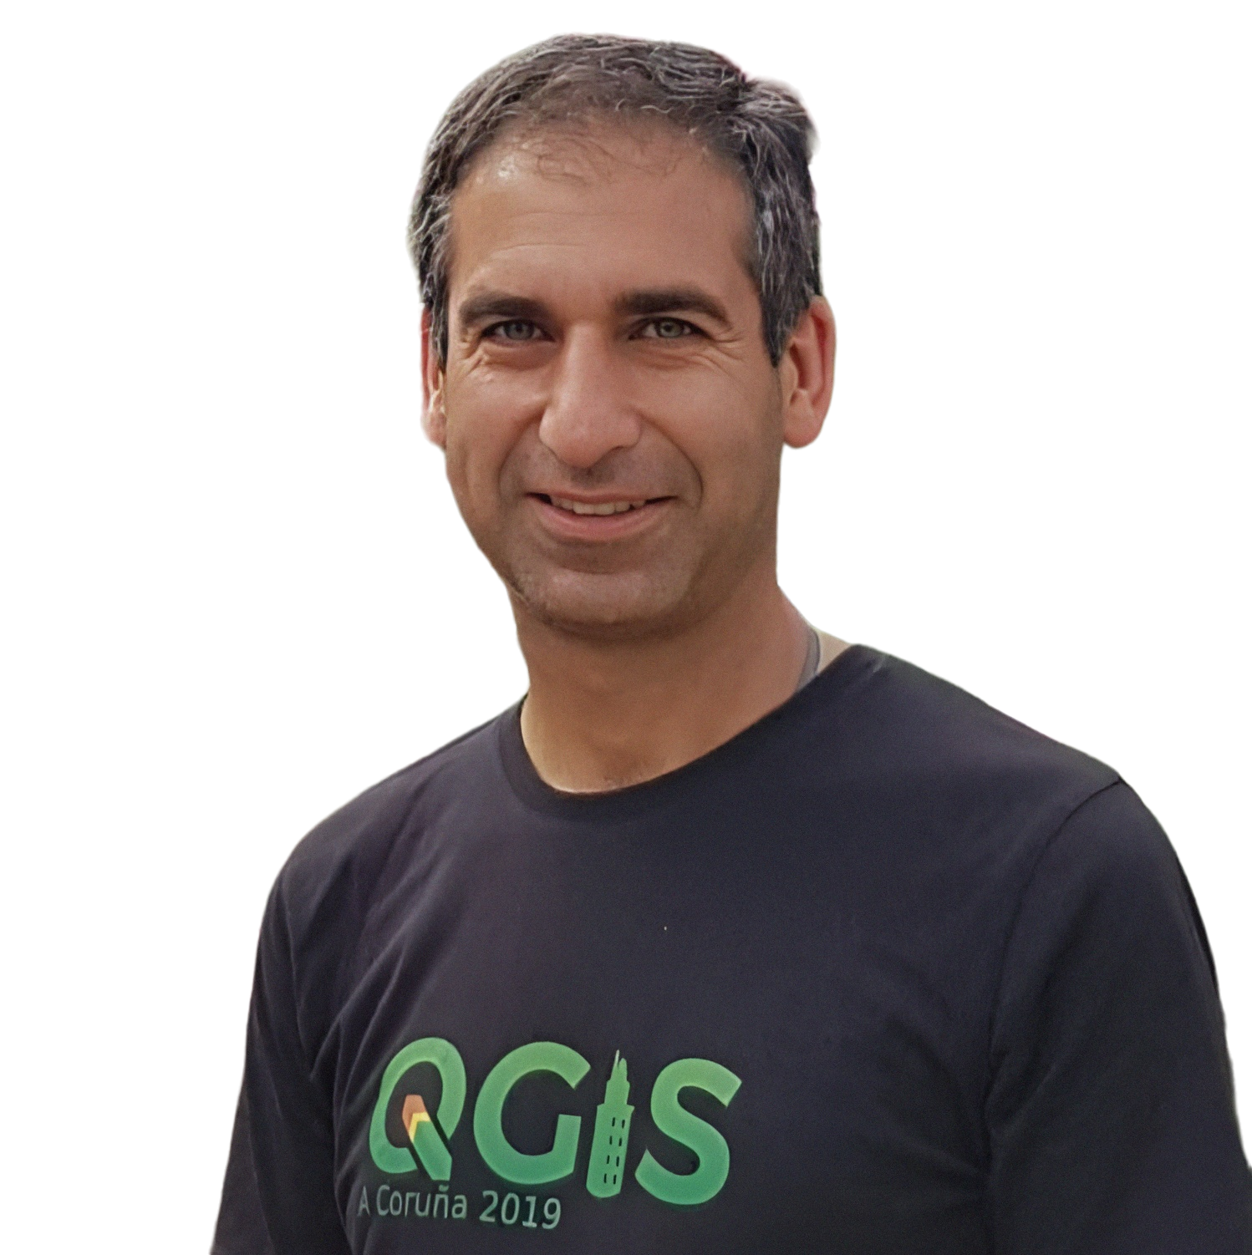



Our partners:

Slide 7
You
What do you do?
Where do you work?
Where do you live?

Slide 8
Raise of hands
Do you have any coding experience?
Did you ever code with C/C++?
Do you have any electronics experience?

Slide 9
IOT

Slide 10
Why?

Slide 11
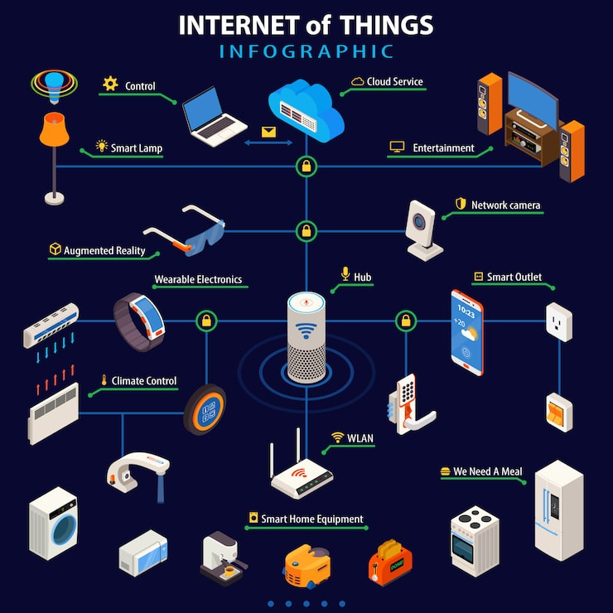
IoT
Internet
Of
Things

Slide 12
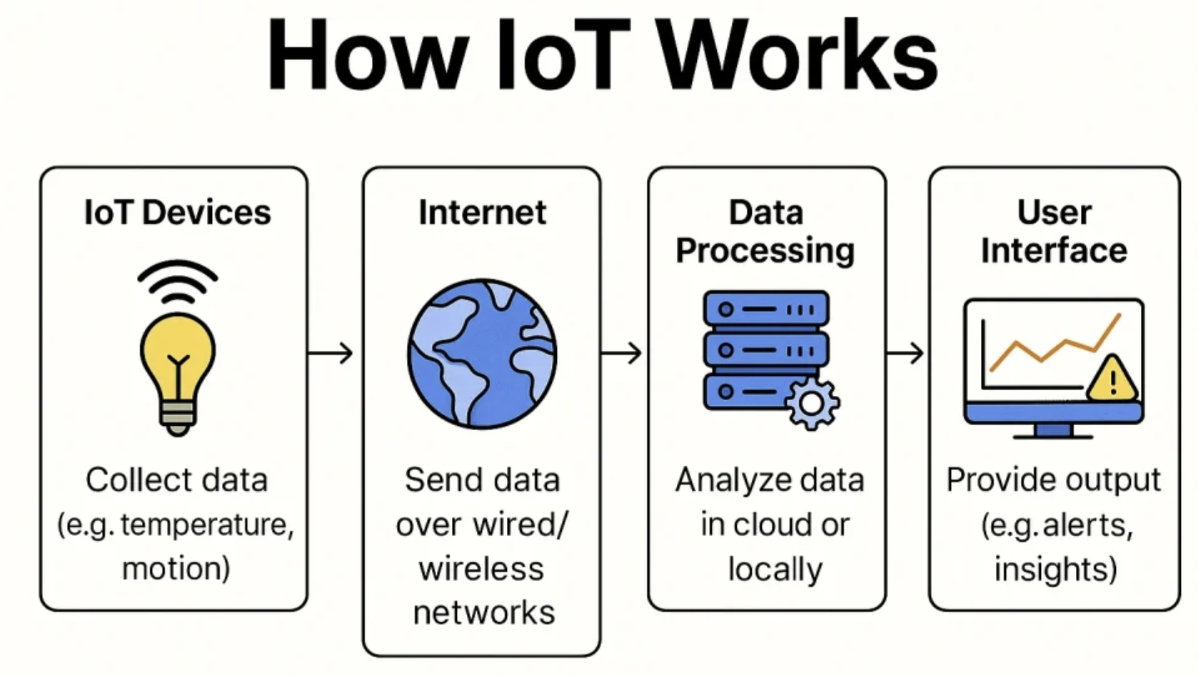

Slide 13
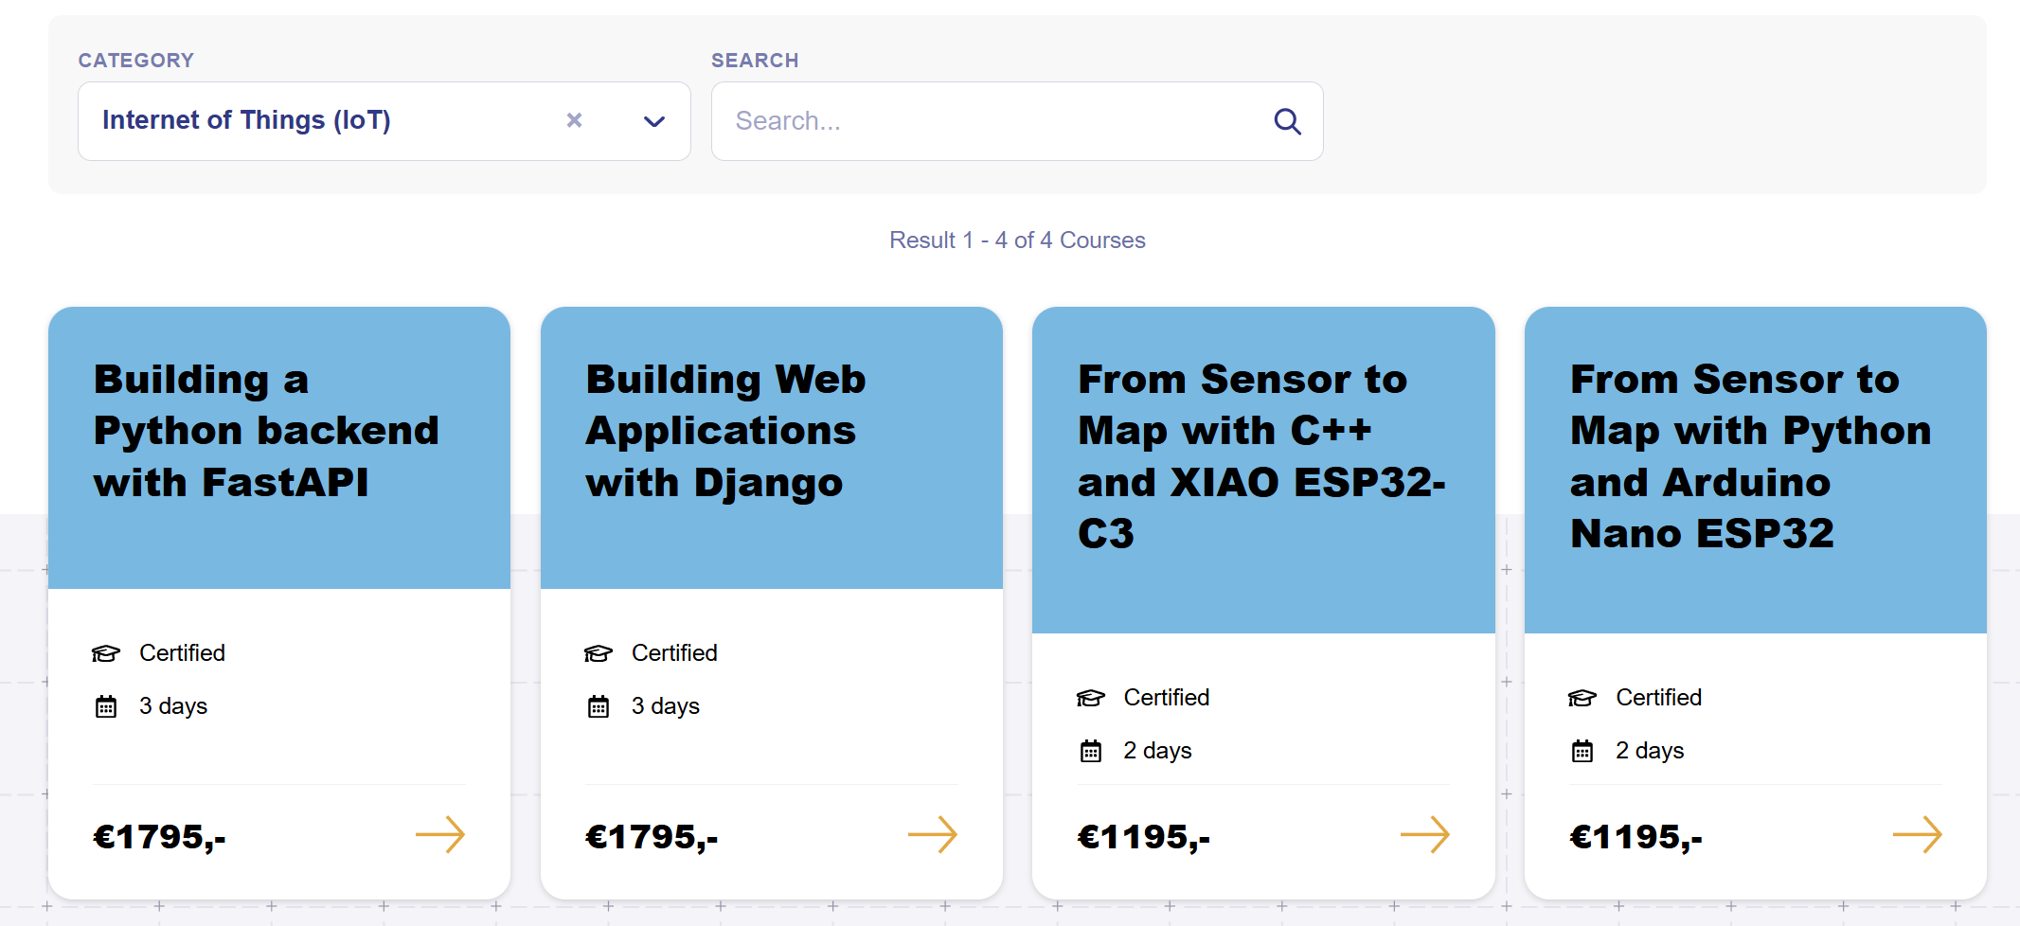
New courses

Slide 14
Today: sneak peak
Basics of IoT
Getting to know the hardware
Sensor: temperature & humidity
GPS antenna
WiFi-connection
GeoJSON
Self-paced

Slide 15
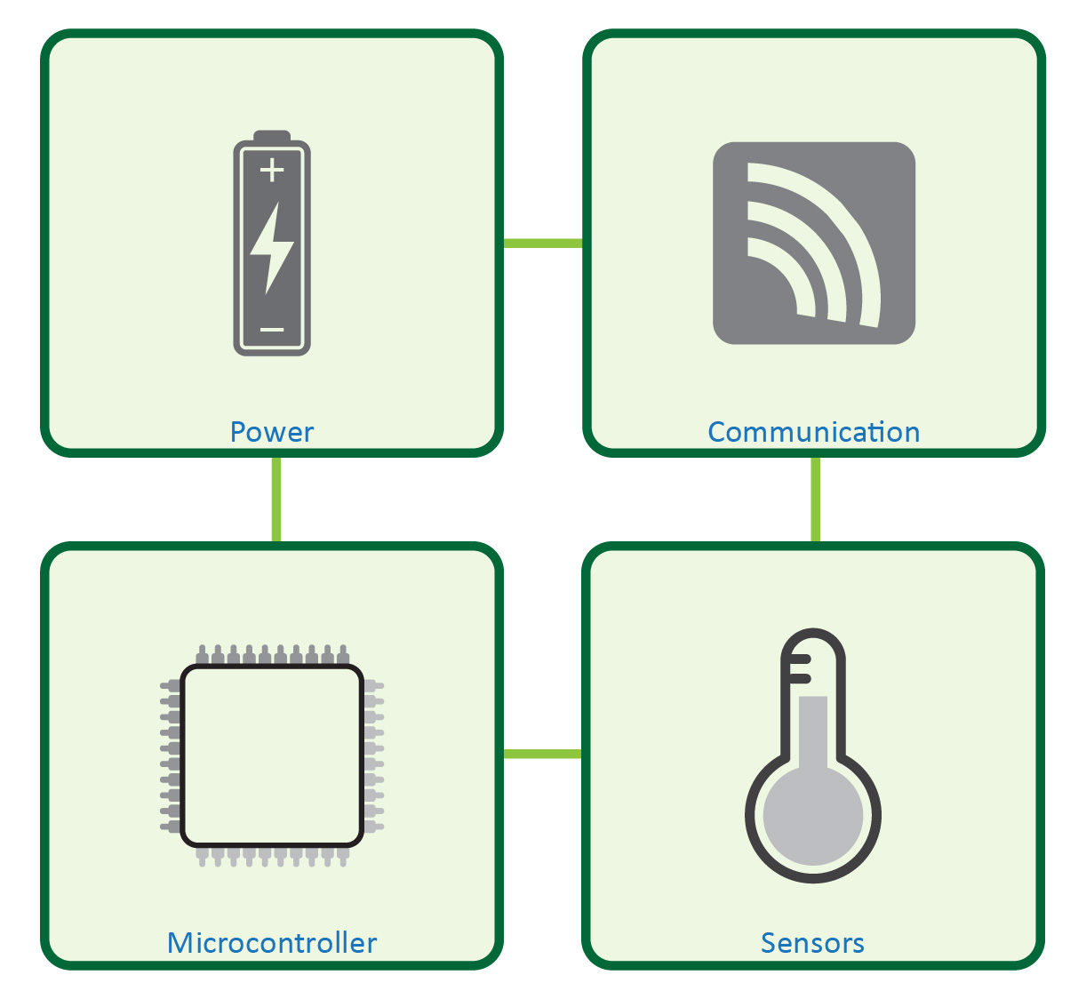
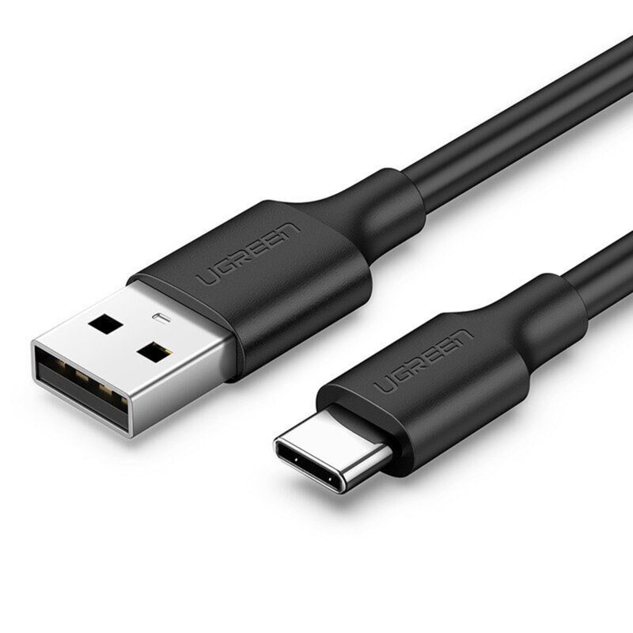
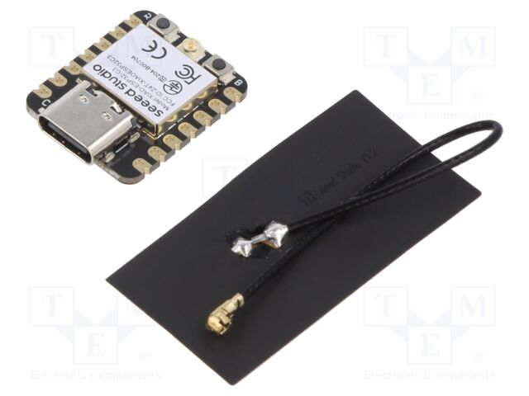
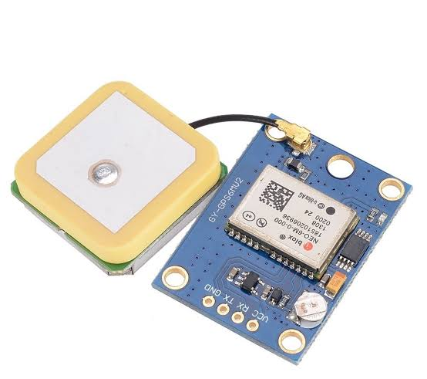
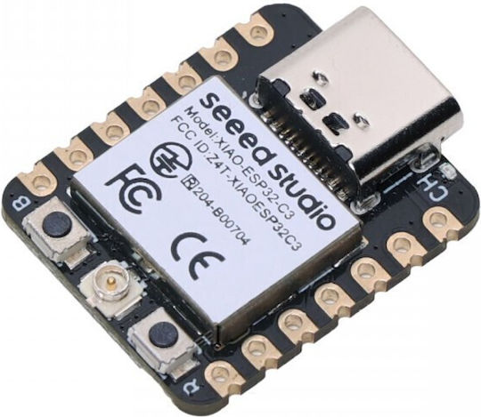
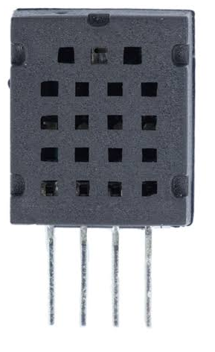
+ GPS

Slide 16
Universal setup
All parts are interchangable
Power cable -> battery
WiFi -> 4G

Slide 17
Not today
OGC sensorthings
Would be a good upgrade
Connecting to a live backend
Building a backend

Slide 18
XIAO
The star of the show

Slide 19
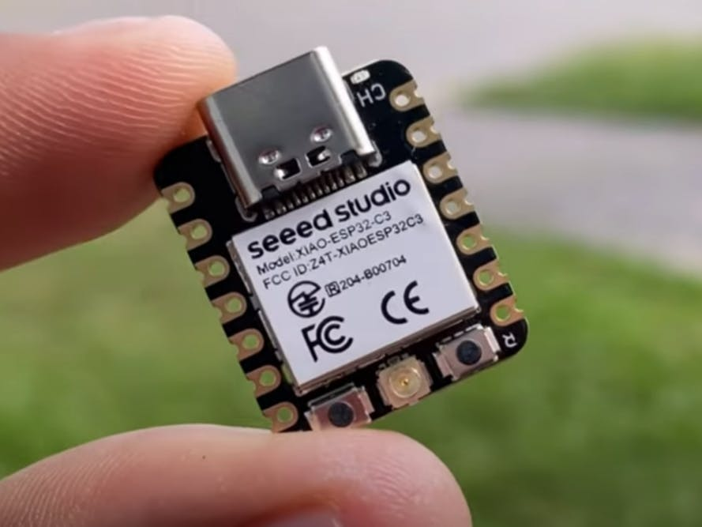

Slide 20
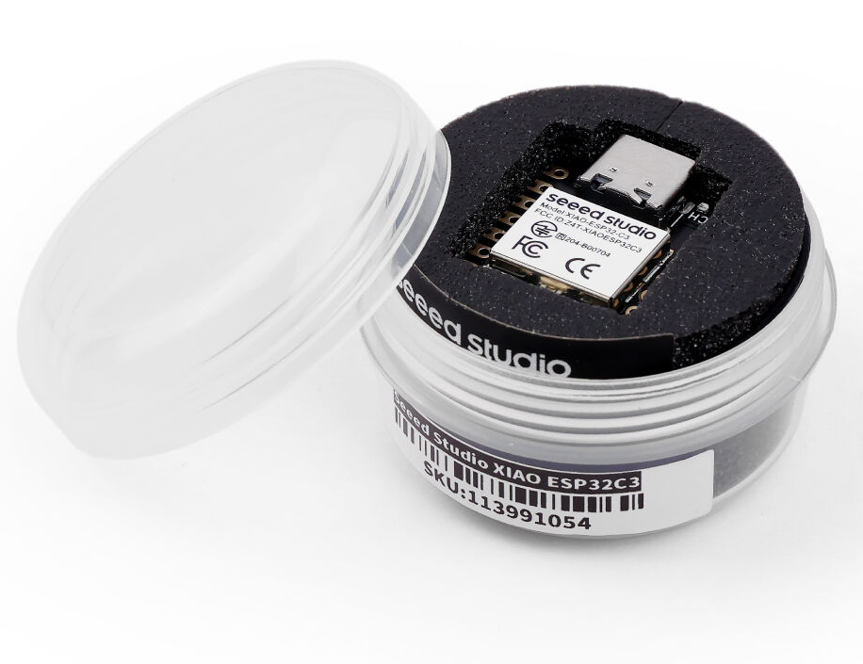
XIAO ESP32 C3
XIAO = “small” in Chinese
ESP32-C3 = the microcontroller chip on the board, made by Espressif
Seeed Studio = the brand
Bluetooth Low Energy
WiFi (antenna)
Header pins (soldering)
Notes:
The ESP32-C3 is a 32-bit single-core RISC-V SoC with Wi-Fi and Bluetooth Low Energy. Seeed’s XIAO ESP32C3 uses that chip, runs up to 160 MHz, and is a very small IoT development board.

Slide 21
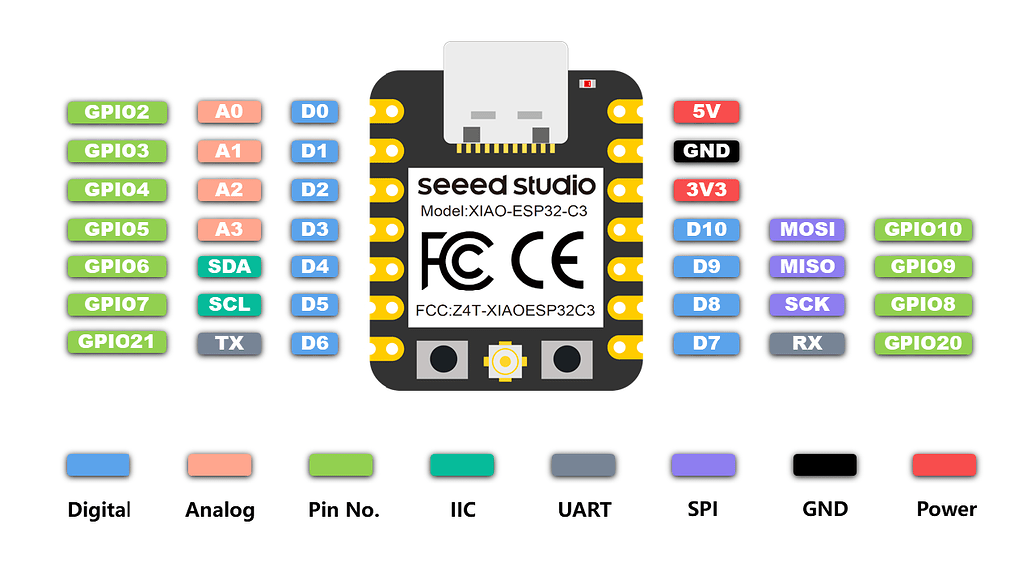
Careful

Slide 23
Simple setup
Blink a LED

Slide 24
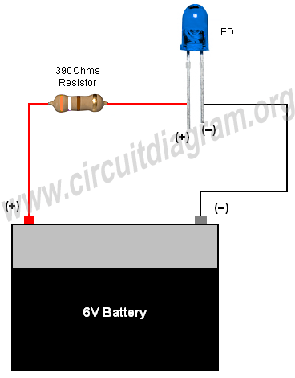
Basic electronics
Power source
LED
Resistor
What can go wrong?

Slide 25
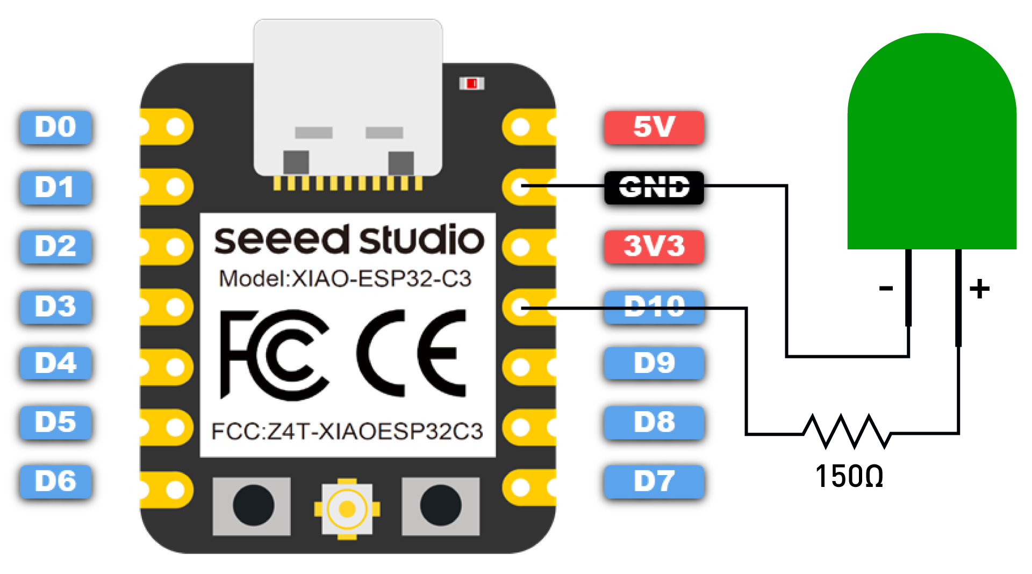
LED XIAO setup
D10 sends a digital signal, enough for LED
Now we can program the LED

Slide 26
Breadboard

Slide 27
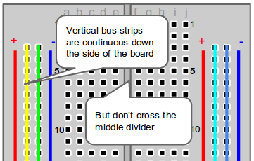
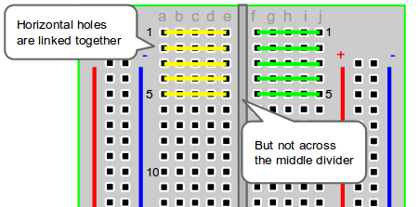

Slide 28
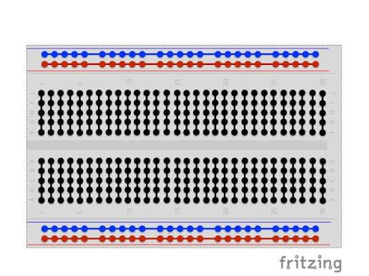

Slide 29
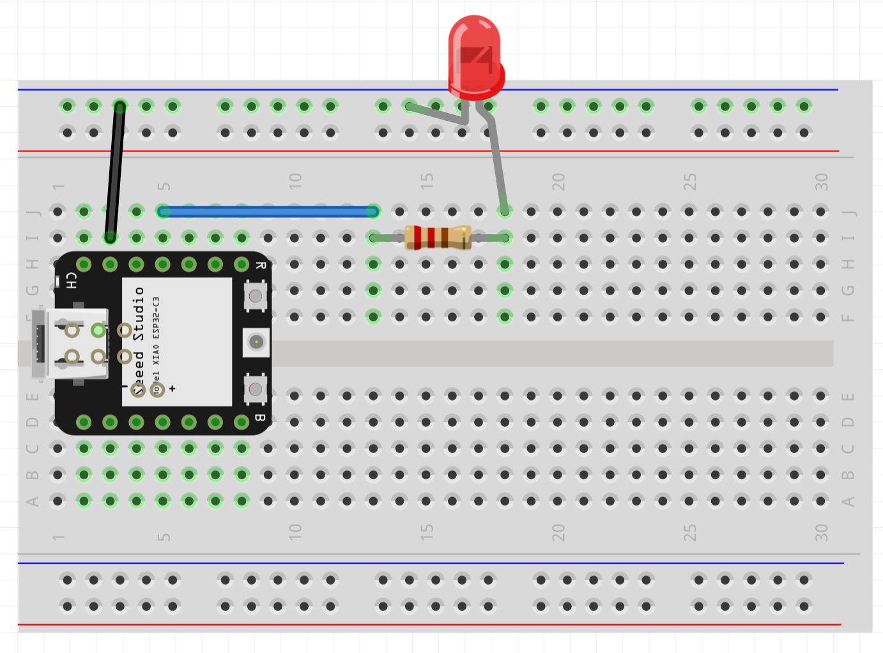

Slide 30
Programming

Slide 31
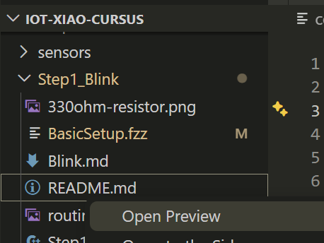
Programming
Arduino IDE
IDE of choice (I use VS-code)
Coding is done
Extend if you want, but not needed in this workshop
github.com/JDVlist/iot-xiao-cursus
.md -> open preview
Thanks to Geonovum

Slide 32
Code overview

Slide 33
Step 1: Blink
Read the docs

Slide 34
Setup
An overview

Slide 35
+ GPS

Slide 36
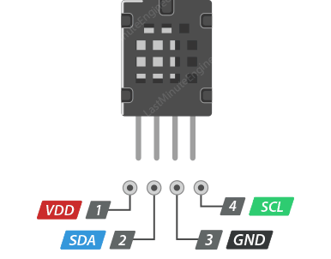
Sensor: AM2320
VDD: positive power supply
GND: ground
SDA: the wire where the sensor sends and receives messages
SCL: the wire that keeps the messages in rhythm, like a ticking clock

Slide 37
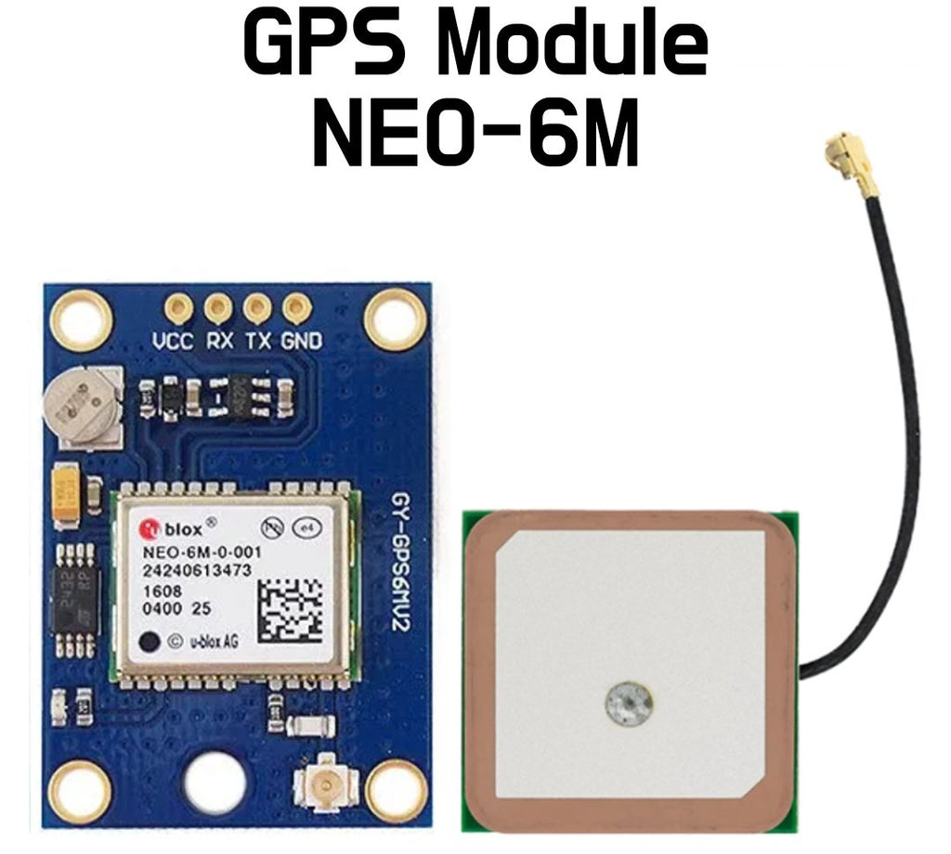
VCC: plus power, like the + side of a battery 5 V
GND: minus/ground, like the - side of a battery
TX: the wire where the GPS talks out to your microcontroller
RX: the wire where the GPS listens to your microcontroller

Slide 38
GNSS vs GPS
GNSS is the general name for satellite navigation systems.
GPS is one specific GNSS system, made by the United States.
Galileo: Europe
GLONASS: Russia
BeiDou: China

Slide 39

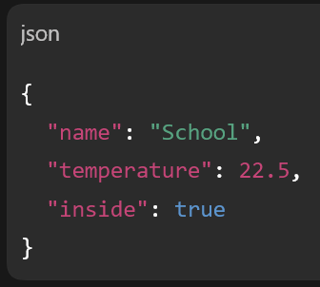
GeoJSON
geojson.org

Slide 40
Wifi
Wi-Fi lets the device connect to the internet without a cable.
For our project, the microcontroller connects to a Wi-Fi network using:
Network name: your Wi-Fi name
Password: your Wi-Fi password
Once connected, it can send data to the backend using HTTP.
Simple idea: Wi-Fi gets the device online, HTTP sends the data.
2.4 GHz Wifi needed
XIAO ESP32 uses 5 GHz Wifi

Slide 41
WiFi Alternatives
LoRaWAN: very long range, very low power, small messages
Bluetooth Low Energy: short range, low power, good near a phone or gateway
Ethernet: wired, stable, no Wi-Fi password needed
Cellular 4G/5G: works almost anywhere with SIM/data plan, uses more power

Slide 42
HTTP
URL says where it goes: backend
Body says what we send: GeoJSON
We send a POST request
Backend is not online
So purely to get an idea
OGC API is next, but out of scope for this workshop

Slide 43
Self-paced
Follow the repo

Slide 44
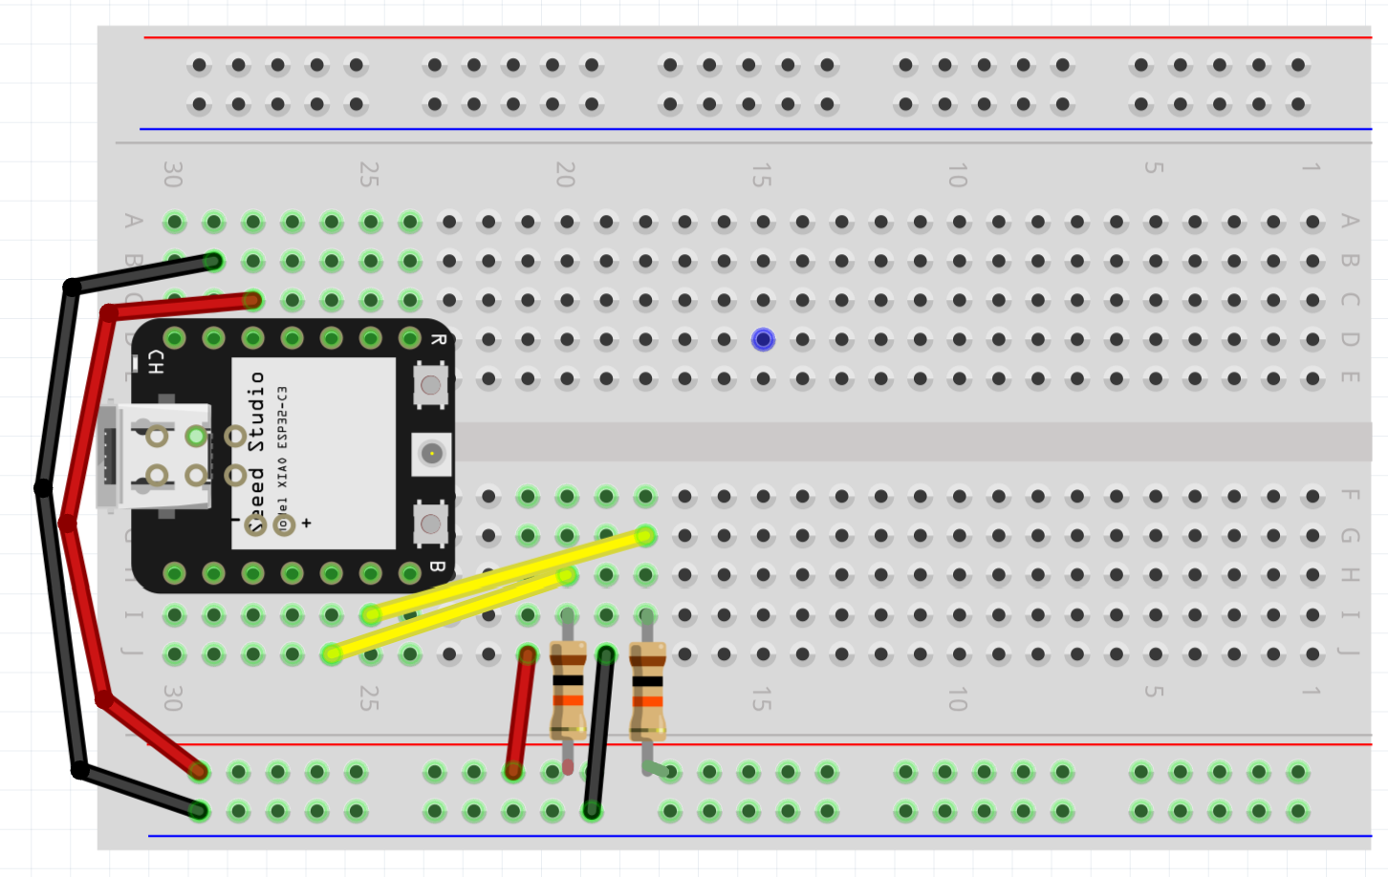
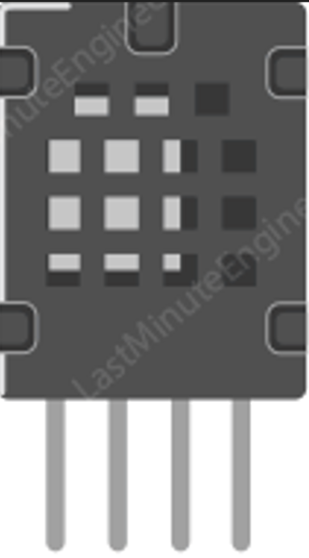

Slide 45
