Slide 1
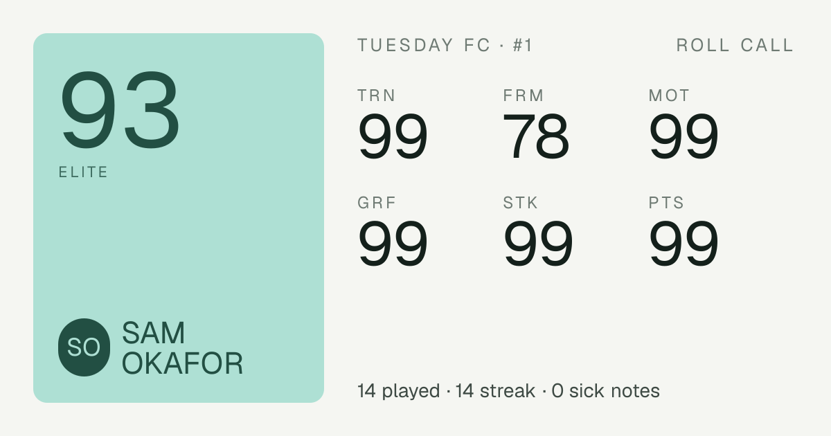
PRE-SEED · LONDON · SEPTEMBER 2026
ROLL CALL
The app for your crew, not your sport.
A REAL SHARE CARD FROM THE LIVE PRODUCT
For the weekly group of 4 to 20 mates who play 5-a-side, book a padel court, play a fourball, train together or watch the race. One place instead of a WhatsApp thread and a pile of bank transfers.
ROLL CALL · PRE-SEED · CONFIDENTIAL
01 / 16
Notes:
Roll Call is the app for your crew, not your sport. It is built for the weekly group of four to twenty mates who already play together and today organise everything in WhatsApp with bank transfers on the side. We are raising a pre-seed round in London in September 2026 to take a working product into a 15-crew pilot and then across the city. The card on the right is a real share card generated by the live code, which matters because the card is how the product spreads.
Source: README.md, business-plan.md.

Slide 2
THE PROBLEM
EVERY WEEKLY SPORTS CREW IN THE UK RUNS ON WHATSAPP AND BANK TRANSFERS.
DROPOUTS
CHASING MONEY
NO-SHOWS
Someone bails at 8pm the night before. The game goes short and the organiser eats the cost.
The organiser fronts £70 to £120 a week and is owed by at least two people at any moment.
Tapped in, never turned up, nobody paid. There is no record and no consequence.
“Dropouts are the single biggest headache.”
1.3★
Playtomic on Trustpilot
Dominated by refund and no-show disputes. The incumbent that owns padel booking is disliked by the people who use it.
CAPO, UK FOOTBALL ORGANISER APP, 2025
We agree. It is the organiser's biggest financial risk and nobody has fixed it.
TRUSTPILOT RATING, SEPTEMBER 2026 RESEARCH
ROLL CALL · PRE-SEED · CONFIDENTIAL
02 / 16
Notes:
Every regular crew has one organiser who books, chases the numbers, fronts the money and spends Sunday evening asking who still owes £7.50. The three failure modes are dropouts, chasing money and no-shows, and WhatsApp plus bank transfer handles none of them. Capo, a UK organiser app launched in 2025, calls dropouts the single biggest headache. Playtomic, which owns padel booking, sits at 1.3 stars on Trustpilot, mostly over refunds and no-shows, which tells you the venue-first tools have not solved the crew's problem either.
Sources: business-plan.md (Problem section; Capo quote; Playtomic Trustpilot rating from our research).

Slide 3
WHY NOW
SPORT FOR 18 TO 35S IS BEING REBUILT AROUND GROUPS, AND IT IS HAPPENING NOW.
400k → 860k
53%
1M
27%
UK padel players, end of 2024 to 2025. More than doubled in one year.
of UK 18 to 34s now choose fitness over nightlife.
Strava clubs in 2025, roughly four times the year before.
of F1 fans are Gen Z, and half of them are women. Watching together is a crew activity too.
LTA, 2025
BLOOMBERG, MAY 2026
STRAVA, 2025
F1 GLOBAL FAN SURVEY, 2025
+561k
Adult football participation in England rose 561k year on year, while 16 to 34 activity has fallen by roughly 0.5M since 2015/16. The people who still play are doing it in fixed groups. The social unit of exercise is the crew, not the club.
SPORT ENGLAND ACTIVE LIVES
ROLL CALL · PRE-SEED · CONFIDENTIAL
03 / 16
Notes:
Four verified signals say the timing is right. Padel went from about 400k to 860k UK players in a single year according to the LTA, with peak courts at 85 per cent occupancy. Bloomberg reported in May 2026 that 53 per cent of UK 18 to 34s pick fitness over nightlife. Strava clubs reached one million in 2025, about four times growth, and the F1 2025 fan survey found Gen Z is 27 per cent of fans with half of them women. Underneath it, Sport England shows adult football up 561k year on year while 16 to 34 activity has fallen since 2015/16: the people who still play are in fixed groups.
Sources: business-plan.md 'Why now' (LTA, Bloomberg May 2026, Strava, F1 2025 survey, Sport England).

Slide 4
THE INSIGHT
THE UNIT OF 18 TO 35 SPORT IS THE CREW, AND NOBODY MODELS IT.
Incumbents model the individual
Loggers, GPS, fantasy: Strava, Hevy, FPL, Sofascore.
Or the institution
Clubs, venues, bookings: Spond, Playtomic, GolfNow, Playfinder.
Nobody models the group of 4 to 20 mates
Who is in, who dropped, who owes, who was player of the match. That layer is open in every sport we looked at.
 | FOOTBALL | PADEL | GOLF | GYM | MOTORSPORT
Regular group organising | Open | Open | Open | Open | Open
Portable identity | Partly | Open | Partly | Partly | Open
Trust and money | Painful | Painful | Painful | Low stakes | Low stakes
Scores and fantasy | FPL, Sofascore | Saturated | 18Birdies, Arccos | Hevy, Strava | Saturated
Booking | Playfinder | Playtomic | GolfNow | Not needed | Not needed
Open and painful: no crew-first product
Partly open: single-sport or logger only
Closed or saturated: we do not compete here
Assessment is ours from competitor review, September 2026. Green cells are where the loop on the next slide lives.
ROLL CALL · PRE-SEED · CONFIDENTIAL
04 / 16
Notes:
This is the insight the company is built on. Every well-funded product models either the individual, which is loggers, GPS and fantasy, or the institution, which is clubs, venues and booking. Nobody models the group of four to twenty mates who actually decide whether Tuesday happens. Read the table by row: regular group organising is open in all five sports, portable identity is open in padel and motorsport and only partly served elsewhere, and money is painful wherever a venue has to be paid. We do not compete in scores, fantasy or booking; those are saturated or venue-owned.
Source: business-plan.md competitive landscape and our own competitor review. The cell ratings are our assessment, not third-party data.

Slide 5
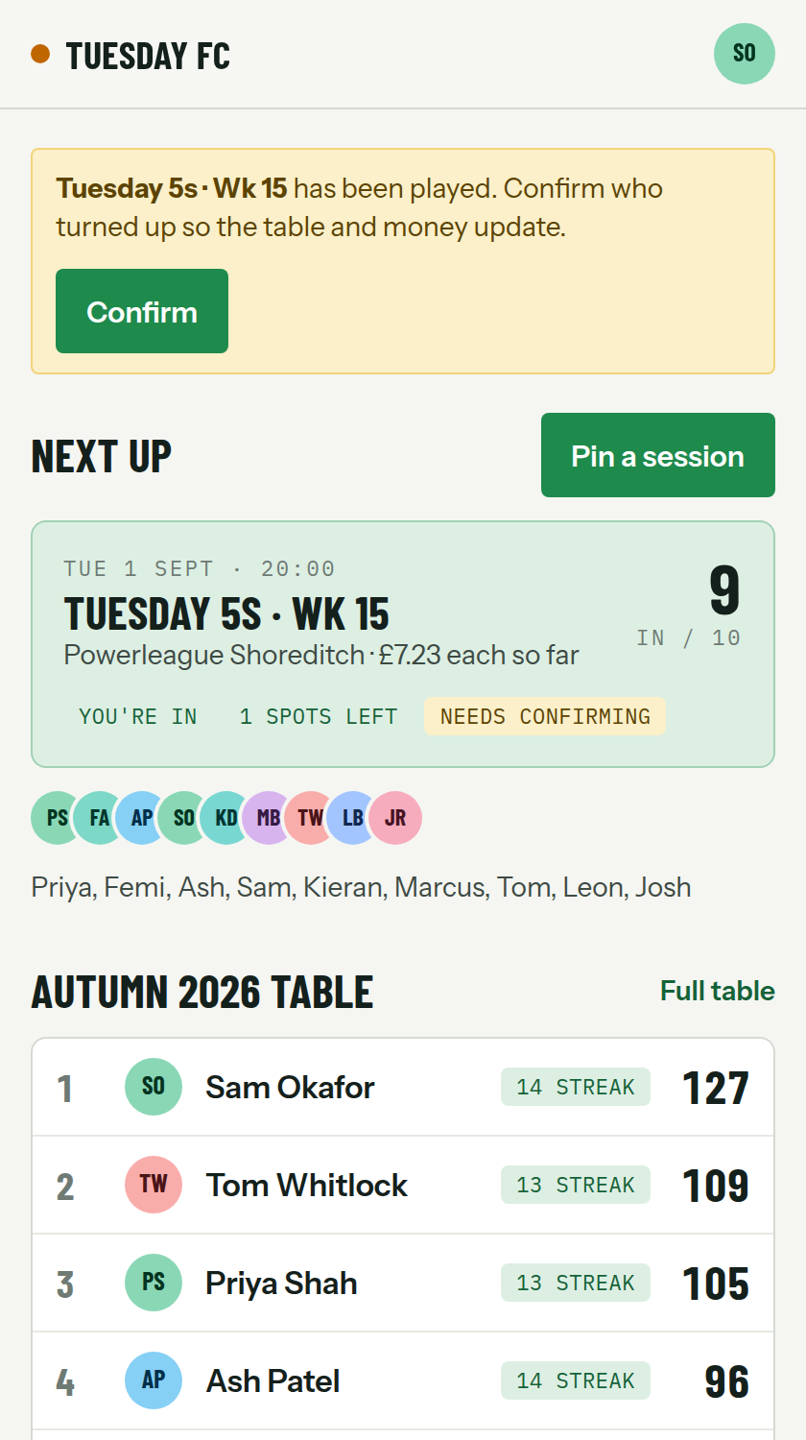
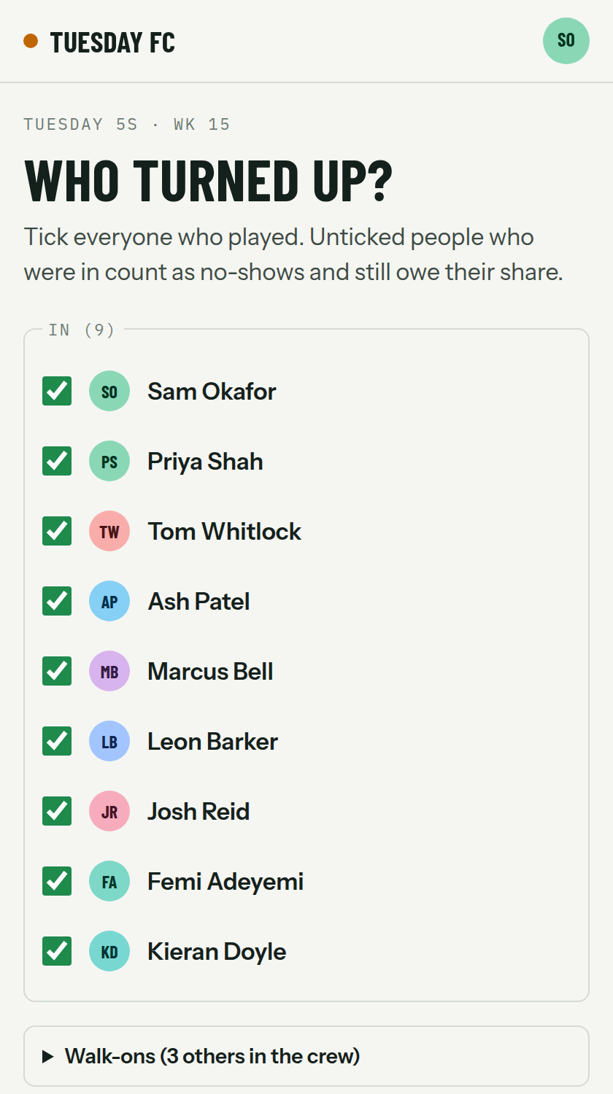
PRODUCT · THE LOOP
PIN IT, TAP IN, TURN UP, RATE IT: THE WHOLE PRODUCT IS ONE LOOP.
1
Pin it
Organiser pins venue, time, cost, spots and a commit-by deadline in under a minute.
2
Tap in
Mates tap in from a share link. No install, just a name. Full? The reserve list auto-promotes.
3
Turn up
Organiser confirms who played. Late drops inside the window and no-shows still owe.
4
Rate it
Three taps: player of the match, ran the hardest, worst miss. Wording changes per sport.
Web-first PWA, zero install for members. The share link is the whole onboarding.
CREW HOME
SESSION, PLAYED
ROLL CALL · PRE-SEED · CONFIDENTIAL
05 / 16
Notes:
The product is one loop and it maps exactly onto what the organiser already does in WhatsApp, minus the chasing. Pin the session, everyone taps in from the link with nothing to install, the organiser ticks who played, and everyone rates in three taps. Two rules do the heavy lifting: the reserve list auto-promotes when someone drops, and a late drop inside the crew's window, default 24 hours, still owes its share. The screenshots are from the live build: the crew home with the next session and the table, and a played session with attendance confirmed.
Sources: README.md, product-spec.md.

Slide 6
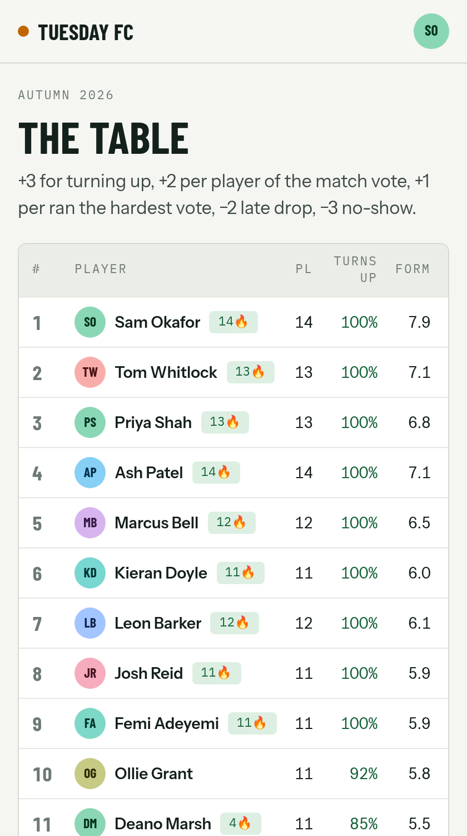
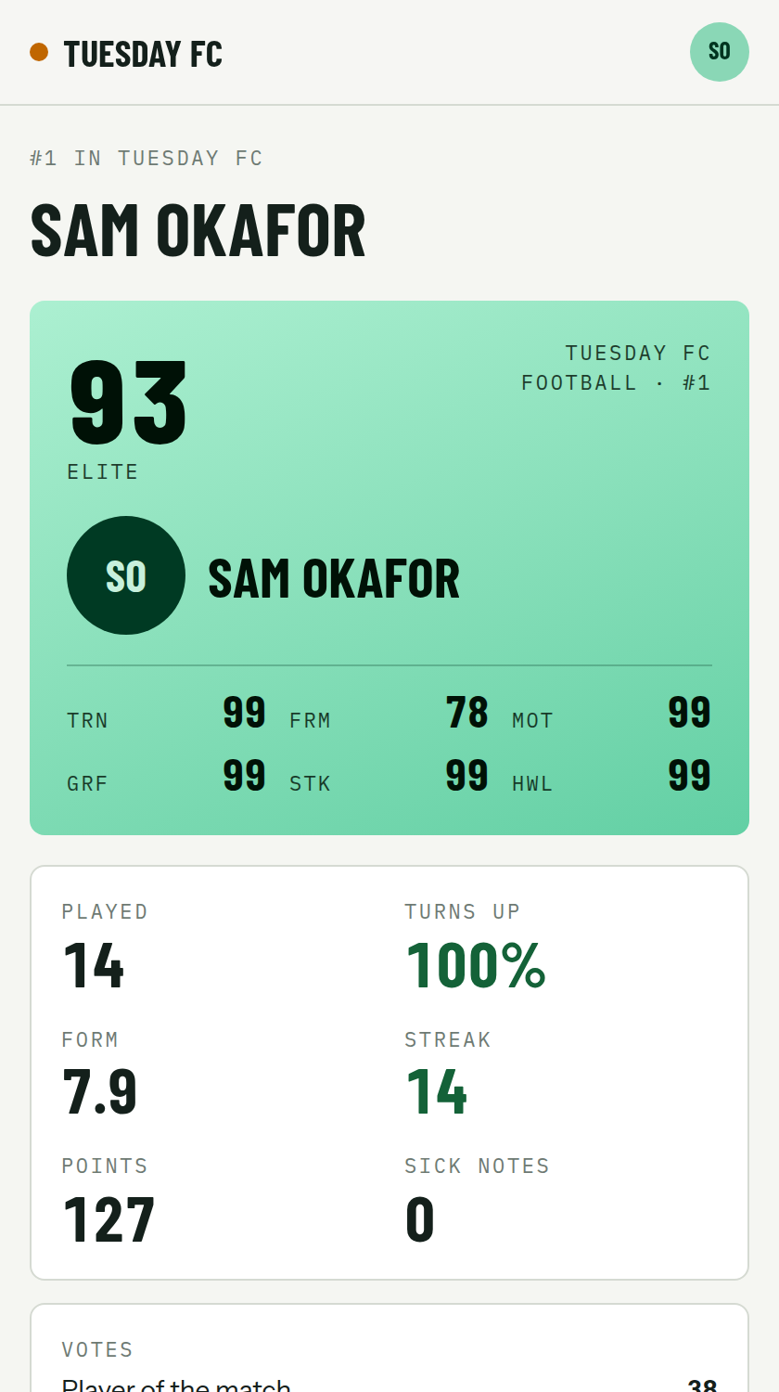
PRODUCT · BRAGGING RIGHTS
BRAGGING RIGHTS KEEP THE CREW COMING BACK. THE CARD IS THE AD.
THE TABLE
+3 turned up, +2 per MOTM vote, +1 per grafter vote, −2 late drop, −3 no-show.
SICK NOTES
Late drops plus no-shows, on a leaderboard the crew will argue about.
STREAKS AND FORM
THE CARD IS THE AD.
Consecutive turn-ups and a 4.0 to 10.0 form score over the last five sessions.
Members share their own cards into the group chat. Each member is in other crews, and the card carries a start-your-own-crew action. That is the referral loop.
PLAYER CARDS
Peer-rated 0 to 99 stats: turns up, form, votes, graft, streak, overall.
SHARE CARDS
Every session and player renders as a 1200 by 630 preview inside WhatsApp.
SEASON TABLE
PLAYER CARD
ROLL CALL · PRE-SEED · CONFIDENTIAL
06 / 16
Notes:
Retention comes from the fun layer. The season table scores turning up and peer votes, and penalises late drops and no-shows, so the Sick Notes leaderboard is something people actually care about. Peer-rated player cards give every member a FIFA-style identity that nobody else can produce because nobody else has the crew's votes. Every session and every player page renders as an image preview in WhatsApp, so the product markets itself in the place the crew already lives. The card is the ad.
Sources: product-spec.md (table, player card, share cards), go-to-market-london.md (referral loop).

Slide 7
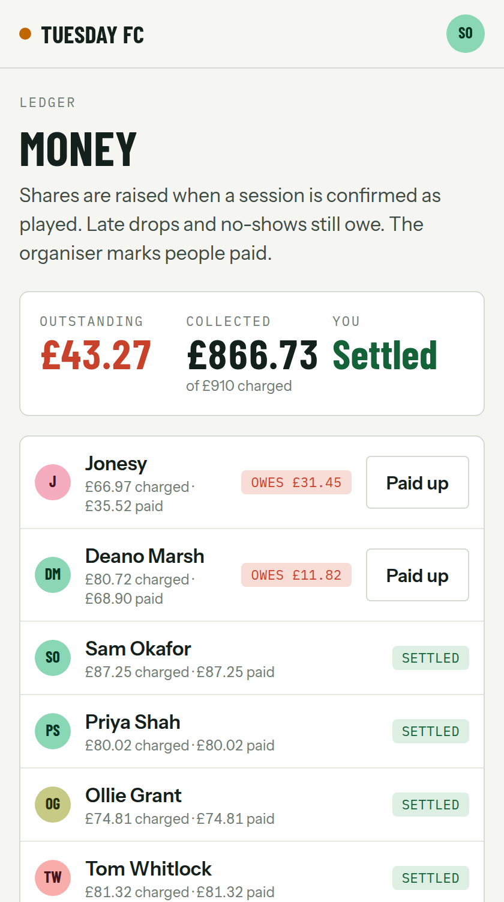
PRODUCT · MONEY
MONEY SPLITS TO THE PENNY, AND A LATE DROP STILL OWES ITS SHARE.
1
Exact splitting
V1 · NOW
Pence only. 'Split it' divides the booking exactly, with remainder pennies going to the first payers so the total is always right.
No fee.
No funds held.
Manual settle.
2
Late drops and no-shows still owe
Who owes: everyone who played, no-shows, and late drops inside the crew's window. The organiser's biggest risk goes away.
V1.1 · NEXT
3
Ledger and mark-as-paid, now
Stripe Connect.
Fee on the card.
No funds held.
Charges minus payments, per person, visible to the whole crew. v1 moves no money and takes no fee, deliberately.
4
Stripe Connect pass-through, next
Members pay through Stripe straight to the organiser. Our fee is shown up front. We never hold funds, so no FCA authorisation is needed.
LEDGER
ROLL CALL · PRE-SEED · CONFIDENTIAL
07 / 16
Notes:
Money is where trust is won or lost, so the rules are exact and boring. Shares are split in pence with the remainder going to the first payers, so the total always reconciles. Everyone who played, every no-show and every late drop owes a share, and the ledger shows who owes what to the whole crew. In v1 the organiser marks people as paid and Roll Call touches no funds, which keeps us outside the Payment Services Regulations. Stripe Connect pass-through comes in v1.1 with the fee disclosed on the pin, the card and at checkout; we never hold anyone's money.
Sources: product-spec.md (Money rules), legal-and-compliance.md (PSRs 2017 section), roadmap.md (v1.1).

Slide 8
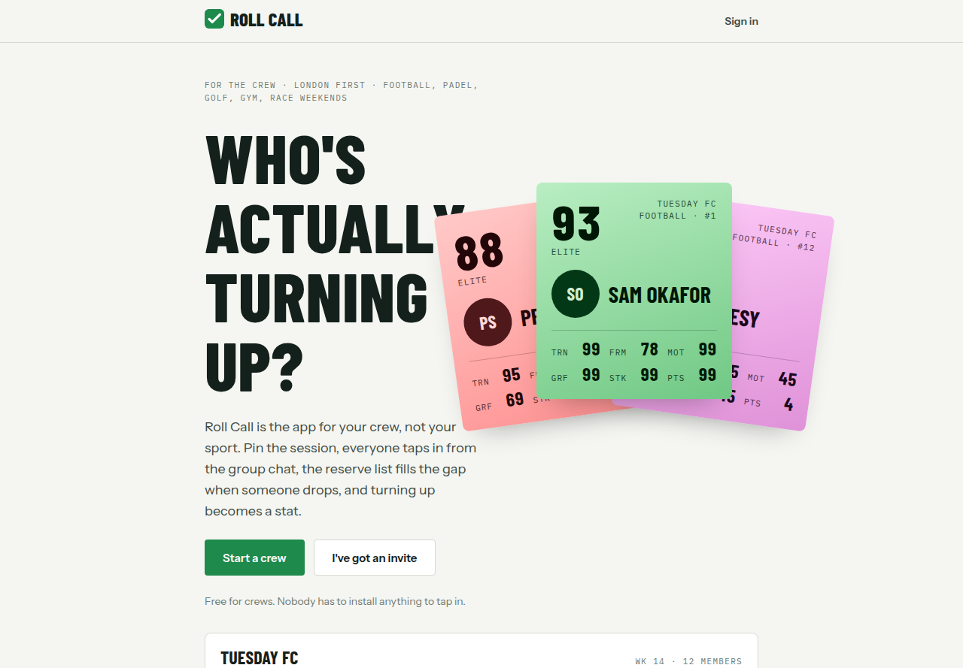
BUILT, NOT SLIDES
V1 IS LIVE CODE, DEPLOYABLE TODAY.
18 + 2
40
1
5
4
screens, plus two share-card image routes
unit tests on rules, redirects and London time
end-to-end test running the whole loop as three people
sports: football, padel, golf, gym, race weekends
side games: teams, americano, Stableford, predictor
Stack. Next.js 16, React 19, TypeScript, Drizzle on libsql, Tailwind. Web-first PWA, share cards via next/og. Docs for product, architecture, design, legal, GTM, metrics and deployment are in the repo.
LANDING PAGE, LIVE BUILD
HONESTY CHECK
Pre-revenue. Pre-users. The 15-crew London pilot starts now. The claim on this slide is that the loop is built and tested, not that it is proven.
ROLL CALL · PRE-SEED · CONFIDENTIAL
08 / 16
Notes:
This is not a slideware round. Version one exists as live code with 18 screens and two share-card image routes, 40 unit tests covering the domain rules, and a Playwright end-to-end test that runs the whole loop as an organiser and two mates in separate browsers through to the table, the ledger and the share-card images. Five sports and four side games are in, and the repo carries the product, architecture, legal, GTM and metrics docs behind this deck. To be clear: we are pre-revenue and pre-users, and the pilot starts now.
Sources: README.md, repo inspection (src/app routes, src/domain tests, e2e/core-loop.spec.ts), package.json.

Slide 9
MARKET
BOTTOM-UP, THE UK HAS ROUGHLY 180,000 REGULAR ADULT CREWS.
SEGMENT | BASIS | REGULAR ADULT CREWS | SESSIONS / CREW / MONTH
Casual 5 and 7-a-side football | Sport England adult football participation; assume 15 to 25% of adult players are in a fixed weekly group of 10 to 14 | 60,000 to 120,000 | 3 to 4
Padel groups | 860k players (LTA); assume 20 to 30% play in a regular four or eight | 40,000 to 65,000 | 3 to 6
Golf societies and fourballs | 12.6M adults play some golf; assume 3 to 5% in an organised society or standing fourball | 25,000 to 50,000 | 1 to 2
Gym crews and race-watching crews | Expansion segments, not sized for revenue in this plan | not sized | not sized
~£1bn / yr
Session money moving through UK crews. Order of magnitude only (assumption).
~180k crews
UK football, padel and golf crews we could serve (assumption).
All crew counts are assumptions derived from participation data, not measured figures. Middle of the three sized ranges gives about 180,000 crews. Session money of £6 to £12 per person and 8 to 12 people per football session are assumptions. Spond alone moves about €270M a year in payments, which supports the shape of the estimate.
300 → 500
Active London crews by month 12, 500 crews across 3 cities by month 18 (targets).
PLAN'S TAM, SAM AND FIRST SOM
ROLL CALL · PRE-SEED · CONFIDENTIAL
09 / 16
Notes:
We size bottom-up from participation data rather than top-down from the sports market, and we label every step as an assumption because it is. Football gives 60 to 120 thousand regular adult crews, padel 40 to 65 thousand and golf 25 to 50 thousand, which lands around 180,000 crews at the midpoints. At £6 to £12 a head and 8 to 12 people, a football crew moves £60 to £140 per session, so the session money across those crews is in the order of a billion pounds a year, order of magnitude only. Spond moving about €270 million a year in payments supports the shape. Our first serviceable target is 300 active London crews by month 12 and 500 across three cities by month 18.
Sources: business-plan.md market sizing table and assumptions; targets from business-plan.md milestones and this deck's ask slide.

Slide 10
COMPETITION
ROLL CALL IS ALONE IN THE CREW AND ADULT-CASUAL CORNER.
ADULT CASUAL
WHY IT HOLDS
Hevy, Strava
A crew brings its own liquidity
individual loggers
ROLL CALL
We never find players. One organiser brings 8 to 20 people in a single share.
Footy Addicts
strangers, per-head fees
crew-first, cross-sport, adult
Cross-sport identity
FPL, Sofascore
the fan, not the player
One player card across football, padel and golf. No single-sport app can build it.
INDIVIDUAL
CREW
Capo, Quick9, ParUp
An adult brand Spond cannot stretch to
single-sport organiser tools
Spond is a parent's app. Ours lives in the group chat.
Playtomic
padel booking, €65M, 1.3★
Spond
Playtomic is padel-only
youth and parents, 4M MAU
And venue-first. The crew, not the court, is our unit.
INSTITUTION / VENUE
ROLL CALL · PRE-SEED · CONFIDENTIAL
10 / 16
Notes:
On one axis is who the product models, the individual or the crew; on the other, who it is built for, the institution and venue or the adult casual player. Hevy and Strava log the individual. FPL and Sofascore serve the fan. Footy Addicts fills games with strangers and is hammered on per-head fees. Playtomic has raised 65 million euros for padel booking and sits at 1.3 stars. Spond has four million monthly users but is a youth-and-parents product. Capo, Quick9 and ParUp are small single-sport organiser tools. Roll Call is alone in crew plus adult casual, and it holds because a crew brings its own liquidity, the cross-sport identity compounds, Spond's brand cannot stretch to adults and Playtomic is padel-only.
Sources: business-plan.md competitive landscape and moat (Spond 4M MAU, Playtomic €65M Feb 2025 and 1.3 stars, Footy Addicts fees).

Slide 11
BUSINESS MODEL
NO SUBSCRIPTIONS. WE EARN FROM MONEY THAT ALREADY MOVES.
Why no subscription. Every incumbent's reviews say the same thing: subscriptions and hidden fees are resented. Golf apps show the ceiling and a paywall on the organiser kills the one person who brings a crew.
UNIT ECONOMICS PER CREW PER MONTH (ASSUMPTIONS)
 | FOOTBALL CREW | PADEL FOUR
Sessions per month | 4 | 4
Money collected per session | £90 | £48
Monthly volume | £360 | £192
Roll Call take at 2.5% + 20p per payer | £17 | £8
Stripe cost, approx 1.5% + 20p | £11.80 | £5.50
Net payments margin | about £5 | about £2.50
Hosting and messaging cost | under £0.50 | under £0.50
PAYMENTS FEE
ASSUMPTION: ~2.5% + 20P PER PAYER
1
A transparent per-session fee on collected money once Stripe Connect is live, shown on the pin and the card. Spond's model, applied to adults.
VENUE PARTNERSHIPS
FROM V2, AFTER RETENTION DATA
2
Venues pay for reliable crews: standing slot placement, off-peak fills, a referral fee or discount share. No booking fee, no exclusivity.
PREMIUM CREW FEATURES
LATER
Payments alone is thin: about £4,000 a month net at 1,000 active crews (assumption). That funds infrastructure, not salaries, which is why venue revenue is the second leg and why we will not raise fees to compensate.
3
Awards night generator, custom card designs, extended history. One-off per crew per season, never rolling.
ROLL CALL · PRE-SEED · CONFIDENTIAL
11 / 16
Notes:
We will not charge a subscription. The review pages of every incumbent, from Playtomic to Footy Addicts to the golf apps, are full of resentment about subscriptions and hidden fees, and a paywall on the organiser removes the only person who brings a crew. Revenue comes from money that already moves: a transparent per-session fee once Stripe Connect is live, which we model at about 2.5 per cent plus 20p per payer as an assumption; venue partnerships that pay for reliable crews; and later one-off premium crew features. The unit economics are honest: about £5 net per football crew per month on payments, so venue revenue is what makes the margin real.
Sources: business-plan.md business model and unit economics table (all figures assumptions); metrics.md fee take definition.

Slide 12
GO-TO-MARKET
LONDON FIRST: 15 CREWS, THEN THE SHARE CARD DOES THE SELLING.
15-CREW PILOT
SHARE-CARD REFERRAL LOOP
VENUE PARTNERSHIPS
CREATOR CONTENT
6 football, 4 padel, 2 golf, 2 gym, 1 race weekend. Organisers found in person at venues, set up on the spot.
→
Every pin, table update and player card goes back into WhatsApp with a start-your-own-crew action.
→
Targets, not yet partners: Powerleague, Goals, Rocket Padel, Padium, Padel Social Club.
→
Season awards reels, Sick Notes leaderboards, player card reveals. The content is the product output.
STAGED MARKETING PLAN · FOUNDER'S PROPOSED BUDGETS, ALL ASSUMPTIONS
STAGE 1 · MONTHS 0 TO 4
STAGE 2 · MONTHS 5 TO 10
STAGE 3 · MONTHS 11 TO 18
£0 paid
£150k paid
£200k paid
Organic plus venues. Growth lead visits four venues a week; content from pilot crews only.
TikTok, Instagram and Meta targeted at London 18 to 34 organisers; venue co-marketing; university and workplace leagues.
Scale to Manchester, Birmingham, Bristol and Leeds using the London playbook.
Gate: 11 of 15 crews still pinning at week 12
Gate: CAC payback under 12 months on payments margin plus venue revenue (assumption)
Gate: 300 active London crews before leaving London
ROLL CALL · PRE-SEED · CONFIDENTIAL
12 / 16
Notes:
We win London one organiser at a time. The pilot is 15 existing crews, spread across sports, whose organisers we find in person at Powerleague, Goals and the padel venues and set up on the spot. From there the share card is the growth mechanic: every action produces an image that goes back into the group chat, and each member is in other crews. Venues come next, and the named venues are targets, not partners yet. The marketing spend is staged and gated. Stage one is zero paid spend and passes only if 11 of 15 crews are still pinning at week 12. Stage two is £150k of paid across TikTok, Instagram and Meta aimed at London 18 to 34 organisers, gated on CAC payback under 12 months. Stage three is £200k to take the playbook to Manchester, Birmingham, Bristol and Leeds, and only after 300 active London crews. All three budgets are the founder's proposals and are assumptions.
Sources: go-to-market-london.md (pilot mix, venues, referral loop, content plan, no paid ads before retention, 300-crew rule); stage budgets and gates are founder assumptions not in the docs.

Slide 13
TRACTION PLAN
THE NORTH STAR IS SESSIONS PLAYED PER CREW PER MONTH.
NORTH STAR
STAGE | METRIC | PILOT TARGET
Activation | Organiser time to first pin, median | under 60 seconds
Activation | Members who respond within 48 hours of a pin | 60% or more
Retention | Crews still pinning at week 12 without a prompt | 73%, 11 of 15 crews
Reliability | Turn-up rate: attended divided by tapped in at deadline | 85% or more
Money | Sessions fully settled within 7 days | 80% or more
Fun | Rating completion within 24 hours of the session | 50% or more
Growth | New crews started from pilot crews' share cards by week 12 | at least 5
3.0
sessions played per crew per month for football and padel crews. 1.5 for golf.
Attendance-confirmed sessions divided by crews that pinned at least one session in the month. If this holds, money moves, cards get shared and venues care.
Targets marked in metrics.md as assumptions will be revised with pilot data. Guardrails run alongside: rating opt-outs, reports per 100 members, repeated-targeting alerts, erasure requests and money disputes. If fewer than 8 crews are active at week 12 we stop and rework the loop before spending on growth.
TARGET, ASSUMPTION
ROLL CALL · PRE-SEED · CONFIDENTIAL
13 / 16
Notes:
One number runs the company: sessions played per crew per month, targeted at 3.0 for football and padel and 1.5 for golf. Everything else is a leading indicator or a guardrail. Activation is time to first pin under 60 seconds and 60 per cent of members responding within 48 hours. Retention is 11 of 15 pilot crews still pinning at week 12 without a prompt from us. Reliability is a turn-up rate of 85 per cent or more, which is the number we take to venues. Money is 80 per cent of sessions settled within seven days, fun is 50 per cent rating completion, and growth is at least five crews born from share cards. If fewer than eight crews are active at week 12 we stop and rework the loop.
Sources: metrics.md (definitions and targets; those marked assumption are pilot targets), go-to-market-london.md pilot success criteria.

Slide 14
ROADMAP
FROM A WORKING LOOP TO A VENUE PROPOSITION IN 12 MONTHS.
V1 · NOW
V1.1 · MONTHS 4 TO 6
V2 · MONTHS 7 TO 12
LATER · MONTH 12+
PILOT
AFTER THE PILOT
LONDON DENSITY
AFTER 300 CREWS
Pin, tap in, reserve list, late-drop rule
Attendance, three-tap ratings, player cards
Season table, streaks, Sick Notes
Exact ledger, mark as paid
Four side games, share cards
Stripe Connect pass-through, fee disclosed
Email and WhatsApp reminders
Calendar export
Venue directory seeded from pilot crews
Accessibility audit to WCAG 2.2 AA
Venue partnerships and reliability score
Standing bookings as a series of pins
Crew-vs-crew challenges
Seasons and awards night generator
Multi-crew player identity
Booking deep links to Playtomic, Playfinder
Strava and Hevy import for gym crews
Karting and sim racing side game
Second UK city
One-off premium crew features
NON-GOALS
No chat. WhatsApp is the chat; we send cards into it. No player-finder. Crews bring their own people. No gambling. Predictor is free with no prizes; side pots are memos, never held. No subscriptions, no wallet, no booking engine.
ROLL CALL · PRE-SEED · CONFIDENTIAL
14 / 16
Notes:
Version one is what the pilot runs on and it is built. Version 1.1, months four to six, is about reducing organiser effort and making money move cleanly: Stripe Connect with the fee disclosed, reminders, calendar export, a venue directory and an accessibility audit. Version two, months seven to twelve, turns reliable crews into a venue proposition with reliability scores, standing bookings, crew-versus-crew fixtures, awards nights and a single player identity across crews. Beyond that, and only after 300 active London crews, come booking deep links, Strava and Hevy import, karting and sim racing, and a second city. The non-goals are deliberate: no chat, no player-finder, no gambling, no subscriptions, no wallet, no booking engine.
Source: roadmap.md.

Slide 15
THE ASK
£500K PRE-SEED FOR 18 MONTHS TO SERIES SEED METRICS.
£500k
40%
Marketing and growth
Staged and gated as on the go-to-market slide: £0, then £150k, then £200k.
30%
Product and engineering
Business plan range £400k to £600k. 18 months of runway.
v1.1 and v2: Stripe Connect, reminders, venue tools, multi-crew identity.
MONTH-18 TARGETS (SERIES SEED)
20%
Team
500
3
Two hires: a growth lead and a community and venues lead, both London.
active crews
UK cities
10%
Legal, compliance, ops
Solicitor review, ICO, Stripe onboarding, accessibility audit, tooling.
Live
Signed
USE OF FUNDS · FOUNDER'S PROPOSED ALLOCATION
payments with fee disclosed
venue partnership deals
Allocation is the founder's proposal for this deck and differs from the draft split in business-plan.md, which groups spend by salaries. Milestones are targets, not commitments.
ROLL CALL · PRE-SEED · CONFIDENTIAL
15 / 16
Notes:
We are raising £500k, inside the £400k to £600k range in the business plan, for 18 months of runway. Forty per cent goes to marketing and growth, staged and gated exactly as on the go-to-market slide so nothing is spent on paid acquisition before retention is proven. Thirty per cent goes to product and engineering for v1.1 and v2, twenty per cent to two hires, a growth lead and a community and venues lead, and ten per cent to legal, compliance and operations including the solicitor review, ICO registration, Stripe onboarding and the accessibility audit. At month 18 we want 500 active crews across three cities, payments live with the fee disclosed, and venue deals signed. Those are targets. The allocation is the founder's proposal and differs from the salary-based draft split in the business plan.
Sources: business-plan.md funding ask (range and milestones); use-of-funds percentages and month-18 targets are founder assumptions for this deck.

Slide 16
TEAM
A SMALL TEAM THAT RUNS THE FIRST 100 CREWS PERSONALLY.
WHO'S
ACTUALLY
TURNING UP?
[ ]
[FOUNDER NAME] · FOUNDER
[One line on background and why this problem. Do not invent: fill in before sending.]
HIRING WITH THIS ROUND
Growth lead
Finds organisers at venues, runs the first 100 crews, owns the content channels.
Community and venues lead
Runs pilot crews' seasons, awards nights and the venue partnership pipeline.
Contract designer
Share cards and player cards, about two days a week.
Start a crew →
rollcall · [url]
ADVISORS TBC · CONTACT: [EMAIL] · [PHONE]
ROLL CALL · PRE-SEED · CONFIDENTIAL
16 / 16
Notes:
The team stays small on purpose. The founder placeholder is to be filled in before this deck is sent; nothing here is invented. The round funds a growth lead who finds organisers at venues and personally runs the first hundred crews, a community and venues lead who runs seasons, awards nights and the venue pipeline, and a contract designer for the cards. Advisors are to be confirmed. We close where the product starts: the only question a crew ever asks is who is actually turning up, and Roll Call is the first product built to answer it.
Sources: business-plan.md team and hiring; hire titles per the founder's brief for this deck.

