Slide 1
Automating PoP Stock Check via Deep Learning
Brooks Beckelman, Zack Bilderback, Estevan Gonzales, Dallas Griffin, Sean Kessel, Davis Townsend

Slide 2
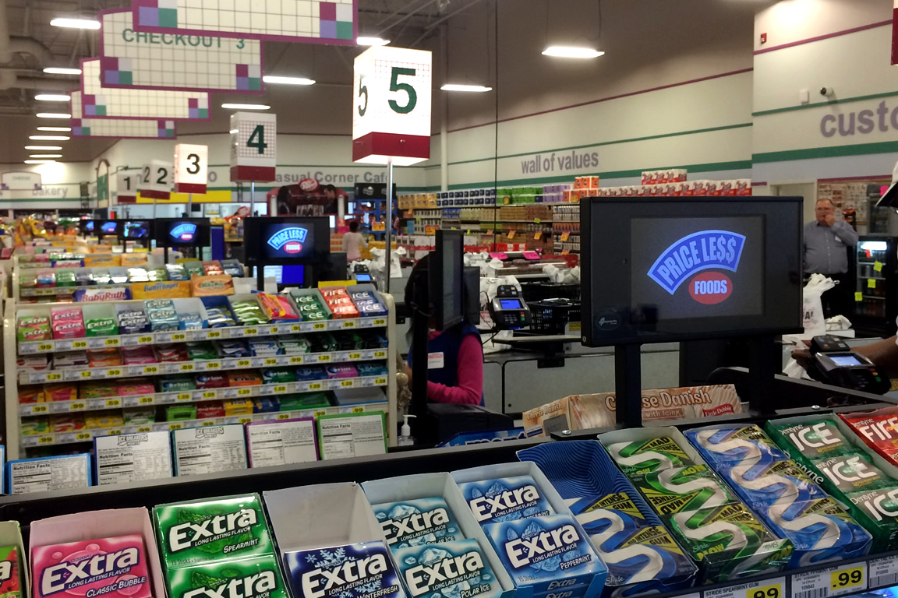
Popspots
Start-up specializing in digital point-of-purchase (PoP) advertisement systems
Work with grocers and retailers to install tablets in check-out aisles
Sell advertisements (still images and/or videos) in 7-second increments on the marketplace
Offer dynamic ad slots for specific regions or locations that only run and charge when customers are in the check-out aisle

Slide 3
Business Case
PoP rack is a major revenue generator for retailers
Nets on average $24,000 per rack per year
Retailers face a significant challenge keeping their PoP racks stocked and in compliance with product placement agreements
Popspots already has tablets in place with cameras pointed directly at racks used primarily for customer “look” tracking
Stock check service would incur limited costs beyond its development and position well with the company’s long-term strategy of leveraging innovative technology to create value at retailer’s PoP

Slide 4
Objectives
Primary: Develop Neural Net that can accurately segment an image of a rack into its component SKUs
Stretch: Refine Neural Net to map segment images to their corresponding SKUs (i.e. Snickers, Kit-Kat, etc.)
Future State: Further refine to estimate the stock level of an SKU (i.e. “fully stocked”, “almost out”, “out of stock”) and link with automated (or semi-automated) restock system

Slide 5
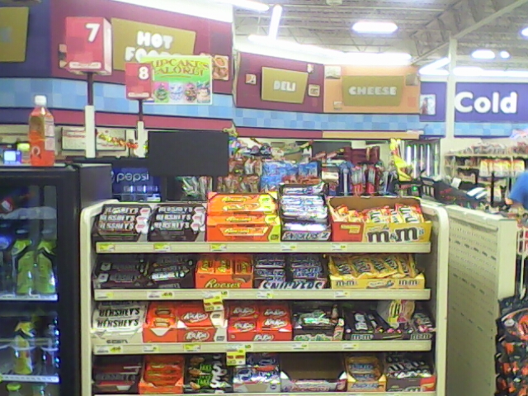
Data Scope
4 images per day of 25 racks at 10 grocery stores taken over 10 business days (~1,000 total images)
~30 SKUs per rack (~30,000 SKUs)
Raw pixels per image: 640 x 480
Pixels in raw dataset: 307,200,000
Training data of ~10 images per unique SKU

