Slide 1
Automating PoP Stock Check via Deep Learning
Brooks Beckelman, Zack Bilderback, Estevan Gonzales, Dallas Griffin, Sean Kessel, Davis Townsend

Slide 2
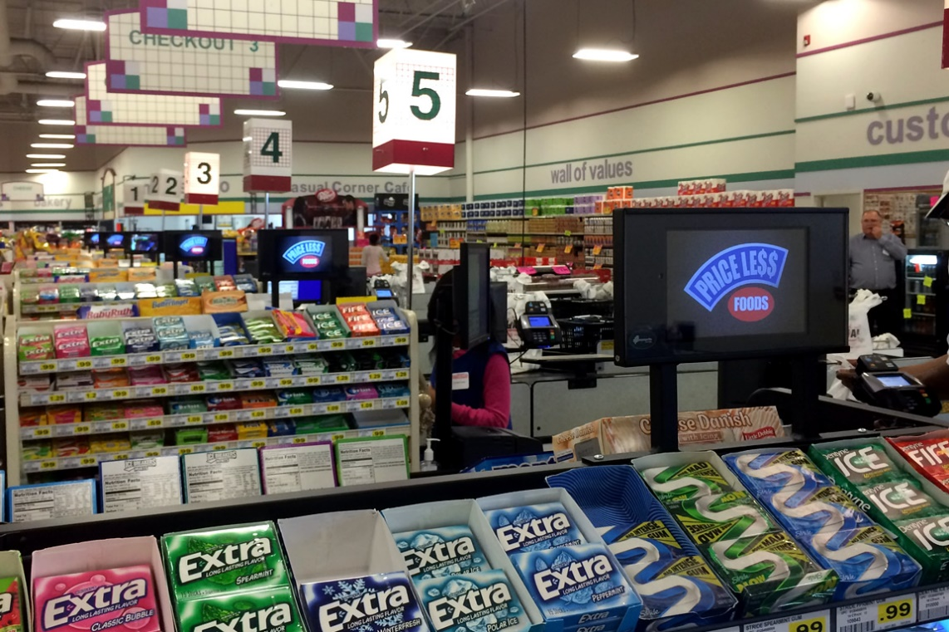
PopSpots
Start-up specializing in digital point-of-purchase (PoP) advertisement systems
Work with grocers and retailers to install tablets in check-out aisles
Sell advertisements (still images and/or videos) in 7-second increments on the marketplace
Offer dynamic ad slots for specific regions or locations that only run and charge when customers are in the check-out aisle
Notes:
ESTEVAN

Slide 3
Business Case
PoP rack is a major revenue generator for retailers
Nets on average $24,000 per rack per year
Retailers face a significant challenge keeping their PoP racks stocked and in compliance with product placement agreements
PopSpots already has tablets in place with cameras pointed directly at racks used primarily for customer “look” tracking
Stock check service would incur limited costs beyond its development and position well with the company’s long-term strategy of leveraging innovative technology to create value at retailer’s PoP
Notes:
ESTEVAN

Slide 4
Objectives
Primary: Develop Neural Net that can accurately segment an image of a rack into its component SKUs
Stretch: Refine Neural Net to map segment images to their corresponding SKUs (i.e. Snickers, Kit-Kat, etc.)
Future State: Further refine to estimate the stock level of an SKU (i.e. “fully stocked”, “almost out”, “out of stock”) and link with automated (or semi-automated) restock system
Notes:
ESTEVAN

Slide 5
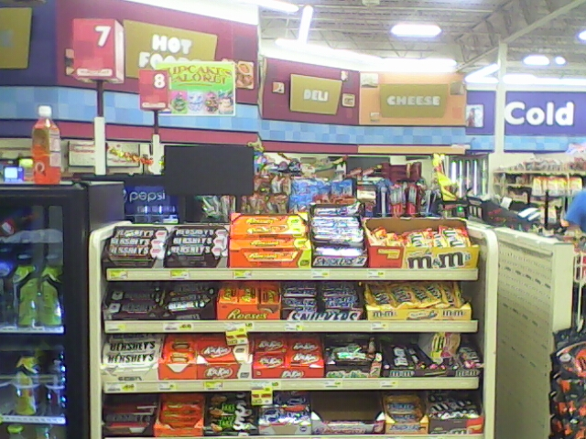
Data Scope
4 images per day of 25 racks at 10 grocery stores taken over 10 business days (~1,000 total images)
~30 SKUs per rack (~30,000 SKUs)
Raw pixels per image: 640 x 480
Pixels in raw dataset: 307,200,000
Training data of ~10 images per unique SKU
Notes:
ESTEVAN

Slide 6

Open Source Computer vision software (OPENCV)
OpenCV was built to provide a common infrastructure for computer vision applications and to accelerate the use of machine perception in the commercial products
The library has more than 2500 optimized algorithms, which includes a comprehensive set of both classic and state-of-the-art computer vision and machine learning algorithms
Started as Intel Research Initiative

Slide 7
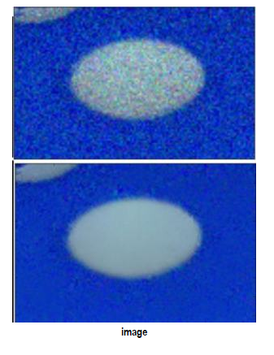
Image preprocessing – image denoising
Non-Local Means Denoising:
Take small window around a pixel
Search for similar windows in the image
Average all the windows
Replace the pixel with result
Basically smooths the image, but makes it more blurry
Note: interestingly, when toggling this preprocessing, it didn’t seem to make much of a difference, even when trying to tune the denoising parameters
May be due to low res nature of our images
Notes:
BROOKS

Slide 8
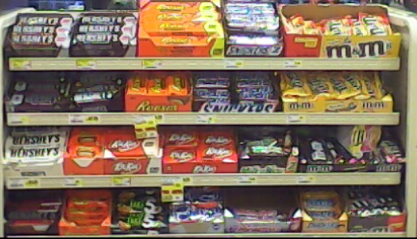
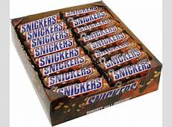
Starting basic – template matching
This method of object detection simply slides the template image over the input image (as in 2D convolution) and compares the template and patch of input image under the template image.
Image
Template
Notes:
BROOKS

Slide 9
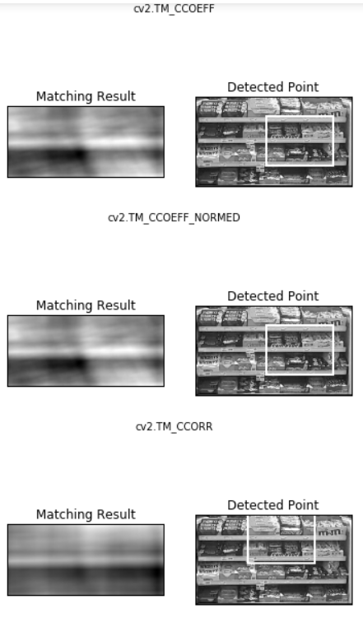
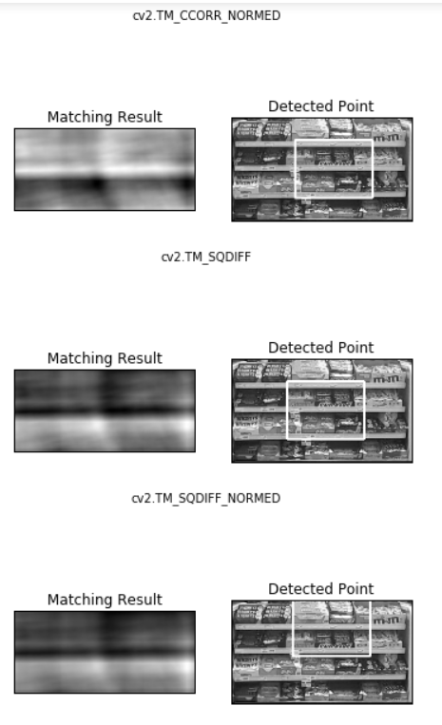
Template matching – example output
Note: “most matched” value is top left of rectangle
We see initial attempt did not do very well
Notes:
BROOKS

Slide 10
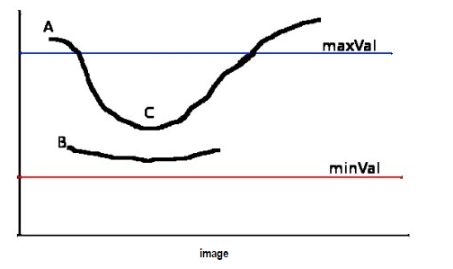

Canny edge detection
Popular edge detection algorithm developed by John F. Canny
Multistage algorithm with the following stages:
Remove noise from image using 5x5 Gaussian filter
Find intensity gradient of the image –filtered with Sobel kernel
Edge gradient and direction found for each pixel
Non-Maximum Suppression
Full image scan done to remove unwanted pixels that may not constitute an edge
Hysteresis Thresholding
Any edges with intensity gradient above maxVal are considered edges for sure
Notes:
SEAN

Slide 11
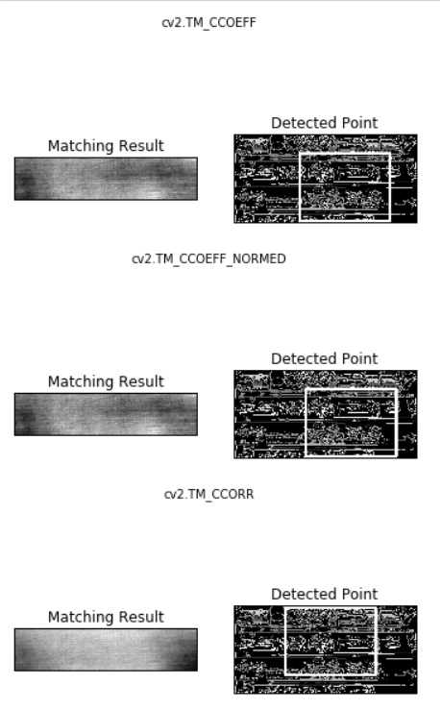
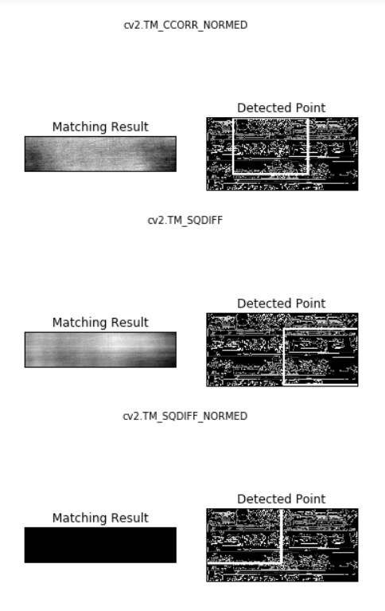
Template matching example output with edges
We thought using edges might help with matching because “snickers” outline could be matched
Edge detection generally good at finding logos, brand names, and anything with defined edges such as words.
Still didn’t seem to work too well, image is very noisy
Notes:
SEAN

Slide 12
issues with template matching
Template Matching is NOT scale-invariant or rotation-invariant
Susceptible to different scale of images and non-affine transformations of image
Template matching only works for detecting single instance of the template
Very difficult to overcome this issue
We attempted further tests with template matching to attempt to overcome these issues
Wanted to stay with easy method of object detection
Notes:
SEAN

Slide 13
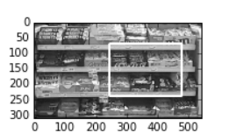
Pseudo-scale-invariance
Used multi-scaling template matching in a cheap workaround to fix the scale-invariance problem
Just continually shrunk the original image until found best match and used this match to draw our rectangle
Still did not perform as well as we wanted
Notes:
DAVIS

Slide 14
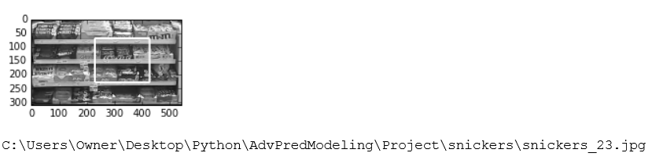
Pseudo-rotation-invariance
Dealt with rotation problem by having folder with many different pics of snickers of different rotations and iterating through this folder to find best match
Similarly poor performance, even when using edge detection
Could have tried artificially rotating single image, but instead just decided to move on to more powerful object detection algorithm
Notes:
DAVIS

Slide 15
ORB (Oriented-FASt and rotated-brief) algorithm
Efficient alternative to SIFT or SURF
Algorithm is not patented (made by OpenCV Labs)
Basically a fusion of FAST key-point detector and BRIEF descriptor with many modifications to enhance the performance.
Importantly, algorithm is scale-invariant and rotation-invariant
Notes:
DAVIS

Slide 16
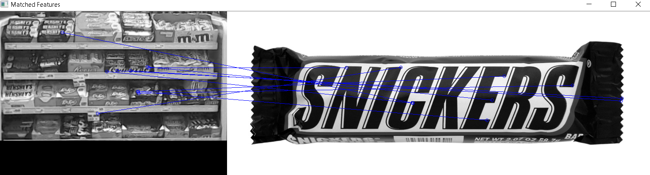
Example of using ORB for feature matching
Blue lines are matched “key-point” features of pic to the image
This is only showing first 10 matches (the “most matching” point)
We see the most matches occur on the snickers box as we want
Notes:
DAVIS

Slide 17
Approach #2: Deep Learning
Step 1: Train Object Detection RNN layers
Step 2: Train Object Classification RNN layers
Step 3: Evaluate Accuracy of Object Detection & Classification
Notes:
DALLAS

Slide 18

Deep Learning | Tool Comparison
Caffe
Native Windows Support
Large repository of code & research papers
TensorFlow
C++ & Python
No native Windows support
Torch
Written in MATLAB/Lua
No native Windows support
Difficult to setup & use
No GPU support on Windows
Rapidly growing in popularity
Theano
Written in Python
C++ Based w/ Python Wrapper
Easy to use
Windows support
Relatively slow
More Information: https://github.com/zer0n/deepframeworks
https://en.wikipedia.org/wiki/Comparison_of_deep_learning_software
Notes:
DALLAS

Slide 19
Deep Learning | Tool Selection
Caffe
Native Windows Support
Large repository of code & research papers
Difficult to setup & use
C++ Based w/ Python Wrapper
Fit for purpose
Notes:
DALLAS

Slide 20
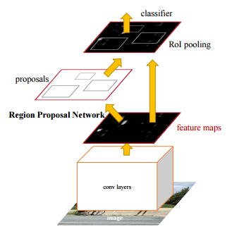
Deep LEARNING | Model Selection
Model: Faster R-CNN
Authors: Shaoqing Ren, Kaiming He, Ross Girshick, Jian Sun
Performs region proposal (i.e. object detection) and object classification in a single, linked convolutional neural network.
Information is shared between region proposal & classification layers, greatly increasing run-time to near real-time (i.e. Production-ready system).
Sources: https://arxiv.org/pdf/1506.01497v3.pdf
https://github.com/rbgirshick/py-faster-rcnn
Notes:
DALLAS

Slide 21
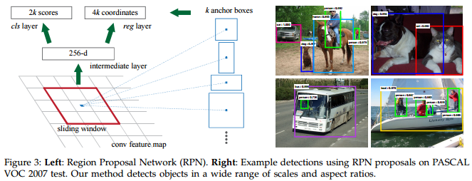
Deep LEARNING | Faster R-CNN
Notes:
DALLAS

Slide 22
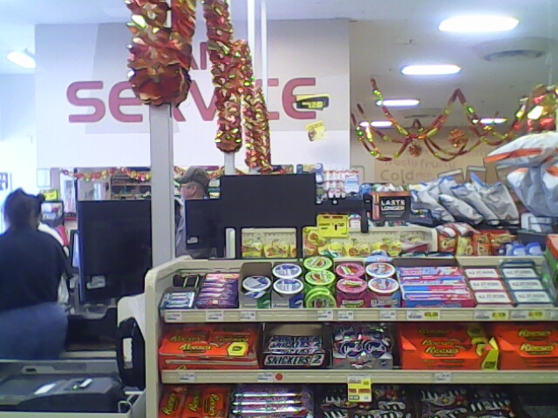
Modeling Challenges
Software issues (deep learning platforms)
Difficult to install
Steep learning curve
Quality of images
Low resolution/blurry
Glare
Image angles and distances
Rack placement varies for different images
Image does not always capture entire rack

Slide 23
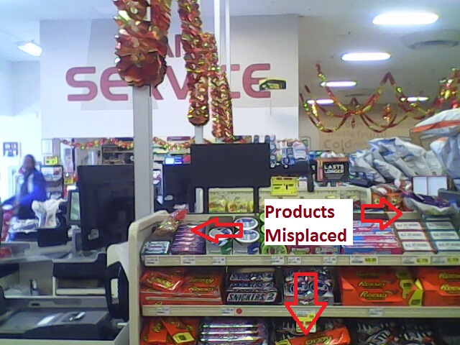
Implementation Challenges
Misplaced products (e.g. Reese’s in a Snickers box)
Background noise
Image does not always capture entire rack

Slide 24
NEXT STEPS
Implement R-CNN for detection & classification of SKUs
Present findings and final model to PopSpots
Enhance algorithm to estimate stock level and evaluate compliance
Notes:
ZACK

Slide 25
Questions

Slide 26
Appendix
Paper about ORB: http://www.willowgarage.com/sites/default/files/orb_final.pdf
http://docs.opencv.org/3.0-beta/doc/py_tutorials/py_feature2d/py_orb/py_orb.html
FAST- http://docs.opencv.org/3.0-beta/doc/py_tutorials/py_feature2d/py_fast/py_fast.html
BRIEF - http://www.robots.ox.ac.uk/~vgg/rg/papers/CalonderLSF10.pdf
http://docs.opencv.org/3.1.0/dc/d7d/tutorial_py_brief.html

