Slide 1
A deformation order analysis tool for vehicle structures in crashworthiness design
Supervisors:
Volker Lange
Lailong Song
Students:
Moustafa Alsayed Ahmad
Daniel Perez Ramirez
Massimo Sferza
Software Lab: 2nd assesment

Slide 2


Our project
First task
Second task
Third task
Create movies

Slide 3
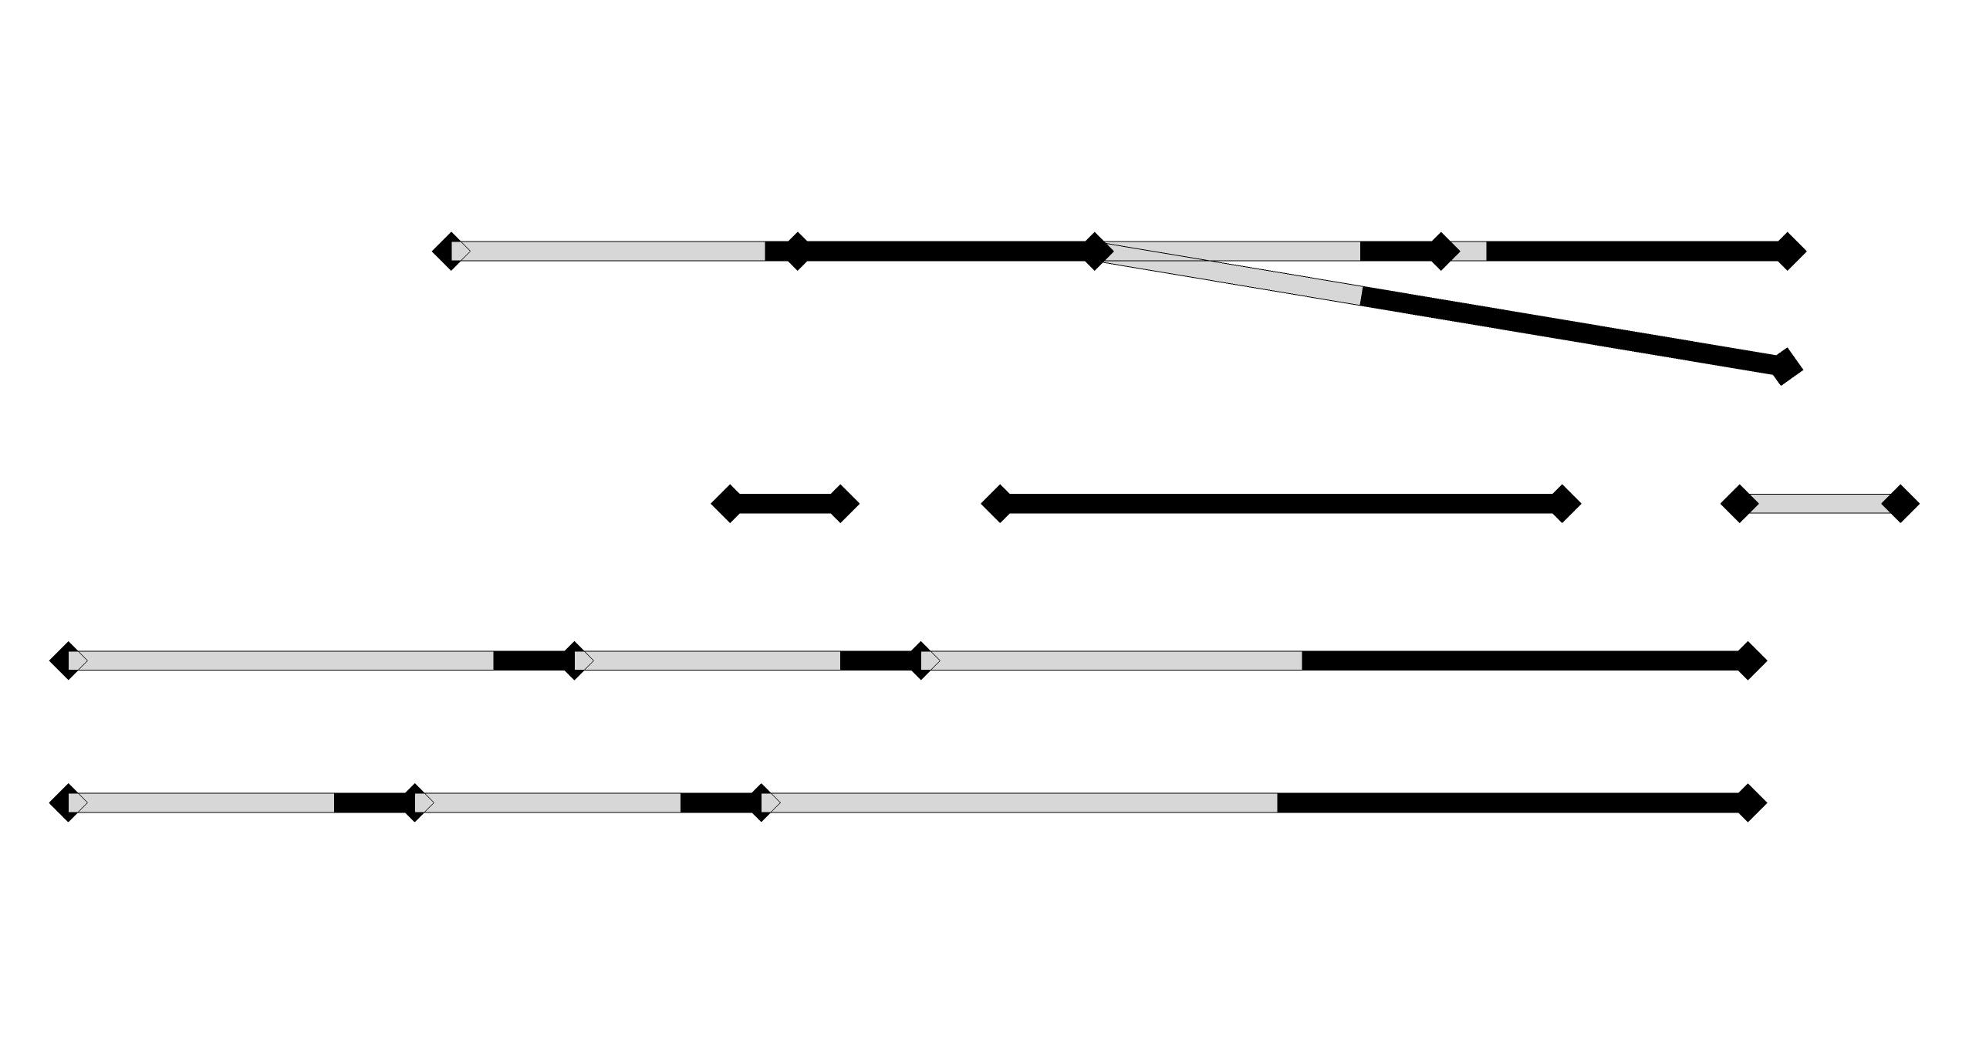





Q: “the complexity of the problem grows with the factorial of the number of components: is brute force a good approach?”
$$3!$$
Therefore brute force is not a problem since our problems are really simple.
But of course there are smarter ways to accomplish the task.
And we’re already working on one.
Let’s consider a possible structure.
In this case the number of possible solutions is:
The complexity is:
$$\prod_{lp}{n_{lp}!}$$
where:
lp goes over the number of loadpaths
n is the number of components of the loadpath
$$3!$$
$$3!$$
$$\prod_{lp}{n_{lp}!}=$$
$$=216$$

Slide 4
Our assumptions

Slide 5
Solutions to task 1
Moustafa’s approach (explanation and accomplishments)
Massimo’s approach (explanation and accomplishments)
Further strategies to reduce complexity and present the results

Slide 6
Solution to task 1

Slide 7
isdh

Slide 8
Description of task 2

Slide 9
Next steps

