Slide 1
A deformation order analysis tool for vehicle structures in crashworthiness design
Supervisors:
Volker Lange
Lailong Song
Students:
Moustafa Alsayed Ahmad
Daniel Perez Ramirez
Massimo Sferza
Software Lab: 2nd assessment

Slide 2
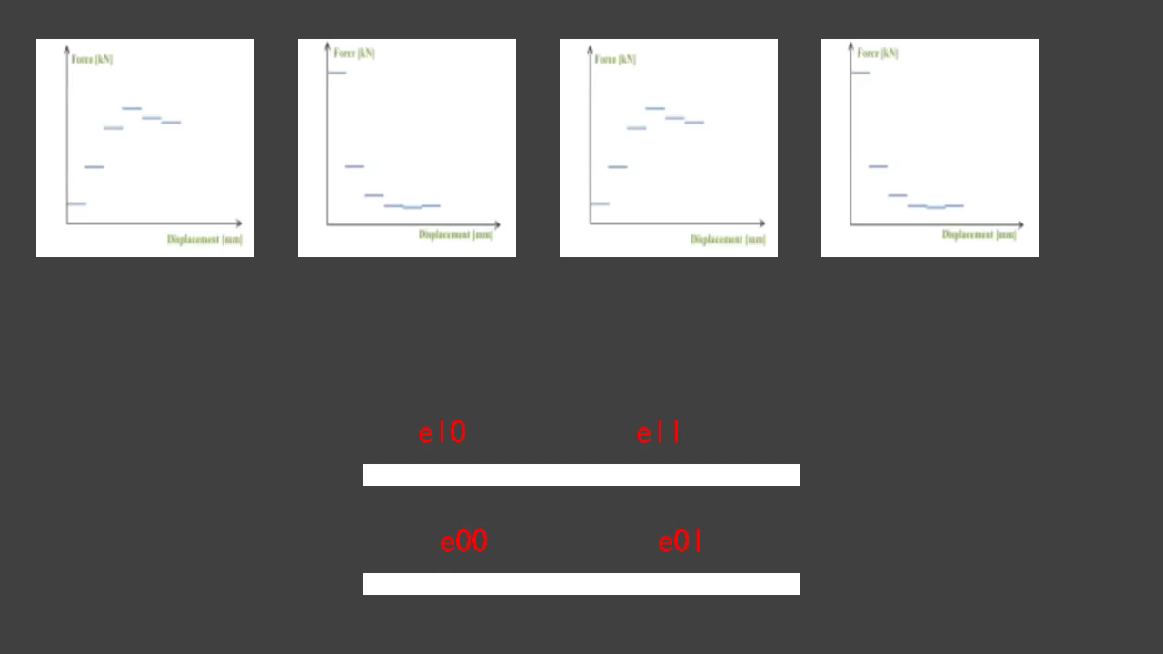
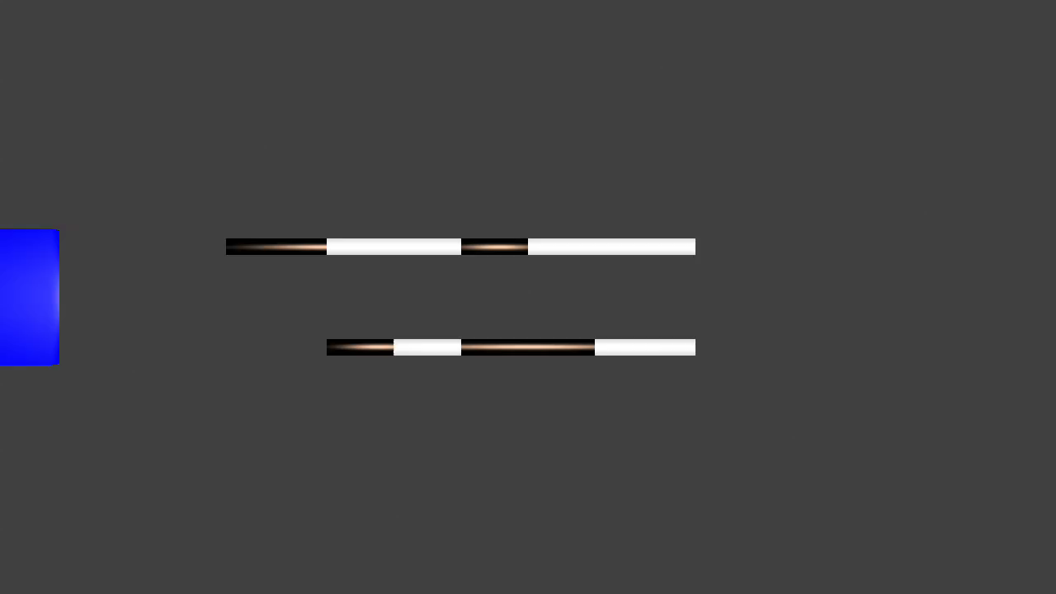
Our project
First task
Second task
Third task
Create movies

Slide 3
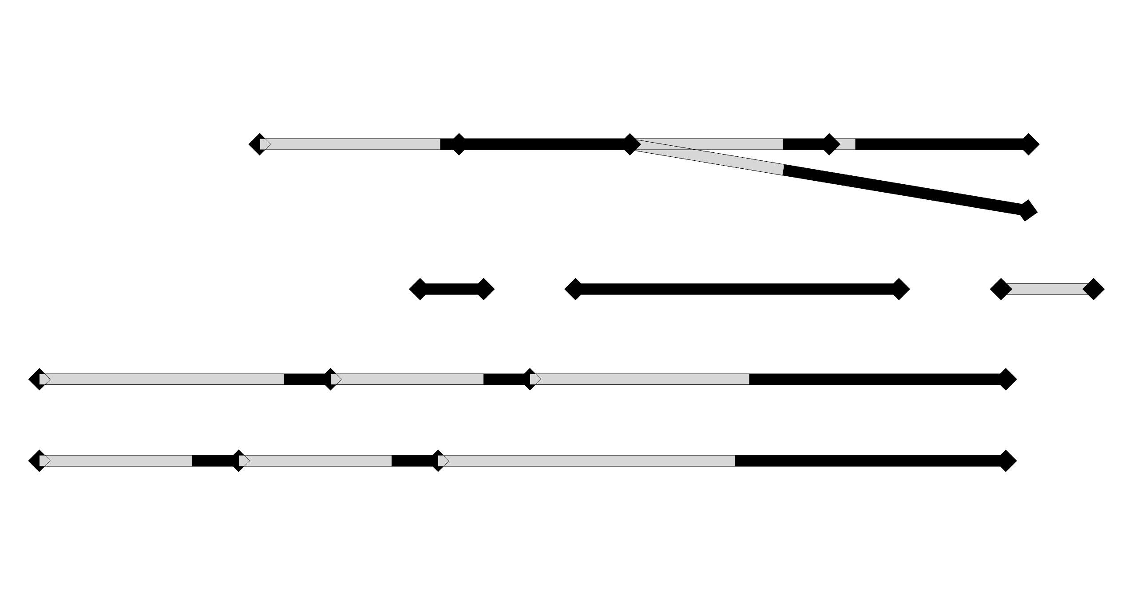





Q: “the complexity of the problem grows with the factorial of the number of components: is brute force a good approach?”
$$3!$$
Therefore brute force is not a problem since our problems are really simple.
But of course there are smarter ways to accomplish the task.
And we’re already working on one.
Let’s consider a possible structure.
In this case the number of possible solutions is:
The complexity is:
$$\prod_{lp}{n_{lp}!}$$
where:
lp goes over the number of loadpaths
n is the number of components of the loadpath
$$3!$$
$$3!$$
$$\prod_{lp}{n_{lp}!}=$$
$$=216$$

Slide 4
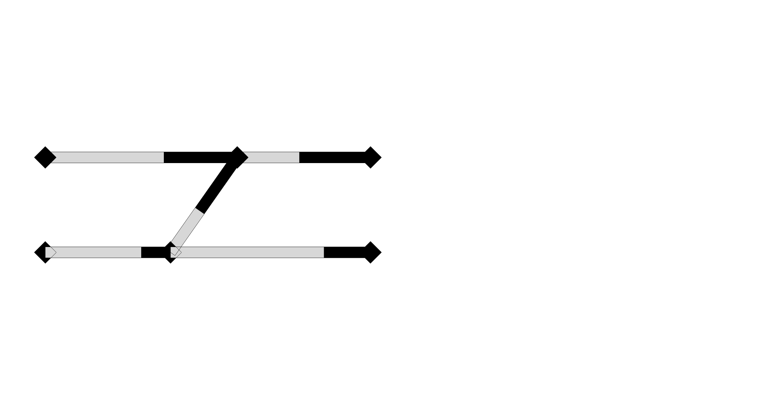
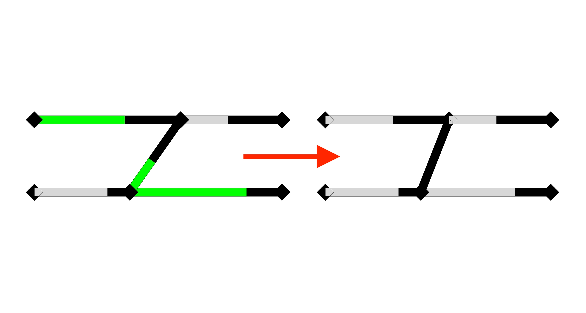
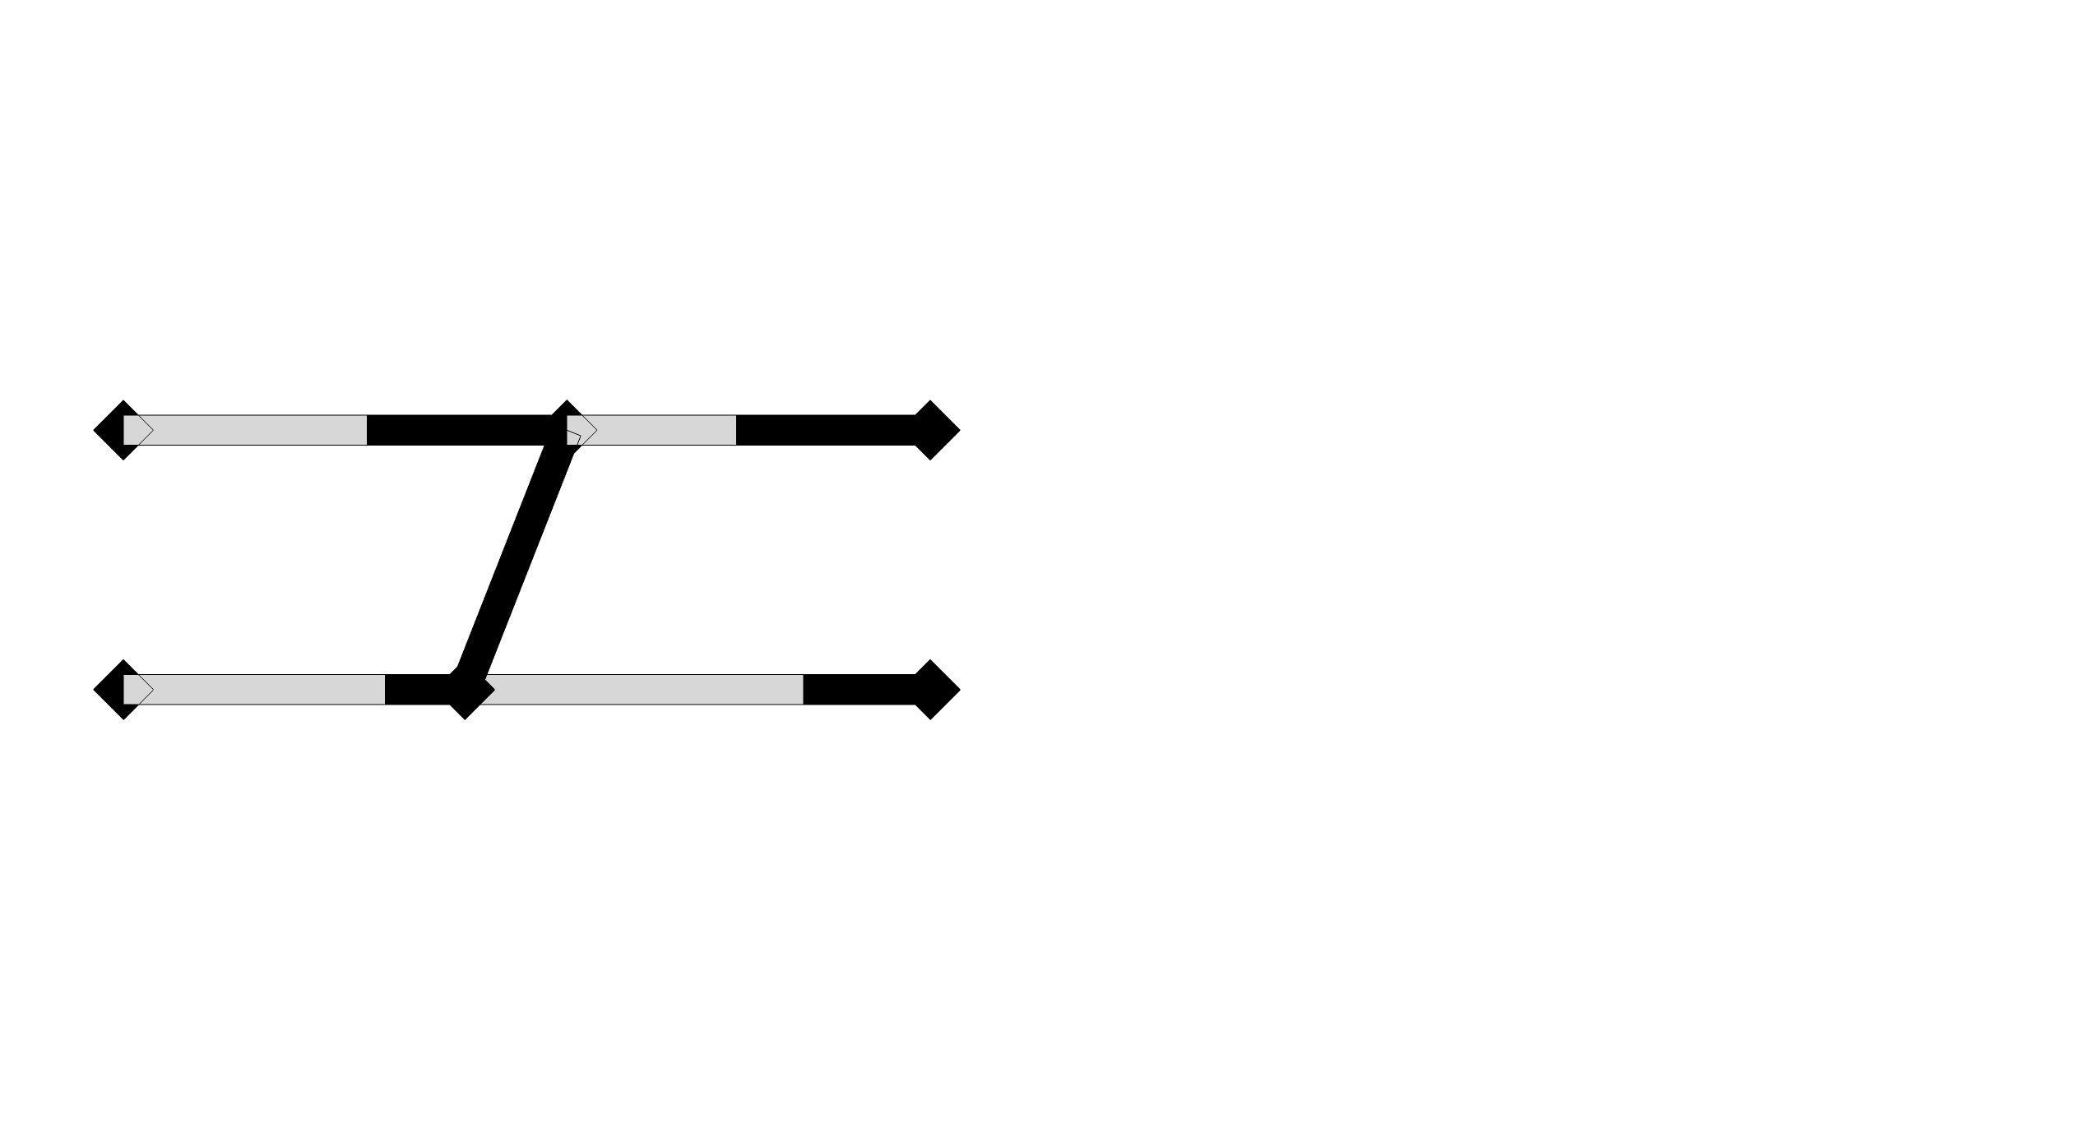
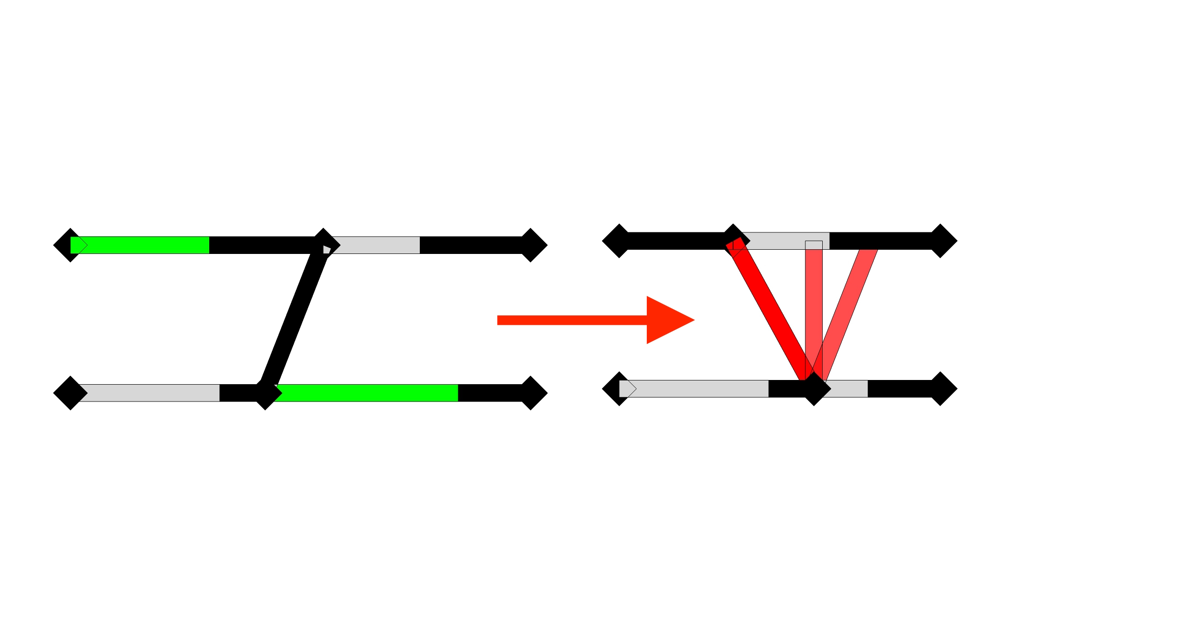
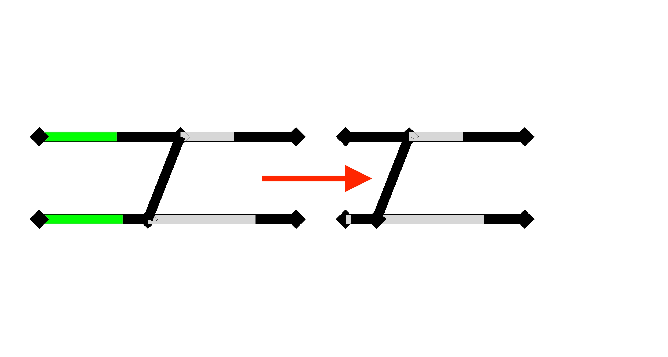
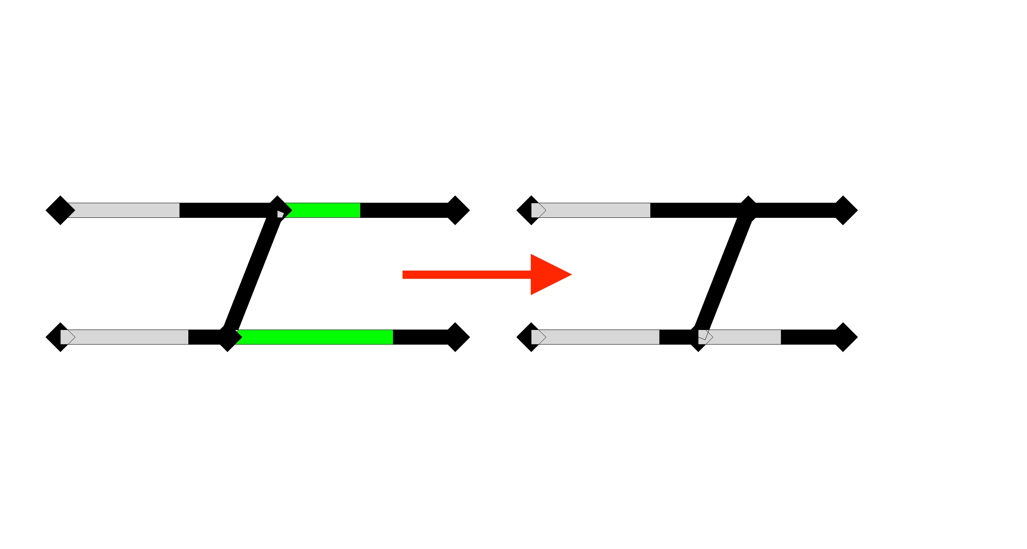
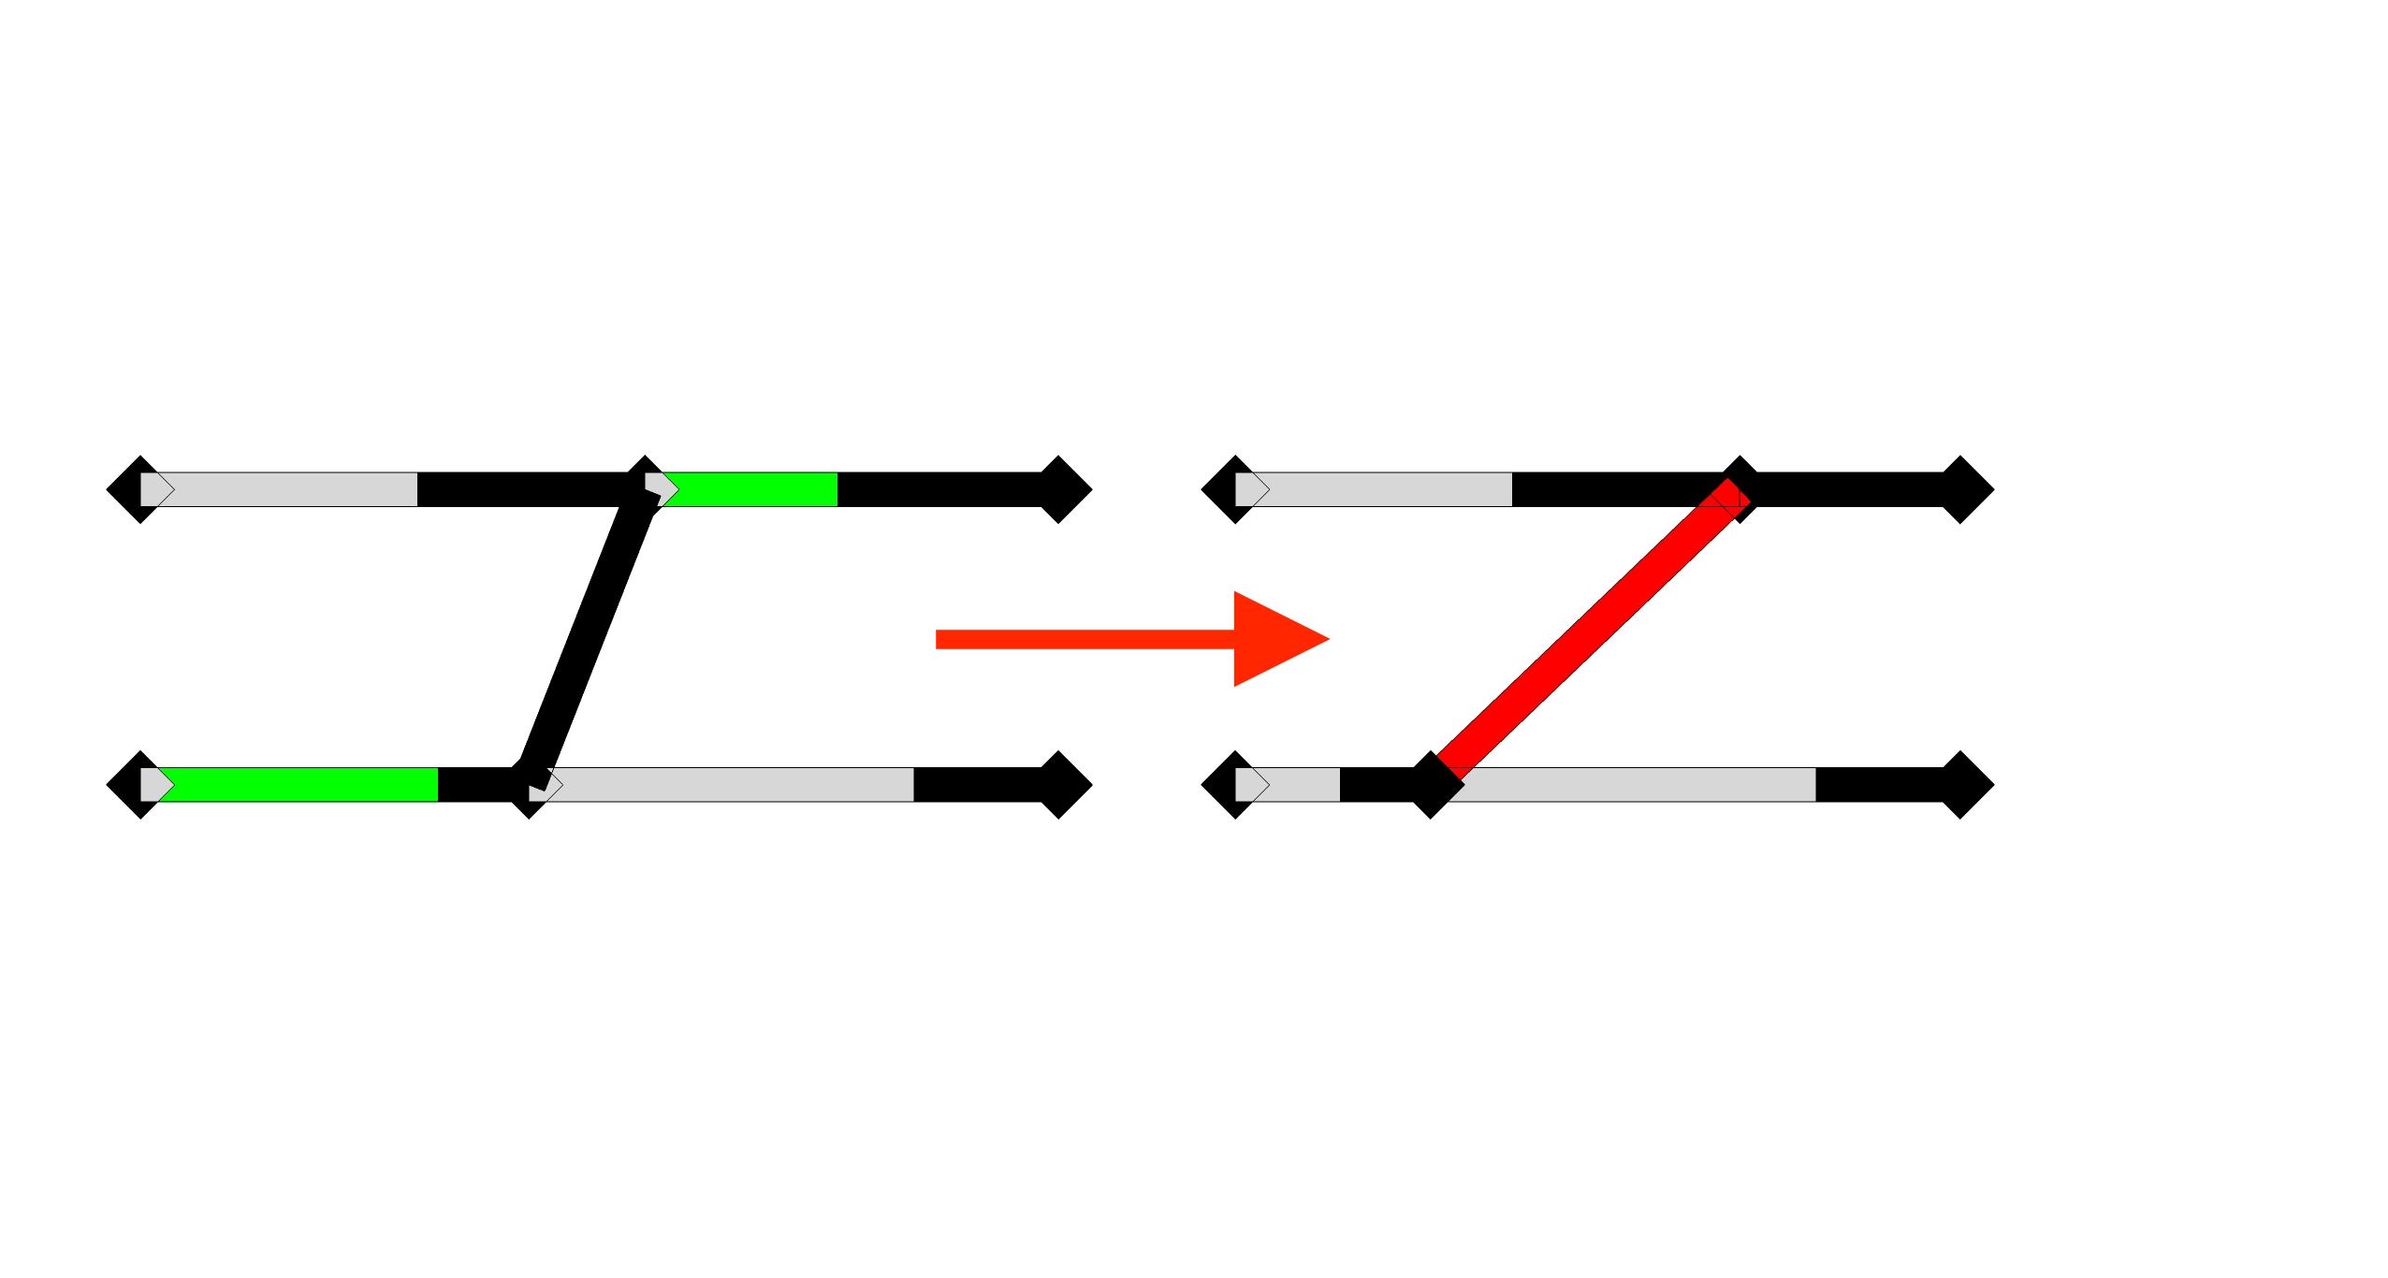
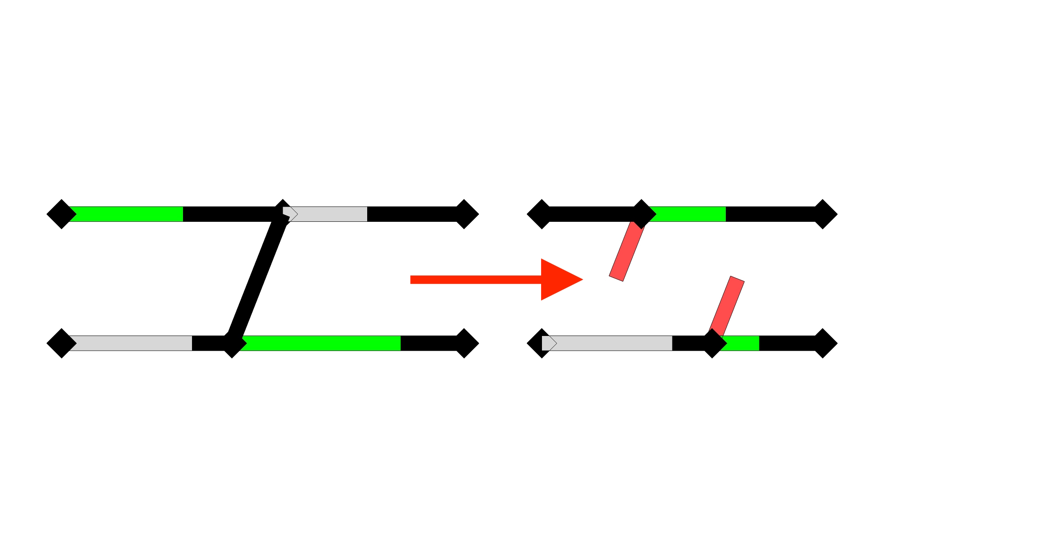
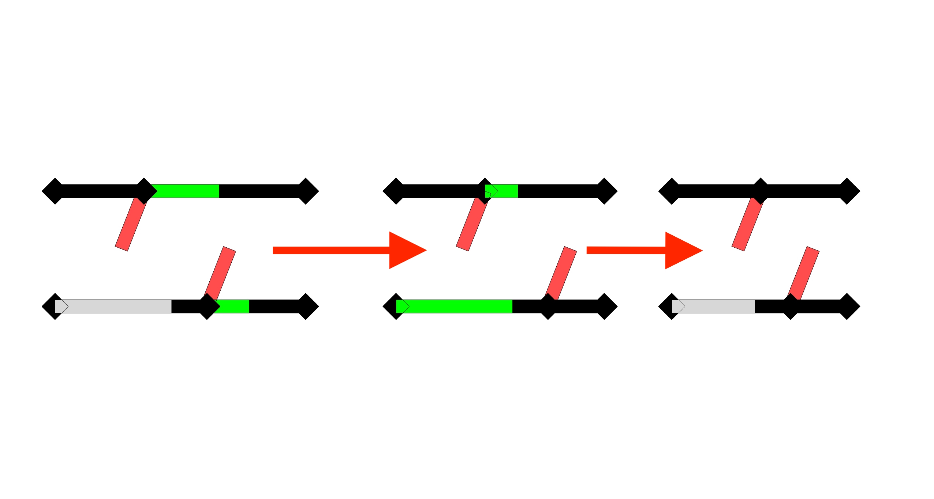
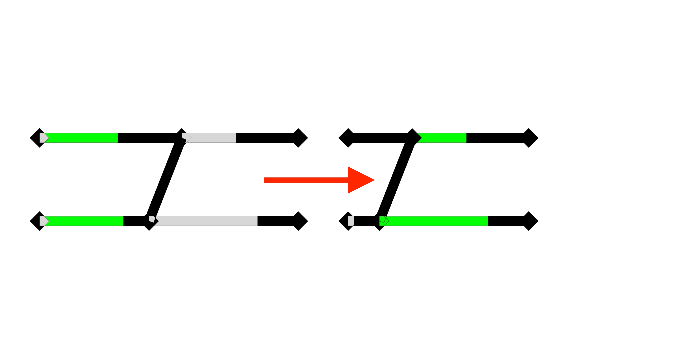
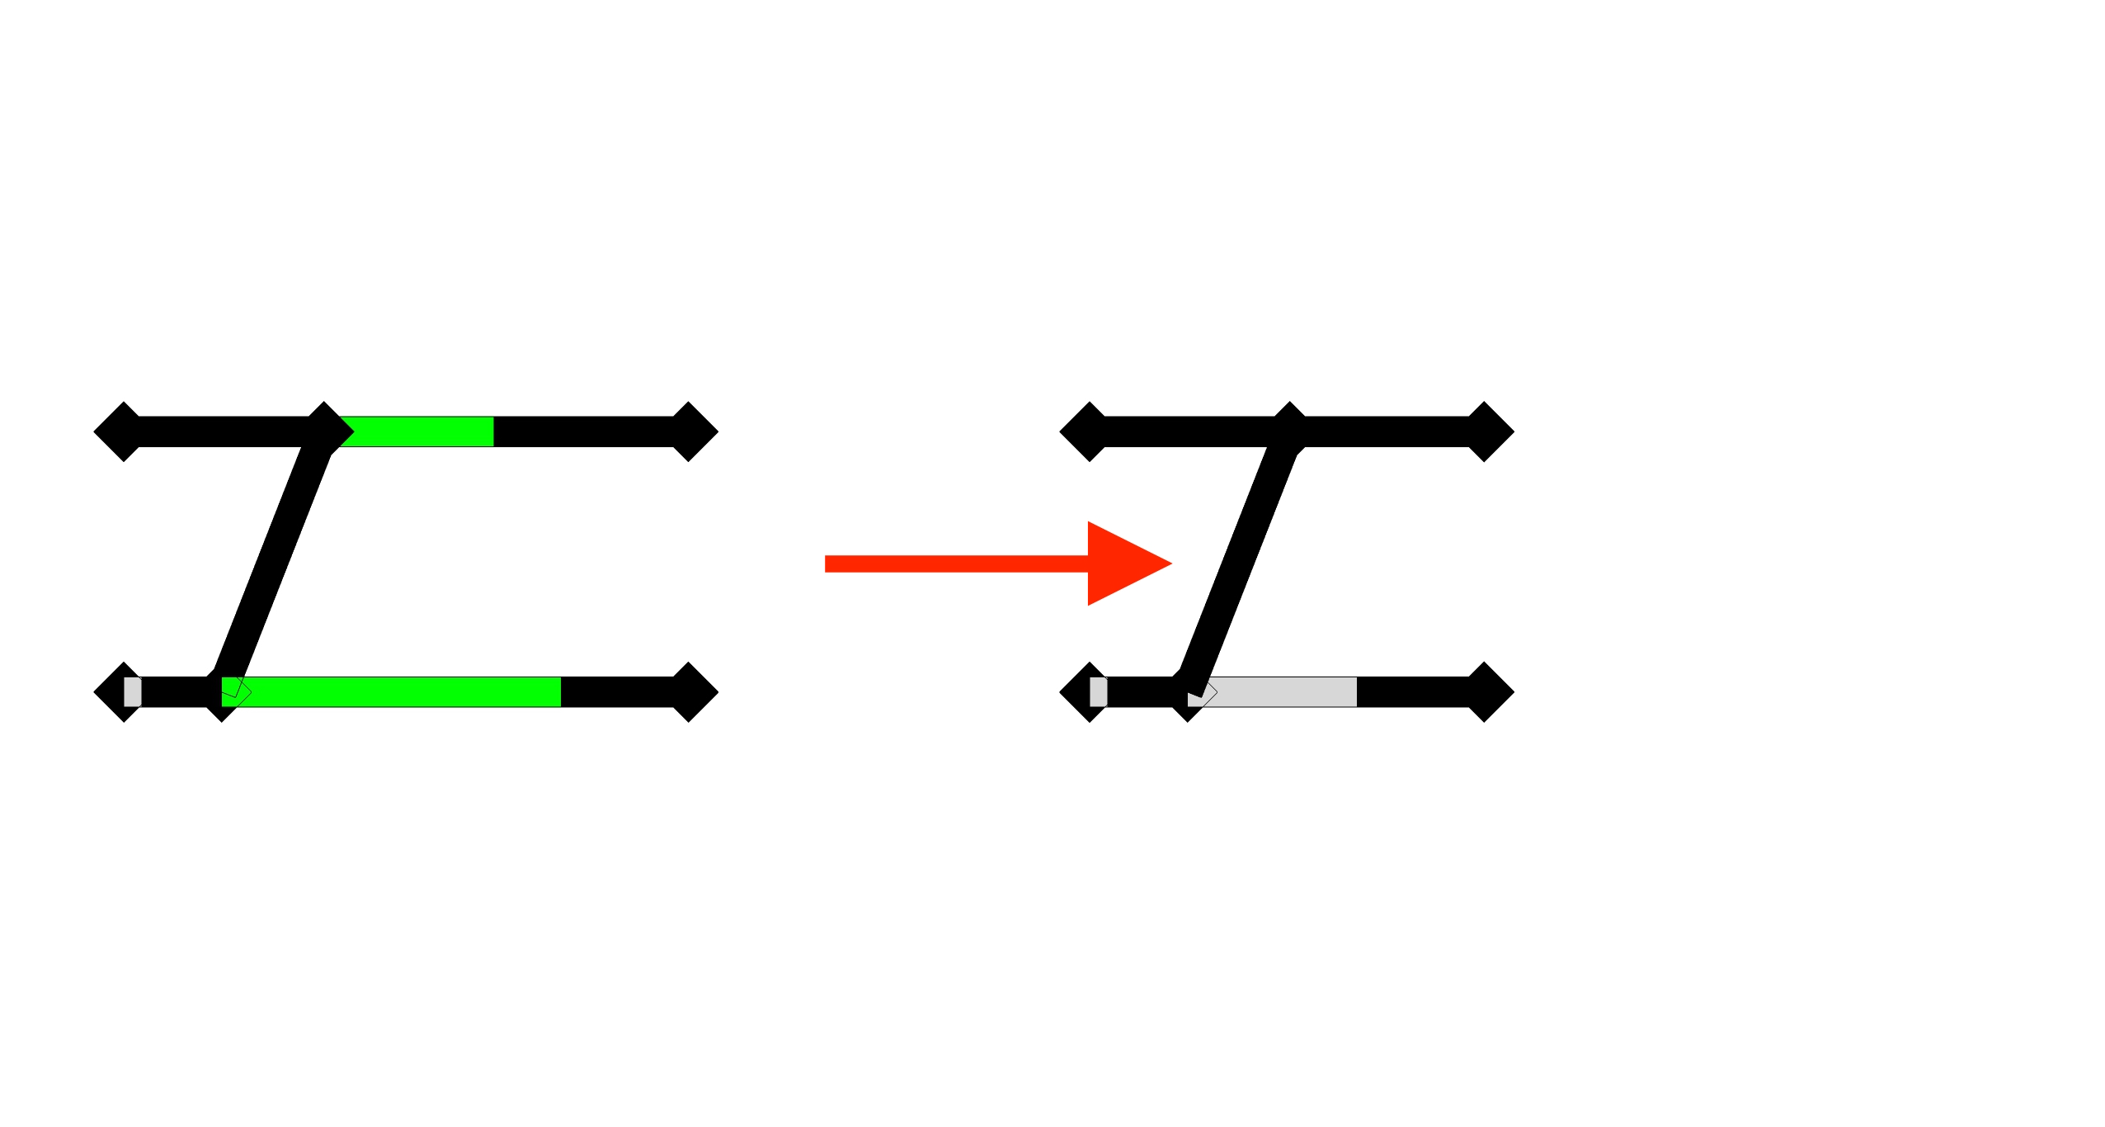
When do the current assumptions fail?
If we stop deforming the bottom right member and deform the members on the left, we obtain the following structure, which is completely deformed
Let’s consider a simple structure
and a particular order of deformation
After the first deformation step the connection has become rigid
What is the next deformation step?
If we keep on deforming the same members, the rigid connection is deformed

Slide 5
Solutions to task 1
Moustafa’s approach (explanation and accomplishments)
Massimo’s approach (explanation and accomplishments)
Further strategies to reduce complexity and present the results

Slide 6
Solution to task 1

Slide 7
isdh

Slide 8
Description of task 2

Slide 9
Next steps

