Slide 1



A Deformation Order Analysis Tool For Vehicle Structures In Crashworthiness Design
Under the supervision of:
Volker Lange
Lailong Song
Students:
Massimo Sferza
Daniel Perez
Moustafa Alsayed Ahmad
Software Lab : 1st Assessment
A Deformation Order Analysis Tool For Vehicle Structures In Crashworthiness Design

Slide 2
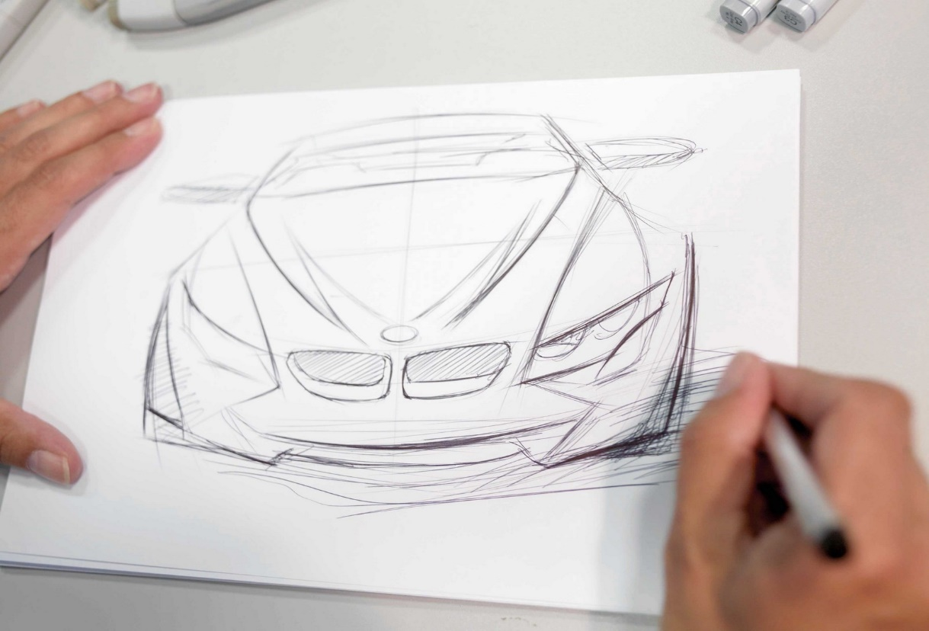
Introduction
Vehicles at the very early stages of the design consist only of perspective drawings and mental concepts ,and some preliminary defined requirements
Ref: http://www.bmwblog.com/2012/03/01/
the-design-process-at-the-bmw-group/
A Deformation Order Analysis Tool For Vehicle Structures In Crashworthiness Design

Slide 3

Introduction (Cont.)
Little or sometimes no information what so ever to start from (NO structure, NO materials, etc.)
- Something has to ignite the spark of design!
Crash Worthiness is one of the sparks that lead to the rest of the car systems’ design!!
CRASH WORTHINESS
REST OF THE CAR DESIGN
Ref: http://idealistcareers.org/5-resources-for-young-
professionals-in-need-of-a-career-igniting-spark/
A Deformation Order Analysis Tool For Vehicle Structures In Crashworthiness Design

Slide 4

Introduction (Cont.)
Engineers start the design of the frontal crash box by inserting a collection of deformable rods and elements just like a puzzle
Ref: http://www.ministryinsights.com
/puzzle-strengths-part-3-
missing-puzzle-piece/
A Deformation Order Analysis Tool For Vehicle Structures In Crashworthiness Design

Slide 5
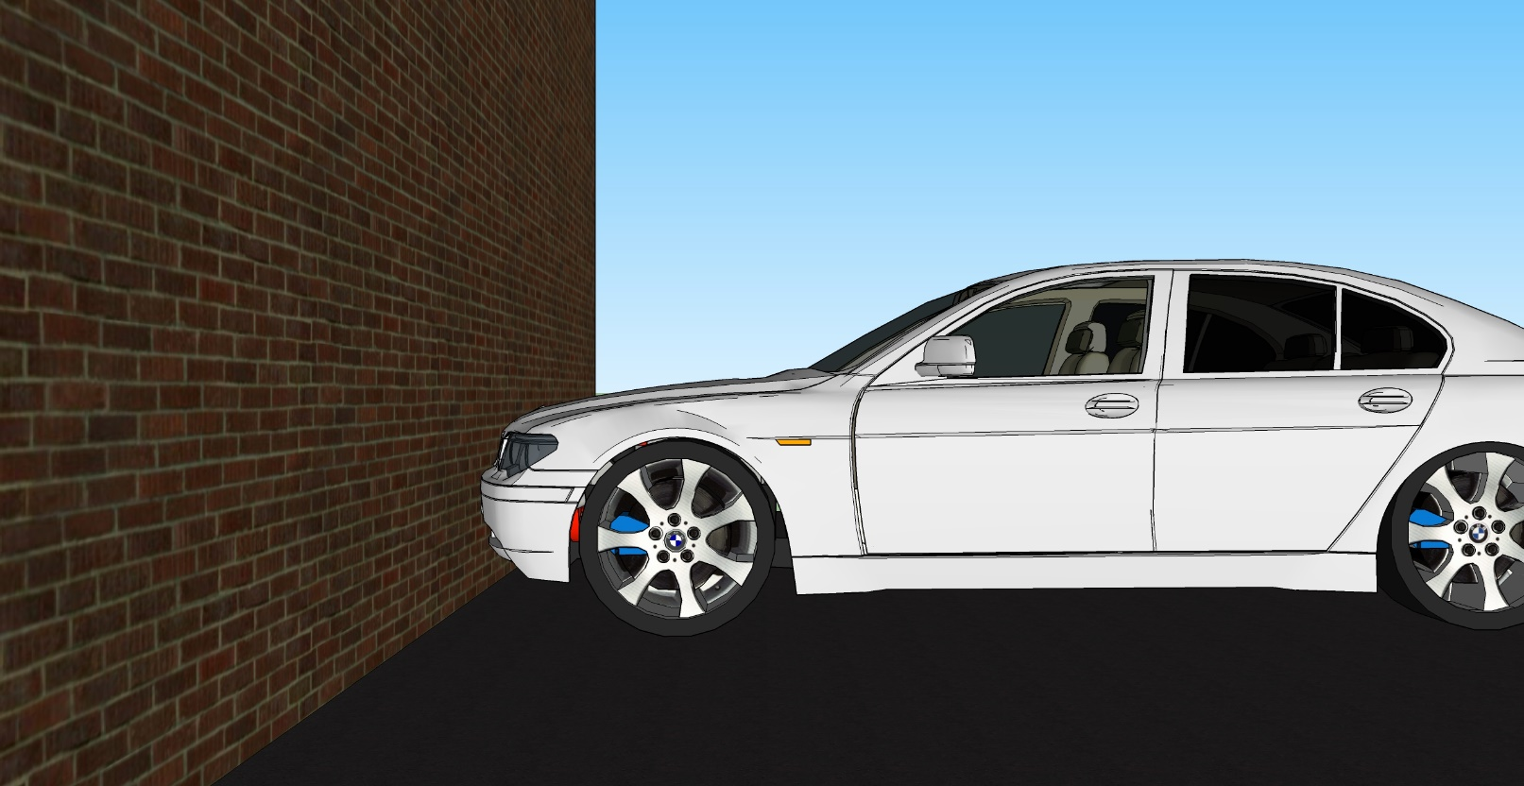
Introduction (Cont.)
Frontal crash box is the main structure targeted with this project, WHERE IS IT?
A Deformation Order Analysis Tool For Vehicle Structures In Crashworthiness Design

Slide 6
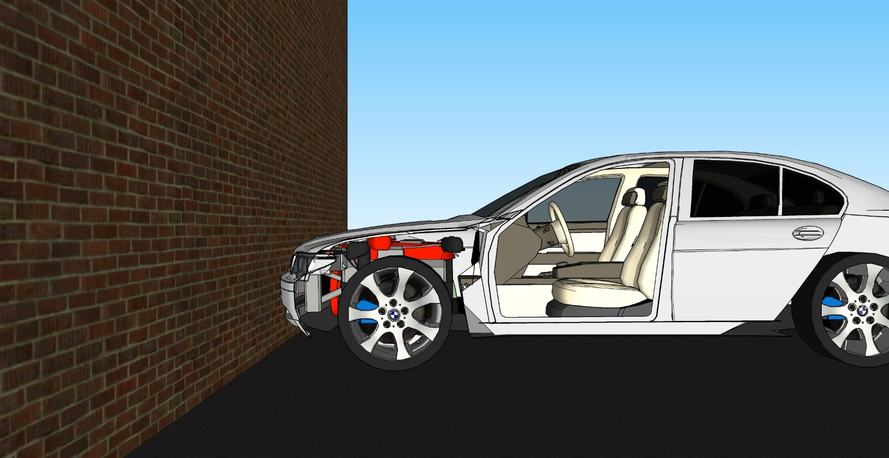
Introduction (Cont.)
Taking off some sheet metals!
A Deformation Order Analysis Tool For Vehicle Structures In Crashworthiness Design

Slide 7
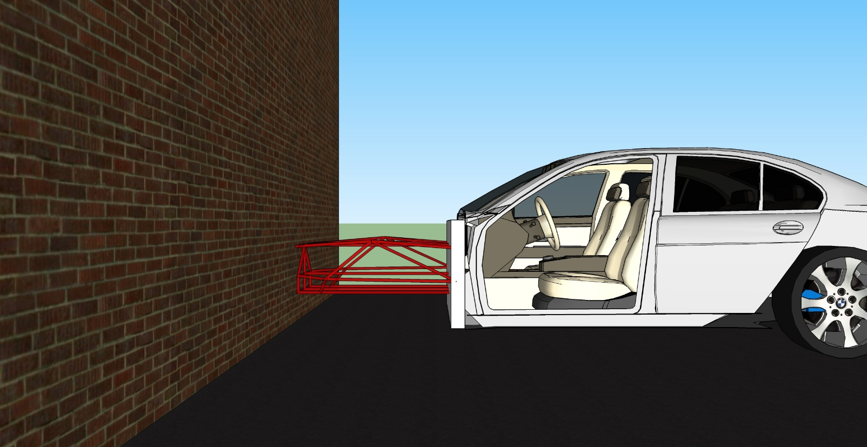
Introduction (Cont.)
Some more, and here is what we are referring to…
A Deformation Order Analysis Tool For Vehicle Structures In Crashworthiness Design

Slide 8
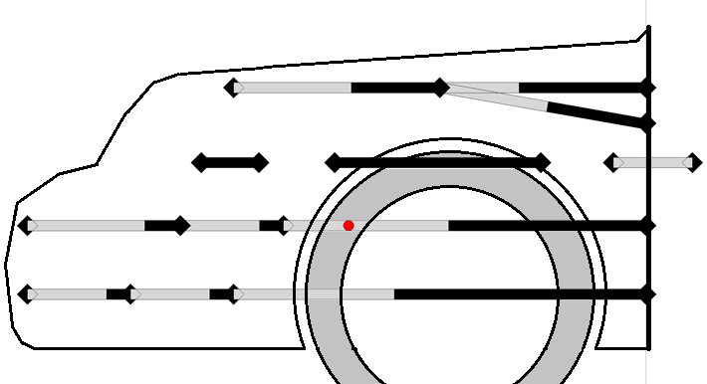
Introduction (Cont.)
The members that have been seen in the crash box can be modeled in a geometry space as the picture below
FIREWALL
FIREWALL
A Deformation Order Analysis Tool For Vehicle Structures In Crashworthiness Design

Slide 9
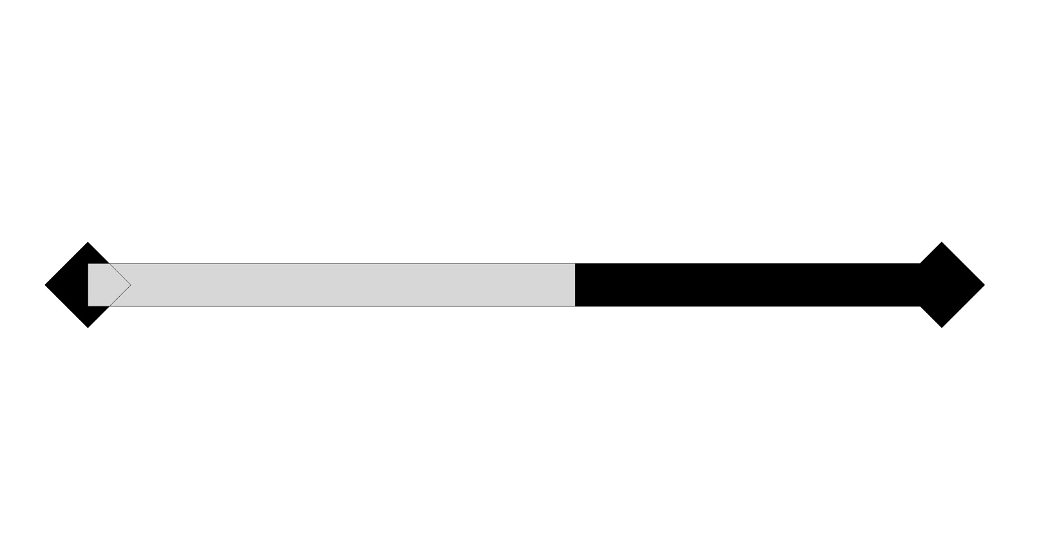
Introduction (Cont.)
- This complicated looking grid can be broken down into a building block called a “member”
- Deformable part and a rigid rest
A Deformation Order Analysis Tool For Vehicle Structures In Crashworthiness Design

Slide 10
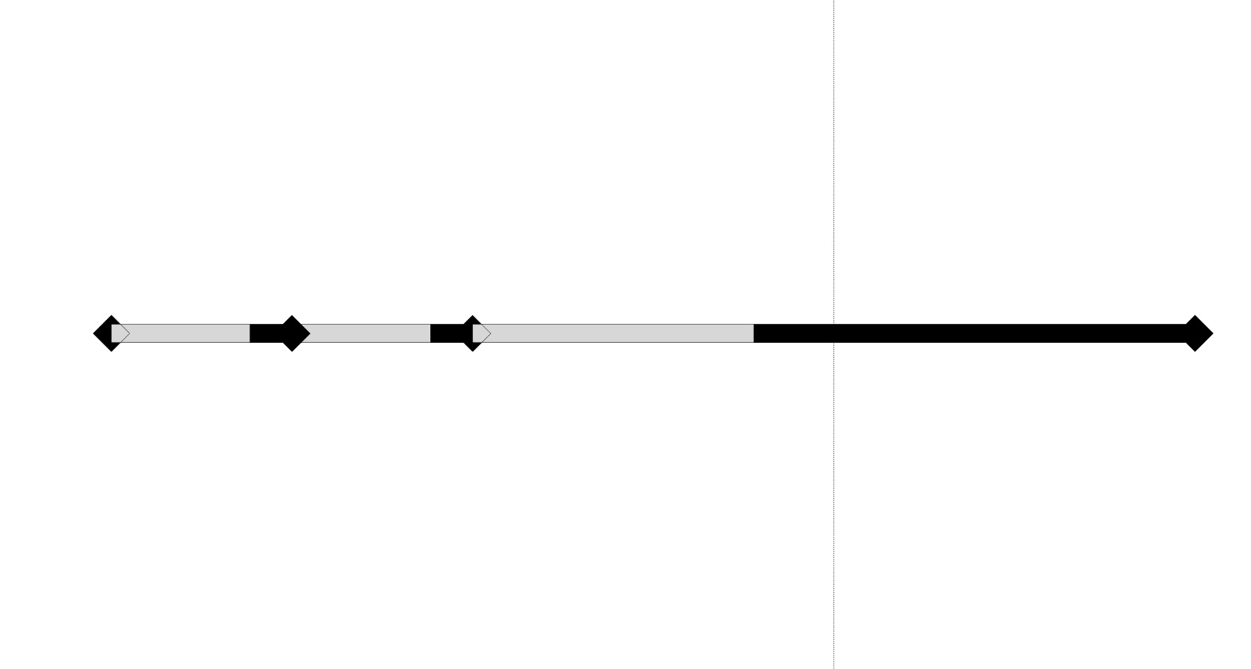
Introduction (Cont.)
Collection of members in series gives what is called as a “Loadpath”
A Deformation Order Analysis Tool For Vehicle Structures In Crashworthiness Design

Slide 11
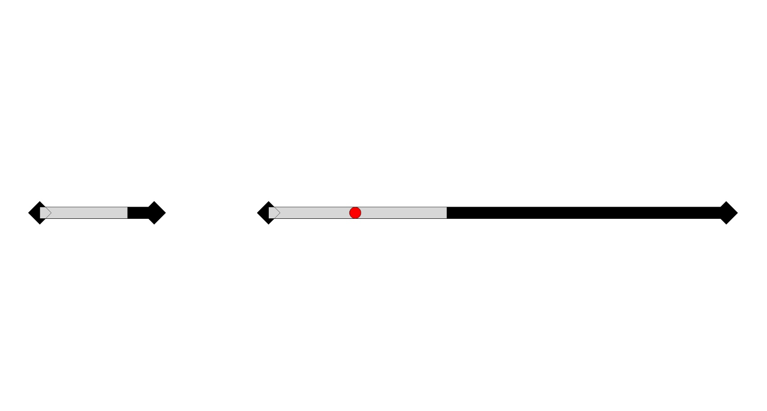
Introduction (Cont.)
These Loadpaths can really get even more complicated by inserting some air gaps in between
A Deformation Order Analysis Tool For Vehicle Structures In Crashworthiness Design

Slide 12
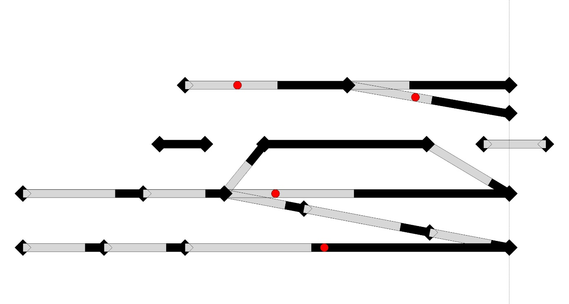
Introduction (Cont.)
- Loadpaths can even be coupled to other Loadpaths!
- Collection of coupled Loadpaths all together gives the overall structure of the crash box
A Deformation Order Analysis Tool For Vehicle Structures In Crashworthiness Design

Slide 13

Order Of Deformation
- So far, we haven't mentioned anything about order of deformation!
- Members deform in a single Loadpath one after the other
- All of the possible sequences that can be had are referred as Order of Deformation “OoD” problem
OR
OR, OR, OR….
A Deformation Order Analysis Tool For Vehicle Structures In Crashworthiness Design

Slide 14
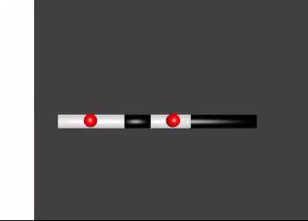
Order Of Deformation (Cont.)
Some short videos that show the idea of Order of Deformation
SECOND – FIRST members
FIRST – SECOND members
OR
A Deformation Order Analysis Tool For Vehicle Structures In Crashworthiness Design

Slide 15
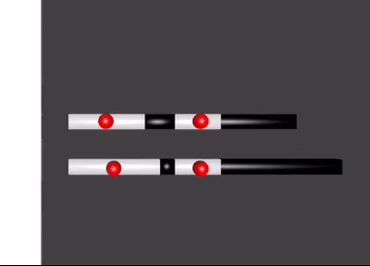
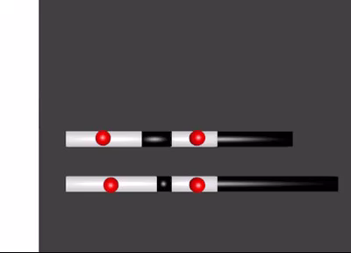
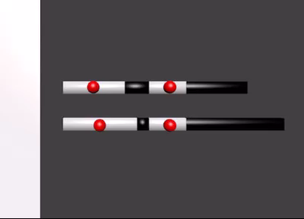
Order Of Deformation (Cont.)
Now what would happen if we have two parallel Loadpaths?!
A Deformation Order Analysis Tool For Vehicle Structures In Crashworthiness Design

Slide 16
Order Of Deformation (Cont.)
Now, imagine how complex multiple coupled Loadpaths are when inserted within the crash box structure
A Deformation Order Analysis Tool For Vehicle Structures In Crashworthiness Design

Slide 17


Order Of Deformation (Cont.)
UNFORTUNATELY, Engineers are still doing that using paper and a pen
A Deformation Order Analysis Tool For Vehicle Structures In Crashworthiness Design

Slide 18

Motivation
- Each possibility can lead to different result with respect to the acceleration and the energy absorption of the crash
- It is worth it to work on something that can solve it automatically
- In order to accelerate this initial design step, we should be able to integrate the computer somewhere within
ORDER OF DEFORMATION
PROBLEM
SOLUTION
Ref: https://en.wikipedia.org/wiki/Desktop_computer
A Deformation Order Analysis Tool For Vehicle Structures In Crashworthiness Design

Slide 19
Motivation (Cont.)
- In a matter of seconds, it can give the engineer all of the possible sequences and which one corresponds to the given mass and material data
- Afterwards, any further adjustments can be easily implemented
A Deformation Order Analysis Tool For Vehicle Structures In Crashworthiness Design

Slide 20
Problem Statement
1- The software should be able to identify ALL of the possible OoDs
2- It should be capable of defining which one of these OoDs is going to be generated for the specific masses and material properties of the car
3- Visualize the results for further understanding of the solutions
A Deformation Order Analysis Tool For Vehicle Structures In Crashworthiness Design

Slide 21
DAS IST ALLES!
VIELEN DANK
THAT’S ALL!
THANKS FOR LISTENING
A Deformation Order Analysis Tool For Vehicle Structures In Crashworthiness Design

