Slide 1
University E-Voting System
Milestone One: Discovery & Architecture
December 2025

Slide 2
Project Overview
🎯 Objective: Secure, accessible digital voting platform
📱 Mobile-first architecture with React Native
🔐 OTP-based authentication for voters
🏛️ Role-based access (Admin, Officer, Candidate, Voter)
📊 Real-time results and audit logging

Slide 3
Key Features
✅ Voter Authentication via OTP (Email)
✅ Candidate Nomination & Approval Workflow
✅ Secret Ballot with Single-use Tokens
✅ Real-time Vote Counting & Results
✅ Immutable Audit Logs
✅ Admin Dashboard for Election Management

Slide 4
Stakeholder Mapping
👤 Administrators - System configuration & oversight
👤 Returning Officers - Nomination approval & monitoring
👤 Candidates - Submit nominations & manifestos
👤 Voters - Verify identity & cast votes

Slide 5
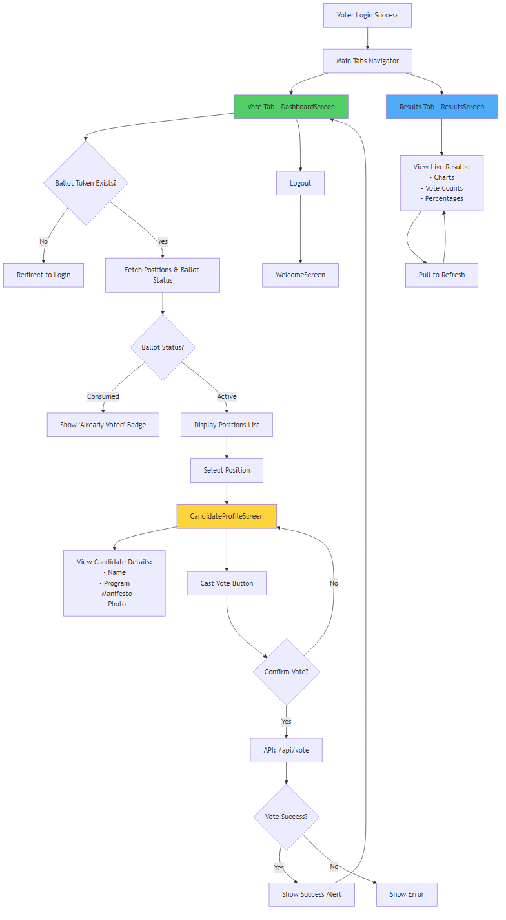
Voter Journey

Slide 6
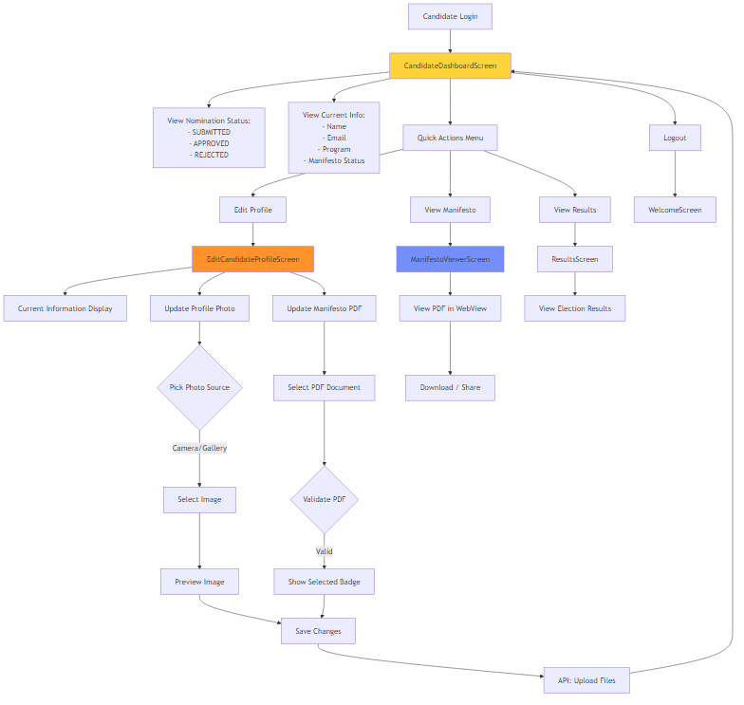
Candidate Journey

Slide 7
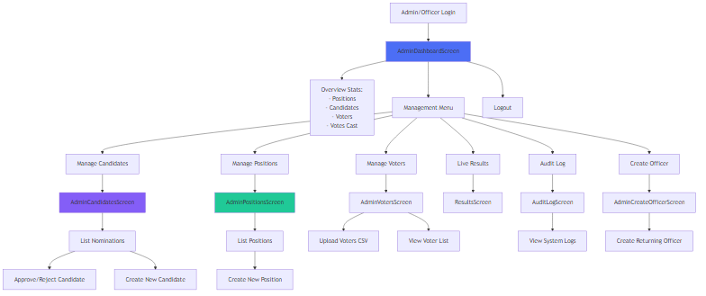
Admin & Officer Journey

Slide 8
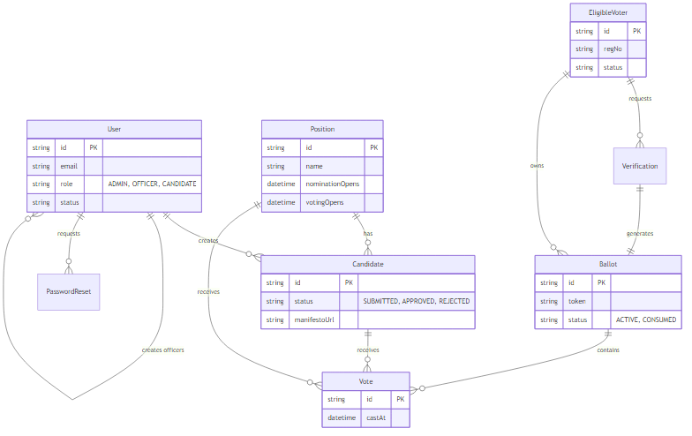
Entity Relationship Diagram

Slide 9
Technology Stack: Backend
⚙️ Runtime: Node.js
🚀 Framework: Express.js
💾 Database: MySQL
🔧 ORM: Prisma
🔐 Authentication: JWT + Bcrypt
📧 Email: Nodemailer

Slide 10
Technology Stack: Mobile
📱 Framework: React Native (Expo)
💻 Language: JavaScript
🔄 State Management: Context API
💾 Storage: AsyncStorage
🌐 Networking: Axios

Slide 11
Security & Risk Mitigation
🔒 Role-Based Access Control (RBAC)
🔑 Two-Factor Authentication (Reg No + OTP)
🎫 Single-use Ballot Tokens
📝 Immutable Audit Logs
🔐 Encrypted Password Storage (Bcrypt)
⚡ Rate Limiting on API endpoints

Slide 12
Development Workflow
📦 Two Repositories:
• Backend API: Evoting-Backend-API
• Mobile App: Evoting_mobile_group3
🌿 Feature-branch workflow
✅ GitHub Actions CI/CD
📝 Conventional Commits
🧪 Automated Testing

Slide 13
Future Plans
🔐 Biometric Authentication (FaceID/TouchID)
⛓️ Blockchain Integration for vote hashes
📲 Push Notifications for real-time updates
🌍 Multi-language Support
📊 Advanced Analytics Dashboard

Slide 15
Thank You
Questions?
University E-Voting System
Milestone One Presentation

