Slide 1
5th Reversing CTF Takeaways
Joachim De Zutter

Slide 2
Who am I
Cyber security researcher
Solved 11 out of 12 challenges of this year’s Flare-On Reverse Engineering CTF

Slide 3
Flare-On Challenge
www.flare-on.com
FireEye Labs Advanced Reverse Engineering team’s annual capture the flag (CTF) contest
12 challenges, 6 weeks
5th CTF (2018) is over => all challenges & solutions are publicly available

Slide 4
#1 & #2: Minesweeper challenges
#1 Java Archive (JAR)
JD-GUI
#2 .NET executable
Telerik JustDecompile

Slide 5
#3: FLEGGO
48 Windows 32-bit PE executables
Password in the resource section of each executable

Slide 6
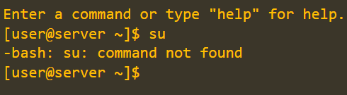
#4: binstall
.NET ConfuserEx → NoFuserEx / de4dot
Installs DLL that hooks browser
Webinjects to add “su” command in JavaScript code of “shell” on flare-on website
Technique used by banking trojans (MiTB)

Slide 7
#5: web2point0
WebAssembly (*.wasm) runs inside a browser
Chrome DevTools for single-stepping

Slide 8
#6: Magic
64-bit Linux ELF asking for 666 keys
Each key checked 33 times with 7 different validation functions (CRC32/modified base64/RC4/Fibonacci/…) => needs automation
GDB scripting (breakpoint commands) or IDAPython

Slide 9
#7: WOW
“Heaven’s Gate” to execute 64-bit code
from 32-bit executable

Slide 10
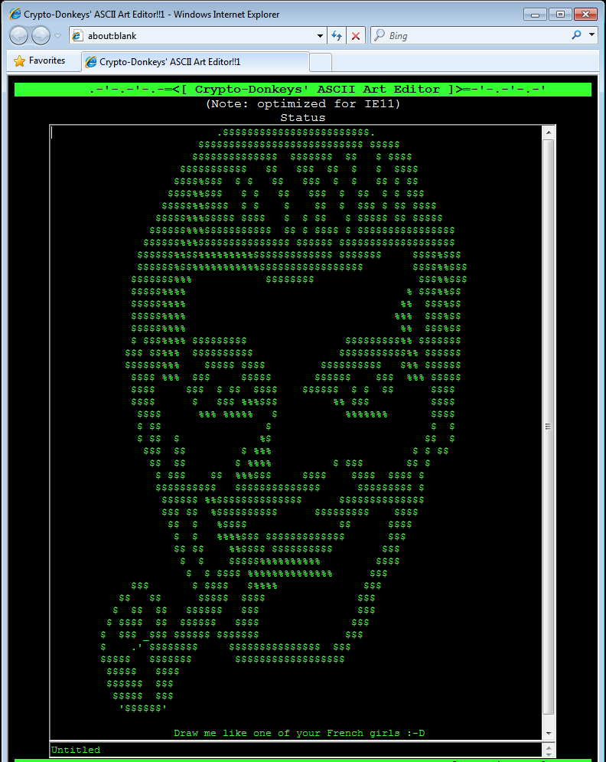
#8: leet_editr
VBScript code decrypted at runtime using vectored exception handler

Slide 11
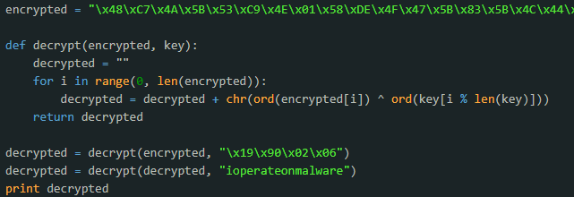
#9: doogie hacker
First sectors of a floppy disk (use f.e. Qemu+IDA)
Date in BCD format obtained using INT 0x1A was used as a partial key for hidden message

Slide 12
#10: golf
Win32 *.exe running fhv.sys 64-bit kernel driver which starts software hypervisor using Intel VMX instructions
Solved by running Windows 7 (64-bit) inside Qemu in 64-bit Linux with KVM and nested VMX enabled

Slide 13
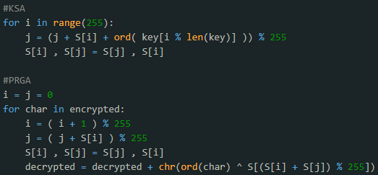
#11: Malware skillZ
pcap + executable
Executable received through DNS TXT records, which get decoded and decrypted with modified RC4 (mod 255 instead of mod 256)
AES encrypted C2/LM communication and ZIP file
Notes:
String obfuscation using LCG for DLL names & ROR13 hashes for function names, see https://www.tophertimzen.com/blog/shellcodeTechniquesCPP/

Slide 14
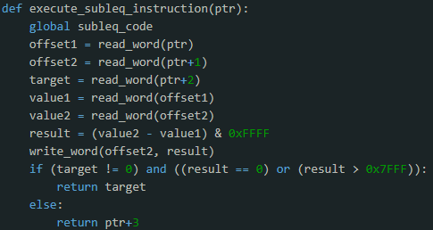
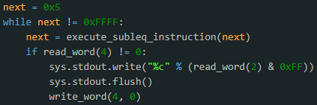
#12: Suspicious Floppy
Disk image, 16-bit code
DOS INT 0x21, AH = 0x3F behaving strange ☺
Interrupt handler with “spy program” could be reversed using Bochs/Qemu + IDA
Inside interrupt handler: subleq OISC emulator running an RSSB OISC emulator to verify password

Slide 15
THANK YOU

