Slide 1

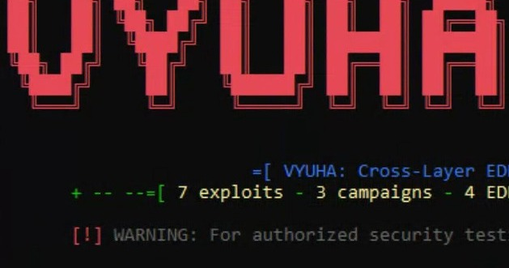
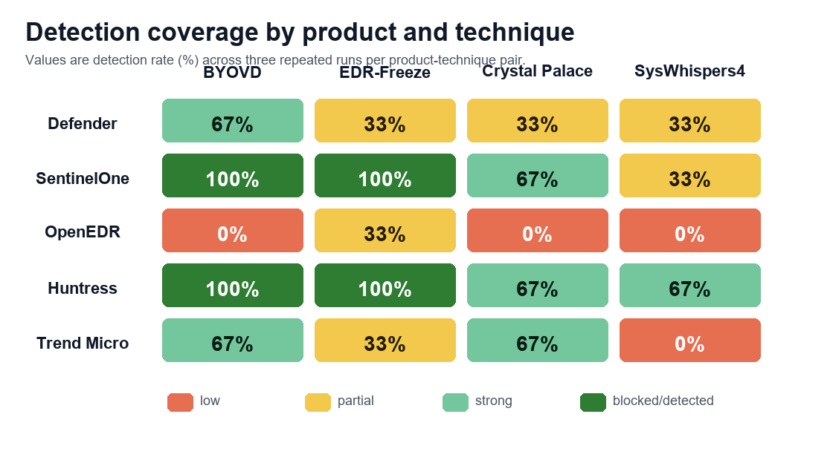
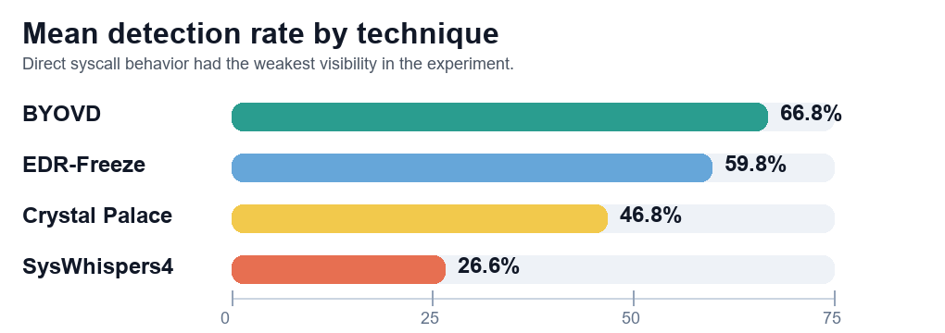
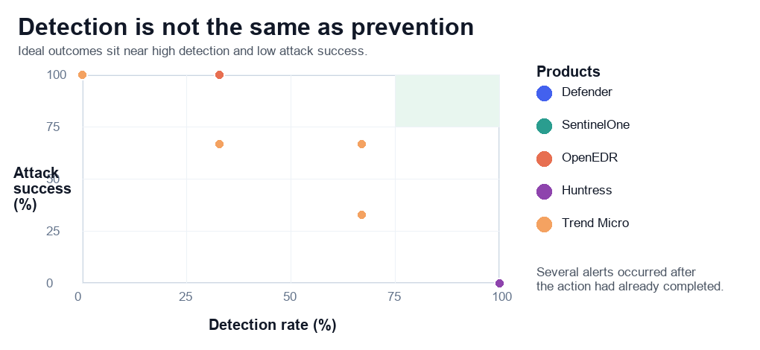
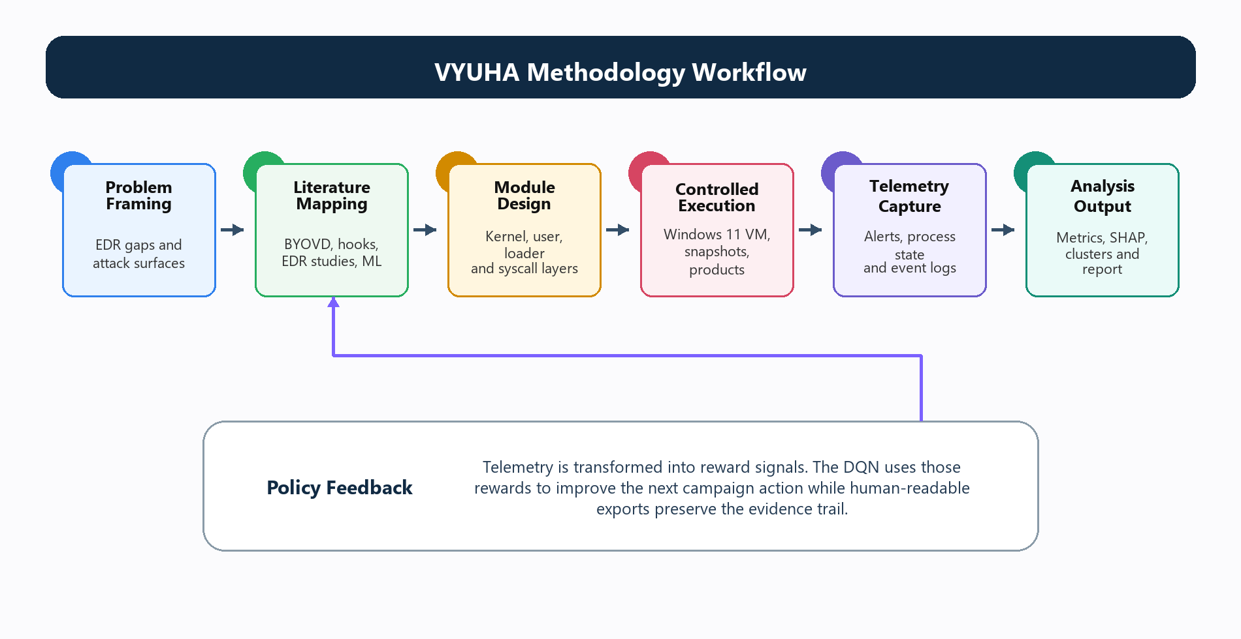
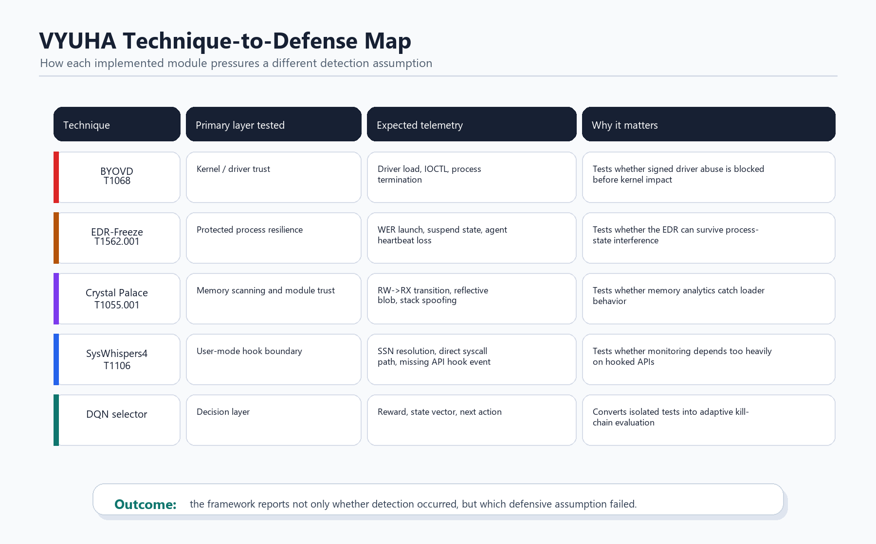
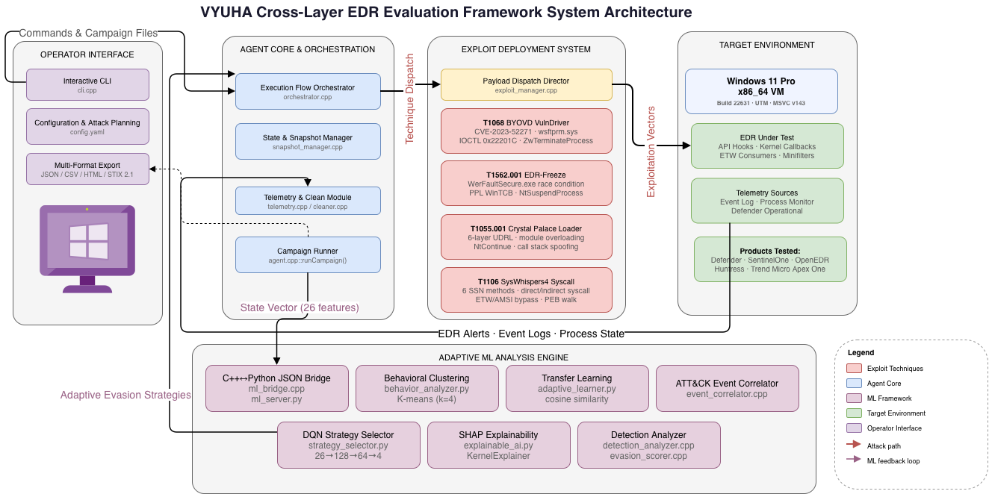

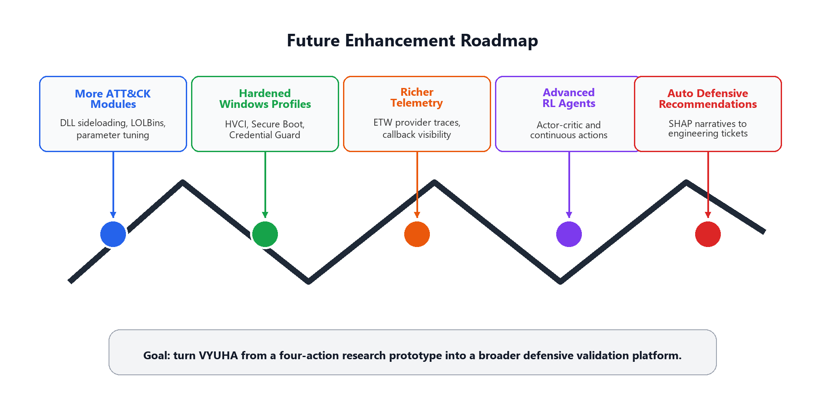
VIII SEMESTER MAJOR PROJECT (CY481P)
Go, change the world
VYUHA: Cross-Layer EDR Kill-Chain Evasion via
Deep Reinforcement Learning-Guided Adversarial Orchestration
Bandaru Jnyanadeep | Bipin Raj C | Karthik Prakash
1RV22CY017 | 1RV22CY020 | 1RV22CS081
Guides: Dr. Minal Moharir, RVCE | Dr. Sebastian Biedermann, Technical University of Applied Sciences, Germany
Abstract
Results
VYUHA is a controlled defensive validation framework for testing whether EDR products detect, block, or miss cross-layer evasion behavior.
It combines four modules: BYOVD, EDR-Freeze, Crystal Palace reflective loading, and SysWhispers4 direct syscall execution.
A DQN selector learns product-specific action choices, while SHAP, clustering, and transfer learning explain defensive patterns.
60
5
4
27%
4.0x
attack instances
EDR products
technique layers
lowest mean detection
transfer speedup
Problem Statement
Modern EDR products observe many endpoint layers, but their detection chain can break at driver trust, process availability, memory inspection, or API-hook visibility.
Existing evaluations often test fixed techniques manually, so they miss how products behave when attack sequencing adapts to previous responses.
Objectives
- Build a modular C++17 framework for controlled EDR evaluation.
- Execute four ATT&CK-mapped techniques across kernel, process, memory, and syscall layers.
- Record success, detection, blocking, time-to-detection, cleanup, and export evidence.
- Use DQN selection plus SHAP, clustering, and transfer learning for explainable comparison.
Methodology
Each run starts from a restored Windows 11 VM snapshot. VYUHA installs one EDR profile, dispatches a selected module, captures alerts, process state, timing, and cleanup status, then computes metrics and reward features. The ML layer uses the same result schema to recommend the next action.
Key Findings
- SentinelOne and Huntress blocked BYOVD and EDR-Freeze in every run.
- Crystal Palace and SysWhispers4 still created partial bypasses in stronger products.
- OpenEDR had the weakest coverage, with several successful runs and no visible alert.
- SysWhispers4 had the lowest mean detection rate, showing that user-mode hook coverage is incomplete.
References
Karantzas & Patsakis (2021), Empirical assessment of EDR systems against APT vectors.
MDSec Research (2020), Bypassing user-mode hooks and direct invocation of system calls.
Haag, Bradley & Hernandez (2025), Living Off The Land Drivers.
Mnih et al. (2013), Playing Atari with Deep Reinforcement Learning.
Lundberg & Lee (2017), SHAP: A unified approach to interpreting model predictions.
Pan & Yang (2010), A survey on transfer learning.
Report QR

