Slide 1
Edge Detection Operators
Samuel Bugeja
Julian Degiorgio
Daniel Briffa
Lola Le Crom

Slide 2
Introduction

Slide 3
Introduction: What Edge Detection Finds
Intensity changes are like looking through fog:
Sharp brightness changes
mark object boundaries.
Edge detection reduces an image to its meaningful intensity changes, while keeping shape information.
Smooth region
Used before segmentation,
object extraction and recognition.
Sudden drop = Edge

Slide 4
Introduction: Families of Edge Detectors
The operators in our presentation detect the same idea in different ways:
First-order Gradients:
Sobel + Prewitt:
Find where change is strong.
Second-order Response
LoG:
Finds where the
First-order gradients flips sign.
Multi-stage Detector
Canny:
Combines smoothing,
thinning and thresholding.

Slide 5
Sobel Operator

Slide 6
Sobel: Gradient-Based Edge Detection
Input
image
Gx kernel:
vertical edges
Gy kernel:
horizontal edges
Combine
responses
Edge
map
Sobel is a first-order derivative method: it looks for large local intensity changes, not zero-crossings.
Gx
Gy
-1
0
1
1
2
1
Gradient Magnitude:
Edge Direction:
-2
0
2
0
0
0
√(Gx² + Gy²)
tan⁻¹(Gy / Gx)
-1
0
1
-1
-2
-1
≈ [Gx] + [Gy]
The centre row/column is weighted more strongly, so Sobel smooths slightly while differentiating.

Slide 7
Sobel: Worked Example
Gy kernel
(10×1 + 10×2 + 10×1) + 0 + 0 = 40
1
2
1
3×3 image patch
×
0
0
0
=
10
10
10
-1
-2
-1
0
0
0
Gx kernel
(10×-1 + 10×0 + 10×1) + 0 + 0 = 0
0
0
0
-1
0
1
×
-2
0
2
=
-1
0
-1
Gy = 40
Gx = 0

Slide 8
Sobel: Worked Example (cont.)
Remember:
Gy = 40
Gx = 0
Gradient Magnitude = √(Gx² + Gy²) = √(40² + 0²) = 40
A high magnitude means Sobel has detected a strong intensity change.
Edge direction = tan⁻¹(Gy / Gx) = tan⁻¹(40 / 0) = undefined
This is a special case where the Edge direction is not computable.
This means that the edge line is perpendicular to the gradient direction
Therefore, in practice it is taken as a 90 degree gradient direction

Slide 9
Sobel: Strengths & Weaknesses
Strengths
Limitations / Failure Cases
Simple, fast and easy to implement.
Works well for strong outer boundaries.
Gives useful edge orientation from Gx and Gy.
Still sensitive to noise, weak contrast and heavy texture.
Can produce thick, broken or false edges.
Does not do edge thinning or linking like Canny.
Best use of Sobel Operator:
Fast & basic edge detection where a rough direction estimate is useful.

Slide 10
Prewitt Operator

Slide 11
Prewitt : Gradient-Based Edge Detection
Similarities to Sobel:
Uniform weights across the kernel:
First-order derivative method:
Gx
Gy
Input
image
Gx kernel:
vertical edges
Gy kernel:
horizontal edges
Combine
responses
Edge
map
-1
0
1
1
1
1
-1
0
1
0
0
0
-1
0
1
-1
-1
-1
Gradient Magnitude:
Edge Direction:
√(Gx² + Gy²)
tan⁻¹(Gy / Gx)
All kernel values are equally weighted, so Prewitt is an average-gradient detector rather than a smoothed one.
≈ [Gx] + [Gy]

Slide 12
Prewitt: Worked Example
Gy kernel
1
1
1
10×1 + 10×0 + 10×(-1) = 0
3×3 image patch
×
0
0
0
=
10
0
0
-1
-1
-1
10
0
0
Gx kernel
10×(-1) + 10×(-1) + 10×(-1)= 0
10
0
0
-1
0
1
×
-1
0
1
=
-1
0
1
Gy = 0
Gx = -30

Slide 13
Prewitt: Worked Example
Gradient Magnitude = √(Gx² + Gy²) = √(0² + [-30]²) = 30
High magnitude: strong intensity change.
Edge direction = tan⁻¹(Gy / Gx) = tan⁻¹(0 / -30) = 0
Since Gx<0, the gradient vector points entirely in the negative x-direction, so the actual direction is 180°. The gradient direction is perpendicular to the edge.
Gradient vector:
Edge detected: Vertical

Slide 14
Prewitt: Strengths & Weaknesses
Strengths
Limitations / Failure Cases
Easy to understand and implement.
Computationally light.
Works best on clean images with clean boundaries.
Weak on noisy image and subtle details.
Can miss fine structure and produce unstable edges.

Slide 15
LoG: Laplacian of Gaussian

Slide 16
LoG: Laplacian of Gaussian and How It Works
LoG is a second derivative method:
First it smooths the image with a Gaussian filter.
It then applies the Laplacian, which measures second-order intensity change.
Edges are detected where the filtered response crosses zero.
This differs from Sobel/Prewitt, which look for large first-order gradients.
Input image
Gaussian smoothing
Laplacian filter
Zero-crossings
Edge map

Slide 17

LoG: Technical Method
Applying Laplacian to a Gaussian-smoothed image utilises the second derivative, as seen in the the formula:
σ controls the amount of smoothing
larger σ = more smoothing, less detail and cleaner edges
smaller σ = less smoothing, more detail and more noise
Notes:
σ is sigma.

Slide 18
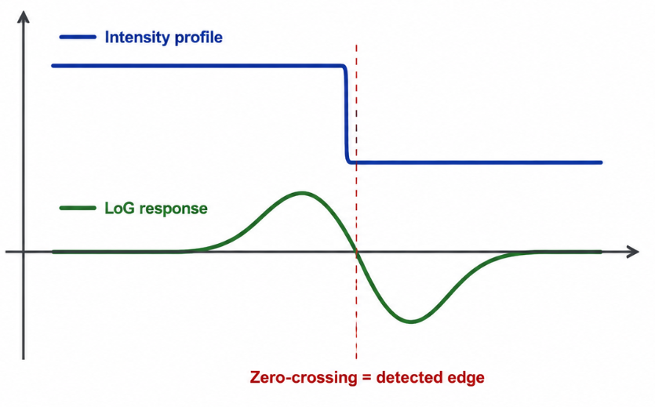
LoG: Interpreting Results
Blue = original image intensity profile.
Green = result after Gaussian smoothing + Laplacian filtering.
LoG does not look for the highest gradient peak, unlike for instance Sobel, instead it looks for where the second derivative changes sign, meaning that the edge is detected at 0.
Notes:
Edge is detected at 0: from positive to negative

Slide 19
LoG: Strengths and Weaknesses
Strengths
Rotationally symmetric, so it does not favour only horizontal or vertical edges.
Able to detect contours clearly using zero-crossings.
Limitations / Failure Cases
Due to using the 2nd derivative, does not directly give edge orientation like Sobel or Prewitt
Sensitive to Gaussian scale and thresholding choices.
Notes:
Use LoG when zero-crossing contour detection is the point.
Avoid using LoG only in very noisy or highly textured images.

Slide 20
Canny

Slide 21
Canny: Multi-Stage Edge Detection
Input image
Gaussian smoothing
Gradient Calculation
Non-Maximum Suppression
Double Thresholding
Hysteresis
Edge map
Canny uses a full pipeline instead of a single filter.
It reduces noise, detects intensity changes, and thins edges.
The final result is usually cleaner, thinner, and more continuous than Sobel or Prewitt.

Slide 22
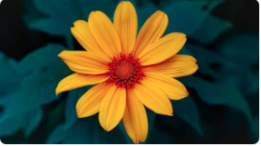
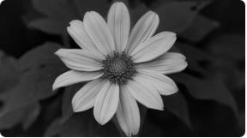
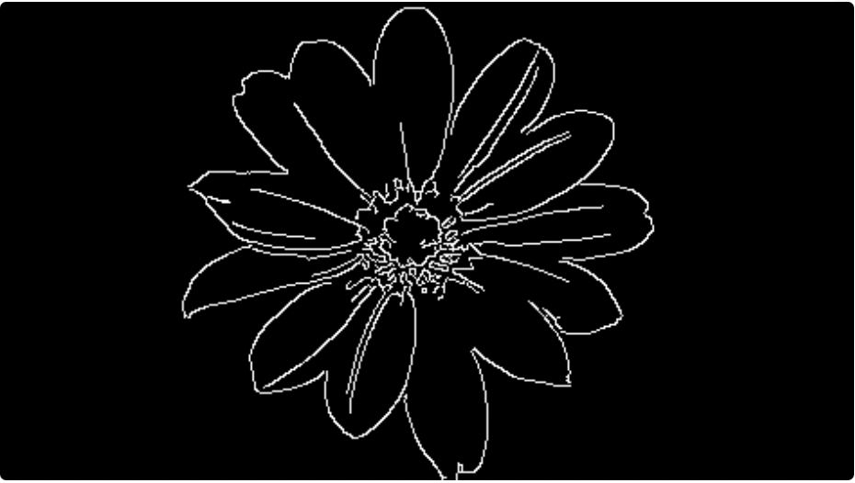
Canny Pipeline: How It Works
Original Image
Smoothed Grayscale Image
Canny Output
Canny smooths the image to reduce noise, detects strong brightness changes, thins the detected edges, and keeps only connected reliable edges.

Slide 23
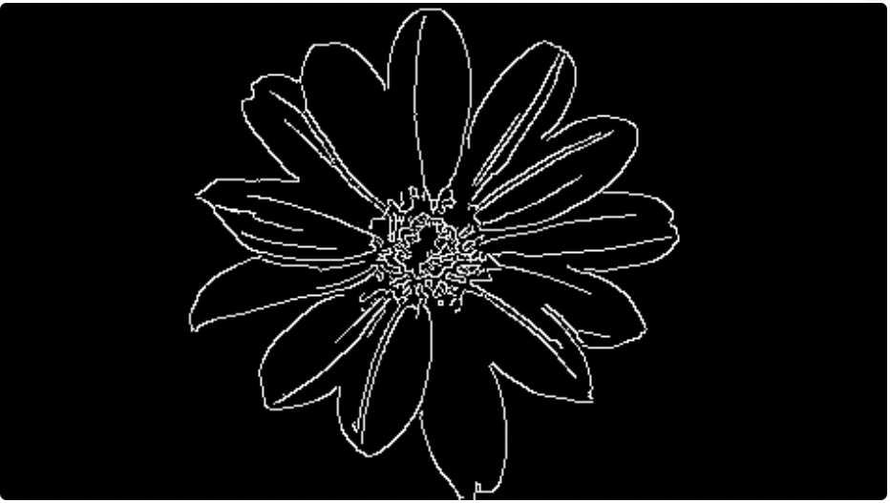
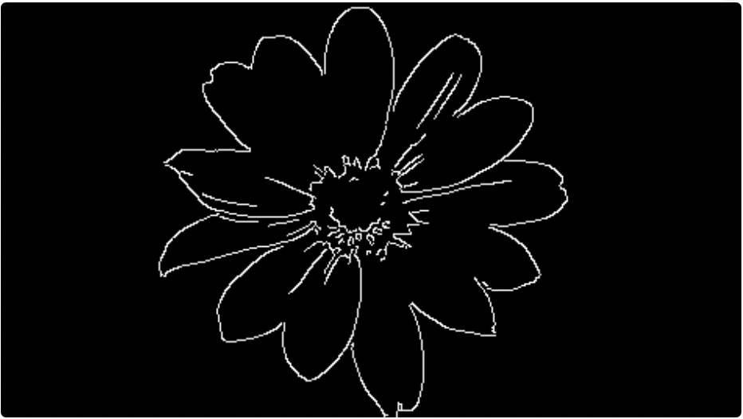
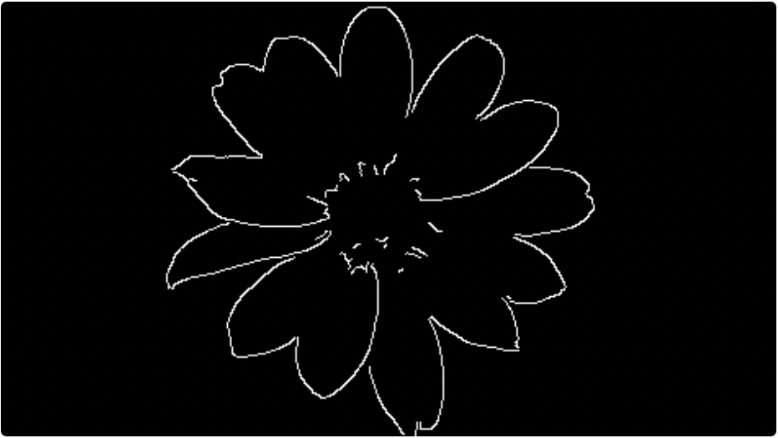
Canny Parameters and Sensitivity
Low Threshold: 20
Medium Threshold: 100
High Threshold: 200
As the threshold increases, Canny becomes stricter: noise and weak details are removed, but fine edges may also disappear.

Slide 24
Canny: Strengths and Weaknesses
Strengths
Produces thin and clean edges.
Reduces noise using Gaussian Smoothing.
Keeps connected edges using hysteresis.
Usually gives better edge maps than Sobel, Prewitt, and LoG.
Weaknesses
More complex and slower than simple filters.
Sensitive to threshold and blur settings.
Can miss weak edges if thresholds are too high.
Can still struggle with very noisy or low- contrast images.
Notes:
Use LoG when zero-crossing contour detection is the point.
Avoid using LoG only in very noisy or highly textured images.

Slide 25
Comparison
And
Real-World Example

Slide 26
Comparison
First-order gradient operators : Sobel and Prewitt
Laplacian of Gaussian
Canny
Easy and light
Gives edge orientation
Sensitive to noise, weak contrast, heavy texture…
Detects contour clearly
Not rotation dependent
Does not give orientation
Sensitive to noise, can produce double edges
Smoothing, Gradients, Thinning, and thresholding
Clean, continuous edges
Complex and heavy

Slide 27
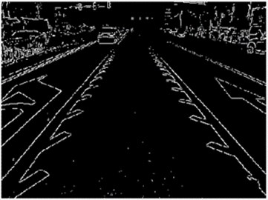
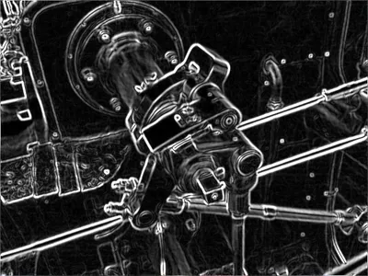
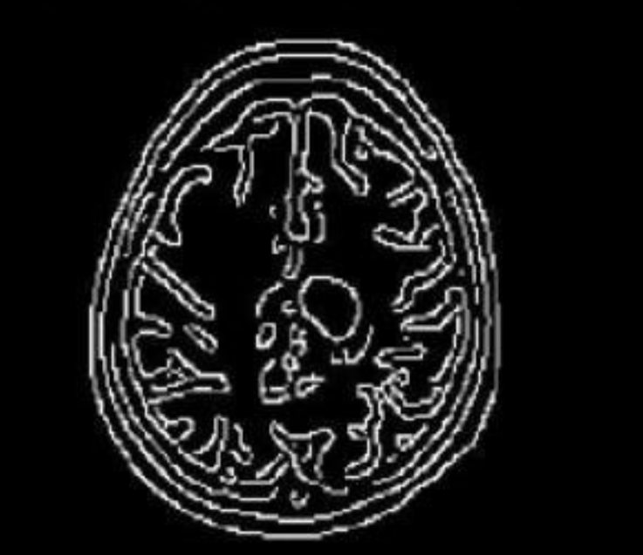
Comparison
First-order gradient operators : Sobel and Prewitt
Laplacian of Gaussian
Canny
Best for clean lines, heavy contrast
Contour detection in any direction
Thin lines and clear end result

Slide 28
Quiz

Slide 29
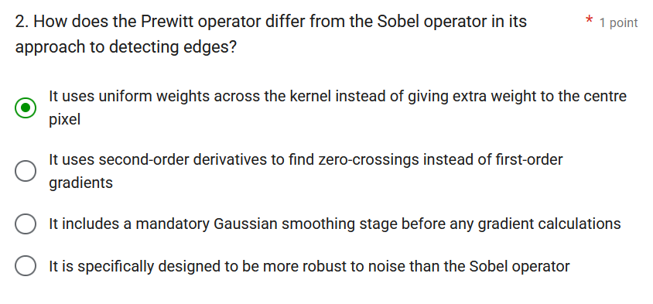
Quiz: Testing Understanding
The quiz is designed to teach through common mistakes. Each question includes plausible wrong answers based on typical misunderstandings, so students have to reason through the concept rather than simply recall definitions.
Provides an understanding
on what each edge detection
operator does better
than the other

