Slide 1
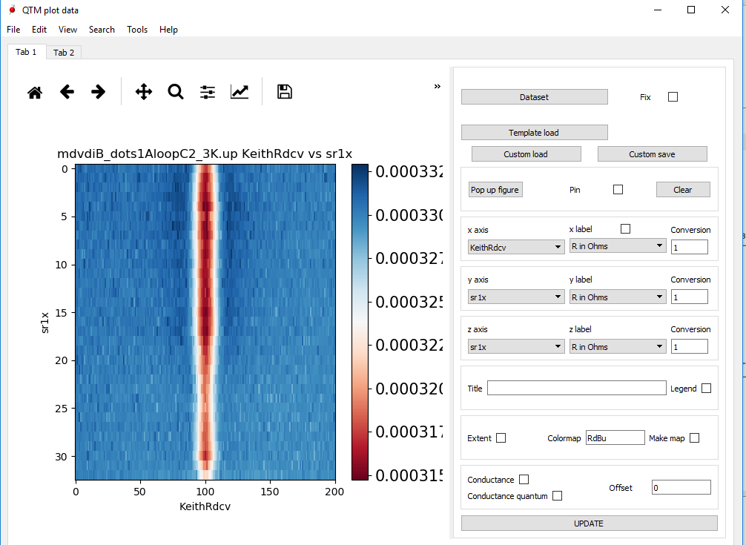
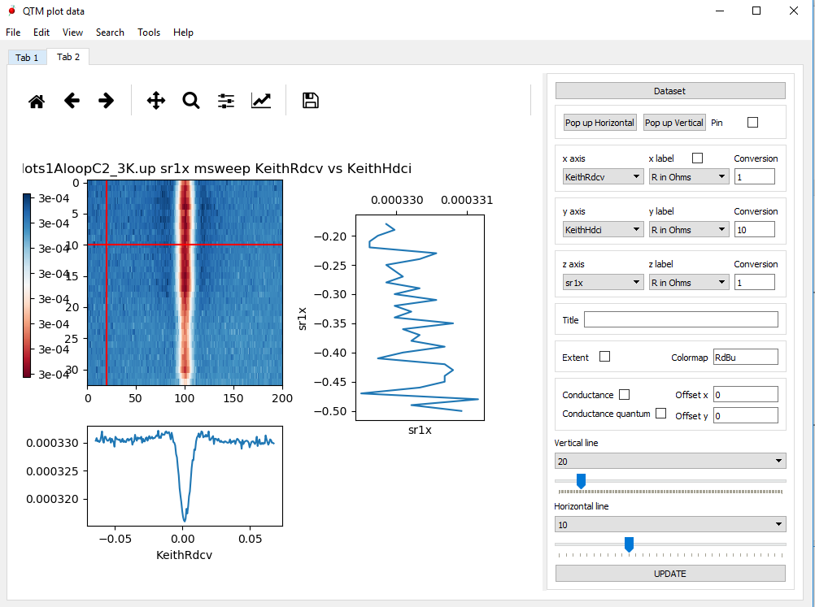
Tab 1: general plotting
Tab 2: maps + profiles
Plot menu
Options to get

Slide 2
Open a load file window
Several files can be uploaded simultaneously
If clicked several files can be uploaded one after the other without refreshing
Tab 1: general plotting
Main graph gets emptied
Open a new window with the plotted figure
If clicked new window does not refresh with new popup
Load a template for the widgets
Convert several plotted line scans into a map
Load the file + the template saved
Save the figure + a text file with the template
Plotted values
If clicked, axis names as labels, otherwise axis names as axis
Convert the plotted values to right units
Give offset between consecutive line scans
Map axis change from number of points to actual units
Map colormap, options from matplotlib library

Slide 3
If clicked several profiles can be plotted without refreshing
Tab 2: map + profiles
Plot 1/data
Open window with the horizontal /vertical profile
Plot 1/data*2e^2/h
Give offset between consecutive line profiles
Sliders to choose which lines to plot in the vertical and horizontal profiles

