Slide 1
Mount Fuji simulations
Constant single mutational fitness coefficient h_0 and zero coupling coeff. J_0=0.
Fixed parameters: L=20, Npop=10^5, mu=10^(-4), sigma_h = 1, D0 = 5, N_simu = 200, B = 10^3, n_seasons = 100,
Lambda_h = 10^(-4), lambda_J = 1, lambda_F* = 10^(-4)

Slide 2
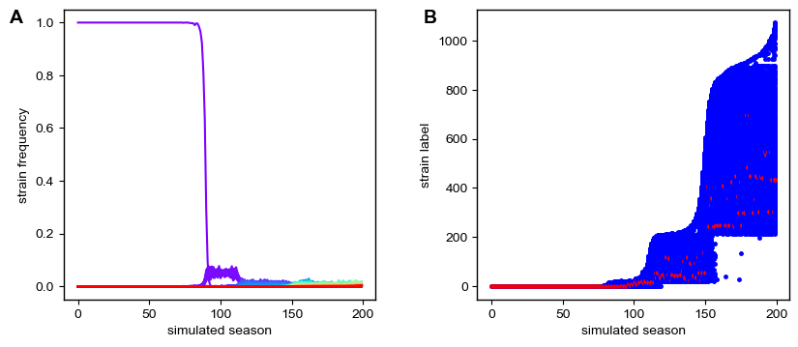
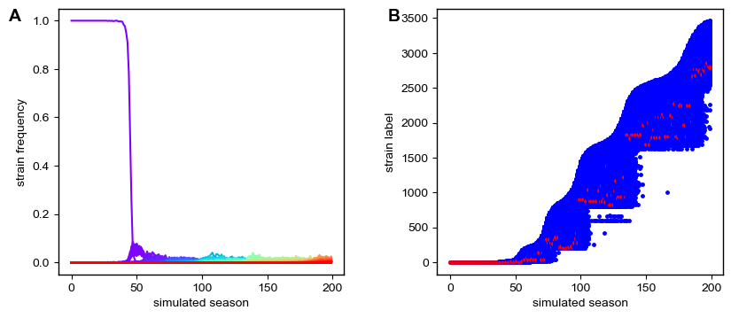
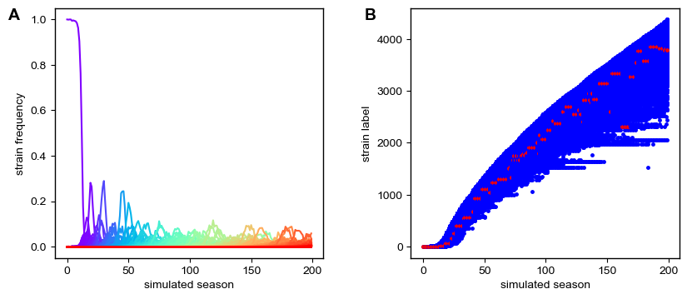
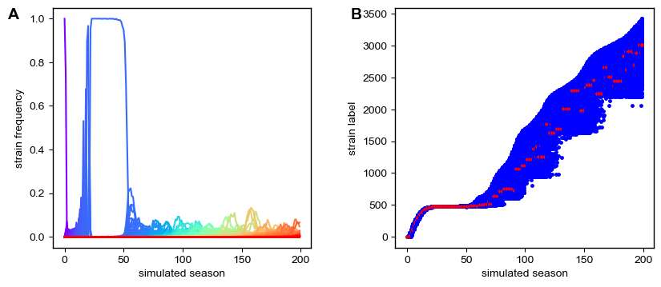
Strain succession in Mount Fuji simulations
h_0=-15
h_0=-7
h_0=-1
h_0=+5

Slide 3
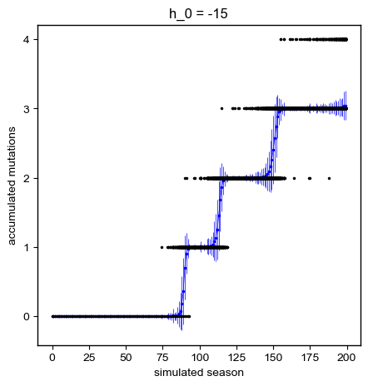
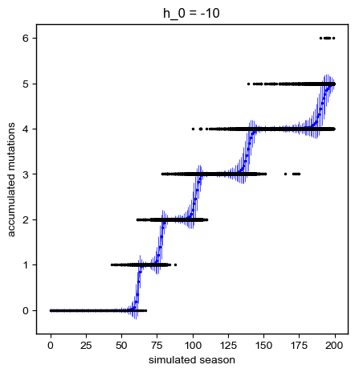
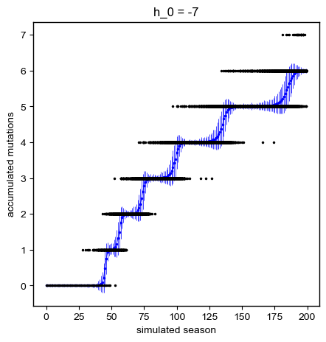
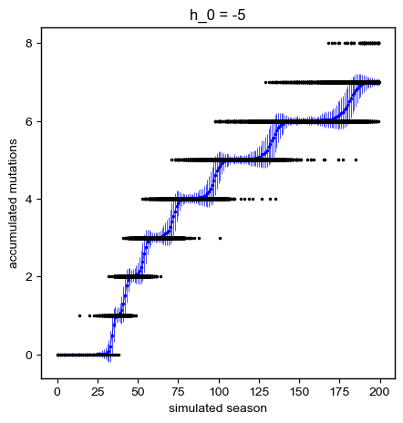
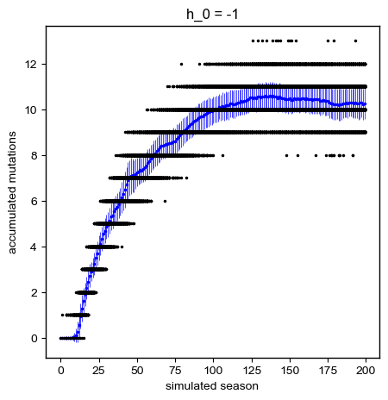
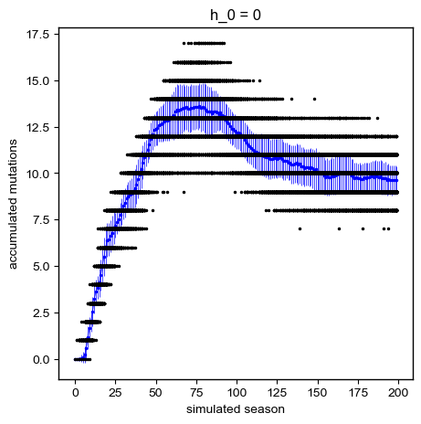
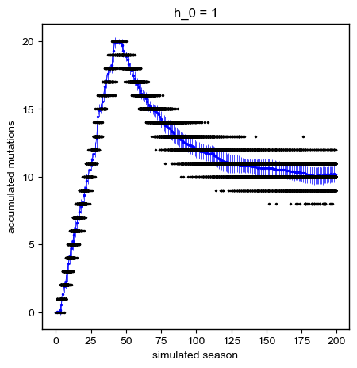
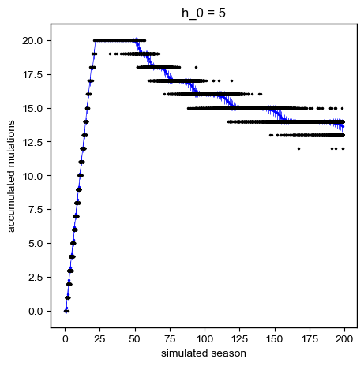
Accumulation of mutations in Mount Fuji simulations
(black individual strains, blue: mean and std, averaged over all observed seqs)

Slide 4
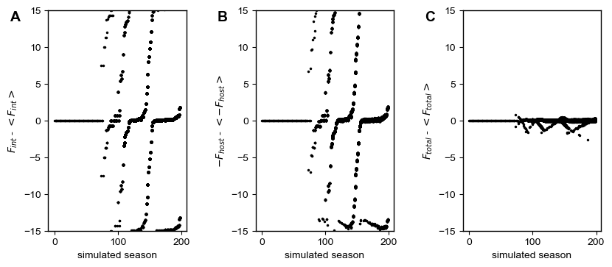
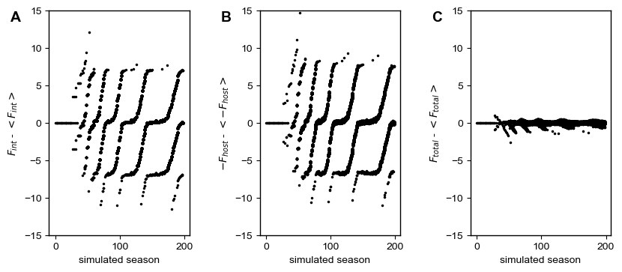
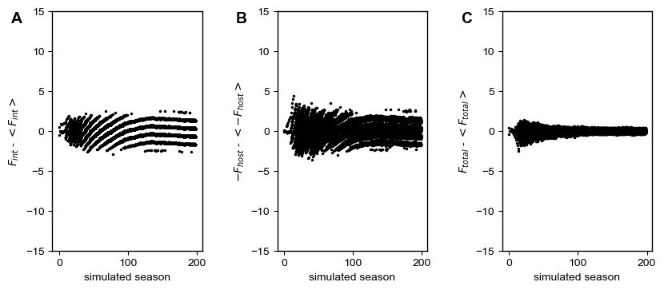
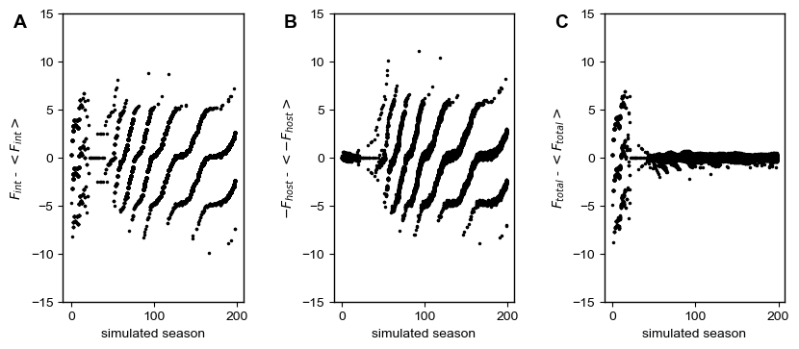
Fitness distributions in each season for Mount Fuji simulations
h_0=-15
h_0=-7
h_0=-1
h_0=+5

Slide 5
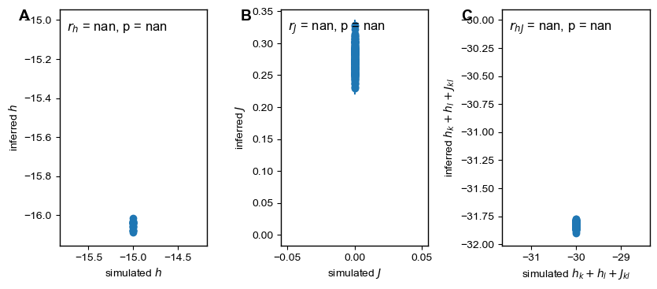
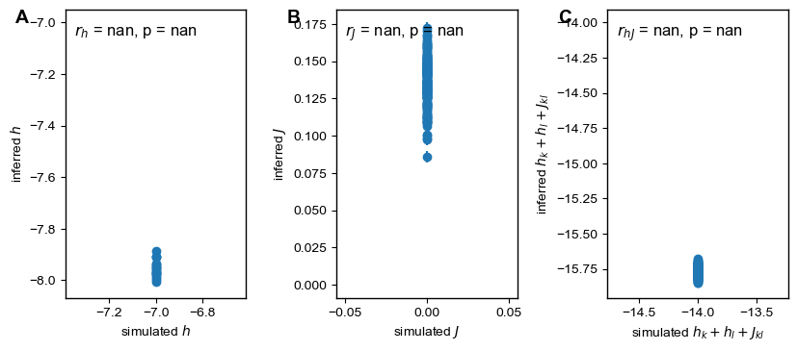
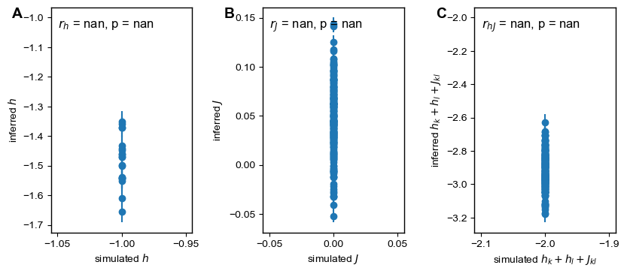
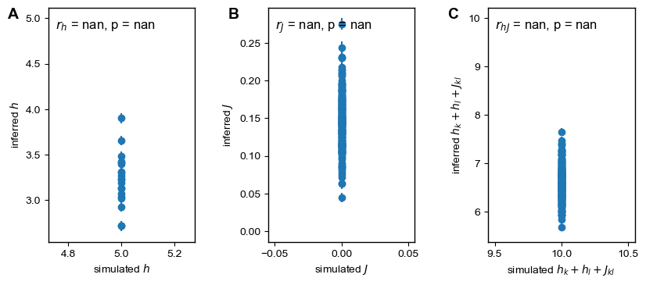
Inference results for Mount Fuji simulations
h_0=-15
h_0=-7
h_0=-1
h_0=+5

