Slide 1
Finding Beta Sheets in Protein Volume Images
with Structure Tensors
Masters project for
Dr Jing He
by
Jeff Donner

Slide 2
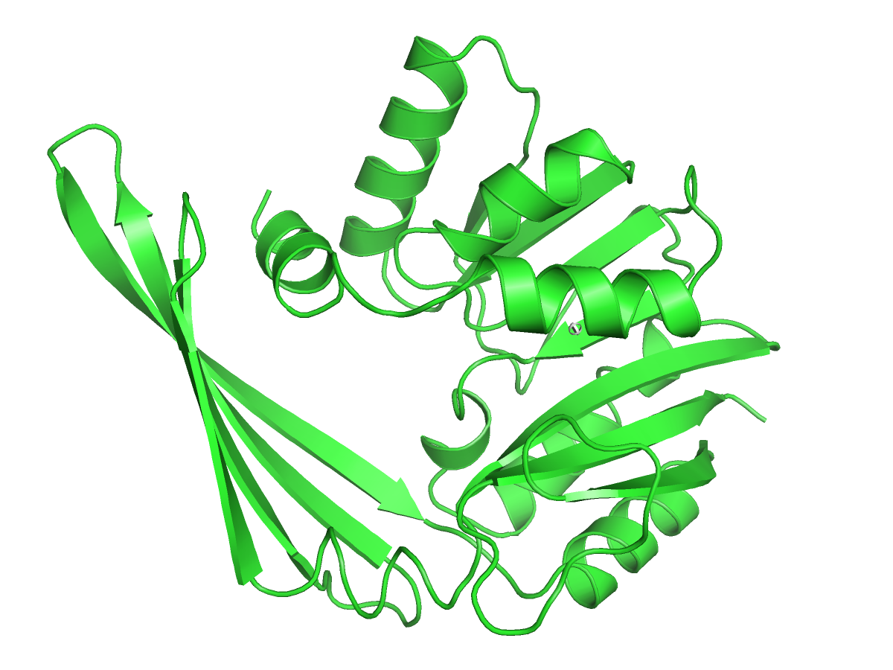
About Proteins and SSEs
Notes:
One sequence
Primary structure is the sequence of amino acids
Secondary structure is the local, common forms eg Helices and beta sheets.
There is tertiary structure, which is outside of our scope.

Slide 3

About Our Protein Images
Cryo-EM density maps
8A, considered intermediate resolution
Our images are synthetic, generated by a program from the EMAN package, 'pdb2mrc', at 8A resolution, broken into 1A voxels
Protein 1CID at
8 Angstrom resolution
Notes:
Take density photos from many directions, work out volume from those.

Slide 4
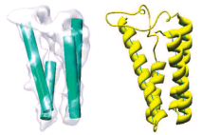
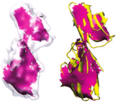
Looking Closer at SSEs
Alpha Helices
Beta Sheet

Slide 5
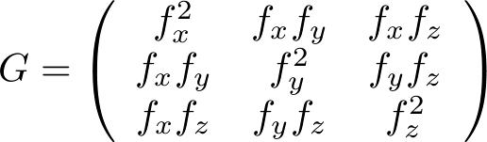
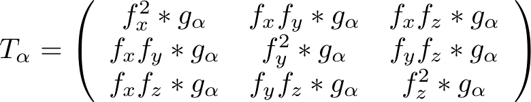
Gradient vs Structure Tensors
Gradient Tensor
Structure Tensor

Slide 6
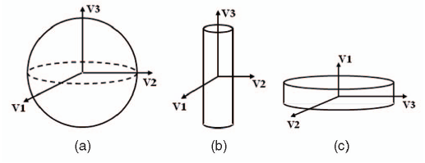
Structure Tensor and Shape
Shapes indicated by eigenvalues vi of structure tensor

Slide 7
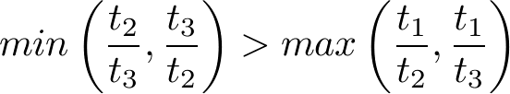
Beta Point Criteria
Rely on thickness instead of length of eigenvectors because similar protein SSEs (eg turns) show similar local structure.
Continue to use the eigenvectors' directions however.
Notes:
For a beta point we want t1 to be much less than t2, t3. and we want those two to be similar.
The left side gives the greatest chance to bring the 'smallness' version of the ratio out. The right hand side gives the greatest chance to be proven as large as one of the others. Only if it's shorter despite all this does the point qualify as a beta.

Slide 8
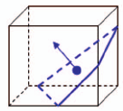
Representational Plane

Slide 9
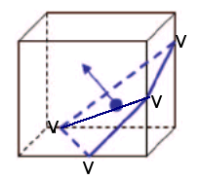
Plane Triangularized
Vertices become new candidate beta points

Slide 10
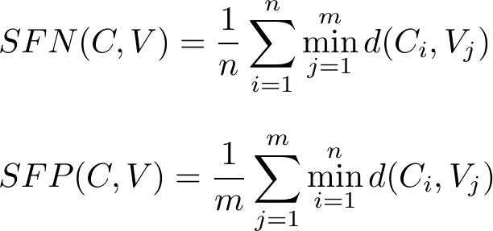
SFN, SFP Defined
SFN - Sheet False Negatives, a measure of beta points missed
SFP – Sheet False Positives, measure of points detected
that aren't there

Slide 11
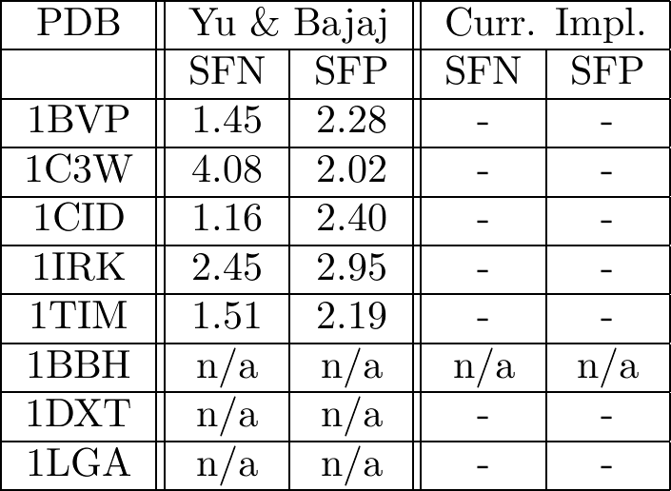
Results
Lower is better for both numbers, but 0 is unreachable
Notes:
Discussion of what these results mean
(Mine not sensitive enough?)
What might be the cause – I have a stopping point, which they don't mention?

Slide 12
PCA vs Local Structure Tensor
PCA vs Local Structure Tensor

Slide 13
Examples of Produced Images?
Notes:
Before the results, I guess

