Slide 1

QTM 151: Lecture 1 - Reviewing GitHub
Dr. Juan Estrada

Slide 2


JE-lecture-notes/qtm151_fall_2023 (github.com)
Lecture notes contained in my Github repository (stored in the above website)

Slide 3
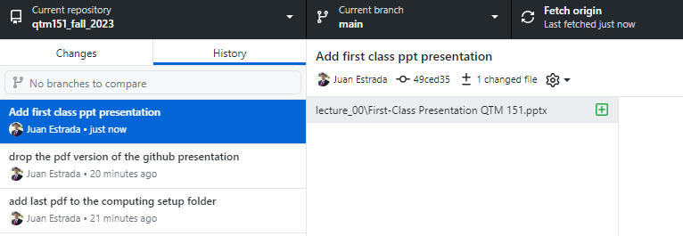
Http://github.com/alejandrosanchezbecerra/qtm151spring2023
The history tab in Github Desktop keeps track of any files that were added, removed, or edited.
Commits are “batches” of changes, that tell collaborators what you’ve been working on.

Slide 4


JE-lecture-notes/qtm151_fall_2023 (github.com)
In “Github1 Getting Started”, you forked the repository. This means that you created your own “website”, copying all the information from mine.
FORK
FORK
github.com/student1/emoryqtm151
github.com/student2/emoryqtm151

Slide 5

github.com/student1/emoryqtm151
github.com/student2/emoryqtm151
FETCH
FETCH
The fetch operation will download information from your website to your personal computer
The first time you copied data to your computer is called “cloning”

Slide 6
github.com/student1/emoryqtm151
github.com/student2/emoryqtm151
PUSH
PUSH
The push operation will upload information from your personal computer to your website

Slide 7


The changes made by each student are not shared across different websites.
Over time the repositories could look quite distinct
github.com/student1/emoryqtm151
github.com/student2/emoryqtm151
The bottom panel shows the commits made by each student

Slide 8
JE-lecture-notes/qtm151_fall_2023 (github.com)
Over time, more lecture notes will get added to the main branch

Slide 9
JE-lecture-notes/qtm151_fall_2023 (github.com)
The option update from “upstream/main” will copy any new files or file changes, from my website to yours. See the “Gitbub3” guide for details
github.com/student1/emoryqtm151

