Slide 1
Opening a bakery in a convenient neighborhood in New York City

Slide 2
Approaches to open or buy a bakery.
In a business area: to provide other businesses like restaurants, cafes, sandwich places, etc.
In a residential area: to provide services directly to people.

Slide 3
Question to determine the best place for a bakery.
What indicators determine a borough is a good borough?
What indicators determine a neighborhood is a good neighborhood ?
Indicator considered in this case.
Boroughs with more neighborhoods.
Venues with few bakeries around.
Population
Density
Gross Domestic Product (GDP)

Slide 4
Source of data.
Borough, Neighborhoods of New York City with their latitudes and longitudes https://cocl.us/new_york_dataset.
The link with resource for developers with codes of type of businesses in Foursquare API venues. https://developer.foursquare.com/docs/resources/categories.
Wikipedia table with demographic information of New York City’s boroughs (population, density, and Gross Domestic Product). https://en.wikipedia.org/wiki/Demographics_of_New_York_City.
Excel worksheet with information extracted from www.point2homes.com. Population and Average Household Income in venues.

Slide 5
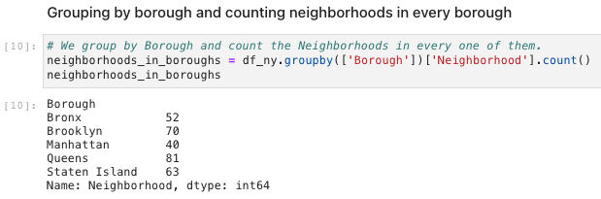
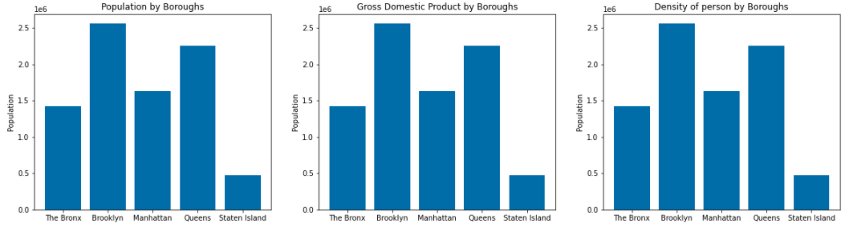
Exploring a borough.
Brooklyn was the borough selected because it is the borough with more neighborhoods, more population, more density, and the best GDP

Slide 6
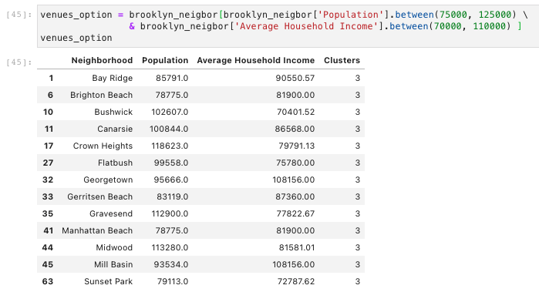
Two options to be considered to make a choice about a best place for a bakery.
Coney Island venue is an option to be considered because is a place with few bakeries around in a broad area
Clustering Method shows different options based on population and average of income in venues. A balance between this two indicator represent good options
Any of this venues could be a good place for a bakery

Slide 7
Conclusion
On my viewpoint, a depth of a study, always depends on data available for analysis.
Even though data used in this case help to make good decisions, more data could be necessary to make a deeper analysis. Variables like income of bakeries around the area selected, rate of crime in the area, etc. could be considered, but all of these depend on the stakeholder’s requirements.

