Slide 1
ECE391 Computer System Engineering Lecture 13
Dr. Zbigniew Kalbarczyk
University of Illinois at Urbana- Champaign
Spring 2014

Slide 2
Lecture Topics
Linux interrupt support (conclusions)
Soft interrupts (tasklets) in Linux
Virtual memory motivation
x86 support for VM
protection model

Slide 3
Aministrivia
Mp2 Due Date
3/10 (R-Z), 3/11 (A-G), 3/12 H-Q
MP3 Teams
Due by end of Friday, March 7th

Slide 4
Interrupt Descriptor Table (IDT)
Associates the interrupt line with the int. handler routine.
256 entries (each 8-bytes) or descriptors; each corresponds to an interrupt vector
hardware interrupts mapped into vectors 0x20 to 0x2F
All Linux interrupt handlers are activated by so called: interrupt gates (a descriptor type)
Whenever an interrupt gate is hit, interrupts are disabled automatically by the processor
Before the kernel enables interrupts it must initialize the idtr register to point to the IDT table (set by the kernel using lidt instruction)
IDT Initialization
Kernel initialization (setup_idt()) fills all the 256 entries of IDT with the provisional (or null) handler
IDT
interrupt[x]

Slide 5
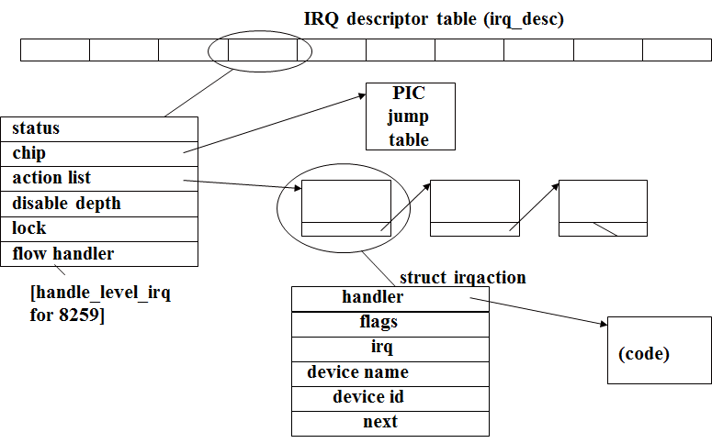
irq_desc Array
Every interrupt vector has its own irq_desc_t descriptor
Descriptors are grouped together in irq_desc array, a data structure supported by Linux
When a device driver calls the request_irq() function a new structure to represent the handler is allocated and initialized

Slide 6
interrupt[NR_IRQS] Array
interrupt [NR_IRQS]
Kernel maintains one global array of function pointers (interrupt[NR_IRQS]) in which it stores pointers to interrupt stubs (NR_IRQS is 16 if we use the PIC)
Int
Stub
Int
Stub
…
Int
Stub
PUSHL $0xFFFFFFFX
JMP common_interrupt

Slide 7
Initialization of Interrupt Gates
During initialization init_IRQ() sets the status field of each IRQ descriptor to IRQ_DISABLED
init_IRQ() updates the IDT by replacing the provisional interrupt gates with new ones
for (i = 0; i < (NR_IRQS; i++)
if (i+31 != 128) >= NR_IRQS)
set_intr_gate(i+32, interrupt[i]);
Interrupt gates are set to the addresses found in the interrupt[NR_IRQS] array

Slide 8
Linux handle_level_irq kernel/irq/chip.c
Critical section begins
Call PIC’s mask_ack function
If interrupt already in progress, do nothing
Atomically decide whether to execute handlers
Set status for execution: in-progress and no longer pending
Critical section ends
Handler execution done via handle_IRQ_event
Critical section begins
When done, remove in-progress flag
and unmask on PIC (unless disabled)
Critical section ends
Notes:
Smp_..id unique identifier for the processor
Mask ack send mask the int and sends EOI
Look the handlers if the IRQ-disable you can do by software mechanism
Software site of disable mechanism
Pending to eventually execute the interrupt
Last disable : it is set when we do software disablement
Other processor may enter the critical section and call disable the IRQ 4 (for example)
Need to check if the int is disable befor we tell PIC to enable this interrupt again

Slide 9
Soft Interrupts in Linux linux/interrupt.h and kernel/softirq.c
When are soft interrupts executed?
after a hard interrupt completes
periodically by a daemon in the kernel
How?
seven or eight prioritized types, including high and low tasklet priorities
linked list for each tasklet priority
run on processor on which interrupt is scheduled
each handler atomic with respect to itself (only)

Slide 10
Soft Interrupts in Linux (cont.) linux/interrupt.h and kernel/softirq.c
Declaring a handler
name for tasklet_struct
an unsigned long
DECLARE_TASKLET (name, func, data);
void (*func) (unsigned long);
linked list
TASKLET_STATE_SCHED, TASKLET_STATE_RUN
# of disables
pointer to the tasklet function integer which can be used by the tasklet function
next
state
count
func
data
Notes:
Macro used to declare the tasklet
Func is the actual handler

Slide 11
Tasklet Scheduling
The following two calls schedule a tasklet for execution
void tasklet_schedule (struct tasklet_struct* t);
void tasklet_hi_schedule (struct tasklet_struct* t);
First form
schedules tasklet at low priority
on the executing processor
Second form schedules at high priority
Enable and disable calls analogous to hard interrupts (including nesting)
Notes:
Schedule for executing the software

Slide 12
Tasklet Execution
do_softirq call
checks per-processor bit vector of pending priorities (high, low, etc.)
executes action for each priority [softirq_vec]
tasklet_action walks through linked list [tasklet_hi_action walks through high-priority list ]
repeats up to 10 times or until no softirqs are raised
Notes:
At the end of Checks the list of tasklets
If there is bug if the tasklet reexcutes itself
This code may hang the kernel

Slide 13
Tasklet Execution Atomicity
Two bits in state changed atomically
TASKLET_STATE_SCHED – tasklet scheduled for execution
TASKLET_STATE_RUN – tasklet executing on some processor
When scheduling
set TASKLET_STATE_SCHED atomically
if already set, schedule call does nothing
Notes:
Using atomic variables
Atomicity supported by stat emachine
Two bits in the tasklet state SCHED and RUN
Atomicity only one processor gets to execute the tasklet

Slide 14
Tasklet Execution Atomicity (cont.)
When executing, for each tasklet in linked list (at either priority)
set TASKLET_STATE_RUN atomically (if already set, stop)
check if tasklet is software disabled (count field)
if so, clear TASKLET_STATE_RUN
leave the tasklet in the linked list for this priority
set the pending bit for this priority
daemon will try again later
clear TASKLET_STATE_SCHED
execute handler
clear TASKLET_STATE_RUN
schedule
no
flags
SCHED
execute/
step B (disabled)
execute/
step A
execute/step E
execute/step E
schedule
RUN
RUN+
SCHED
execute/step C
execution (execute/step D) occurs in lower two states (and execute/step A fails in these states)
Notes:
Four state because we have four bits
If you win then the tasklet goes to the link list
Interupt can come can do soft irq
Count filed is not zero this is disable and you should not run it
Tasklet can reschedule itself in state RUN
What is the sched occurs in another state
Why we do not check disable before A?

Slide 15
Virtual Memory Definition
What is virtual memory?
indirection between memory addresses seen by software and those used by hardware
typically done with large blocks, e.g., 4kB or 4MB in x86
virtual
addresses
(per program)
physical
addresses,
including
memory-
mapped I/O
4kB
4kB
4kB
4kB
. . .
called an
address
space
not in use/
not visible
to this
program
not actually
in memory
Notes:
Virtualization
- Memory
- Processor
Finite resources illusion that resources are bigger than they are physically
Does not matter what physical resources we have

Slide 16
Virtual Memory Motivation
Why use virtual memory? (in decreasing order of importance)
protection
one program cannot accidentally or deliberately destroy another’s data
the memory is simply not accessible
more effective sharing
two (or more) programs that share library code can share a single copy of the code in physical memory
code and data not actively used by a program
can be pushed out to disk
to make room for other programs’ active data
provides the illusion of a much larger physical memory
Notes:
Sharing
Many programs use standard c lib
With vrt mem you put one copy in physical memory

Slide 17
Virtual Memory Motivation (cont.)
no fragmentation (little to none)
systems without virtual memory suffer fragmentation when try to multitask
e.g., if we run A followed by B followed by C, and B finishes, we can’t give D a contiguous block of memory, even though it fits in the absolute sense
simplifies program loading and execution: no relocation of code, rewriting stored pointer values, etc.
A
A
A
A
B
B
D
C
C
Notes:
Picture shows physical memory
Code must be relocatable
Fragmentation o the disk
Conseptually same blocks files are not contigous on the disk
Programs may start in the sam virtual address only the physical address changes

Slide 18
x86 Support for VM
protection model
segmentation
paging
logical
address
seg.
unit
linear
address
paging
unit
physical
address
Notes:
Address translation

Slide 19
x86 Protection Model
Four rings: kernel (ring 0) through user (ring 3)
lower numbers are more privileged
lower numbers never call/trust higher numbers
higher numbers call lower numbers only through narrow interfaces (e.g., system calls)
CPL – current privilege level (of executing code)
RPL – requested privilege level; when code at high privilege level executes on behalf of code at lower level, some accesses may voluntarily lower privilege to that of caller/beneficiary
DPL – descriptor privilege level; level necessary to execute code/data
if MAX(CPL,RPL) > DPL, processor generates an exception (general protection fault)
0
kernel
1
2
3 user
not used by Linux
Notes:
Protection model is done by two bits (four levels or rings)
For supporting virtual machines some time ring 1 and 2 are used
Intermediate levels e.g., some device drivers (e.g., camera)
Not supported well in x86 and in Linux

