Slide 1
ECE391 Computer System Engineering Lecture 2
Dr. Zbigniew Kalbarczyk
University of Illinois at Urbana- Champaign
Spring 2014

Slide 2
Aministrivia
MP0
due Tuesday 7:00pm
you can hand in anytime during office hours
singe-up to hand in by Tuesday 7:00pm
the staff will call you -> you must hand in when called
Tip
gcc -S
compiles C file to assembly
default file produced <program name>.s
don’t use with –o

Slide 3
Introduction and Basics
What is x86? (Intel-32-bit architecture, rather than AMD-64)
variable-length instruction encoding (1-16 bytes)
small register set: 8 mostly general-purpose
32-bit, byte-addressable address space
complex addressing modes
many data types supported by hardware
Most modern ISAs (e.g., MIPS, Sparc, PowerPC) differ on most points (except memory)

Slide 4
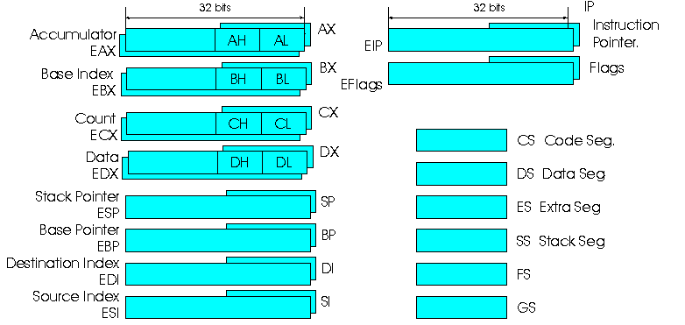
Registers
General purpose registers

Slide 5
Registers
extended, i.e., 32-bit
EAX accumulator EIP instruction pointer
EBX base (of array) EFLAGS flags/condition codes
ECX count (for loops)
EDX data (2nd operand)
ESI source index (string copy)
EDI destination index
EBP base pointer (base of stack frame)
ESP stack pointer
Use % as a prefix for registers in assembly
Other registers: floating-point, MMX, etc. (not discussed in this class)

Slide 6
Data Types
8-, 16-, 32-bit unsigned and 2’s complement
IEEE single- and double-precision floating point
Intel “extended” f.p. (80-bit)
ASCII strings
Binary-coded decimal

Slide 7
Memory
Microprocessor addresses a maximum of 2^{n} different memory locations, where n is a number of bits on the address bus
Memory
x86 supports byte addressable memory
byte (8 bits) is a basic memory unit
e.g., when you specify address 24 in memory, you get the entire eight bits
when the microprocessors address a 16-bit word of memory, two consecutive bytes are accessed

Slide 8
How are bytes stored to memory?
big-endian
(big end first)
EAX (4 bytes)
larger addresses
little-endian
(little end first)
x86 uses this approach

Slide 9
x86 Instructions – Basics
Operations, data movement, condition codes, control flow, stack ops, data size conversion
Operations
arithmetic logical shift
ADD AND SHL
SUB OR SAR
NEG NOT SHR
INC XOR ROL
DEC ROR
typically 2-operand instructions (destination and one source are the same)

Slide 10
Operations – Example
second source
destination and first source
ORL %ECX, %EBX # EBX ← EBX OR ECX
operation
comment marker
data type
(technically optional)
L = long (32b)
W = word (16b)
B = byte (8b)

Slide 11
Immediate Values
immediate value marker
$0x_______ hex
$0________ octal
$53 decimal
how big can they get?
usually up to 32 bits
larger constants → longer instructions
length of operand must be encoded, too
what does the following instruction do?
ANDL 0, %EAX
answer is NOT EAX ← 0
instead:
EAX ← EAX AND M[0]
(usually crashes)
1,2, …..9

Slide 12
Data Movement: Memory Addressing
Memory operand has this general form
displacement(SR1,SR2,scale)
address is: displacement + SR1 + SR2 * scale
1,2,4,8 (defaults to 1)
defaults to 0
any but ESP
any

Slide 13
Instructions
immediate, register, or memory reference
MOV src, dst
LEA src, dst
Examples:
MOVW %DX, 0x10(%EBP) # M[EBP + 0x10] ← DX
MOVB (%EBX,%ESI,4), %CL # CL ← M[EBX + ESI * 4]
register, or memory reference
register only
memory reference only – address stored in dst
(can’t both be memory references)

Slide 14
Instructions: Examples to Solve
EAX ← M[0x10000 + ECX]
[answer] MOVL 0x10000(%ECX), %EAX
M[LABEL] ← DI
[answer] MOVW %DI, LABEL
ESI ← LABEL + 4 (two ways!)
[answer] MOVL $LABEL + 4, %ESI
LEAL LABEL + 4, %ESI
ESI ← LABEL + EAX + 4
[answer] LEAL LABEL + 4(%EAX), %ESI
expression calculated by assembler; instruction holds one displacement value

Slide 15
Condition Codes (in EFLAGS)
Among others (not mentioned in this class)…
SF: sign flag: result is negative when viewed as
2’s complement data type
ZF: zero flag: result is exactly zero
CF: carry flag: unsigned carry or borrow occurred
(or other, instruction-dependent meaning, e.g., on shifts)
OF: overflow flag: 2’s complement overflow (and other instruction-dependent meanings)
PF: parity flag: even parity in result (even # of 1 bits)

Slide 16
What Instructions Set Flags (condition codes)?
Not all instructions set flags
Some instructions set some flags!
Use CMP or TEST to set flags:
CMPL %EAX, %EBX # flags (EBX – EAX)
TESTL %EAX, %EBX # flags (EBX AND EAX)
Note that EBX does not change in either case

