Slide 1
ECE391 Computer System Engineering Lecture 5
Dr. Zbigniew Kalbarczyk
University of Illinois at Urbana- Champaign
Spring 2014

Slide 2
Lecture Topics
x86 assembly wrap-up
role of system software
system calls, exceptions, & interrupts
processor support for interrupts

Slide 3
Aministrivia
MP1 Handin and Demo Schedule
Monday 2/10, 7:00pm
students with last names start with A-G
Tuesday 2/11, 7:00pm
students with last names start with H-Q
Wednesday 2/12, 7:00pm
students with last names start with R-Z
You must be present at 7:00pm with an MP1 gradesheet printed in order to handin

Slide 4
Data Type Alignment (1)
Memory addresses
when loading data from or storing data to memory
use address that is multiple of size of data
Examples
for bytes, use any address
for words (16-bit), use even addresses only (multiple of 2 bytes)
for longs (32-bit), use multiple-of-4 addresses only

Slide 5
Data Type Alignment (2)
Rationale: simplifies implementation of processor-memory interface
required by many modern ISAs
optional on x86 (but very slow if you don’t align)
x86 has alignment check flag (AC), but usually turned off
Use “.ALIGN 4” (number is an argument) to align x86 assembly
for x86 assemblers, you can even do so in the middle of code

Slide 6
Device I/O
How does a processor communicate with devices?
Two possibilities
independent I/O — use special instructions and a separate I/O port address space
memory-mapped I/O — use loads/stores and dedicate part of the memory address space to I/O
x86 originally used only independent I/O
but when used in PC, needed a good interface to video memory
solution? put card on the bus, claim memory addresses!
now uses both, although ports are somewhat deprecated

Slide 7
Device I/O
I/O instructions have not evolved since 8086
16-bit port space
byte addressable
little-endian (looks like memory)
instructions
IN port, dest.reg
OUT src.reg, port
the register operands are NOT general-purpose registers
all data to/from AL, AX, or EAX
port is either an 8-bit immediate (not 16!) or DX

Slide 8
Role of System Software (1)
System software serves three purposes
virtualization
protection
abstraction (particularly hiding asynchrony)
virtualization:
the illusion of multiple/practically unlimited resources
protection:
reduce/eliminate the chance of accidental and/or malicious destruction of data/results by another program

Slide 9
Role of System Software (2)
abstraction:
hide fundamentally asynchronous nature of processor/device interaction
provide simpler and more powerful interfaces (integrated w/protection)
your code
someone
else’s code
neither can cross
protection boundary
buf
buf
buf
ETH

Slide 10
System Calls, Interrupts, and Exceptions (1)
recall that subroutines allow a programmer to encapsulate common operations
the operating system
want to provide an interface including common operations
BUT don’t want to re-link programs
NOR rely on everyone having exactly the same OS version
CALL
1
4
5
CALL
6
2
7
3

Slide 11
System Calls, Interrupts, and Exceptions (2)
solution
add a level of indirection!
with indirection
to rewrite OS, just change the table
application code does not change
called
“handlers”
or “handler
procedures”
0
CALL #1
1
2
3
4
table of
function
pointers

Slide 12
System Calls, Interrupts, and Exceptions (3)
in LC-3, we used the TRAP instruction; in x86, it’s the INT instruction:
INT 8-bit imm. # (PUSH EIP), EIP ← table[imm8]
the RTL is actually a little more complicated, as you’ll see later in course
called a trap (after instruction, or trap door through protection boundary)
also called a system call (for operating system)

Slide 13
System Calls, Interrupts, and Exceptions (4)
vector tables/jump tables
i.e., tables of function pointers
convenient abstraction for many procedure-like activities
Question:
What happens if software does something wrong, e.g.,
accesses a non-existent memory location?
issues an illegal/undefined instruction? divides by 0?
What do we do to handle problems?
state machine that you design for processor may have don’t cares
state machine that you build will do something (may be unknown)
so just let it run! (e.g., 6502 did so… and programmers used!)

Slide 14
System Calls, Interrupts, and Exceptions (5)
a better solution: exceptions!
processor maps each problem to a vector #
calls procedure in vector table by #
Where else might we use vector tables?
Consider processor interactions with devices
a disk access takes about 10 milliseconds
new machines in lab: 10 ms = 32 million cycles
should processor sit around asking, “Are my data here yet?”

Slide 15
System Calls, Interrupts, and Exceptions (6)
analogous to posting a letter to a friend in Europe
and checking your mailbox every minute for a reply
instead, have your mail carrier ring your doorbell when it arrives
in a processor, we call that an interrupt
How can we use a vector table for interrupts?
each device has a vector #
call corresponding procedure in vector table when device generates
x86 ISA
uses one table for all three kinds
called the Interrupt Descriptor Table (IDT)

Slide 16
Processor Support for Interrupts (1)
How does a processor support interrupts?
Logically…
N=8 on x86 (and LC-3)
How should we change a processor’s state machine to incorporate interrupts?
INTR
N
which one?

Slide 17
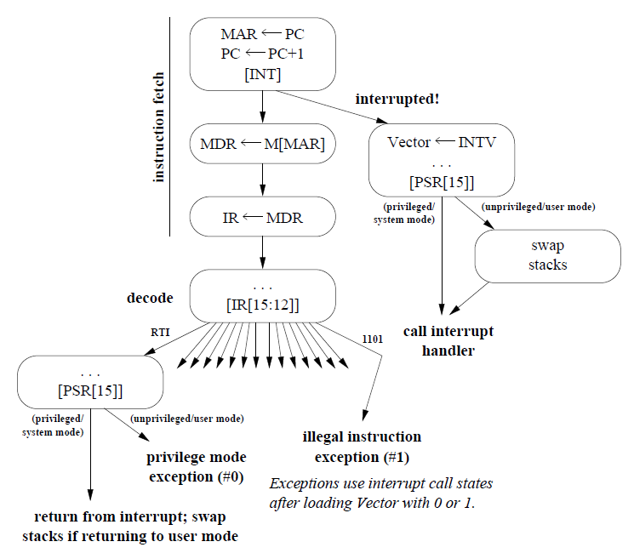
LC-3 state machine interrupt support

Slide 18
Processor Support for Interrupts (2)
x86 allows software to block interrupts with a status flag (in EFLAGS)
normal interrupts occur only when the interrupt enable flag (IF) is set
some interrupts are too important
e.g., memory errors, power warnings, etc.
these are NOT maskable, and use a separate input to processor
called non-maskable interrupts (NMI)
INTR
x86
NMI
8
which (uses data bus)

Slide 19
Interrupt Descriptor Table
as mentioned earlier
x86 uses a single vector table
the Interrupt Descriptor Table (IDT)
hold vectors for interrupts, exceptions, and system calls
note that this picture is partly OS-specific
the exception vector numbers are specified by Intel – Why?
A: generated directly by processor’s state machine
programmable interrupt controller (PIC) will be discussed later;
range of vectors generated is programmable, and is shown for Linux 2.4
note that a single entry is used for all system calls in Linux

Slide 20
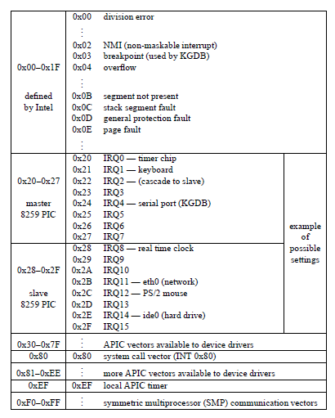
Interrupt Descriptor Table

Slide 21
Shared Data and Resources (1)
The question
interrupt handlers and programs share resources
What resources are shared between them?
How might interactions cause problems?
What can we do to fix those problems?

Slide 22
Thought Problem on Shared Resources (2)
Obvious things
registers
solution? save them to the stack
memory
solution? privatize
will still need to share some things; discussed later

Slide 23
Thought Problem on Shared Resources (3)
Less obvious
condition codes
solution? again, save them to the stack
shared data
For example MP1/real-time clock driver
shared 4-byte variable holding: interrupt count (high 3 bytes) and last interrupt type (low byte)
interrupt handler counts interrupts and sets type: type is alarm clock, periodic, or update (1 sec period)
system call (read)
reads shared variable
resets interrupt count to 0

Slide 24
Thought Problem on Shared Resources (4)
More subtle
external state (e.g., on devices)
compiler optimization (e.g., volatility)
security leaks
e.g., application waits for interrupt, then observes values written by OS to stack
solution? use separate stack for kernel

