Slide 1
ECE391 Computer System Engineering Lecture 8
Dr. Zbigniew Kalbarczyk
University of Illinois at Urbana- Champaign
Spring 2014

Slide 2
Lecture Topics
Synch issues
Conservative synchronization design
Semaphores
Reader/writer synchronization
Selecting a synchronization mechanism
Notes:
Example of big lock use in old Linux

Slide 3
Aministrivia
Midterm Exam1
October 03, 2013
On the class web site:
Look the old exams
Study guide (to be added)
Review session

Slide 4
Linux’ Lock/CLI Combo
static spinlock_t the_lock = SPIN_LOCK_UNLOCKED;
unsigned long flags;
spin_lock_irqsave (&the_lock, flags);
/* the critical section */
spin_unlock_irqrestore (&the_lock, flags);
asm volatile ("
PUSHFL
POPL %0
CLI
" : "=g" (flags) /* outputs */
: /* inputs */
: "memory" /* clobbers */
);
spin_lock (&the_lock);
Notes:
Why FLAG ?
Compiler may not produce what you need , therefore you use embedded/inline asm
No portable
Preprocessor macro (parameterized d form of string replacement)
Any register
Memory can change
On uniprocessor this is NOP spinlock if you tell the kernel to compile for the uniprocessor
Unlock is not a macro
(Notice: Bit test and set (bts) alone does not guarantee the atomicity of the operation. )
Needs LOCK prefix
xchg is atomic i.e., it always asserts the LOCK signal regardless of the presence or absence of the LOCK prefix

Slide 5
Linux’ Lock/CLI Combo (cont)
spin_unlock (&the_lock);
asm volatile ("
PUSHL %0
POPFL
" : /* outputs */
: "g" (flags) /* inputs */
: "memory", "cc" /* clobbers */
);

Slide 6
Comments on code
Notice that spin_lock_irqsave changes the flags argument (it’s a macro)
The “memory” argument
tells compiler that all memory is written by assembly block
prevents compiler from moving memory ops across assembly
The “cc” argument
condition codes change
can lead to subtle bugs if left out!
spin_lock and spin_unlock calls
become NOPs on uniprocessors
in that case, calls just change IF
Restore rationale: may have had IF=0 on entry; if so, STI is unsafe

Slide 7
Another Philosophy Lesson
Synchronization issues
five hungry philosophers
five chopsticks
Protocol
take left chopstick (or wait)
take right chopstick (or wait)
eat
release right chopstick
release left chopstick
digest
repeat
problems? deadlock!

Slide 8
Another Philosophy Lesson (cont.)
How about the following protocol?
take left chopstick (or wait)
if right chopstick is free, take it
else release left chopstick and start over
eat
release right
release left
digest
repeat
Does this work?

Slide 9
Another Philosophy Lesson (cont.)
What if all philosophers act in lock-step (same speed)?
left left left left left
release release release release release
left left left left left
release release release release release
left left left left left
(ad infinitum)
Called a livelock

Slide 10
Another Philosophy Lesson (cont.)
To solve the problem, need (partial) lock ordering
e.g., call chopsticks #1 through #5
protocol: take lower-numbered, then take higher-numbered
two philosophers try to get #1 first
can’t form a loop of waiting philosophers
thus someone will be able to eat
Notes:
Do need to compare any two lock
Any required by a give piece of code

Slide 11
Example of Code Understanding
Given code in left column
Which other columns are compatible (i.e., can’t lead to deadlock)?
#0 #1 #2 #3
lock A lock B
lock B lock A lock A lock B
. . . .
. . . .
. . . .
unlock B unlock A unlock A unlock B
unlock A unlock B
Columns 2 and 3 are compatible with column 0
Notes:
Lockirq a
Lock B lockirqsave
Unlock B
Critical section in an interupt
Programio control
No critical section in an interrrupt handler
unlockA
Save site is to use irqsave
IF 0
IF+1

Slide 12
Conservative Synchronization Design
Getting synchronization correct can be hard
it’s the focus of several research communities
On uniprocessor
mentally insert handler code between every pair of adjacent instructions
ask whether anything bad can happen
if so, prevent with CLI/STI

Slide 13
Conservative Synchronization Design (cont)
On a multiprocessor
consider all possible interleavings of instructions
amongst all pieces of (possibly concurrent) code
ask whether anything bad can happen
if so, use a lock to force serialization
good luck!

Slide 14
Conservative Synchronization Design (cont)
What does “bad” mean, anyway?
A conservative but systematic definition
if any data written by one piece of code
are also read or written by another piece of code
these two pieces must be atomic with respect to each other

Slide 15
Conservative Synchronization Design (cont)
not shared
Consider the following two pieces of code…
write X write Q
read A read A
compare A, 4 read B
jne target multiply A by B
read B write A
add 1 to B read R
write B write S
target: read Y
read B
write Z
not shared
not shared
not shared
reading B is not a conflict
not shared
Methodology courtesy of
Andrew Chien’s Concert work in 90s]
Notes:
Ignore the parts that do not touch shared data

Slide 16
Conservative Synchronization Design (cont)
not shared
What variables are shared? [A and B]
step 0: ignore the parts that don’t touch shared data
step 1: calculate read & write sets
A: read A: read & written
B: read & written B: read
step 2: check for R/W, W/W relationships
A written by right side, read by left
B written by left side, read by right
must be atomic!
step 3: add lock(s) to guarantee atomic execution (pick order if > 1 locks)
step 4: optimize if desired

Slide 17
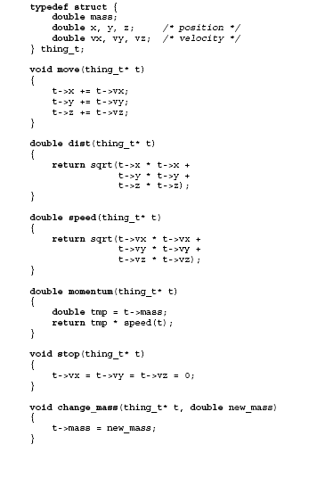
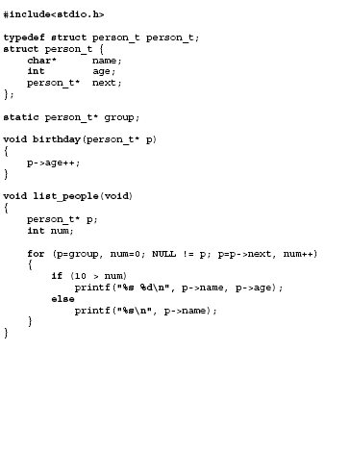
Notes:
Objects methods to manipulate them
Which subroutines excute in atomic fashion with respect to each other

Slide 18
Conservative Synchronization Design – Example Code Analysis
Read/write sets
move reads position, velocity writes position
dist reads position
speed reads velocity
momentum reads mass, velocity
stop writes velocity
change_mass writes mass
Edges in graph imply need for atomicity
move
dist
speed
stop
momentum
change_mass
Notes:
Move read position, velocity
Write position
Dist read position
Speed read velocity
Momentum reads mass
Mass and valocity
Stop write velocity
Change mass write mass
Check relationships write read
Each lock as a circle
All eges must be in one circle
Must pick the lock order so thers is not deadlock ifor some of the lock order
Mass lock
Velocity lock
Position lock

Slide 19
Conservative Synchronization Design – Example Code Analysis (cont)
Each lock = circle in graph
All edges must be contained in some circle
One lock suffices, but prevents parallelism (performance)
Could use three (as shown above); then MUST pick a lock order!

