Slide 1
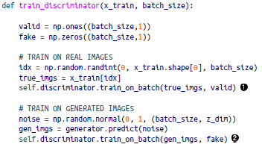
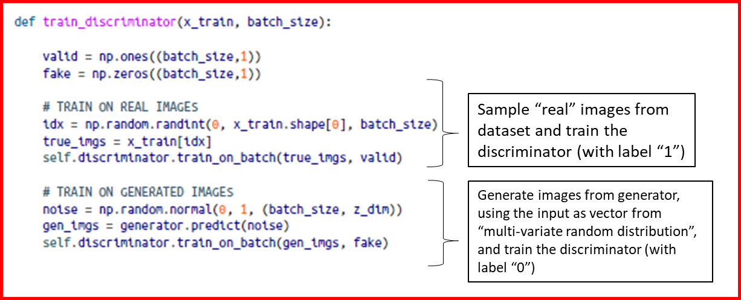
Sample “real” images from dataset and train the discriminator (with label “1”)
Generate images from generator, using the input as vector from “multi-variate random distribution”, and train the discriminator (with label “0”)

Slide 2

Label = 1 given for the generator’s model training

