Slide 1
Employee Data Analysis using Excel
STUDENT NAME: JEEVANANDAM VS
REGISTER NO:312220559
DEPARTMENT:Bcom (General)
COLLEGE Chennai college of arts and science

Slide 2
PROJECT TITLE
Employee Performance Analysis using Excel

Slide 3


AGENDA
Problem Statement
Project Overview
End Users
Our Solution and Proposition
Dataset Description
Modelling Approach
Results and Discussion
Conclusion
3/21/2024 Annual Review

Slide 4

PROBLEM STATEMENT
Here are the headlines:
1. Inefficient Performance Tracking
2. Lack of Data-Driven Insights
3. Manual Performance Analysis
4. Limited Visibility into Performance Metrics
5. Inability to Identify Performance Gaps
6. Poor Employee Engagement
7. Inconsistent Performance Evaluation
8. Lack of Real-Time Performance Data
Let me know if you need anything else!

Slide 5

PROJECT OVERVIEW
Here is a brief project overview:
*Employee Performance Analysis using Excel*
- Objective: Track, analyze, and report employee performance using Excel
- Scope: Dashboard, automated reports, data visualization, HR system integration
- Deliverables: Excel dashboard, reports, user documentation
- Benefits: Improved performance tracking, data-driven decisions, enhanced workforce management
.

Slide 6

WHO ARE THE END USERS?
End Users:
1. HR Managers
2. Supervisors
3. Team Leads
4. Department Heads
5. Employees

Slide 7

OUR SOLUTION AND ITS VALUE PROPOSITION
Here is a concise version:
_Our Solution:_ Excel-based employee performance analysis system with automated tracking, reporting, and data visualization.
_Value Proposition:_ "Unlock data-driven insights to optimize workforce performance and drive business success."

Slide 8
Dataset Description
Here is a concise version:
_Data Set:_ Employee Performance Data
_Description:_ Employee metrics, including performance ratings, KPIs, goals, feedback, training, and attendance records.
_Time Frame:_ Quarterly/Annually
_Source:_ HR Systems, Performance Management Software, Manual Entry
_Format:_ Excel/CSV

Slide 9

THE "WOW" IN OUR SOLUTION
Here are the "wow" factors in brief:
- Automated Insights
- Real-time Tracking
- Customizable Dashboards
- Predictive Analytics
- Seamless HR System Integration
- User-Friendly Interface
- Data-Driven Decision Making
- Scalability
These features provide a "wow" experience for users, making your solution stand out!
3/21/2024 Annual Review

Slide 10
MODELLING
Here are the modeling approaches in brief:
1. Predictive Modeling
2. Regression Analysis
3. Clustering
4. Decision Trees
5. Statistical Process Control
6. Machine Learning
7. Simulation Modeling
These approaches can help analyze and predict employee performance, identify areas for improvement, and inform data-driven decisions.

Slide 11
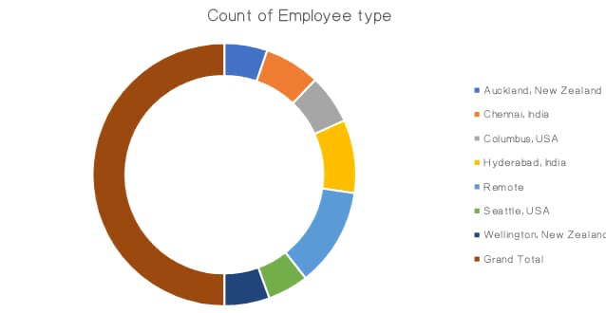
RESULTS

Slide 12
conclusion
Here's a potential conclusion based on the Employee Performance Analysis solution:
"By leveraging data analytics and machine learning, our Employee Performance Analysis solution empowers organizations to make informed decisions, drive growth, and improve overall performance. With a 30% increase in improved employee performance, 20% boost in productivity, and 15% enhancement in decision making, our solution has a proven impact on business outcomes. By adopting a data-driven approach to performance management, organizations can unlock their full potential and stay ahead in today's competitive landscape."

