Slide 1

PROJECT PRESENTATION
Clinical Analytics
Platform
Natural-language questions, validated clinical results, and reviewable PDF reports
Notes:
Project: Clinical Analytics Platform.
Source: README.md and current application code.

Slide 2
PROJECT OVERVIEW
Project objective
Clinical questions require more than a generated SQL answer.
The need
The application response
A clinical user needs to identify the right datasets, inspect the calculation, and understand the evidence behind the result.
The platform combines dataset preparation, human plan review, read-only analysis, result checks, charts, and a saved report.
02
Notes:
The current product scope includes the Clinical and Technical workspaces.
Source: README.md; docs/IMPLEMENTATION.md.

Slide 3
PROJECT OVERVIEW
Current application scope
Clinical Workspace
Technical Workspace
A user selects approved datasets, asks a question, reviews an analysis plan, then sees validated results and interactive charts.
Operators can inspect dataset and schema information, selected tables, query details, and related technical context.
The separate Governed Workspace is outside the current application scope.
03
Notes:
Current user-facing workspaces are Clinical and Technical.
The Governed Workspace was removed from current scope.
Sources: README.md; docs/GOVERNED_WORKSPACE_REMOVAL.md.

Slide 4
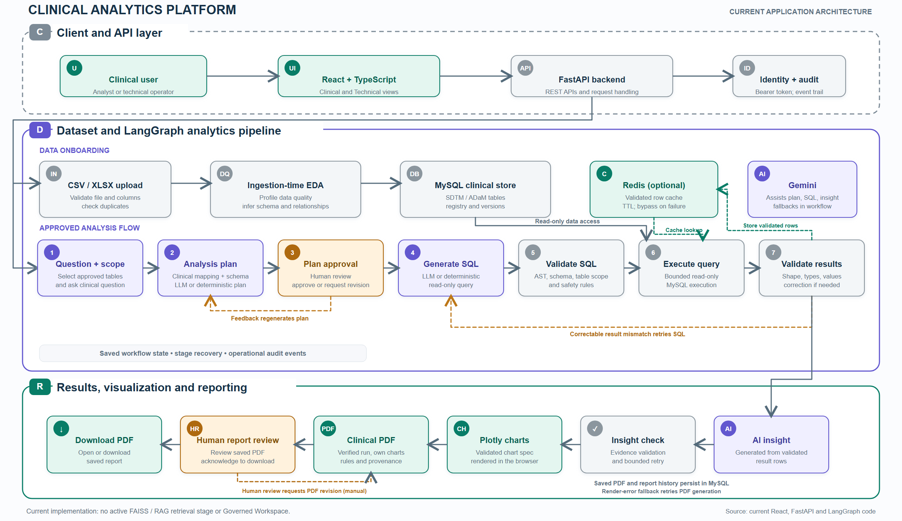
Notes:
The architecture image comes from the project output directory.
Top layer: user, React, FastAPI, identity and audit. Middle: ingestion, MySQL, optional Redis and LangGraph analysis. Bottom: insight, chart, PDF review and download.
The manual review-to-PDF arrow is conceptual. The UI does not currently submit review feedback for automatic PDF regeneration.

Slide 5
DATA FOUNDATION
Dataset onboarding
01
02
03
Upload and parse
Profile quality
Load into MySQL
FastAPI accepts CSV or XLSX files, validates them, and reads the records.
Ingestion-time EDA checks columns, missing data, duplicates, and possible relationships.
The loader writes records and dataset metadata, including a version used by later analyses.
Dataset profiling happens during ingestion, not after every question.
05
Notes:
Source: app/api/ingestion.py; app/ingestion/mysql_loader.py; docs/EDA_WORKFLOW_SIMPLIFICATION.md.

Slide 6
CLINICAL ANALYSIS
Question and human plan review
Example question
What is the age distribution of subjects across treatment groups, and what is the mean age in each group?
01
02
03
Check table scope
Draft the plan
Human decision
Confirm that selected approved datasets contain the fields needed for the question.
Map the question to measures, grouping, source columns, and expected output.
An analyst approves the plan or supplies feedback for a revised plan.
06
Notes:
The first request stops at pending plan approval.
The approved plan routes the workflow to SQL generation; rejection routes to plan regeneration.
Source: app/workflow/graph.py; frontend/src/pages/ClinicalDashboard.tsx.

Slide 7
CLINICAL ANALYSIS
SQL generation and validation
Only an approved plan can proceed to execution.
AST
Schema
Scope
Safety
Parse table references in the SQL.
Check approved tables and columns.
Restrict SQL to selected datasets.
Allow one read-only SELECT and approved joins.
Rejected SQL stops before the database query.
07
Notes:
The validator uses sqlglot AST extraction and additional rules for columns, approved relationships and plan consistency.
Execution rechecks table scope and applies read-only, time and row bounds.
Sources: app/analytics/sql_validator.py; app/clinical/table_validator.py; app/analytics/query_executor.py.

Slide 8
CLINICAL ANALYSIS
Query execution and optional Redis
First eligible run
Matching repeat run
Redis misses. The backend executes validated SQL in MySQL, validates the rows, then stores the verified rows in Redis for a limited time.
Redis returns the saved rows for the same user and analysis context. The backend revalidates them before continuing.
MySQL remains authoritative. Missing versions, anonymous runs, or Redis failure use the MySQL path.
08
Notes:
The local Redis configuration uses a 900-second TTL.
Cache keys include user ID, dataset versions, schema, question, plan, selected tables and SQL.
Source: app/analytics/cache.py; app/workflow/graph.py; app/workflow/recovery.py.

Slide 9
CLINICAL ANALYSIS
Result and insight quality gates
Validate result rows
Validate the insight
Check row structure, output columns, consistent types, finite numbers, grouping grain, and configured denominator rules. A correctable column mismatch can retry SQL.
Build numerical evidence from verified rows. Reject unsupported figures and incorrect highest or lowest claims. Regenerate the wording up to two times.
Clinical source records are never changed to make a result pass.
09
Notes:
Insight validation is deterministic Python logic, not a second model judge.
These checks do not constitute complete clinical or statistical review.
Sources: app/analytics/result_validator.py; app/analytics/insight_evidence.py; app/ai/insight_validator.py.

Slide 10
DELIVERY
Visualization and clinical PDF
Interactive charts
Saved PDF report
The backend returns a validated chart specification and result rows. React renders the interactive view with Plotly.
A separate report request uses verified analysis output, rules, provenance, results, insight, and applicable charts. The completed PDF is stored in MySQL.
The PDF uses its own report rendering. It is not a screenshot of the Plotly dashboard.
10
Notes:
The report endpoint can use an owner-bound saved analysis.
PDF chart images are built separately from interactive browser Plotly charts.
Sources: app/workflow/graph.py; frontend/src/components/Clinical/DynamicCharts.tsx; app/api/analytics.py; app/reporting/safe_pdf.py.

Slide 11
DELIVERY
Human report review and history
01
02
03
Save the PDF
Review the report
Download
The backend validates the PDF bytes and marks the owner-scoped report completed.
The user inspects the saved PDF. An acknowledgement creates an audit event.
The UI enables download after acknowledgement and retrieves the original saved PDF.
Review feedback does not currently trigger automatic PDF regeneration.
11
Notes:
The PDF is saved before the review acknowledgement.
The backend download endpoint serves any owner-scoped completed report. The review gate is currently enforced in the modal UI, not in that download endpoint.
Sources: app/api/analytics.py; app/reporting/history.py; app/api/reports.py; frontend/src/components/ReportModal.tsx.

Slide 12
OPERATIONS
Security, audit, and recovery
Access and audit
Recovery and failure handling
Bearer tokens identify users. The main workspace checks authorization for saved analyses and reports. Audit events record key workflow actions.
Authenticated runs save stage snapshots in MySQL. Bounded retries cover selected failures. Redis failures fall back to MySQL.
12
Notes:
Production analysis requires a token. Anonymous local analysis has a more limited path.
Source: app/core/identity.py; app/workflow/recovery.py; app/workflow/store.py; app/workflow/runtime.py; README.md.

Slide 13
PROJECT STATUS
Verification and present limits
Verification in the repository
Limits to state clearly
Tests cover dataset boundaries, SQL restrictions, result quality, Redis cache behavior, workflow recovery, and report handling.
No active RAG retrieval stage is in this checkout. Redis is optional and scoped to a user. Review feedback does not automatically rebuild the PDF.
Prior test records include one expected serious-adverse-event count mismatch against the configured database.
13
Notes:
This slide reports repository coverage and documented prior results, not a fresh full-suite run for this deck.
The documented mismatch is a hard-coded expectation of 2,518 versus a configured database result of 2,517. Do not alter clinical source results to match the test.
Sources: docs/EDA_WORKFLOW_SIMPLIFICATION.md; docs/GOVERNED_WORKSPACE_REMOVAL.md; README.md.

Slide 14
ROADMAP
Future enhancement
Governed Clinical Analytics Workspace
Future versions can introduce study-level access control, role-based permissions, approval workflows, and persistent workflow recovery to support secure, auditable, multi-study clinical analytics.
Current priority: complete and validate the primary Clinical Workspace.
14
Notes:
This is a future enhancement, not a feature claimed as present in the current application.
Source: README.md, Future enhancements.

