Slide 1
DEPARTMENT OF COMPUTER SCIENCE AND ENGINEERING
Fault Identification in Over Head Transmission Line
PROJECT STUDENT
Jeevanantham S

Slide 2
AGENDA
Certificate
Introduction
Abstract
Objective
System Architecture / Ideation Map
Module Implementation
Results and Discussions
Conclusion
References

Slide 3
INTRODUCTION
Overhead transmission lines are essential for electrical power distribution
Traditional systems rely on manual fault detection and delayed maintenance
Faults such as phase failure, line breakage, and voltage fluctuations affect power supply
Conventional methods cannot provide real-time monitoring and instant alerts
The proposed IoT-Based Fault Identification System continuously monitors transmission lines
ESP32 microcontroller is used for intelligent fault detection and control

Slide 4
ABSTRACT
This project presents an IoT-based system for fault identification in overhead transmission lines using the ESP32 microcontroller. The system continuously monitors the three phases—Red (R), Yellow (Y), and Blue (B)—to detect faults such as phase failure, line breakage, and voltage fluctuations in real time. Unlike traditional monitoring methods that depend on manual inspection and delayed reporting, the proposed system provides automatic fault detection, protection, and instant alerts. Signal conditioning circuits are used to safely convert high-voltage AC signals into low-voltage DC signals suitable for the ESP32 controller. When a fault is detected, the system activates LEDs and a buzzer for local indication and simultaneously disconnects the load using a relay module to improve safety and prevent equipment damage. In addition, IoT integration through the Blynk cloud platform enables remote monitoring and instant mobile notifications. The system enhances reliability, reduces downtime, improves operational safety, and supports modern smart grid applications through real-time monitoring and intelligent fault management.

Slide 5
OBJECTIVE
To detect faults in overhead transmission lines in real time
To continuously monitor the Red (R), Yellow (Y), and Blue (B) phases
To identify faults such as phase failure, line breakage, and voltage fluctuations
To provide automatic protection using relay-based load disconnection
To generate instant visual and audible alerts using LEDs and buzzer
To improve safety, reliability, and efficiency in power transmission systems

Slide 6
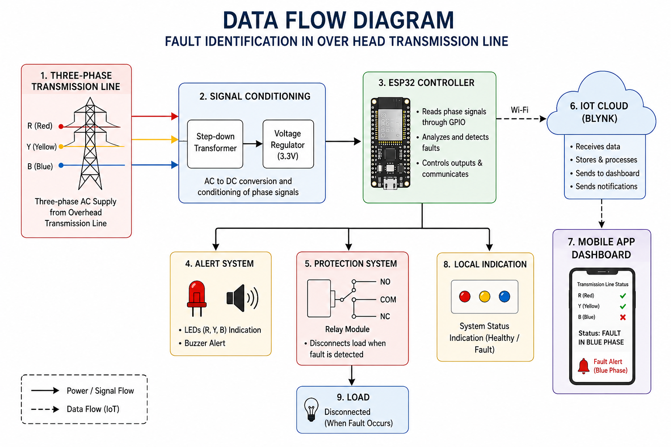
SYSTEM ARCHITECTURE/ IDEATION MAP

Slide 7
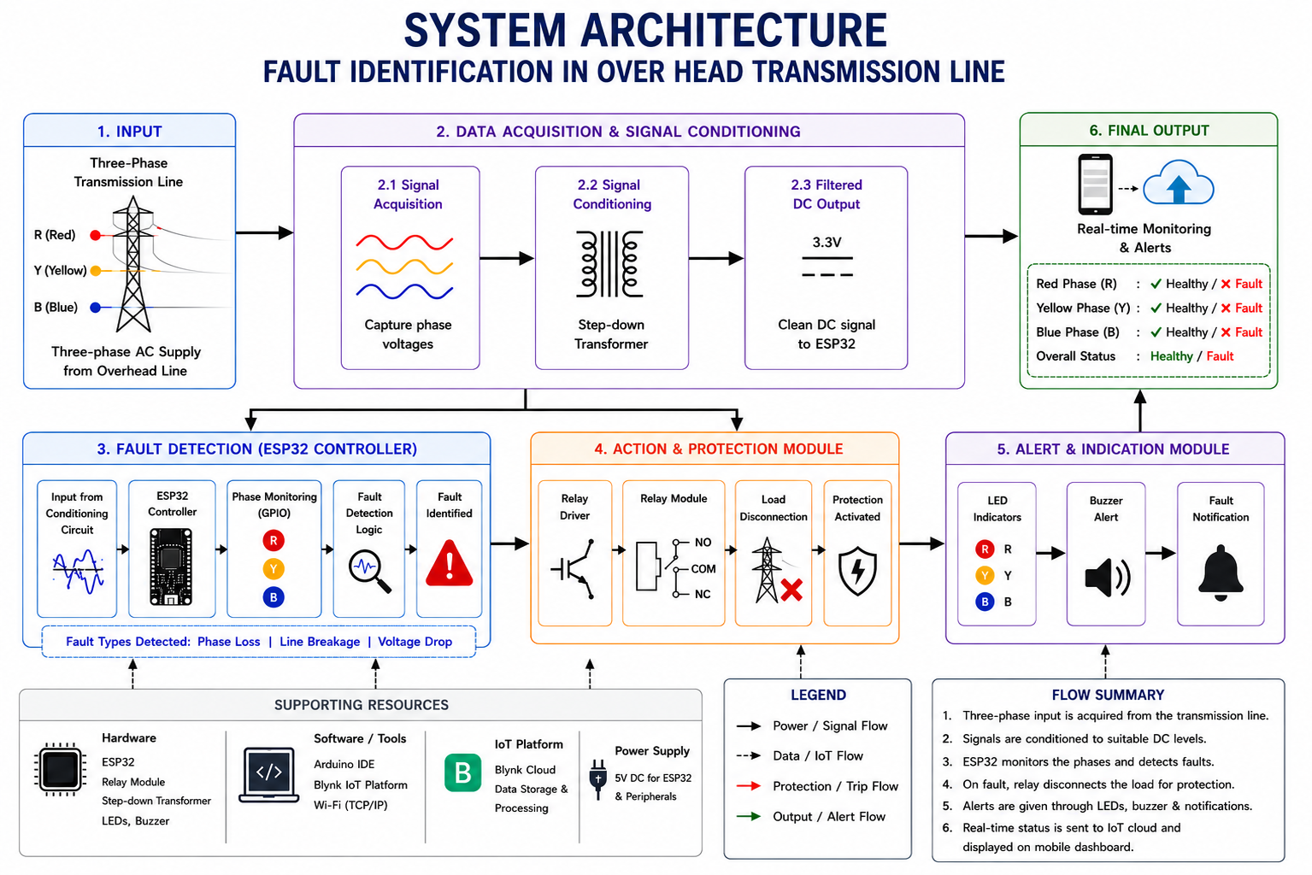
SYSTEM ARCHITECTURE/ IDEATION MAP

Slide 8
MODULE IMPLEMENTATION
Fault Detection Process:
Collected input signals from the three-phase transmission line (R, Y, B)
Used step-down transformers to reduce high AC voltage safely
Applied voltage regulation (3.3V) for ESP32 compatibility
Continuously monitored phase conditions through the ESP32 controller
Improved detection accuracy using stable and filtered input signals
Enabled safe and reliable real-time fault monitoring in the transmission system

Slide 9
MODULE IMPLEMENTATION
Phase Monitoring System:
Continuously monitors the Red (R), Yellow (Y), and Blue (B) phases
Detects faults such as phase failure, line breakage, and voltage drop
Uses ESP32 microcontroller for real-time monitoring and control
Reads phase signals through GPIO input pins
Activates relay module, LEDs, and buzzer alerts during fault conditions
Sends real-time fault information to the IoT cloud platform

Slide 10
MODULE IMPLEMENTATION
Alert and Protection System:
Detects abnormal conditions in the transmission line instantly
Activates LED indicators to show the faulty phase
Generates buzzer alerts for immediate fault notification
Prevents equipment damage and improves system safety
Uses relay module to disconnect the load automatically
Enables real-time monitoring and remote notifications through mobile dashboard
Sends fault status updates to the IoT cloud platform

Slide 11
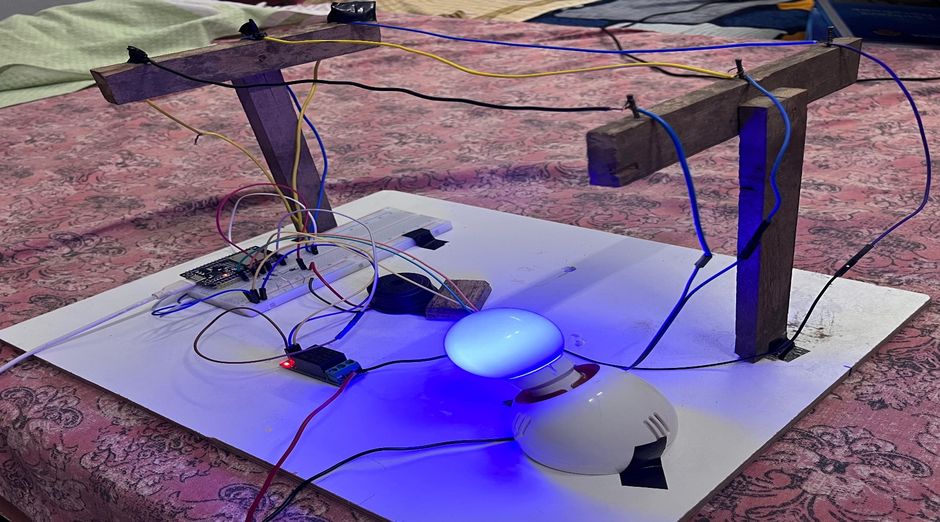
RESULTS AND DISCUSSIONS
COMPLETE SYSTEM SETUP:

Slide 12
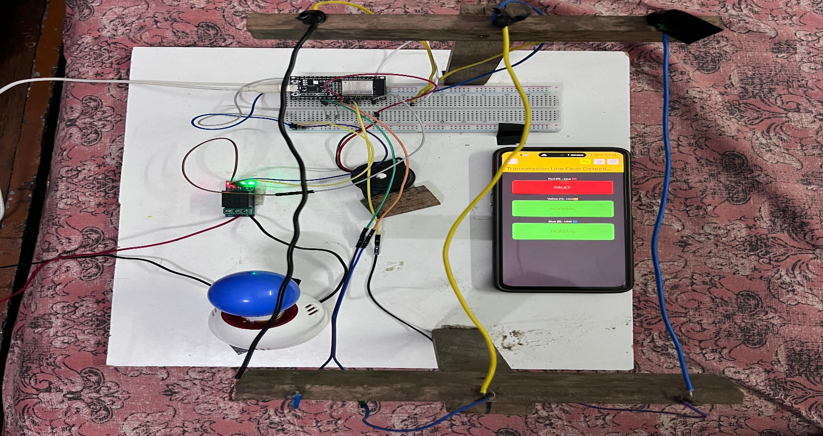
RESULTS AND DISCUSSIONS
PROTOTYPE WITH MOBILE MONITORING:

Slide 13
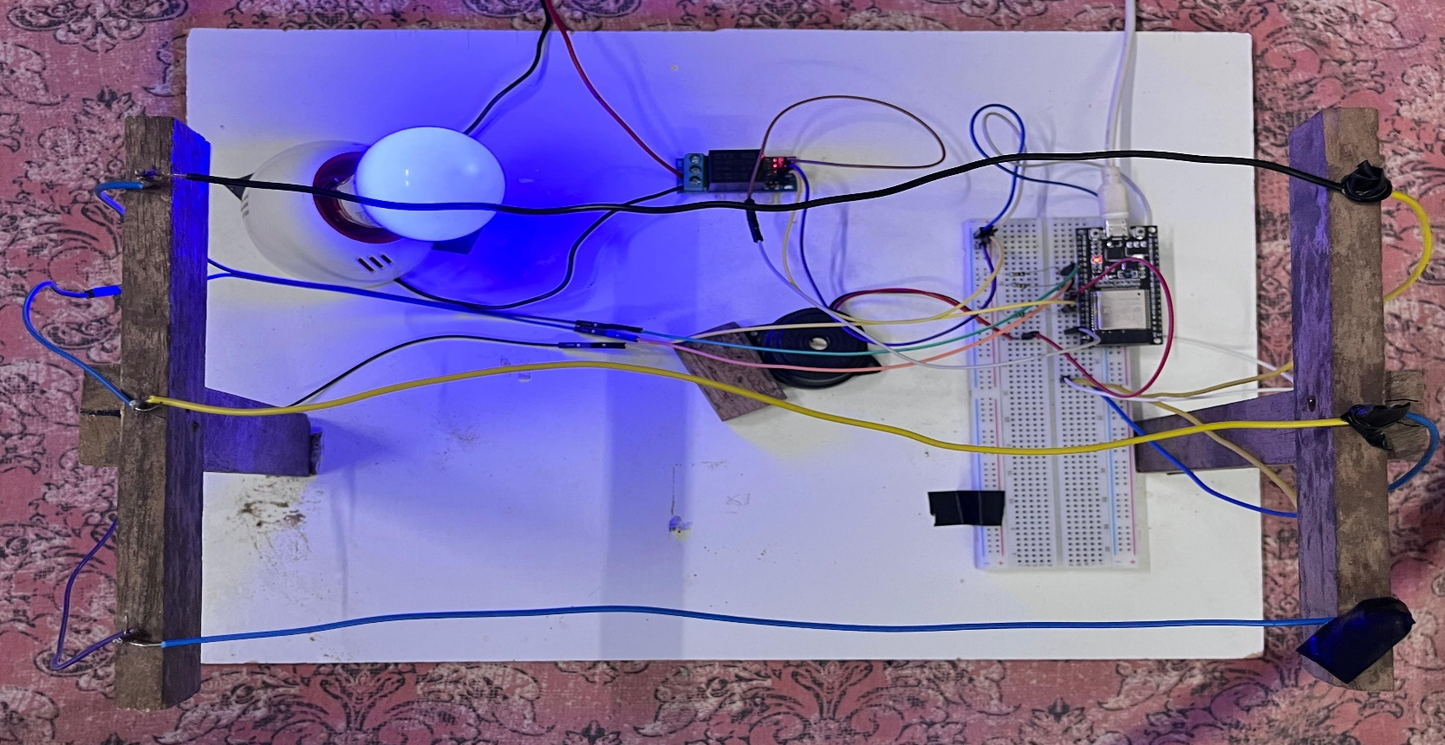
RESULTS AND DISCUSSIONS
TRANSMISSION LINE CONNECTIONS:

Slide 14
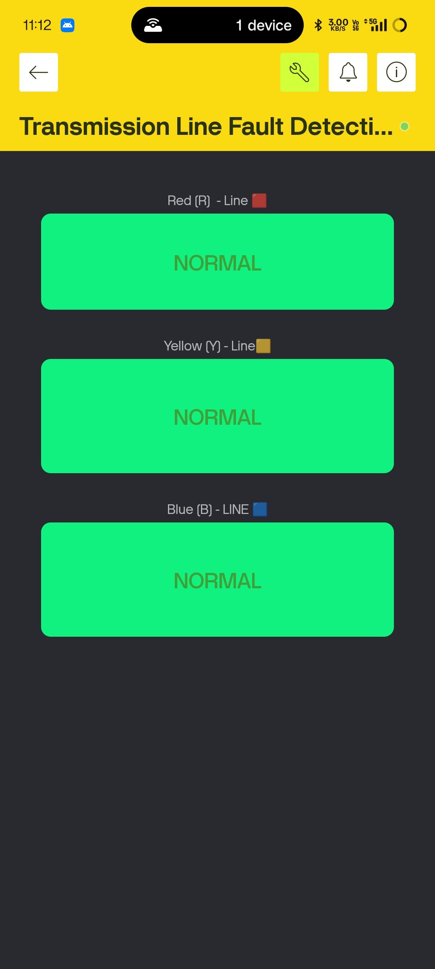
RESULTS AND DISCUSSIONS
NORMAL CONDITION OUTPUT:

Slide 15
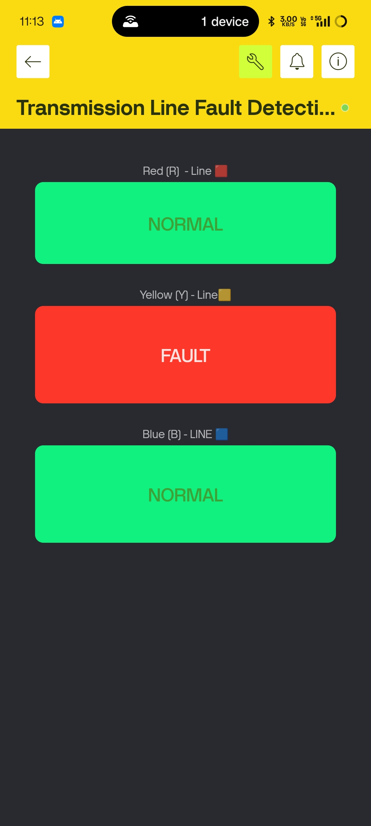
RESULTS AND DISCUSSIONS
FAULT DETECTION OUTPUT

Slide 16
CONCLUSION
Developed an IoT-based fault identification system for overhead transmission lines using ESP32
Successfully detected phase faults in Red (R), Yellow (Y), and Blue (B) transmission lines in real time
System provided fast fault response with automatic relay protection and alert generation
IoT integration enabled remote monitoring and instant fault notifications through mobile dashboard
Implemented visual and audible indications using LEDs and buzzer for effective fault identification
Demonstrates improved safety, reduced downtime, and enhanced reliability in smart power monitoring systems

Slide 17
THANK YOU
We thank God, Our Department, Guide, Panel Members, Supportive Professors and all Technical and non Technical staff who helped us in our Project.

