Slide 1
EN.580.428 Genomic Data Visualization Lesson 4 Non-linear Dimensionality Reduction: T-distributed Stochastic Neighbor Embedding
Prof. Jean Fan

Slide 2
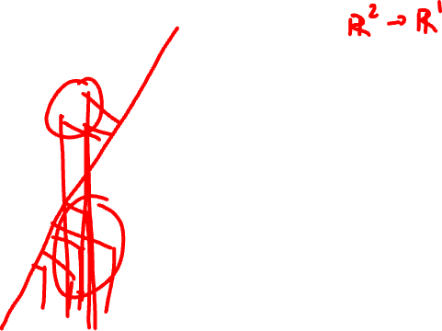
Remotivating Dimensionality Reduction
Gene B
Gene A

Slide 3
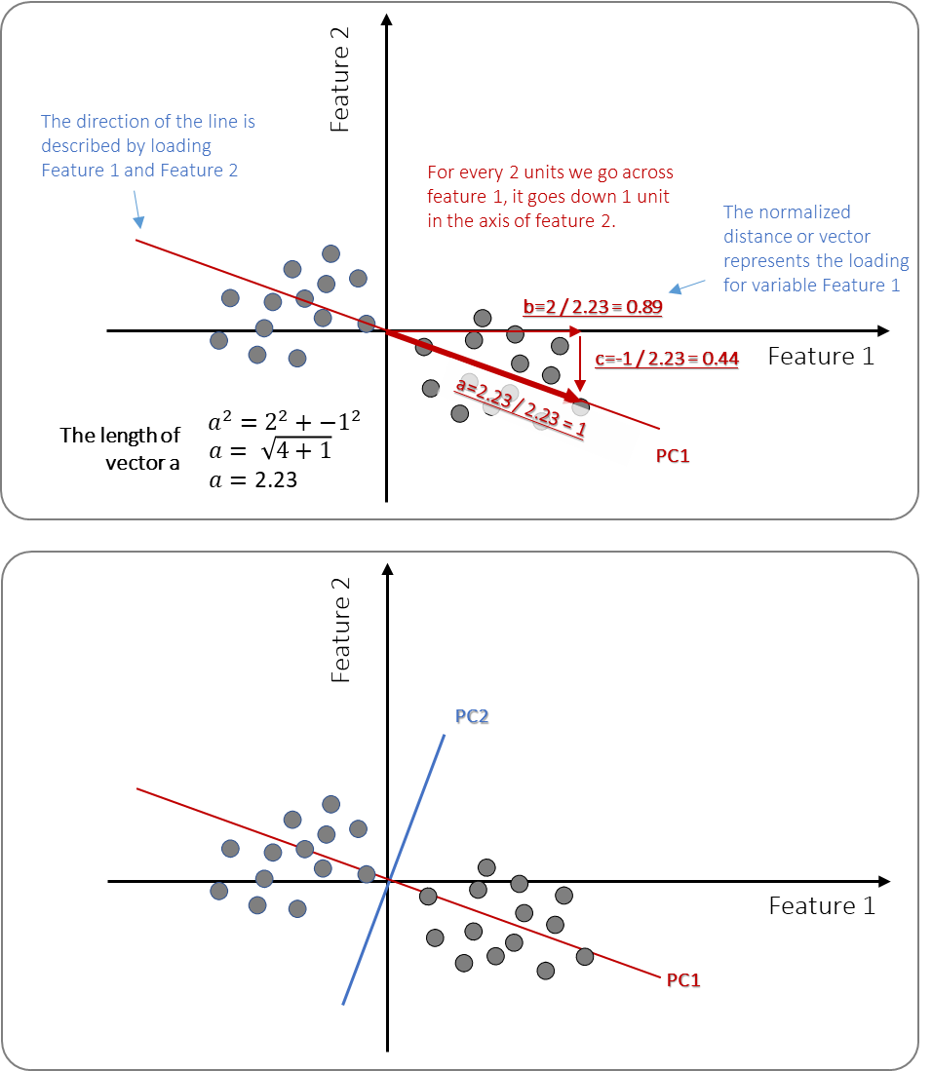
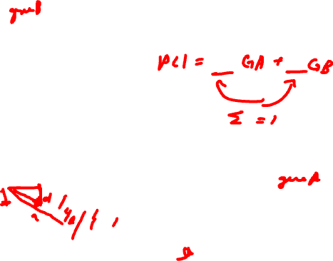
PCA review

Slide 4

PCA review

Slide 5
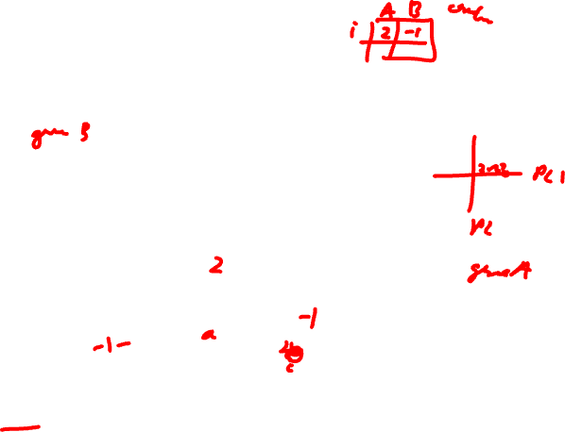
PCA review

Slide 6
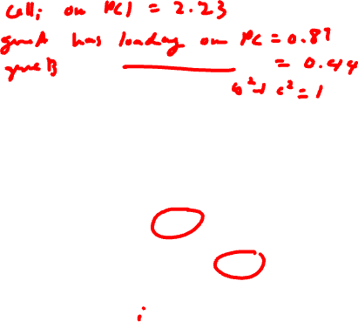
PCA review

Slide 7
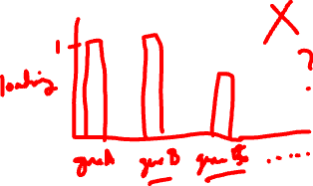
PCA review
Practice
The loading value of geneA on PC1 is 1
What is the loading value of all other genes on PC1?

Slide 8
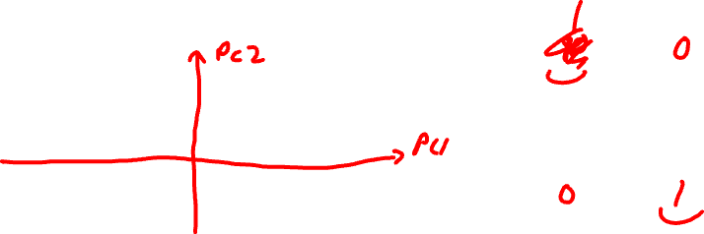
Consider the following centered gene expression
Practice
Gene B
PC1 = geneA + geneB
Gene A
PC2 = geneA + geneB

Slide 9
Lesson learning objectives
Learn about and apply t-SNE

Slide 10
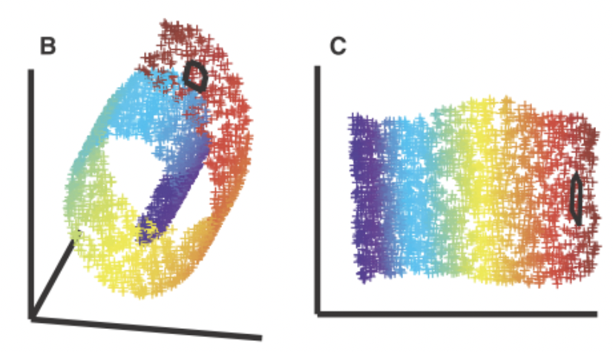
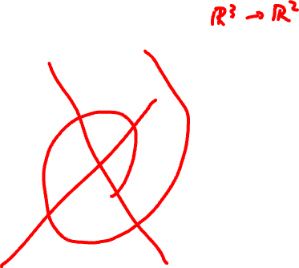
Motivating non-linear dimensionality reduction → linear dimensionality reduction insufficient
3D
Nonlinear 2D

Slide 11
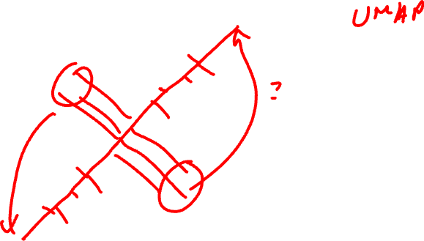
T-distributed Stochastic Neighbor Embedding
Gene B
Gene A

Slide 12
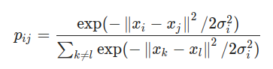
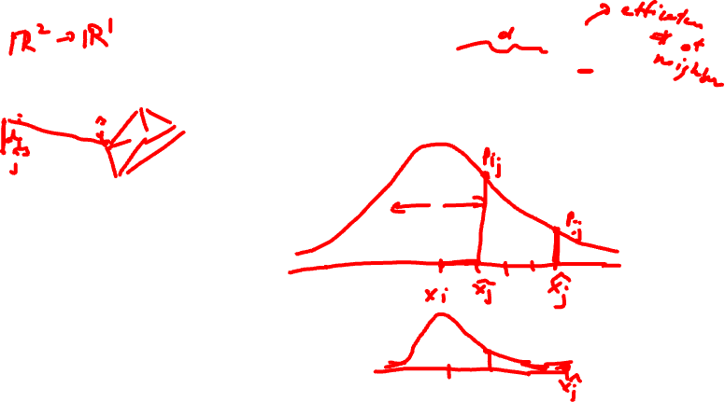
Step 1: compute scaled similarity P in high-dimensional space
perplexity
Gene B
Gene A

Slide 13

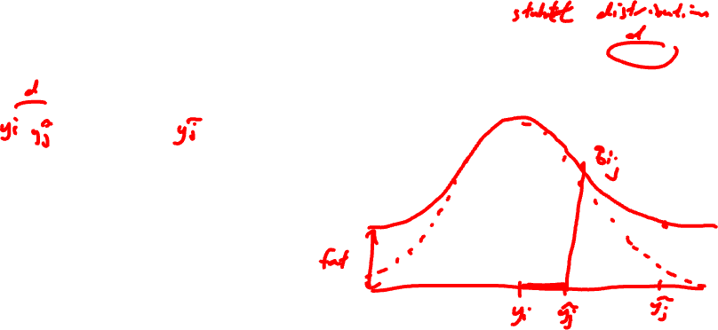
Step 2: place cells into low dimensional space and compute another scaled similarity metric Q
tSNE-1

Slide 14

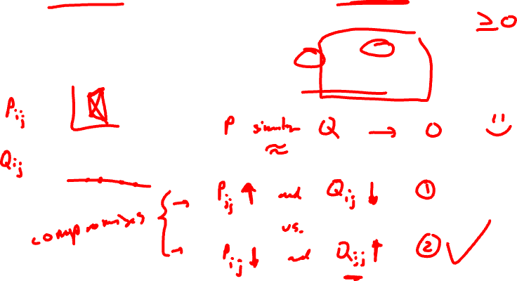
Step 3: P is fixed. Iteratively find a Q to minimize the KL divergence between P and Q

Slide 15

Given P, which Q has a smaller KL divergence?
Practice
P
Q₁
Gene B
tSNE-1
Q₂
tSNE-1
Gene A

Slide 16
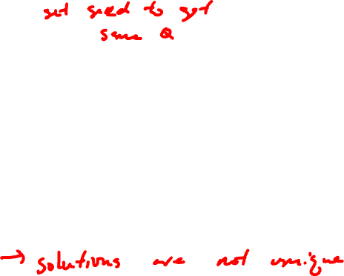
Given P, which Q has a smaller KL divergence?
Practice
P
Q₁
Gene B
tSNE-1
Q₂
tSNE-1
Gene A

Slide 17
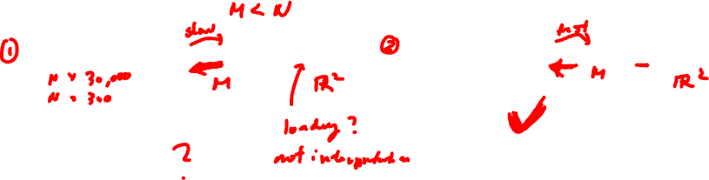
tSNE in practice is often combined with PCA
Practice
Gene expression -> tSNE -> PCA
Gene expression -> PCA -> tSNE

Slide 18
Hands-on Component
Please install these R packages
install.packages(‘Rtsne’)
install.packages(‘patchwork’)
HW2
How do the gene loadings on the first PC relate to features of the genes such as its mean or variance?
How do the genes with high versus low loadings relate to each other? How are they patterned relative to each other in the tissue?
How do tSNE coordinates change as you increase or decrease the number of PCs?
How do tSNE coordinates change as you increase or decrease the perplexity?

