Slide 1
Homework Assignment 2
Due Wednesday (Midnight Baltimore Time)

Slide 2
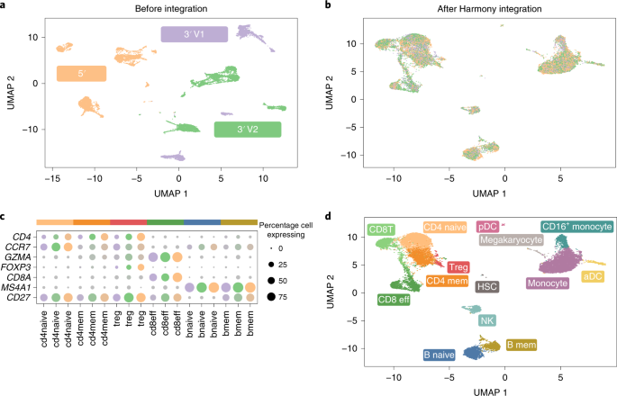
Figure caption: Three PBMC datasets were assayed using different protocols: 5′ (orange, n = 7,697 cells), 3′ V1 (purple, n = 4,809 cells) and 3′ V2 (green, n = 8,380 cells). a, Before integration, cells group by dataset. b, After Harmony integration, datasets are mixed together. c,d, Using canonical markers (c), we identified (d) five shared subtypes of T cell and two shared subtypes of B cell.
Source: https://www.nature.com/articles/s41592-019-0619-0

Slide 3
The authors were trying to explain the following points (make more salient) with each referenced data visualization:
“We gathered three datasets of human PBMCs, each assayed on the Chromium 10X platform but prepared with different protocols: 3′ end v1 (3pV1), 3′ end v2 (3pV2) and 5′ end (5p) chemistries. After pooling all the cells together, we performed a joint [dimensionality reduction and clustering] analysis. Before integration, cells group primarily by [protocol] (Fig. 4a)”
“[Our tool] Harmony…removed [protocol]-specific [technical] variation within each cluster [such that] in the final integrated space, the datasets are well mixed (Fig. 4b)”
“[Harmony] clustered the cells into biologically coherent groups [corresponding to known cell-types and are consistent with the expression of the expected canonical marker genes] (Fig 4c-d)”

Slide 4
Homework
Your homework is to write a description of these 4 data visualizations using vocabulary you have learned about in Lesson 1.
Include in your description for each data visualization (1) the data type that is being visualized, (2) the geometric primitives and (3) visual channels used, and (4) whether you think the authors were effective in their data visualization.
(5) Include also a description of how you could improve these data visualizations to enhance saliency of the original points the authors were trying to communicate. What could you change? What could you add or take away?

Slide 5
Submitting your HW

Slide 6
To submit your homework, follow these steps
Update your personal fork by fetching upstream
Save your description to the homework/hw2/ folder using [JHED]-hw2.txt
fun fact: what you write for this homework will not be visible on the course website
Make a pull request

