Slide 1
Homework Assignment 4
Due Wednesday (Midnight Baltimore Time)

Slide 2
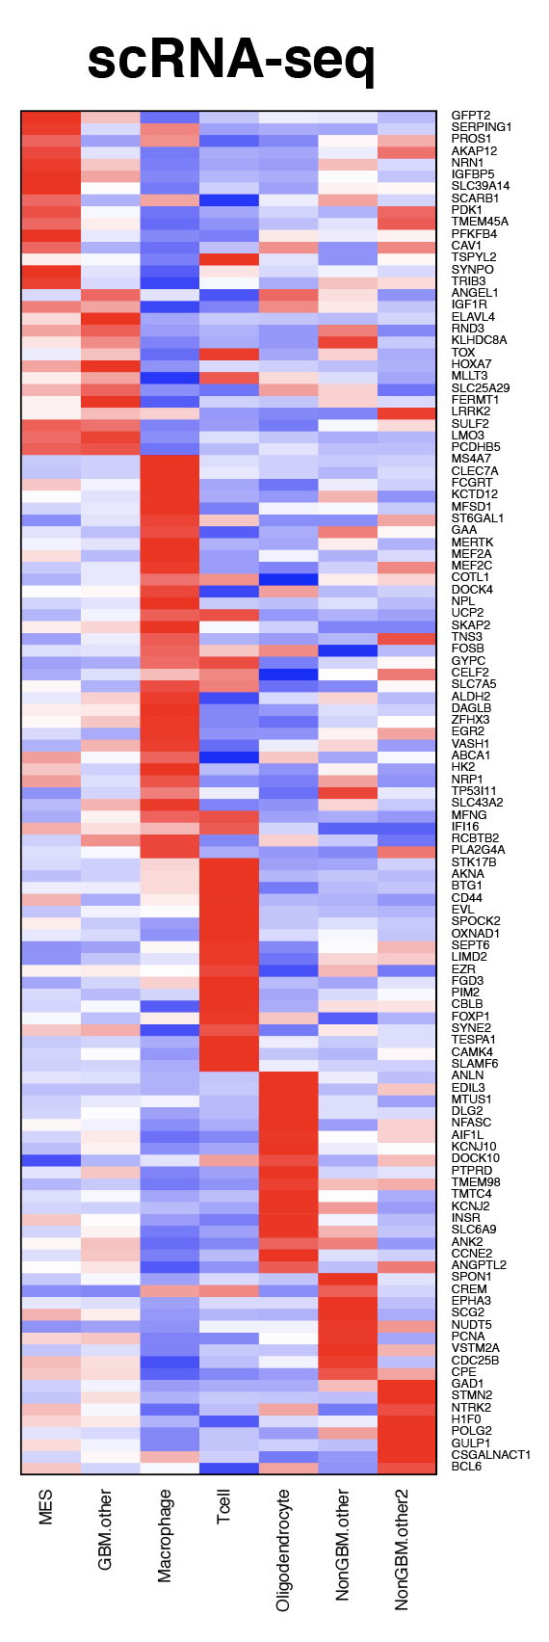
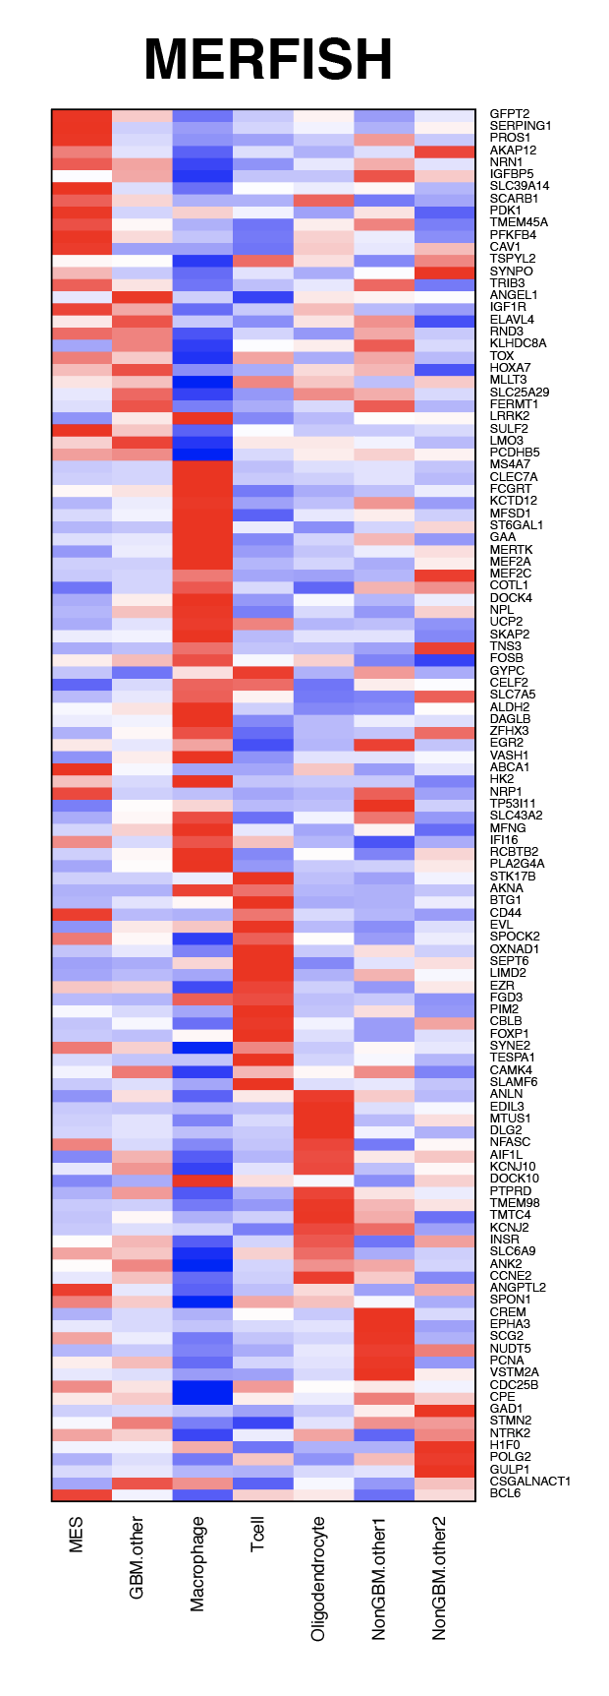
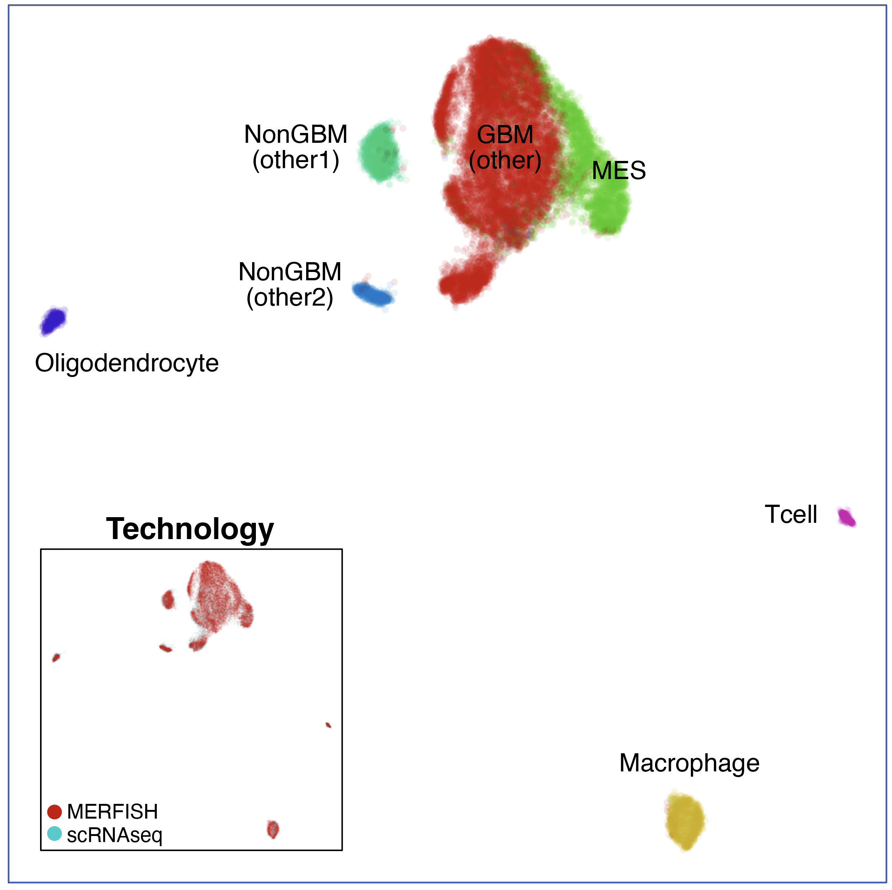
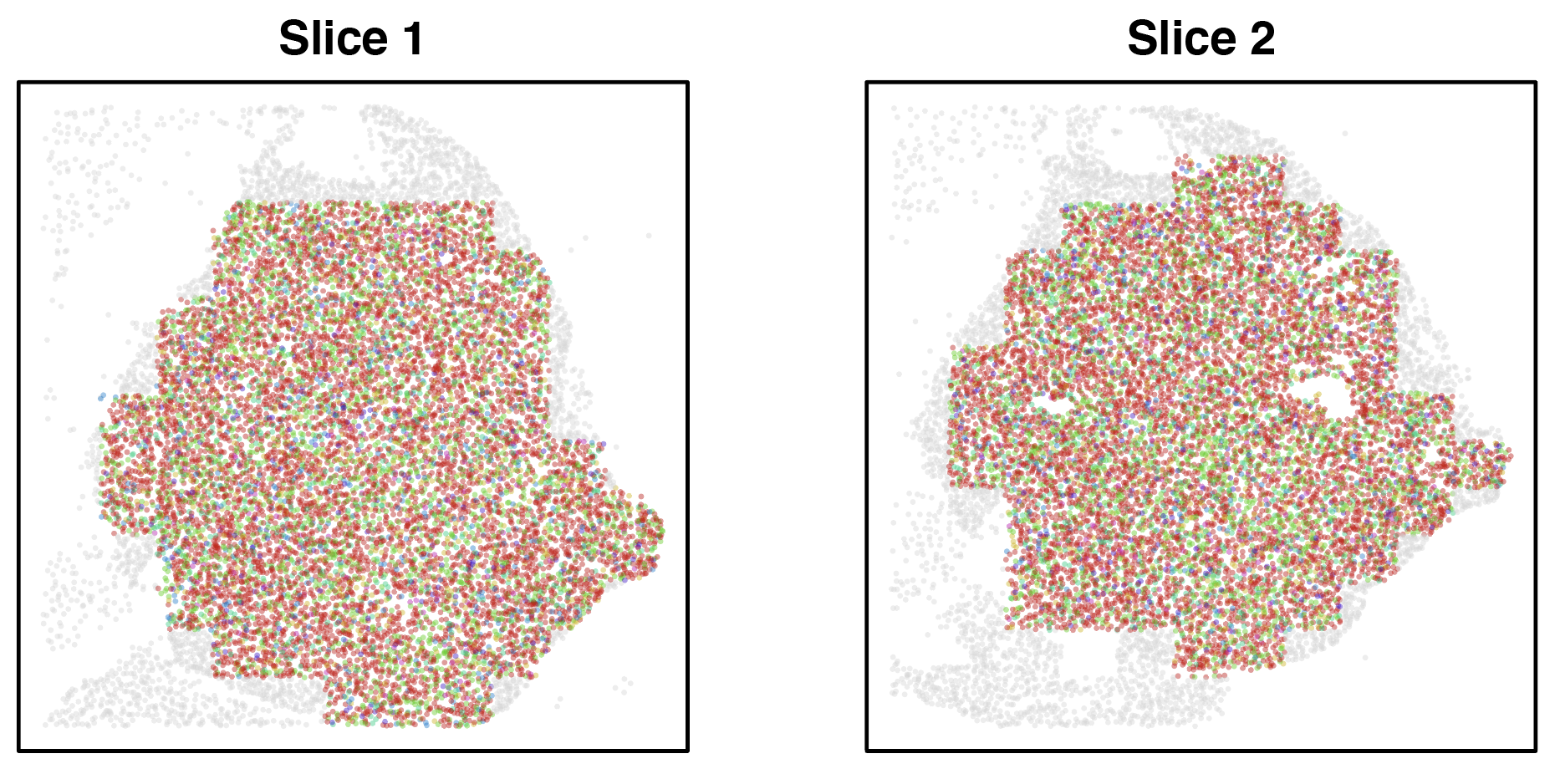
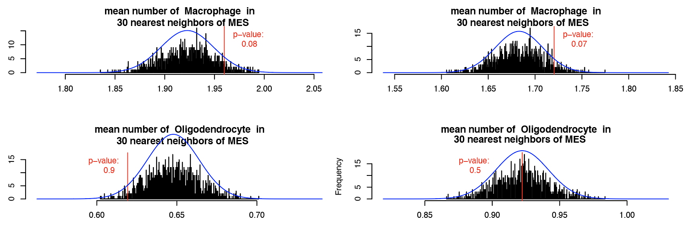
A
B
Figure legend: In situ spatial transcriptomics shows enrichment of macrophages around MES-like cells in human GBM.
A) UMAP embedding of gene expression profiles measured by MERFISH and single-cell RNA-sequencing integrated using Harmony. Cells are colored by cell-type. Inset shows UMAP embedding with cells colored by data modality.
B) Heatmap showing the average expression of genes measured by single-cell RNA sequencing (left) and by MERFISH (right) scaled across identified cell-types.
C) GBM tumor biopsy sections measured by MERFISH with cells colored by cell-type from A. Unannotated cells are colored in grey.
D) Histogram showing observed mean number of macrophages (top) and oligodendrocytes (bottom) in 30 nearest cells to each MES-like GBM cell (red line) and distribution expected at random (black lines). Blue line shows the fitted normal distribution. Tumor section 1 shown on left and tumor section 2 shown on right.
C
D

Slide 3
The authors were trying to explain the following points (make more salient) with each referenced data visualization:
Integrative analysis between MERFISH and scRNA-seq allowed us to identify MES-like and macrophage cells with consistent transcriptomic profiles (FigX A-B)
Spatial analyses are consistent with the observation that macrophages are enriched in the vicinity of MES-like cells whereas other cell-types like oligodendrocytes are not (FigX C-D)

Slide 4
Homework
Your homework is to write a description of these 4 data visualizations using vocabulary you have learned about in Lesson 1.
Include in your description for each data visualization (1) the data type that is being visualized, (2) the geometric primitives and (3) visual channels used, and (4) whether you think the authors were effective in their data visualization.
(5) Include also a description of how you could improve these data visualizations to enhance saliency of the original points the authors were trying to communicate. What could you change? What could you add or take away?

Slide 5
Submitting your HW

Slide 6
To submit your homework, follow these steps
Update your personal fork by fetching upstream
Save your description to the homework/hw4/ folder using [JHED]-hw4.txt
fun fact: what you write for this homework will not be visible on the course website
Make a pull request

