Slide 1
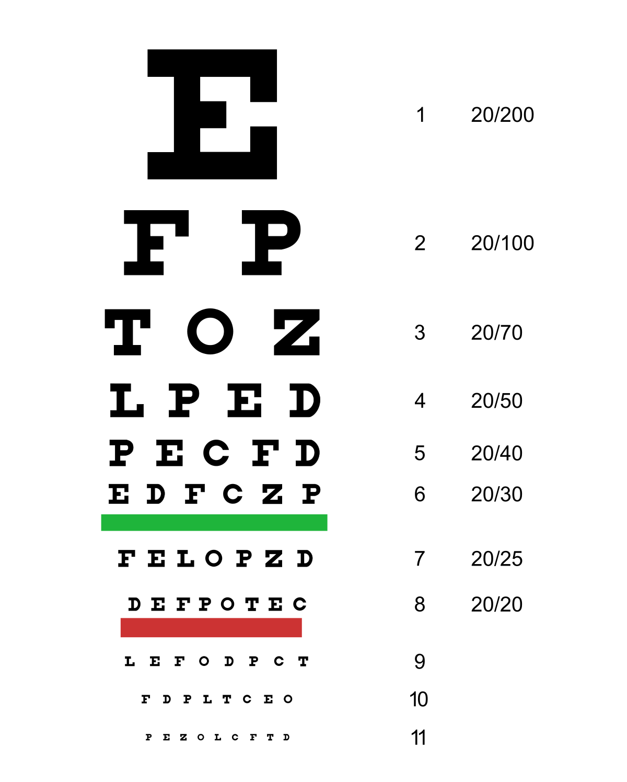
Genomic Data Visualization Final Project please move forward if you cannot read this from where you are

Slide 2
Quiz reveal

Slide 3

Quiz reveal

Slide 4
Quiz reveal
Any guesses how the data was simulated?

Slide 5
Learning objectives
Through this course, you’ve learned to analyze many different types of spatial omics datasets
Now it’s time to work as part of a team to discover something new
In your final projects, you will work in assigned teams of two
You will analyze a spatial omics dataset of your choosing
You will make a presentation with data visualizations teaching the class about that you discovered

Slide 6

Team assignments
Yuqi and Sai: Team Elephant
Stella and Yash: Team Avocado
Kalen and Lyla: Team Jigglypuff
Please move to be seated with your team member
Please take 5 minutes to come up with a team name

Slide 7

Pick your starter Pokemon dataset
Take 5 minutes to discuss with your team mate any preferences for picking datasets
Each team must analyze a different dataset
Order will be determined based on random numbers
MERFISH cortex
CODEX spleen
Visium breast cancer

Slide 8

bit.ly/GDV_merfish2
MERFISH cortex

Slide 9

bit.ly/GDV_bc
Visium breast cancer

Slide 10

bit.ly/GDV_spleen3
CODEX spleen

Slide 11
Project goals
Your team is going to become the experts on your particular dataset
Your goal is to analyze the dataset to discover potentially interesting new biology
You must consult literature to determine whether you are recapitulating known biology or discovering something potentially new
New cell-type
New spatial organization of many cell-types
You will make a final presentation teaching us about your dataset, your analysis approach, and the potentially interesting biology you’ve discovered

Slide 12
Final presentation guidelines
25 minute presentation, 5 minutes for questions
Give overview of technology used to generate data
Perform and make data visualizations characterizing data quality
Quality of cells/spots
Quality of genes/proteins
Perform clustering and differential expression analysis to identify and interpret cell-types
Visualize results to convince us you have done a good job
Ex. Heatmap of marker genes in cell-types
Visualize how cell-types are organized within the tissue and in the 2D reduced dimensional embedding space

Slide 13
Looking forward
March 14 -> no class, please work on project
March 16 -> no class, please work on project
March 18 -> final presentations
Please spend this class making sure you have what you need to analyze the dataset
Ask any questions
Class will be dismissed early today at 9:15

