Slide 1
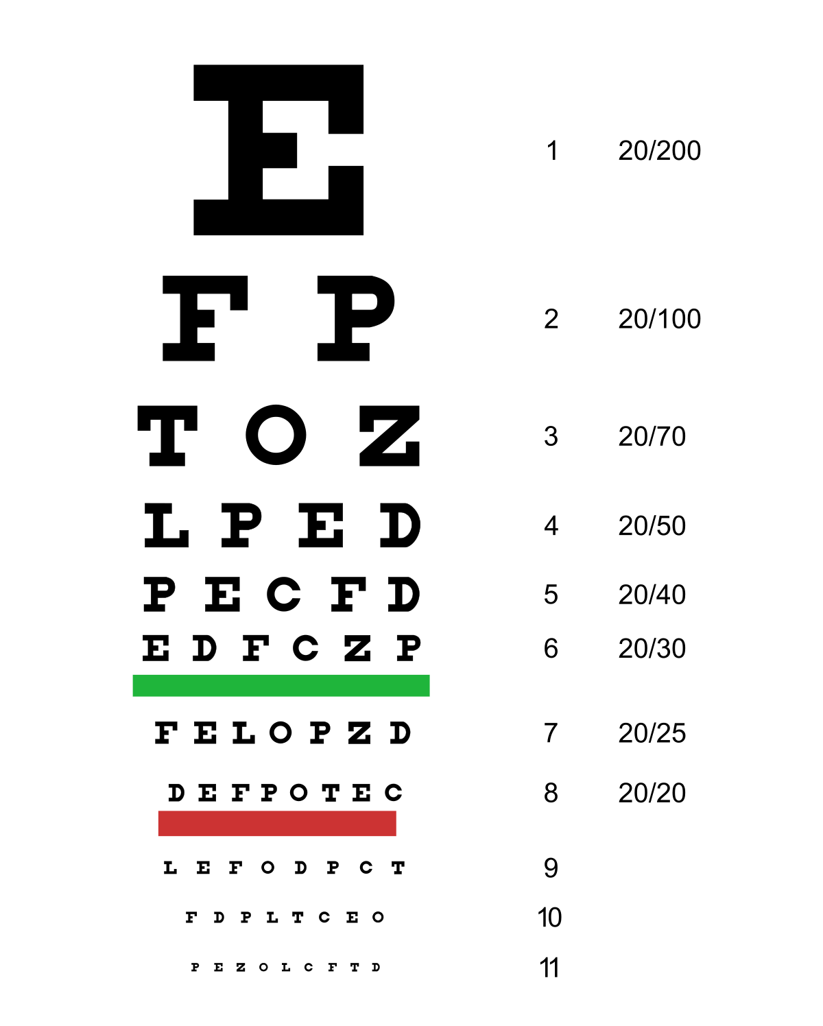
Genomic Data Visualization Final Presentations please move forward if you cannot read this from where you are

Slide 2
Learning objectives
Team presentation order: Elephant, Avocado, Jigglypuff
~25 minute presentation
Share screen on Zoom
Will be given 5 minute warning at 20 minute mark
5 minutes for audience gives presenters feedback: bit.ly/GDV_pr2
And ask questions
At least one question/comment from each team
After presentations, give teammate feedback + final reflection card: bit.ly/GDV_frc

