Slide 1
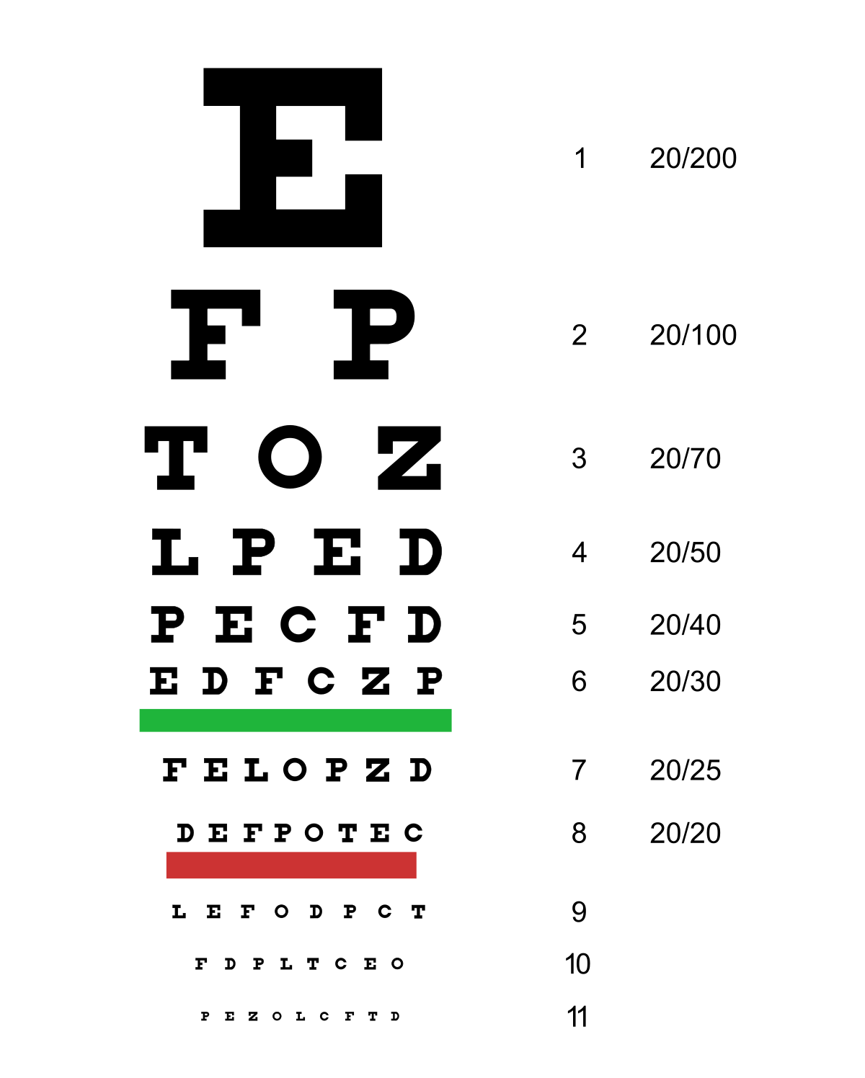
Genomic Data Visualization Guest Speaker:
Lyla Atta please move forward if you cannot read this from where you are

Slide 2
Optional take home retake
Old answers will be Slacked to you
Optionally retake the quiz at: bit.ly/GDV_quizfinal
Due Thursday 8pm
Quiz review will be Friday

Slide 3
Reminder: optional extra credit homework
Deadline is 3/11 6pm
In either the MERFISH or Visium dataset, perform clustering analysis.
Pick a cluster.
Perform differential expression analysis to identify genes upregulated in this cluster. Interpret this cluster. What cell-type do you think it is? You will likely need to read about the genes upregulated in this cluster to determine the cell-type.
Visualize the spatial distribution this cell-type.

Slide 4
Looking ahead
Today and next class have guest presentations
Provide feedback: bit.ly/GDV_pr2
Eventually, you will make presentations and give feedback to each other

