Slide 1
Homework Assignment 1
Due Saturday (Midnight Baltimore Time)

Slide 2
Create and describe a Data Visualization using MERFISH or VISIUM
Your description of your data visualization must address the following questions:
What type of data are we visualizing?
What geometric primitives and visual channels are we using to encode this data?
What trend in the data are you trying to make more salient with your visualization? What Gestalt principles or knowledge about perceptiveness of visual encodings are you using to accomplish this?
You must include the entire code you used to generate the figure so that it can be reproduced.
You must provide attribution to external resources referenced (if any) in writing your code.

Slide 3
Example
I am visualizing quantitative data of the expression level of the Gad1 gene across spots in the Visium dataset.
I am using the geometric primitive of areas to encode this information.
I am using the visual channel of position on the x axis to encode the Gad1 expression level in the form of the counts-per-million normalized gene expression level that is log10 transformed with a pseudocount of 1.
I am using the visual channel of position on the y axis to encode the frequency of spots that express Gad1 at different magnitudes.
I am also using the visual channel of hue to distinguish between spots that have no detected expression of Gad1 versus spots that have some detected expression of Gad1.
My explanatory data visualization seeks to make more salient how there are two populations of spots in this data: one that have some detected expression of Gad1 and one that does not. I am using the Gestalt principle of similarity via color to emphasize the two different groups of spots.

Slide 4
Code used
data <- read.csv('~/Desktop/class/genomic-data-visualization/data/Visium_Cortex_varnorm.csv.gz')
gexp <- data[, 4:ncol(data)]
rownames(gexp) <- data[,1]
# CPM normalize
numgenes <- rowSums(gexp)
normgexp <- gexp/rowSums(gexp)*1e6
# plot
library(ggplot2)
df <- data.frame(log10(normgexp[, c('Gad1', 'Slc32a1')]+1))
ggplot(data = df,
mapping = aes(x = Gad1)) +
geom_histogram(mapping = aes(fill = df$Gad1 > 0))

Slide 5
Submitting your HW

Slide 6
To submit your homework, follow the steps from HW0, summarized here
0. Update your personal fork by fetching upstream
1. Save your data visualization to the homework/hw[N]/ folder using [yourname].png
2. Create a .md file in main/_posts/ following the 2022-01-31-jfan9.md file
3. Double check your post and make a pull request as you learned from HW0

Slide 7
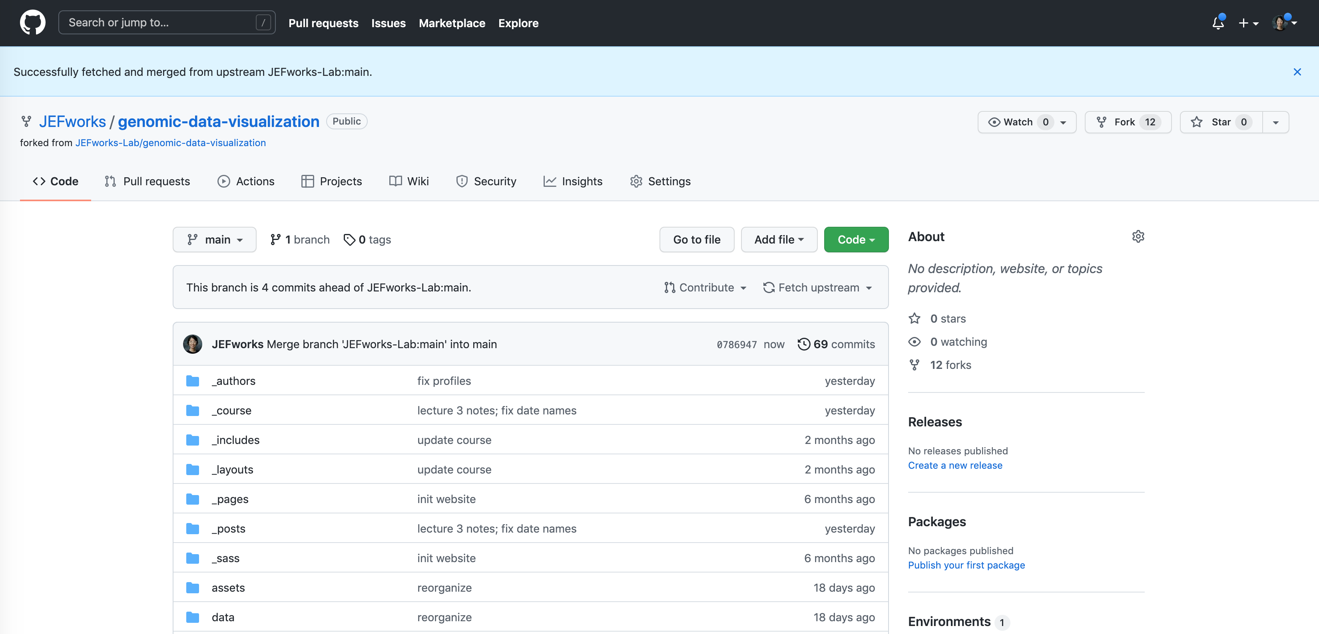
0. Update your personal fork by fetching upstream

Slide 8
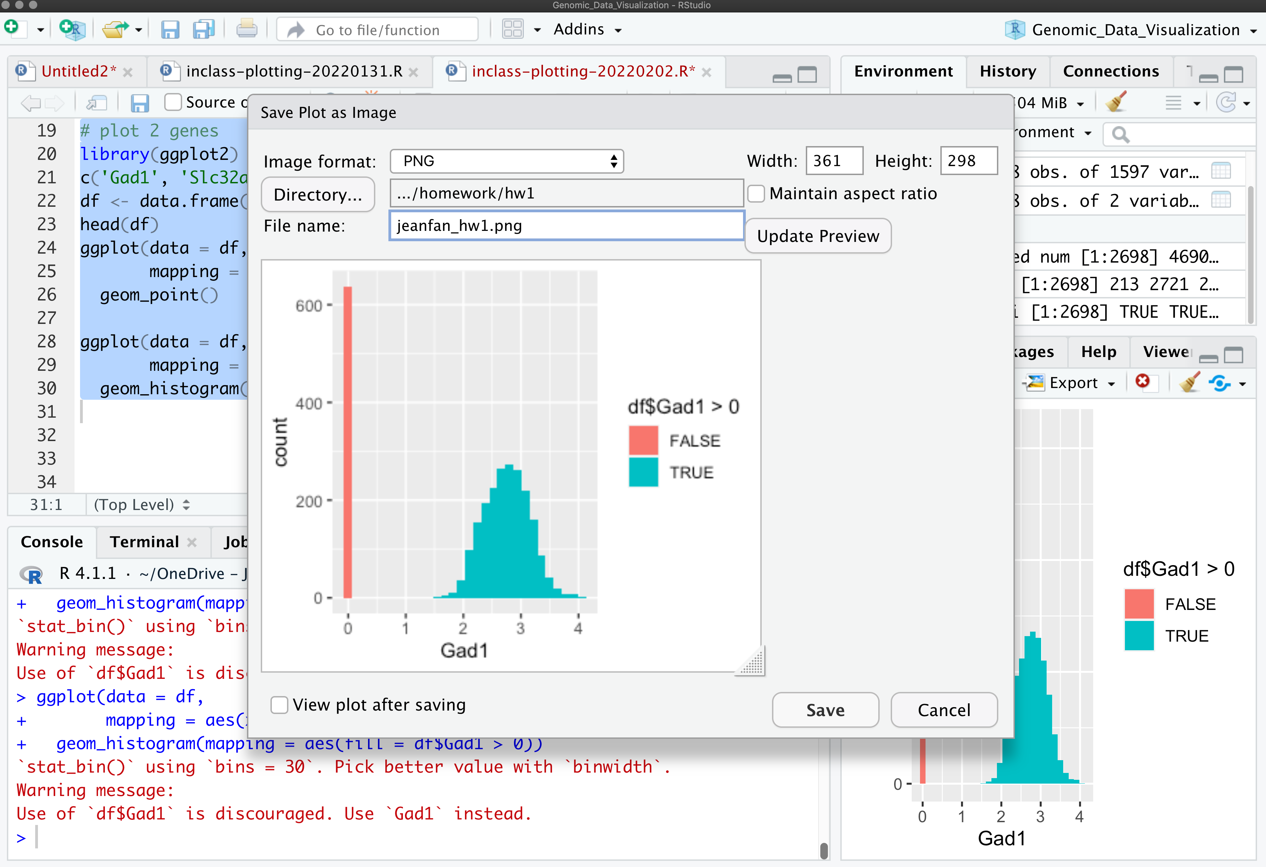
1. Save your data visualization to the homework/hw[N]/ folder using [yourname]_hw[N].png

Slide 9
2. Create a .md file in main/_posts/ following the 2022-01-31-jfan9.md file
Update the date on the file name to [the date the homework was assigned]-[your jhed].md
Note that the format of the date is [year]-[month]-[day]
Your file will likely look something like this to the right but with the highlighted components changed
Note that the ”image:” should point to the image you just uploaded to the homework/ folder so please update the file names accordingly
---
layout: post
title: "Sample Homework Submission"
author: Prof. Jean Fan
jhed: jfan9
categories: [ HW1 ]
image: homework/hw1/jeanfan_hw1.png
featured: false
---
[description]
```{r}
[code]
```

Slide 10
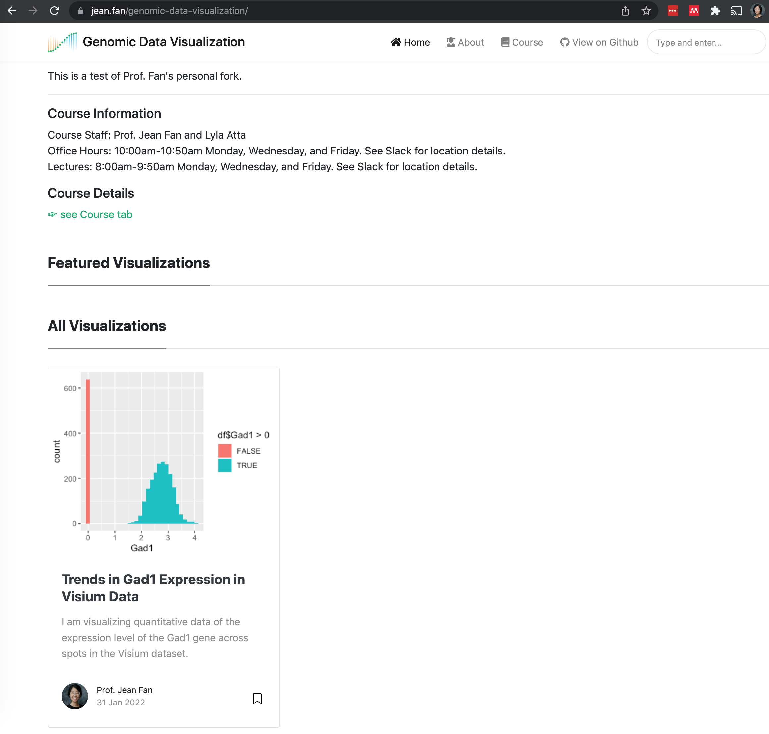
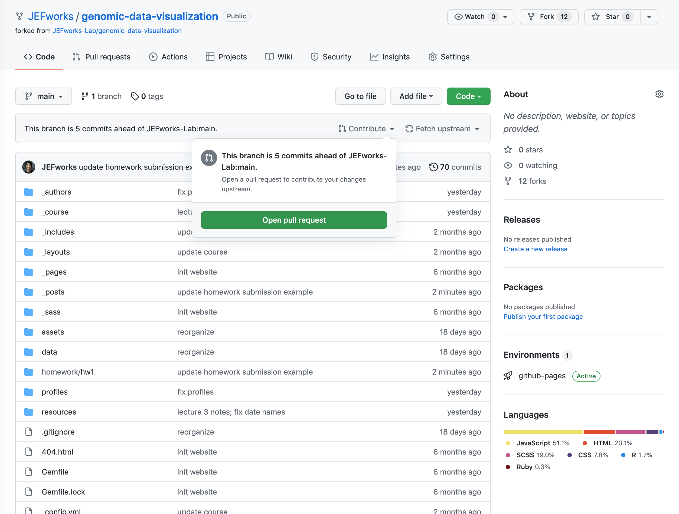
3. Double check your post and make a pull request as you learned from HW0

