Slide 1
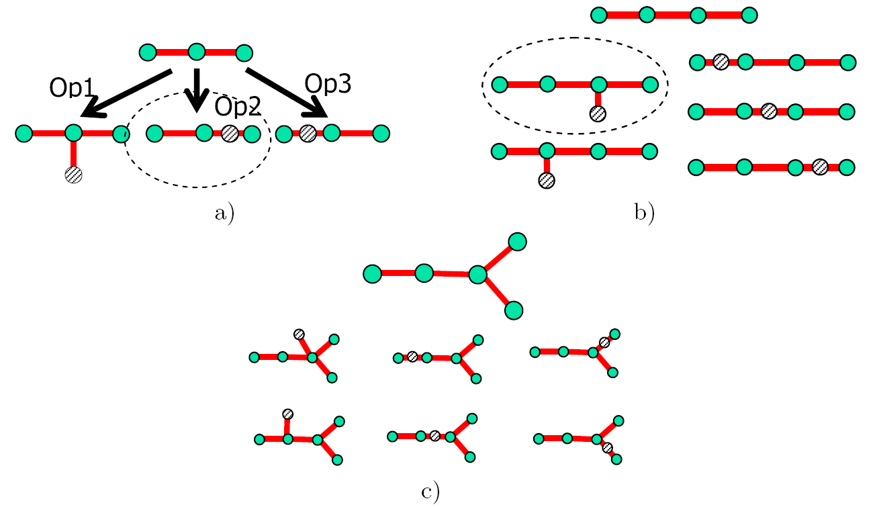
Illustration of the simple “add node to a node” or “bisect an edge” graph grammar. a) We start with a simple 2-star from which one can generate three distinct graphs shown. The “Op1” operation is adding a node to a node, operations “Op1” and “Op2” are edge bisections (here they are topologically equivalent to adding a node to a terminal node of the initial 2-star). For illustration let us suppose that the “Op2” operation gives the largest elastic energy decrement, thus it is the “optimal” operation. b) From the graph obtained one can generate 5 distinct graphs and choose the optimal one. c) The process is continued until a definite number of nodes are inserted. (Reproduced from Gorban&Zinovyev, IJNS, 2010).

