Slide 1
Retail Inventory Forecast Dashboard
SKU-Level Demand Forecasting for Smarter Inventory Planning
Presented by Jeisa Mathew

Slide 2



OVERVIEW
Executive Summary
The business problem, solution, and value in one view
Problem
Solution
Outcome
Some stores overstock while others run out of stock, creating inconsistent inventory allocation across the retail network.
Forecast SKU-level demand, compare it with inventory, classify risk, and recommend reorder / transfer / hold actions.
A Tableau dashboard shows managers where action is required and where inventory should be held.
76,000
18
5 × 20
0.62%
Records
Fields
Stores × SKUs
Overall Forecast Bias
2

Slide 3

1. Industry
Retail inventory planning across multiple stores and overlapping SKUs
Business context
Retailers operate multiple stores carrying overlapping SKUs. Inventory needs vary by store because local demand, seasonality, promotions, and other conditions are not identical.
Retail
Project focus
SKU-level demand forecasting + inventory risk monitoring + action-oriented dashboarding.
Multi-store chains
3

Slide 4



2. Company Examples
Organizations facing multi-store inventory challenges
Large multi-store grocery chains
Electronics retail chains
Clothing and apparel retail chains
Why this matters
Any retailer with overlapping SKUs across stores faces the same issue: the same SKU can have different demand and inventory pressure in different stores. The project dataset spans 5 categories (Clothing, Electronics, Furniture, Groceries, Toys), and the dashboard is built around the store × SKU view.
4

Slide 5
3. Business Background
Why inventory forecasting is a store-level business problem
Historical demand
Forecast demand
Compare with inventory
Identify risk
Take action
1
Retailers manage many SKUs across multiple stores.
2
Demand can vary by location and time.
3
Seasonality and promotions can change expected demand.
4
Inventory decisions must consider future demand, not only current stock.
5

Slide 6

4. Business Problem
The core inventory imbalance
Overstock
Stockout
Inventory is far above expected demand, tying up capital and increasing holding pressure.
Inventory is insufficient for expected demand, creating potential lost sales and poor availability.
Core challenge
The same SKU can be healthy in one store, at risk in another, and overstocked elsewhere.
Dashboard example (30 Jan 2024): SKU P0015 has only 0.9 days of cover at store S001 (stockout risk), but 7.0, 4.7 and 5.0 days at S002, S004 and S005 (overstock risk).
6

Slide 7

5. Why Existing Solutions Fail
Limits of static or manual store-level reordering
1
Static reorder points may not reflect changing demand.
2
Manual judgment can be inconsistent across stores.
Project response
Use a rolling demand measure with a seasonal index, then compare forecast demand with inventory to flag risk and recommend an action.
3
Current inventory alone does not show future SKU-level demand.
4
Seasonal and promotional patterns can be missed without a demand-adjusted view.
7

Slide 8
6. Business Impact
Dashboard snapshot as of 30 Jan 2024 (100 store × SKU pairs)
9 pairs
285
28 pairs
15,351
Stockout Risk
Units short (reorder)
Overstock Risk
Units on hand (hold)
Stockout risk means potential lost sales and poor customer availability.
Overstock risk means capital tied up in inventory beyond expected demand.
The dashboard turns both risks into reorder, transfer, or hold decisions.
8

Slide 9

7. Problem Statement
One concise project objective
Build a SKU-level demand forecasting dashboard that flags stockout and overstock risk per store and recommends reorder / transfer actions.
Forecast SKU-level demand
Flag risk per store
Recommend reorder / transfer
9

Slide 10
8. Business Objectives
Measurable goals, with the current dashboard baseline
01
02
03
Reduce stockout-risk pairs
Reduce overstock-risk pairs
Keep forecast bias near zero
9 of 100
28 of 100
0.62%
pairs at stockout risk today
pairs at overstock risk today
overall forecast bias today
10

Slide 11



9. Functional Requirements
What the solution must do
Forecast demand per SKU and store
Flag Stockout, Stockout Risk, Overstock Risk, or Healthy
Recommend Reorder / Transfer In, Hold Orders / Transfer Out, or No Action
Visualize inventory risk on a map and by category
Provide reorder-priority and hold-list views
11

Slide 12



10. Non-Functional Requirements
Usability and maintainability expectations
Refreshable
Filterable
Readable
New source data can flow through the Excel → Tableau pipeline.
Filters let managers slice the same dashboard views.
Color-coded risk status and KPI tiles make it clear at a glance.
Dashboard filters
Promotion Status
Category
Region
Seasonality
Forecast Risk Status
Weather Condition
12

Slide 13
11. Data Required
Dataset structure and validation
76,000
18
Jan 2022 – Jan 2024
5 × 20
Records
Fields
Date range
Stores × SKUs
Core: Date, Store ID, Product ID, Category, Region, Inventory Level, Units Sold, Units Ordered
Context: Price, Discount, Promotion, Competitor Pricing, Weather Condition, Seasonality, Epidemic
Demand and forecasting inputs: Demand, Rolling 30 Day Avg Demand, Seasonal Index
Data source
Public Kaggle dataset "Retail Store Inventory and Demand Forecasting" (sales_data.csv). It is a practice / synthetic dataset used for this assignment, not real company data.
13

Slide 14





12. Suggested Tech Stack
A clear split of responsibilities between the two tools
Excel — Power Query
Tableau
Data cleaning and validation: data types, categorical values, binary flags, and business-rule checks.
Calculated fields, demand forecast logic, inventory-risk classification, KPIs, visual analytics, and dashboards.
Delivery
PowerPoint presentation
→
GitHub repository
→
LinkedIn showcase
14

Slide 15
13. AI/ML Concepts
A simple moving-average forecast with a seasonal adjustment
Forecasting method
Risk logic
Evaluation metric
Forecast = Rolling 30 Day Avg Demand × Seasonal Index
Stockout Risk if inventory < 1 day of forecast; Overstock Risk if > 4 days; otherwise Healthy
Forecast Bias % = SUM(Forecast) ÷ SUM(Demand) − 1 → 0.62%
The forecast is in-sample: it is calculated on the same historical data, so bias shows how well the method fits, not future accuracy.
15

Slide 16
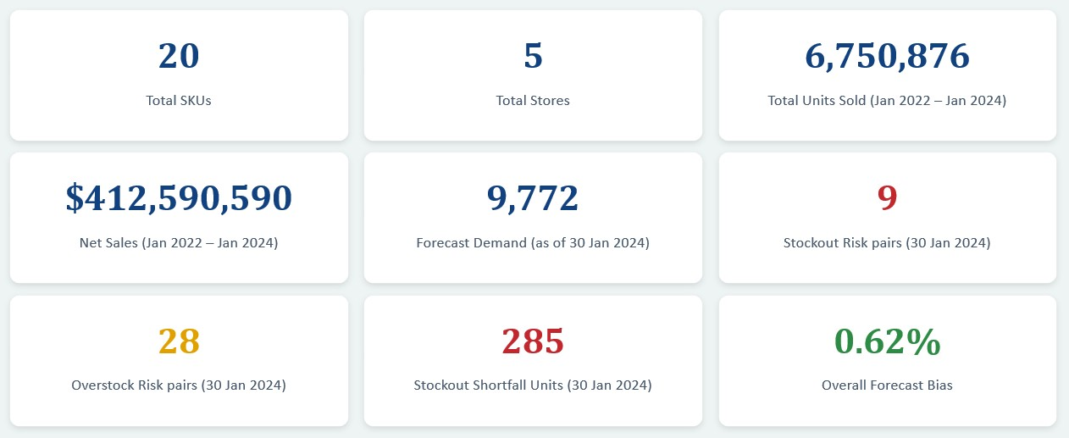
14. KPIs
16

Slide 17
15. Business Outcome
How the dashboard supports inventory decisions
Forecast
Risk
Action
Find store × SKU pairs that need attention faster.
Separate reorder / transfer-in cases from hold / transfer-out cases.
Cut potential lost sales from insufficient inventory.
Cut excess inventory exposure by identifying hold candidates.
Transfer first, buy second
5 SKUs are red in one store and orange in another. Moving stock covers 169 of the 285 units short; the other 116 need a normal reorder.
17

Slide 18
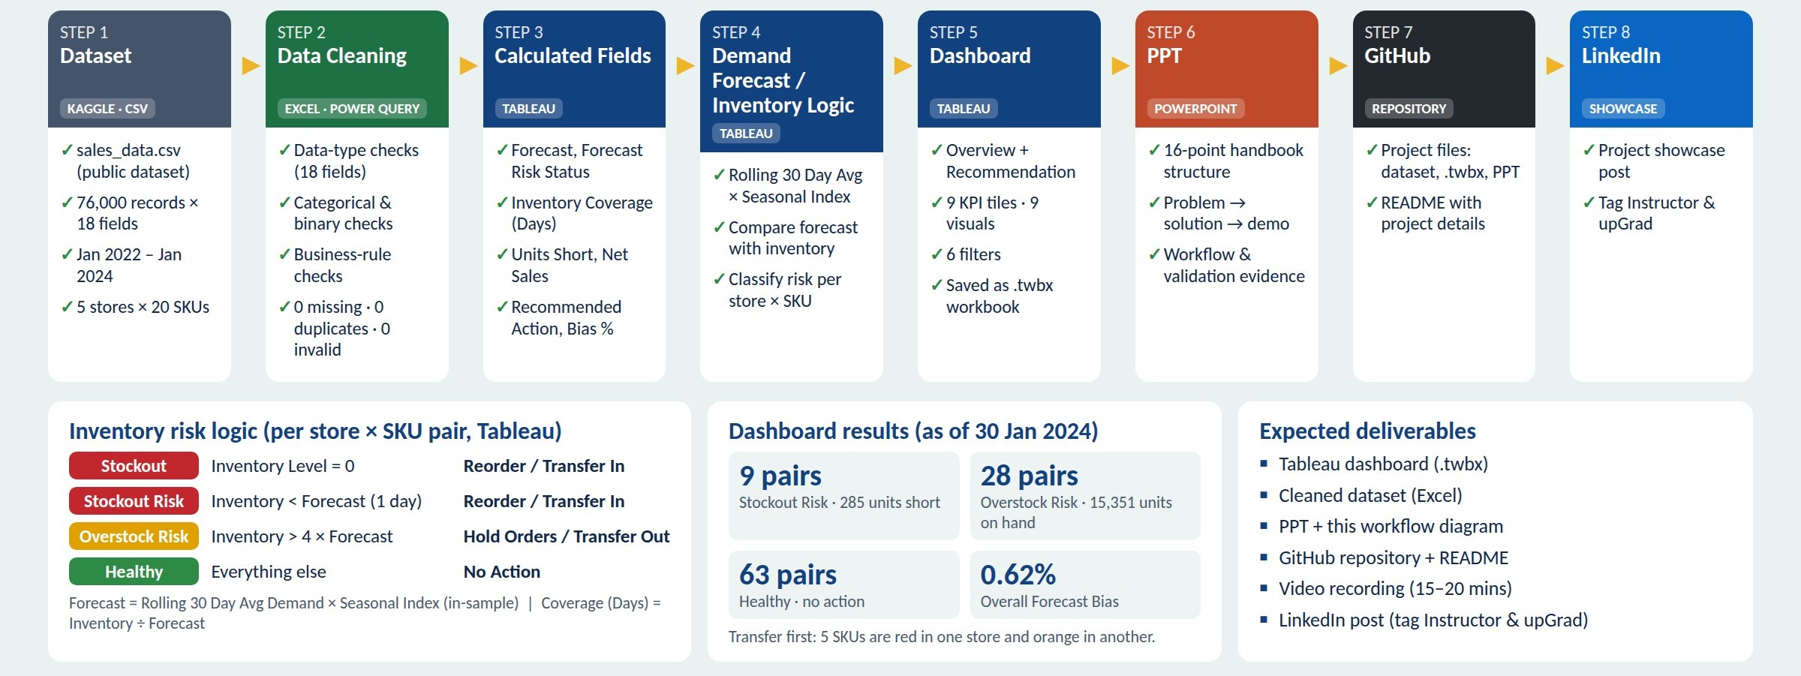
ARCHITECTURE
16. Project Workflow
From raw data to business decision support
18

Slide 19
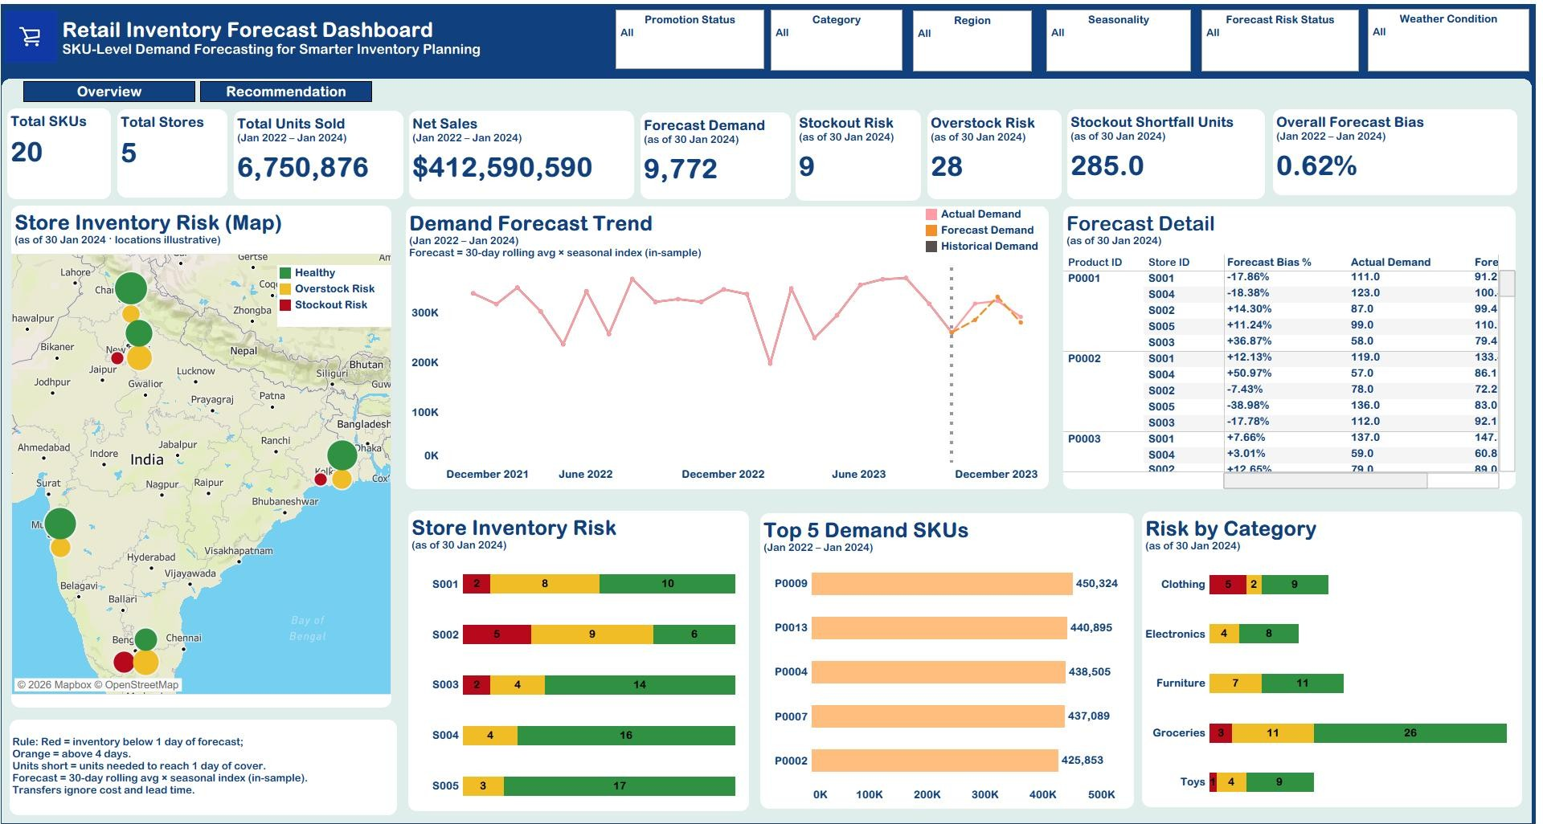
DEMONSTRATION
17. Tableau Dashboard — Overview
Executive inventory monitoring and demand forecast
19

Slide 20
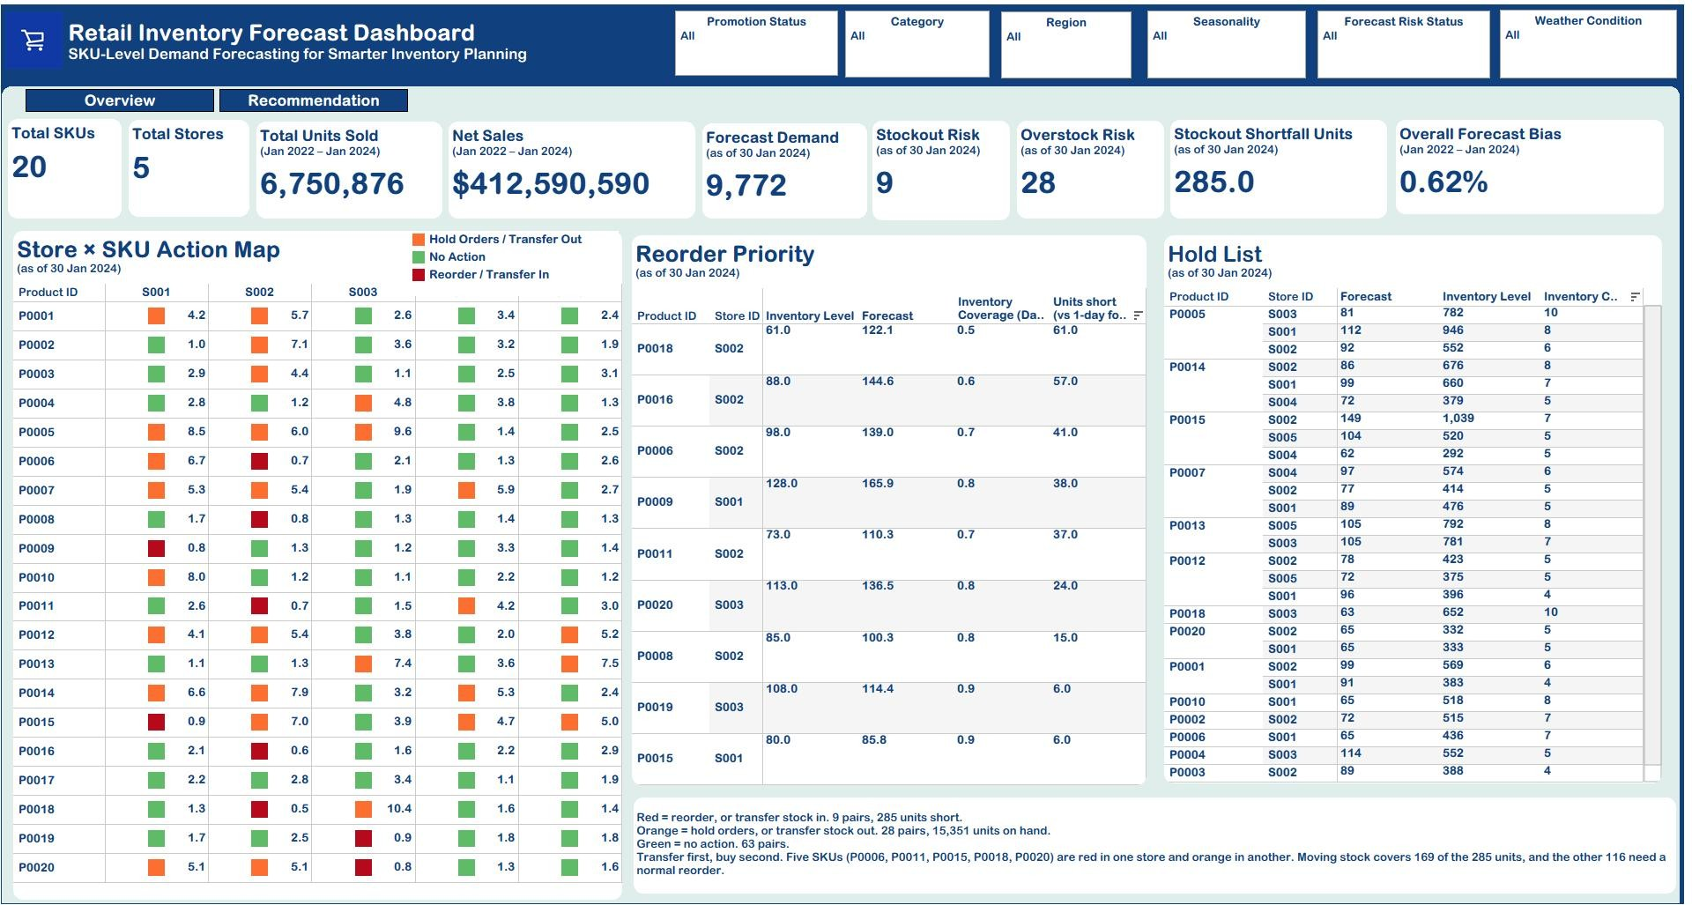
DEMONSTRATION
18. Tableau Dashboard — Recommendation
Store × SKU action map, reorder priority, and hold list
20

Slide 21
Thank You
Retail Inventory Forecast Dashboard
Forecast
Identify
Act
Estimate future SKU-level demand
Find stockout & overstock risk
Reorder, transfer, or hold

