Slide 1
DATA SCIENCE TRAINING TRACK · RETAILNOW CASE STUDY
From Messy Data to
Business Decisions
Excel data cleaning + Generative AI, applied to 415 raw RetailNow orders
415 → 400
8
10
ORDERS CLEANED
CATEGORIES STANDARDIZED
AI PROMPTS LOGGED

Slide 2
THE BUSINESS PROBLEM
One quarter of orders, and no one had cleaned it up
RetailNow is a mid-sized online retailer selling across 8 categories, Pan-India. Every quarter the Operations Manager exports raw order data, and different regional teams enter it differently. The CEO asked for clean numbers and clear recommendations before next week's leadership meeting.
KNOWN DATA ISSUES
Order Date
5+ formats mixed, plus blanks
Product Category
39 spelling/casing variants of 8 categories
415
14
Customer Name / Email
Mixed case, extra spaces, initials only, blanks
order records exported
columns per record
Region
Typos (Nort/Sout/Wast), inconsistent casing
Quantity
Text values, blanks, a suspicious 9999, negatives
15
400
Unit Price
₹ / Rs. / $ prefixes, comma separators
exact duplicate rows found
clean records after dedup
Discount (%)
Mixed number / text / percent formats
Payment / Status
Inconsistent casing and abbreviations
Customer Rating
Blanks and out-of-range values (0, 6, -1)
02

Slide 3
PART A · DATA CLEANING
The exact rule applied to every messy column
Raw data was kept untouched on its own sheet; every rule below was applied on a copy in Power Query, so the cleaning is fully auditable.
Order Date
Unit Price
Parsed 5 mixed formats (yyyy-mm-dd, mm/dd/yyyy, dd-mm-yyyy, yyyy.mm.dd, dd Mon yyyy) with format-specific Date.FromText; blanks given sequential placeholder dates from 01-Jan-2025 so no two are identical.
Stripped ₹ / Rs. / $ symbols and comma separators, then safely converted to a number; blanks and unparseable values return null.
Customer Name
Discount (%)
Trimmed extra/double spaces, applied consistent Proper Case, and derived a name from the email address when the name field was blank (e.g. shreya.das7@gmail.com → Shreya Das).
Stripped "%" and converted to decimal; caught and corrected a scale bug where "10%" and plain "10" were not landing on the same scale, so every value is now a true decimal (0–0.15).
Email
Payment Method
Blank values flagged as "Missing" rather than left blank, so incomplete records are visible without guessing an address.
Standardized COD / Credit Card / Debit Card / Net Banking / UPI across all abbreviations and casing via exact matching, with Proper Case as a fallback.
Region
Order Status
Fixed 3 exact typos (Nort/Sout/Wast → North/South/West) using whole-value matching — not substring replace, which had earlier corrupted "South" into "Southh".
Casing-only issue (DELIVERED/delivered) — Power Query's built-in Capitalize Each Word was sufficient, no custom formula needed.
Product Category
Customer Rating
39 spelling/casing variants mapped to the 8 real categories in one Custom Column step, using Text.Contains keyword matching instead of a separate merge table.
Out-of-range and blank values (0, 6, -1, blank) replaced with 1; valid ratings 1–5 kept as-is.
Quantity
Duplicate Rows
Text values converted ("two"→2); blanks, "unknown", negatives and the 9999 outlier all capped to 9, the highest genuinely valid quantity in the data.
15 exact duplicate order rows identified and removed — 415 raw rows → 400 clean rows.
03

Slide 4
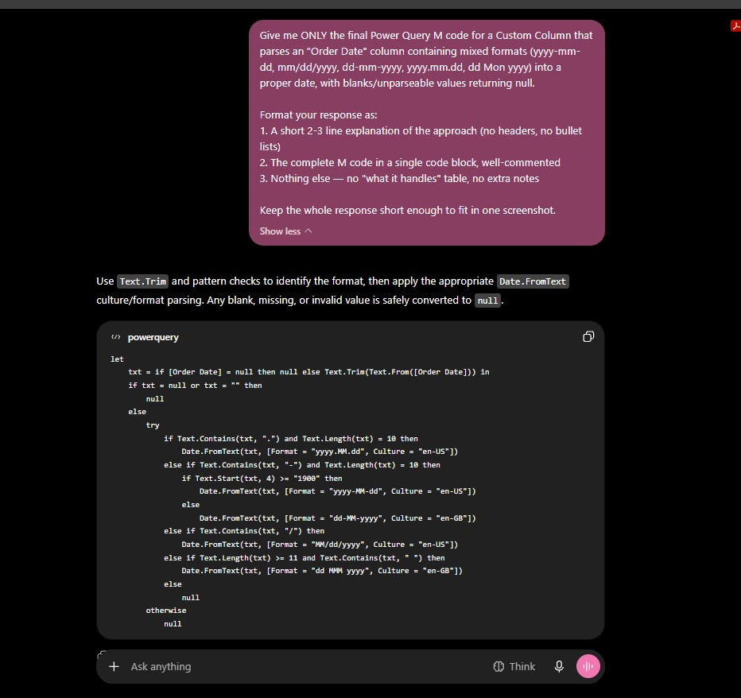
PROMPT 1
Order Date
WHAT I CHANGED FROM AI RESPONSE
I used ChatGPT's formula exactly as given, and also followed its advice, as there were mixed formats (like yyyy-mm-dd, mm/dd/yyyy, dd-mm-yyyy, yyyy.mm.dd, dd Mon yyyy) and blanks — the given formula correctly parsed all these mixed formats into one single, consistent date format and returned null for blank values. To replace the nulls with a continuous date format, I used an Index column to generate unique, sequential placeholder dates starting from 01-Jan-2025, so each originally-missing date got a distinct value instead of a repeated or fabricated single date.
10

Slide 5
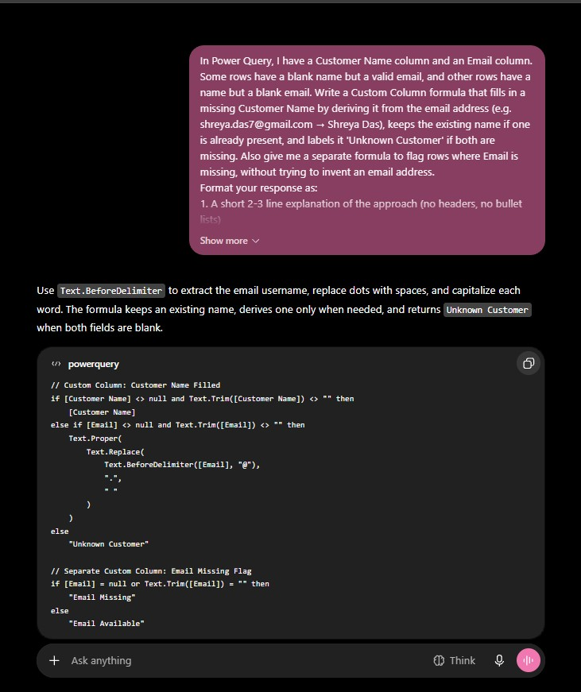
PROMPT 2
Customer Name from Email
WHAT I CHANGED FROM AI RESPONSE
The first formula ChatGPT gave me for pulling names from emails left a stray number in the derived name — for example, 'abc.xyz0@gmail.com' produced 'Abc Xyz0' instead of 'Abc Xyz'. I noticed this when I checked a few rows, so I asked for a fix that removes the trailing numbers properly before applying proper case. Later, I also used TRIM to collapse any extra/double spaces left in the Customer Name column, ensuring names like 'Abc Xyz' became 'Abc Xyz'.
11

Slide 6
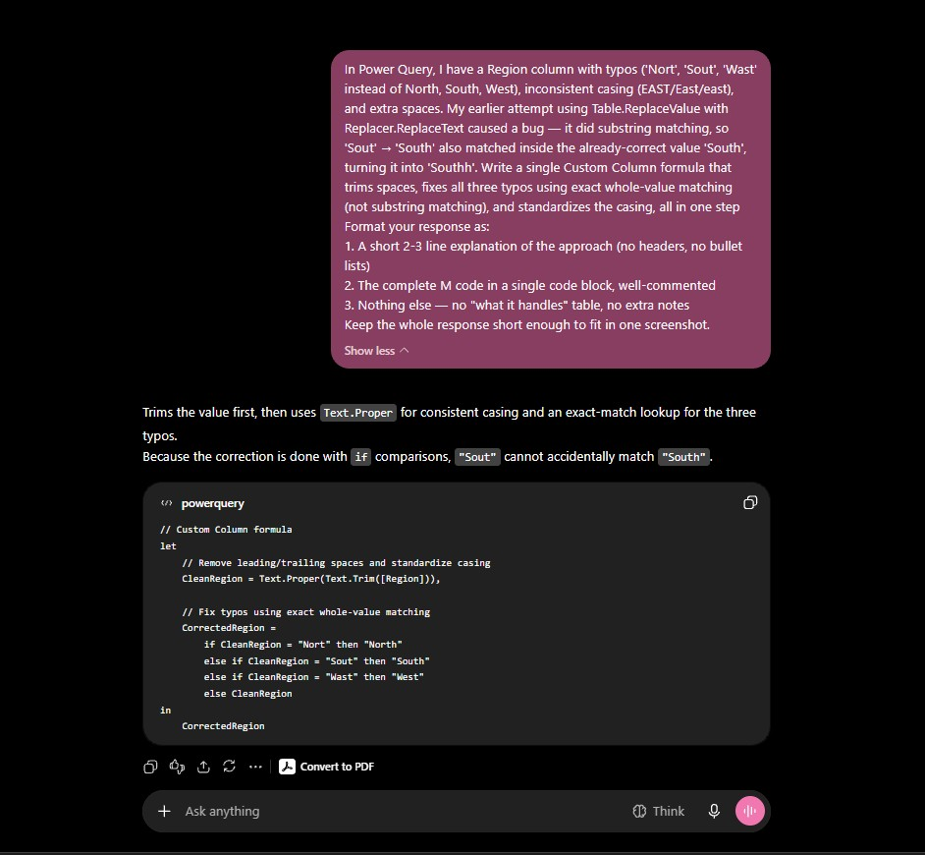
PROMPT 3
Region Spelling Error
WHAT I CHANGED FROM AI RESPONSE
I used ChatGPT's suggestion here instead of the manual Replace Values method I was using before, since that one had caused a substring bug (e.g. 'Sout' → 'South' also matching inside the already-correct 'South', turning it into 'Southh'). This new approach fixed typos ('Nort', 'Sout', 'Wast') using exact matching and standardized casing, all in a single step.
13

Slide 7
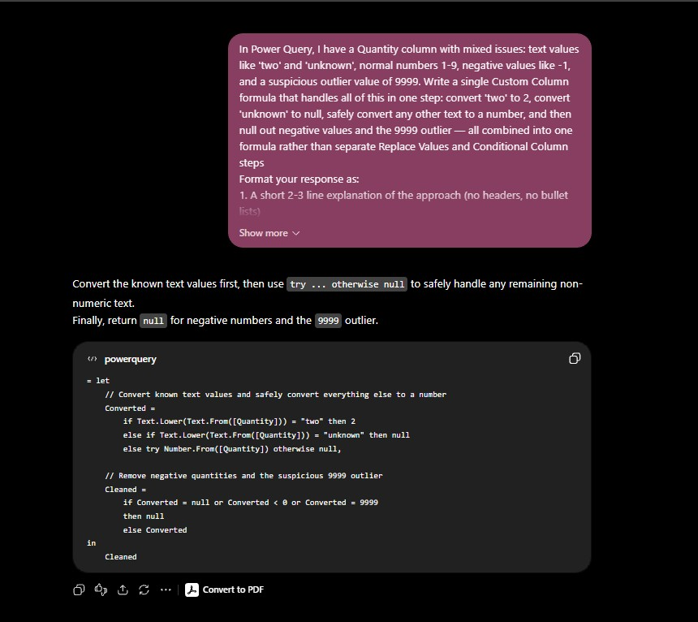
PROMPT 4
Quantity
WHAT I CHANGED FROM AI RESPONSE
I used ChatGPT's formula exactly as given — it combined everything (fixing text values, negatives, and the outlier 9999) into one step instead of doing it separately.
15

Slide 8
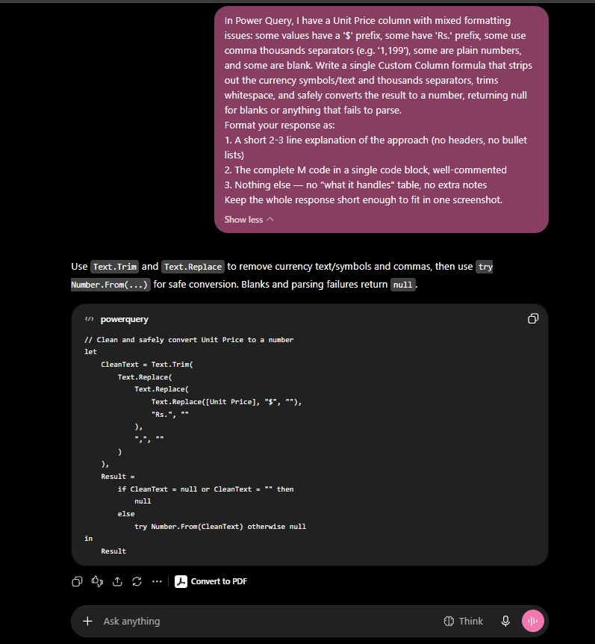
PROMPT 5
Unit Price
WHAT I CHANGED FROM AI RESPONSE
The first version of this formula would have broken on any price that was already stored as a number instead of text. I caught that and asked for a fix that safely handles both cases.
16

Slide 9
THE CLEAN NUMBERS
400 orders, one quarter, fully reconciled
₹13,55,618
400
₹3,389
TOTAL REVENUE
CLEAN ORDERS
AVERAGE ORDER VALUE
2.68 / 5
₹34,626
2.55%
AVERAGE CUSTOMER RATING
TOTAL DISCOUNT GIVEN
DISCOUNT AS % OF REVENUE
Source: Cleaned_Data pivot summary, RetailNow Q1–Q2 export (400 valid orders after de-duplication)

Slide 10
WHERE THE REVENUE COMES FROM
Apparel leads categories; West leads regions
READING THE PATTERN
Apparel (₹2.62L) is almost 3× Beauty, the lowest category (₹95K). West (₹4.07L) leads all regions; North is lowest (₹3.03L), about 25% behind. Within the matrix, Apparel-in-South is the single strongest combination (₹79.5K); Groceries-in-North is the weakest (₹15.7K).
05

Slide 11
FULFILMENT HEALTH
Only 3 in 10 orders were actually delivered
WHY THIS MATTERS
35% of orders are Cancelled or Returned combined. Overall rating is a middling 2.68/5 — Home & Kitchen customers are happiest (3.17), Books customers are least satisfied (2.33). This deserves a dedicated root-cause pass by region and category.
06

Slide 12
TIMING & PAYMENT BEHAVIOUR
November peaks, July dips; Debit Card spends the most
ORDER COUNT BY PAYMENT METHOD
COD
116
Credit Card
110
UPI
66
Net Banking
64
Debit Card
44
COD is still the single most-used method (116 orders) even though it has a lower AOV than Debit Card — cash-on-delivery trust remains strong for RetailNow's customers.
07

Slide 13
PART B · GENAI-ASSISTED INSIGHTS
What the clean numbers are telling us
1
Categories & Regions
2
Cancellations & Returns
Apparel leads (₹2.62L), Beauty trails (₹95K) — top is almost 3× bottom. West leads regions (₹4.07L), North is lowest (₹3.03L), ~25% behind. November was the peak month (₹1.63L); July was the trough (₹83.7K).
Only 29.5% of orders are Delivered. Pending (19.25%), Returned (18.5%) and Cancelled (16.5%) combine so that 35% of orders are Cancelled or Returned — a real fulfilment problem, not noise.
3
Price, Discount & Ratings
4
Payment Behaviour
Total discount is ₹34,626 — just 2.55% of revenue, so discounting is not eating into margin. Home & Kitchen has the best rating (3.17) but only mid-tier revenue; Books has the lowest rating (2.33). Overall rating (2.68/5) needs improvement.
Debit Card customers spend the most per order (₹3,718 AOV); Credit Card the least (₹3,063). COD remains the most-used method (116 orders) — many customers still prefer cash on delivery even for higher-value baskets.
08

Slide 14
CRITICAL REVIEW
Stress-testing the first draft before it reached the CEO
Draft claim: “Apparel is our best category because it has the highest revenue.”
AI's critique: revenue alone doesn't prove “best.” You'd also need profit/margin, quantity sold, and average selling price to confirm strength — and returns/cancellations, discounts, ratings, and growth over time to see what revenue alone hides.
EXECUTIVE SUMMARY
Apparel led category performance at ₹2,62,466, while Beauty trailed at ₹95,247; West was the strongest region (₹4,06,635) and North the weakest (₹3,03,463). Delivery stood at 29.5%, with 35% of orders cancelled or returned, and November recorded the peak (₹1,62,977) while July was the low point (₹83,674). Debit Card customers delivered the highest AOV (₹3,718) while COD remained popular with 116 orders. Home & Kitchen led ratings at 3.17, Books lagged at 2.33, and overall customer satisfaction (2.68) needs improvement; discounts contributed only 2.55% of revenue, with no material margin impact.
RECOMMENDATIONS FOR THE CEO
1
Audit the delivery funnel by region & category — 35% Cancelled+Returned is too high to leave unexamined before next quarter.
2
Protect and grow Apparel and the West region with dedicated stock depth and marketing spend.
3
Run a quality & pricing review for Beauty and Books — lowest revenue and lowest ratings (2.60, 2.33).
4
Plan promotions ahead of July's seasonal dip and reinforce the November peak with adequate stock.
5
Incentivize prepaid methods — Debit Card has the highest AOV (₹3,718) — while keeping COD support, since it's still the most-used method (116 orders).
09

Slide 15
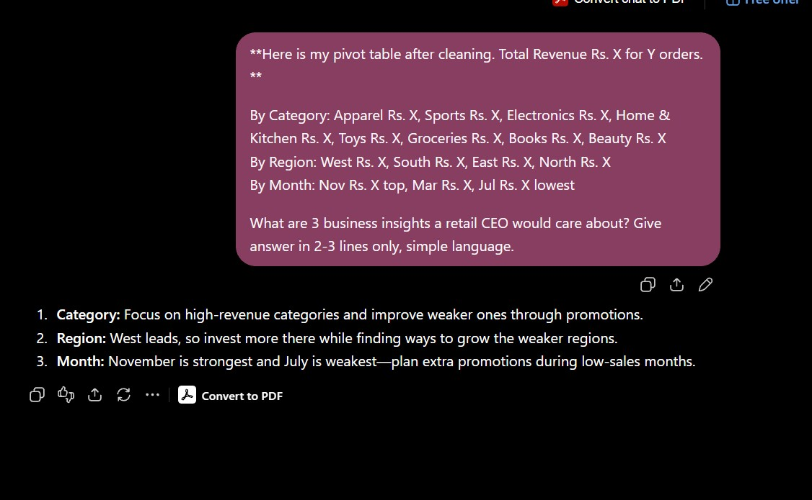
PROMPT 6
Business Insight — Category/Region
WHAT I CHANGED FROM AI RESPONSE
I pasted my real pivot insights with dummy value into AI instead of asking general question, and used AI's 3 points as base but rewrote them in my own simple language with actual Rs. values.
21

Slide 16
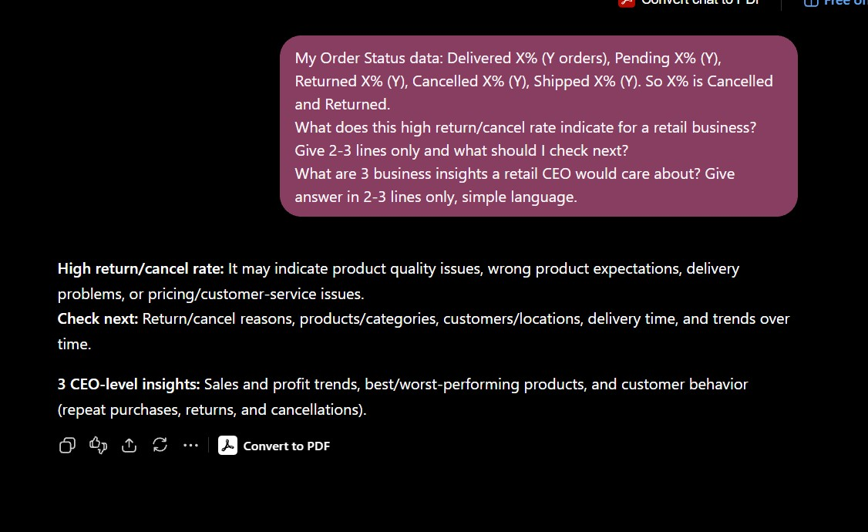
PROMPT 7
Business Insight — Cancellations Pattern
WHAT I CHANGED FROM AI RESPONSE
I pasted my real pivot insights with dummy value into AI instead of asking general question, and used AI's 3 points as base but rewrote them in my own simple language with actual Rs. values.
22

Slide 17
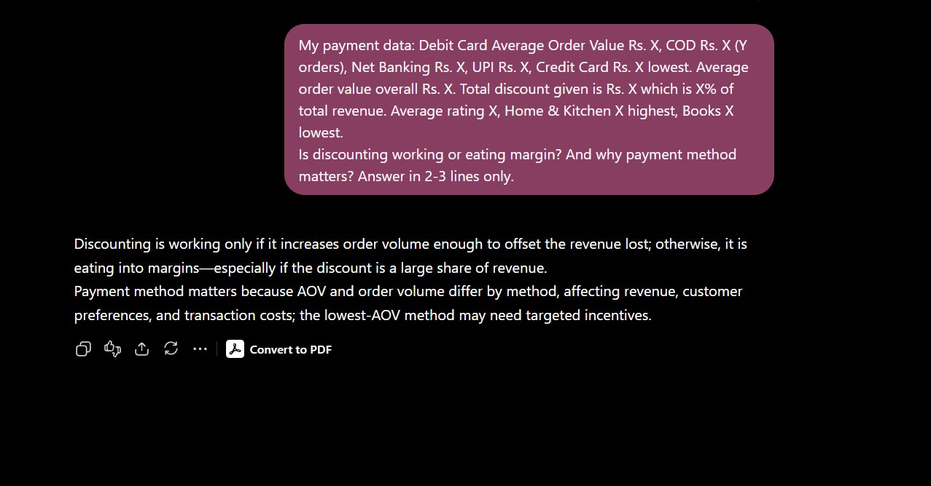
PROMPT 8
Business Insight — Pricing/Discount
WHAT I CHANGED FROM AI RESPONSE
I pasted my real pivot insights with dummy value into AI instead of asking general question, and used AI's 3 points as base but rewrote them in my own simple language with actual Rs. values.
23

Slide 18
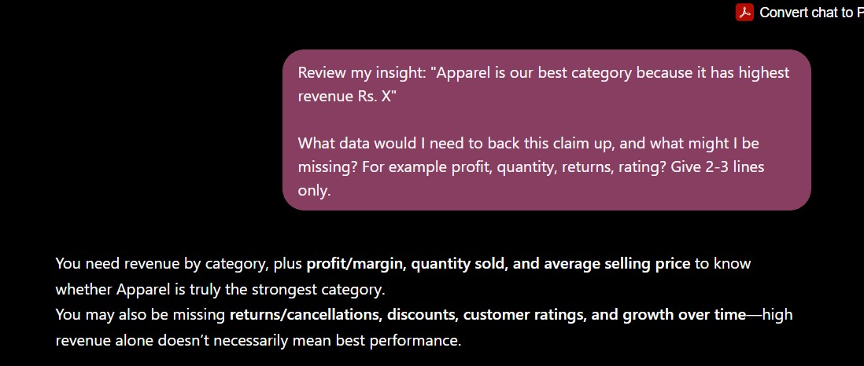
PROMPT 9
Critical Review
WHAT I CHANGED FROM AI RESPONSE
I pasted my real pivot insights with dummy value into AI instead of asking general question, and used AI's 3 points as base but rewrote them in my own simple language with actual Rs. values.
24

Slide 19
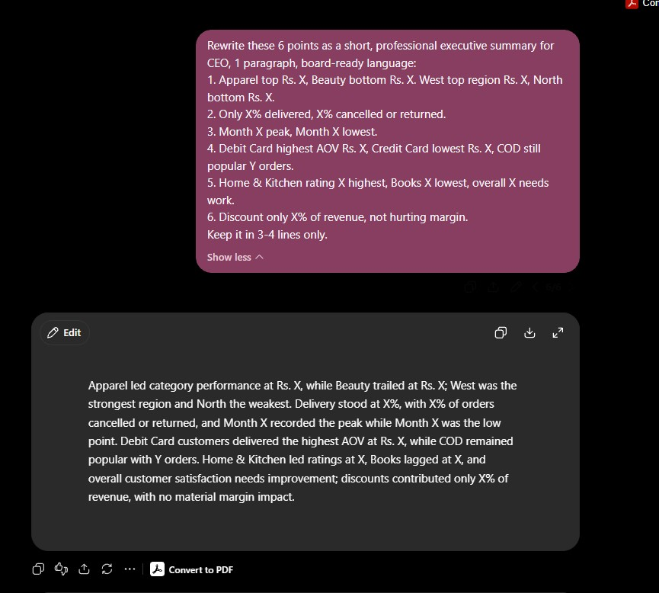
PROMPT 10
CEO Report Writing
WHAT I CHANGED FROM AI RESPONSE
I pasted my real pivot insights with dummy value into AI instead of asking general question, and used AI's 3 points as base but rewrote them in my own simple language with actual Rs. values.
25

Slide 20
Thank You

