Slide 1
Fighters of Dos
Wizards of Dos
Lanssie Ma, Timothy Storm, Nate Zhiran Chen, Robert Sun, Jesus Carillo, Jason Libbey

Slide 2
GamePlay
A 3D pvp fighting game
2 players at a time
Goal is to beat the other player while taking advantage of the pros and cons of the stages.

Slide 3
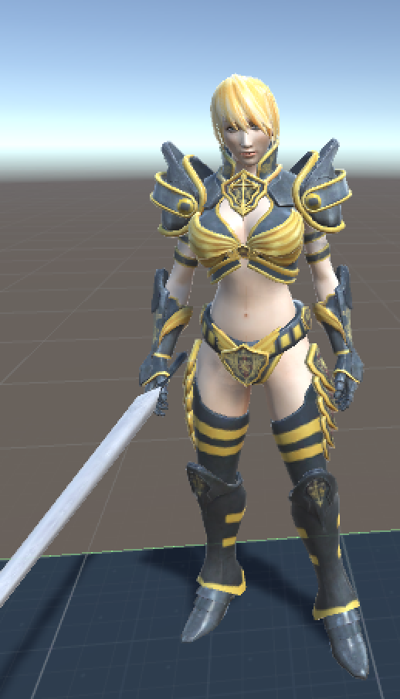
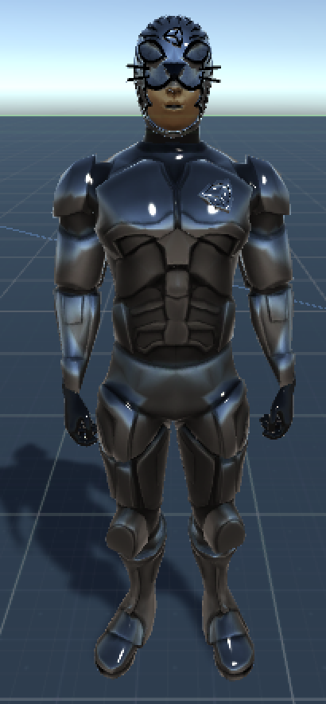
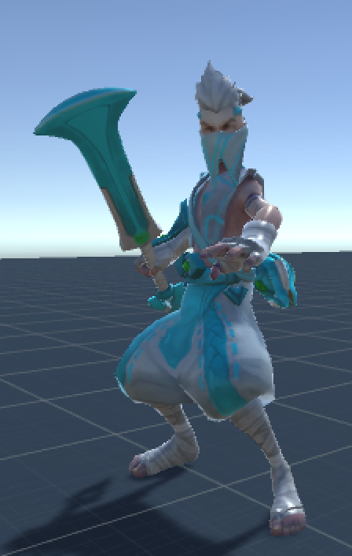
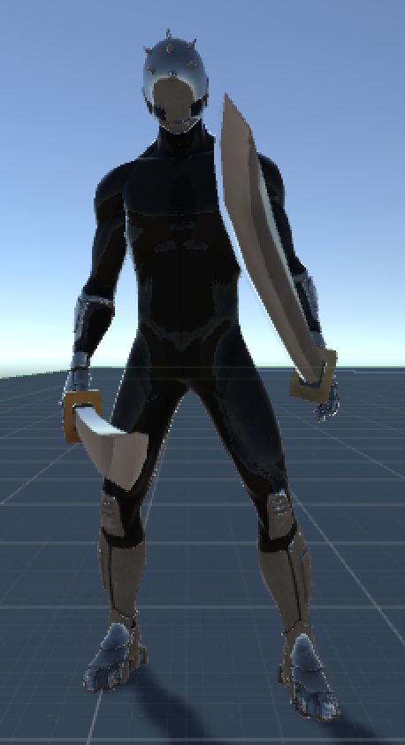
Characters
Maria
Masked Torra
Ekko
Ninja
3 attacks
Walk, Run, Jump, Attack
Ragdoll

Slide 4
Environments
Hell
Ground disappears and drops out over time.
Fireballs
Japan
Has food that gives you increase in health points.
Ice Glacier
Platforms to jump on.
Slippery
Spiders
Swamp
Swamp water hurts your health if you touch it
Center tree generates once in a while and acts as a safe haven temporarily.

Slide 5
AI
Fireballs
Spawn and seek players to attack them
Spiders
Spawn and attack players.

Slide 6
The End
Thank you!

