Slide 1


Team Details: MoveBooks AI
Team name: MoveBooks AI
  Team lead: Jincen E Mathew
  Team member: Kunal Nangia
  Contact: Pending owner input
Problem: BFSI: Intelligent Risk, Fraud & Financial Experiences
Notes:
Original official template preserved. Product/company: MoveBooks AI by Movers & Ledgers. User-confirmed team name MoveBooks AI, team lead Jincen E Mathew, team member Kunal Nangia. Contact remains pending owner input. Selected BFSI title confirmed by user in docs/submission/problem-statement.md.

Slide 2
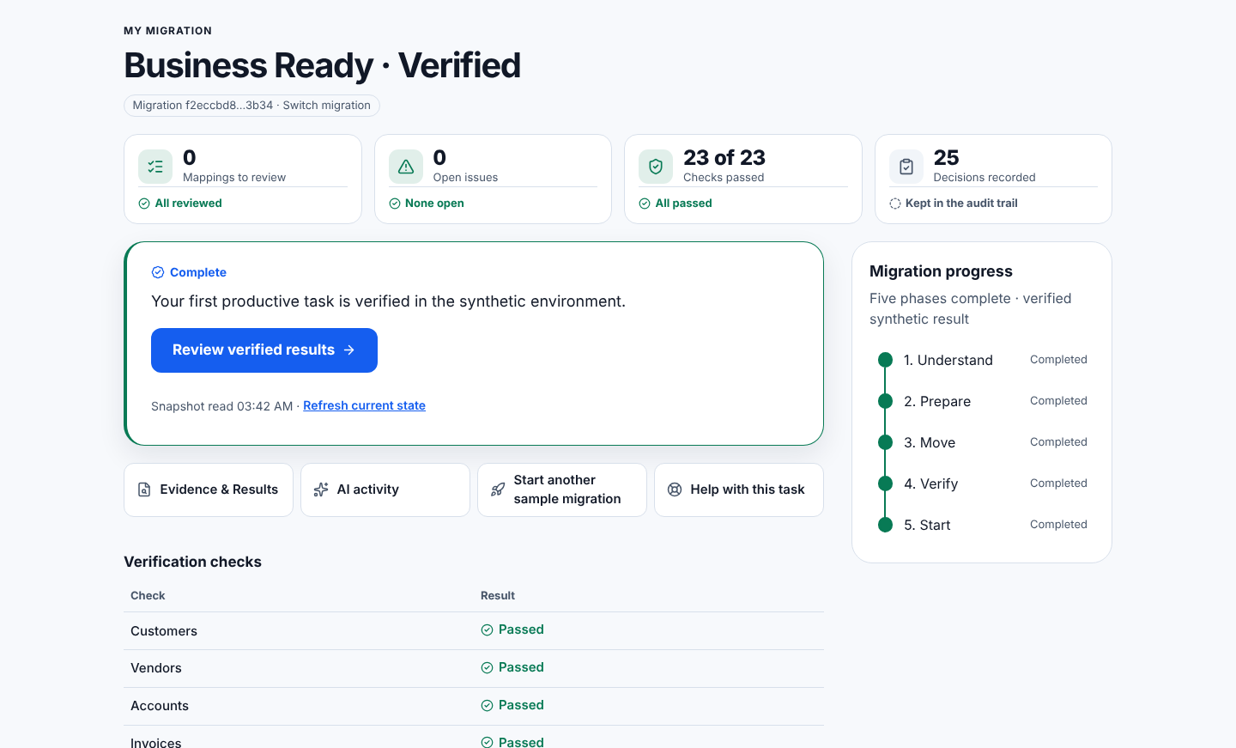
Bounded synthetic Beta.
Explore Demo, My Migration, Play and local test-package validation.
Humans approve. Deterministic tools verify.
Bounded live Gemini test passed; the public Beta stays deterministic.
Notes:
Scope statement in the template's black panel. Screenshot: My Migration completed state, local capture at fa13e9e (docs/submission/final-experience/evidence/journey-fa13e9e/full-page/my-migration-complete.png). Local demo identity and real local API; not the deployed product, not live AI.

Slide 3
Brief about the idea
MoveBooks AI
Move your books. Keep your confidence.
Help accountants understand readiness, make informed mapping decisions and verify the first productive task after a migration.
Play teaches concepts. Explore Demo rehearses Harbor Light Books. Try Your Data validates permitted test CSV/JSON packages locally.
Current boundary: synthetic information, synthetic target and approved first invoice. No real provider migration.
Notes:
Sources: docs/PRODUCT_CONSTITUTION.md; docs/working-backwards/; docs/product-management/. Value is a product hypothesis, not measured customer impact.

Slide 4
Opportunities
Financial handover risk: an import can finish while mappings, configuration or the first working task remain unresolved.
Proposed differentiation: one governed path from learning and readiness to approved decisions, reconciliation and verified productive use.
How it works: deterministic agents run the workflow; a gated Gemini Advisor explains and an independent Reviewer challenges. Humans retain financial authority.
USP hypothesis: coherent, evidence-backed migration confidence. No competitor-superiority or measured impact claim.
Notes:
Sources: product constitution and Working Backwards internal FAQ. Customer needs and competitive wedge remain hypotheses, not completed research or comparative results.

Slide 5
List of features offered by the solution
Play and My Migration: a learning mission; returning users resume or switch migrations from an owner-scoped list.
Explore Demo: discovery, readiness, versioned plan, account 1200 mapping, human decisions and synthetic migration.
Try Your Data: local validation, actionable errors, replacement/revalidation and explicit review. Hosted handoff remains gated.
Reasoning and review: user-requested bounded advisor, independent challenge and clearly labeled deterministic fallback.
Trust: checkpoints, idempotency, controlled recovery, exact reconciliation, sensitive approval and verified synthetic FPU.
Notes:
Sources: feature contracts; accepted browser traces in browser-play and browser-journey. Explicit fallback labels do not establish live model execution.

Slide 6
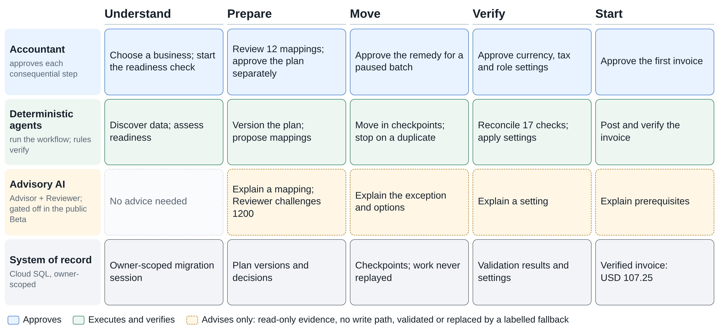
Process flow diagram or Use-case diagram
Notes:
User / agent / system swimlane. Source: docs/submission/assets/movebooks-swimlane.html (editable) and .png. Lanes match the implemented workflow (agents/orchestrator stage orchestrators, services/api reasoning and reviewer, runtime/persistence). Advisory AI is gated off in the public Beta; in the recorded demo it runs as a labelled deterministic fallback.

Slide 7
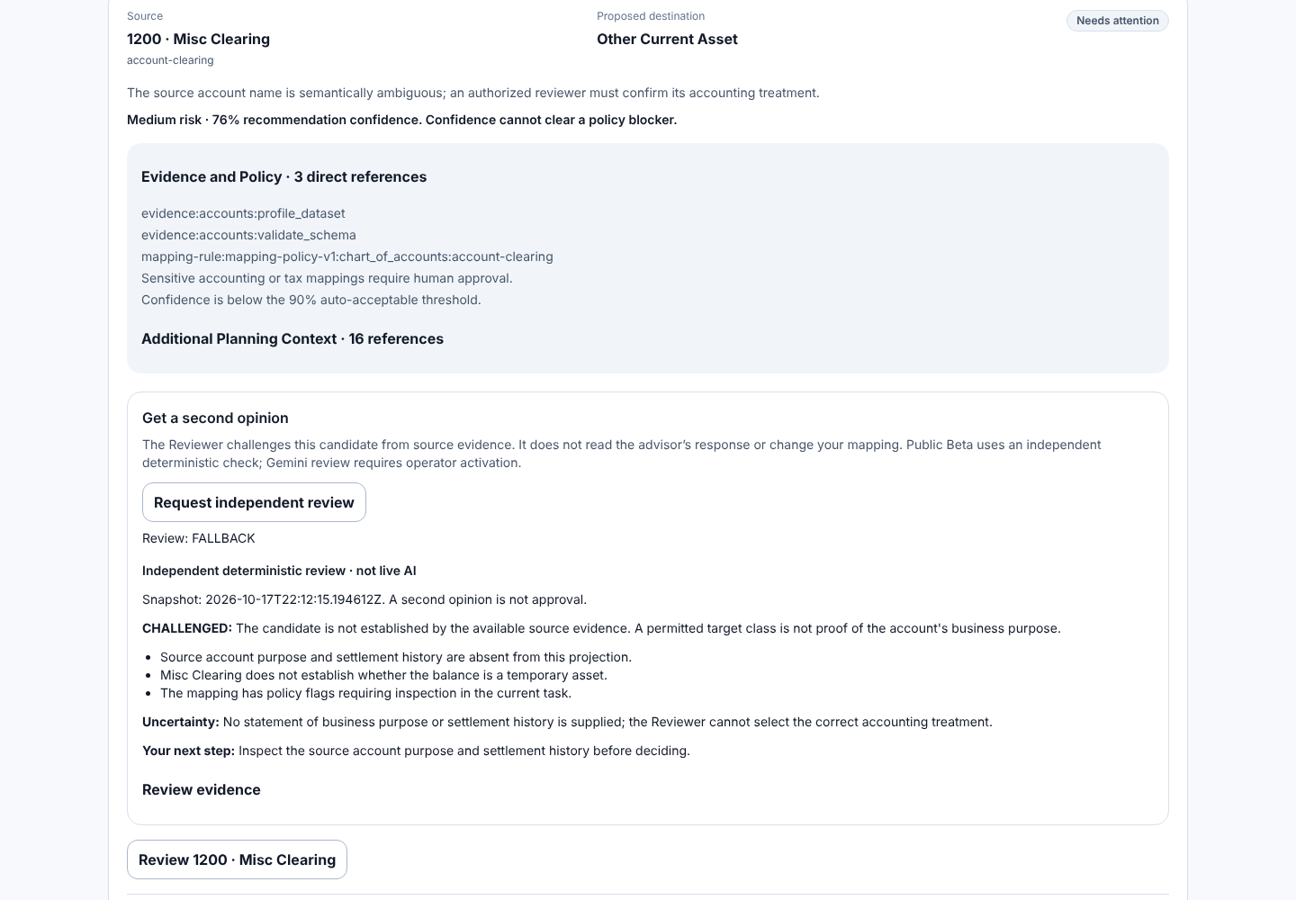
Wireframes/Mock diagrams of the proposed solution (optional)
Implemented decision UI
Inspect account 1200.
Request independent review.
See uncertainty and evidence.
Approve, reject or modify.
Authentic local candidate screenshot, not a simulated mockup or deployed-candidate claim.
Notes:
Source: evidence/journey-fa13e9e/full-page/prepare-independent-review.png. Independent deterministic review labelled not live AI; the Reviewer never sees Advisor output (offline evaluation canary check).

Slide 8
Architecture diagram of the proposed solution
Accountant / UI
Authenticated API
Python workflow
Financial tools
Cloud SQL
Human decisions
Gemini / Reviewer
Advice returns to the accountant; only deterministic operations change financial state. 13 roles, 7 ADK definitions, 2 gated model pathways, 0 autonomous agents.
Notes:
Editable native diagram. Counts are code-grounded: 13 registered roles (agents/registry.py), 7 ADK definitions (orchestrator root_agent plus 6 stage builders, not invoked by the API), 2 model-capable pathways invoked by the API (Advisor, Reviewer; gated off in the deployed Beta), 0 verified autonomous agents.

Slide 9
Technologies to be used in the solution
Application: Next.js / TypeScript UI and FastAPI / Python services, with Firebase Hosting, Cloud Run, Firebase Authentication and Cloud SQL boundaries.
AI source: bounded Vertex AI / Gemini and Google ADK advisory integration. Public API remains deterministic-only; a bounded live run on gemini-3.5-flash-lite passed 14/14.
Operational source: owner-scoped Firestore reservations and outcome readback. Dormant Singapore database, deny-client rules and index provisioned; both control flags false.
Supporting adapters: private Cloud Storage, allowlisted Secret Manager, sanitized Logging. Source presence does not prove active service use.
Notes:
Sources: architecture/deployment documents; cloud-inspection-2026-10-17.md; current user-approved dormant Phase A evidence. Phase A resource provisioning does not establish application activation, effective runtime IAM, live inference or live owner-isolation acceptance.

Slide 10
Estimated implementation cost (optional)
No measured implementation spend, current workload quote or commercial price is asserted.
Cost model: Cloud Run compute/time, SQL capacity/storage/backups, model input/output tokens, Firestore operations, storage/egress and logs.
Human effort includes financial review, support and recovery. Publish region, pricing date, workload assumptions and observed spend before a numerical estimate.
Controls bound exposure through owner quotas, conservative durable budget reservations and a kill switch. Resource free-tier metadata is not a guarantee of zero cost.
Notes:
Source: Working Backwards internal FAQ and model controls. No invented financial impact or price. Cost model intentionally remains unpriced until verified prices and workload inputs exist.

Slide 11
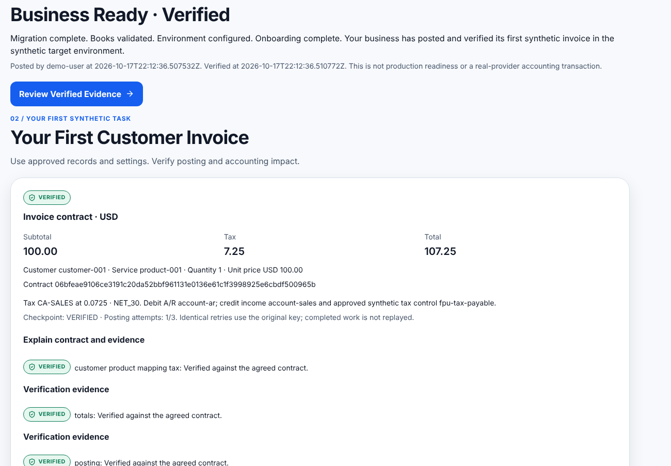
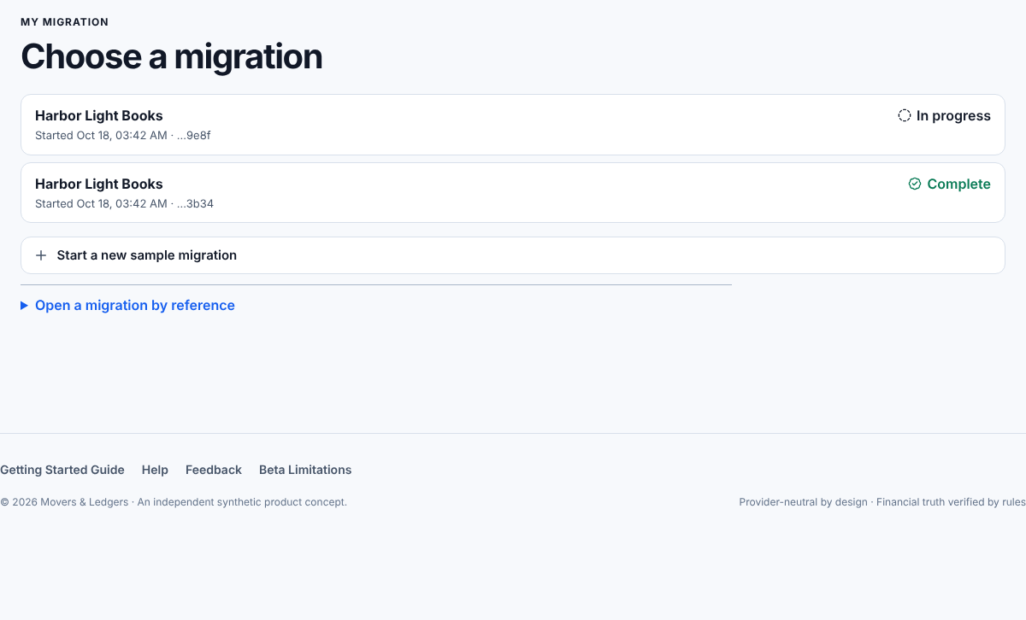
Snapshots of the prototype
Owner-scoped migration picker
Approved invoice and verified FPU
Local captures at fa13e9e on the real local API. Synthetic invoice USD 107.25 incl. tax.
Notes:
Sources: evidence/journey-fa13e9e/full-page/picker-two-migrations.png and start-verified-fpu.png. Run: 21/21 checks, real local API, demo identity, deterministic-only. No real provider accounting effect claimed.

Slide 12
Prototype Performance report/Benchmarking
663 backend passed
696 frontend passed
0 failed, 86 skipped; source 09a8d01
52 files; lint/types/build passed
Backend with all optional Google libraries installed: 663 passed, 0 failed. Without them, 26 failures, all missing-library only.
End-to-end UI journey 21/21 checks on the real local API, recorded as a 3:43.7 video. Offline Advisor/Reviewer evaluation 23/23 (boundaries, not model accuracy).
Live Gemini: one bounded Advisor + Reviewer run passed 14/14 (4 model calls). Release: candidates smoke-tested 13/13; npm and pip audits 0 known vulnerabilities.
Notes:
Backend 663 passed / 0 failed / 86 skipped at 09a8d01 in a venv with '.[cloud,agents]' installed; default sandbox lacks google-genai/firestore and shows 26 import failures. Frontend 696/52 files, typecheck, lint and production build pass. Journey and video: evidence/journey-fa13e9e. Agent evaluation: evidence/agents/offline-agent-eval.json (scripted doubles; measures validation and authority, not model quality). Release evidence: docs/release/evidence. Image scans not run here (registries blocked); they run in Cloud Shell.

Slide 13
Additional Details/Future Development (if any)
Done: bounded live Gemini test (14/14), images built and scanned, no-traffic candidates deployed and smoke-tested (13/13).
Next, release-gated: database backup, API-first promotion with recorded rollback revisions, then real Google sign-in and two-account isolation.
Hosted uploads require their independent parser-isolation, malware, identity/tenant, retention, abuse and negative-test gate. Local validation stays available.
Later: supported provider adapters, reviewed real-data handling, delegated roles and observed customer outcomes. No current real-provider migration is offered.
Notes:
Sources: product roadmap; release-authorization-plan.md. Hypothetical mature PR/FAQ never authorizes current cloud, upload or financial activation.

Slide 14
Provide links to your:
GitHub Public Repository
https://github.com/JEMathew/movers-and-ledgers
Demo Video Link
Public URL pending upload. Local file: movebooks-demo.mp4 (3:43.7, H.264), recorded on the real local API.
Final Product Link
https://movebooks-si.web.app
Reachable public Beta. This does not prove the submission candidate is deployed.
Notes:
Video file: docs/submission/assets/movebooks-demo.mp4, SHA-256 in evidence/journey-fa13e9e/recording/video-manifest.json. Public video URL is created only when the owner uploads it. Product URL reachable on 17 Oct; the integration candidate is not deployed yet.

Slide 15
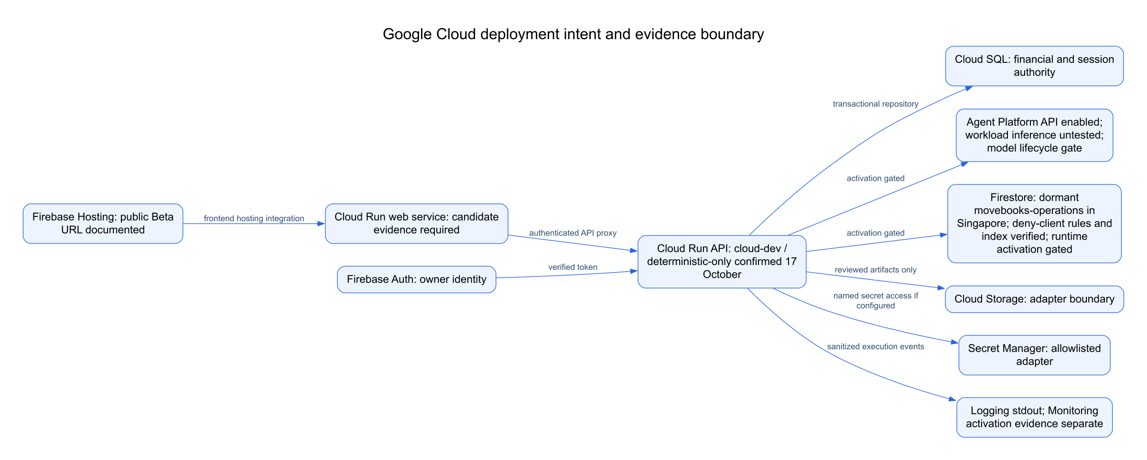
Google Cloud implementation and release gates
Dormant operations resources are provisioned. Both control flags remain false. Live inference is verified only in a bounded test harness; activation needs separate authorization.
Notes:
Exact current root-rendered architecture PNG reused. Editable source: docs/architecture-experience/source/google-cloud-deployment.mmd and SVG export. Cloud SQL remains financial authority; operational readback is not financial audit or model-success proof.

Slide 16


