Slide 1


Team Details: MoveBooks AI
Team name: MoveBooks AI
  Team lead: Jincen E Mathew
  Team member: Kunal Nangia
  Contact: Pending owner input
Problem: BFSI: Intelligent Risk, Fraud & Financial Experiences
Notes:
Original official template preserved. Product/company: MoveBooks AI by Movers & Ledgers. User-confirmed team name MoveBooks AI, team lead Jincen E Mathew, team member Kunal Nangia. Contact remains pending owner input. Selected BFSI title confirmed by user in docs/submission/problem-statement.md.

Slide 2
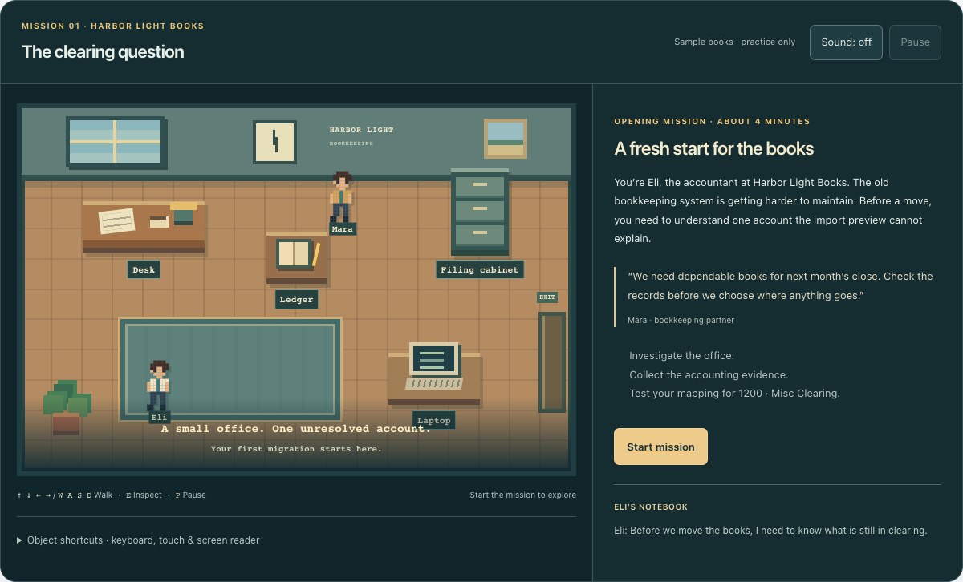
Bounded synthetic Beta.
Play, Explore Demo and local test-package validation.
Humans approve. Deterministic tools verify.
Live Gemini and operational readback remain gated.
Notes:
The template download-instruction panel is repurposed in place as the scope statement. Its black layout and image/text frames are preserved. Screenshot is accepted local candidate, not deployed product or live AI.

Slide 3
Brief about the idea
MoveBooks AI
Move your books. Keep your confidence.
Help accountants understand readiness, make informed mapping decisions and verify the first productive task after a migration.
Play teaches concepts. Explore Demo rehearses Harbor Light Books. Try Your Data validates permitted test CSV/JSON packages locally.
Current boundary: synthetic information, synthetic target and approved first invoice. No real provider migration.
Notes:
Sources: docs/PRODUCT_CONSTITUTION.md; docs/working-backwards/; docs/product-management/. Value is a product hypothesis, not measured customer impact.

Slide 4
Opportunities
Financial handover risk: an import can finish while mappings, configuration or the first working task remain unresolved.
Proposed differentiation: one governed path from learning and readiness to approved decisions, reconciliation and verified productive use.
How it works: bounded AI explains evidence and uncertainty. An independent Reviewer challenges assumptions. Humans retain financial authority.
USP hypothesis: coherent, evidence-backed migration confidence. No competitor-superiority or measured impact claim.
Notes:
Sources: product constitution and Working Backwards internal FAQ. Customer needs and competitive wedge remain hypotheses, not completed research or comparative results.

Slide 5
List of features offered by the solution
Play: keyboard/touch office mission with evidence, a mapping puzzle and accessible alternatives.
Explore Demo: discovery, readiness, versioned plan, account 1200 mapping, human decisions and synthetic migration.
Try Your Data: local validation, actionable errors, replacement/revalidation and explicit review. Hosted handoff remains gated.
Reasoning and review: user-requested bounded advisor, independent challenge and clearly labeled deterministic fallback.
Trust: checkpoints, idempotency, controlled recovery, exact reconciliation, sensitive approval and verified synthetic FPU.
Notes:
Sources: feature contracts; accepted browser traces in browser-play and browser-journey. Explicit fallback labels do not establish live model execution.

Slide 6
Process flow diagram or Use-case diagram
Choose Play, Explore Demo or local test-package validation
Understand
Prepare
Move
Verify
Start
Discover / Assess
Plan / Map / Approve
Migrate / Resolve
Validate / Configure
Onboard / FPU
Consequential choices require the authorized human. Financial discrepancies block progress. Policy alone permits bounded transient retries.
Completion: required controls pass, then an approved synthetic invoice receives deterministic verification.
Notes:
Editable native process diagram. Source: canonical lifecycle in docs/PRODUCT_CONSTITUTION.md and apps/web/components/journey/journey.ts.

Slide 7
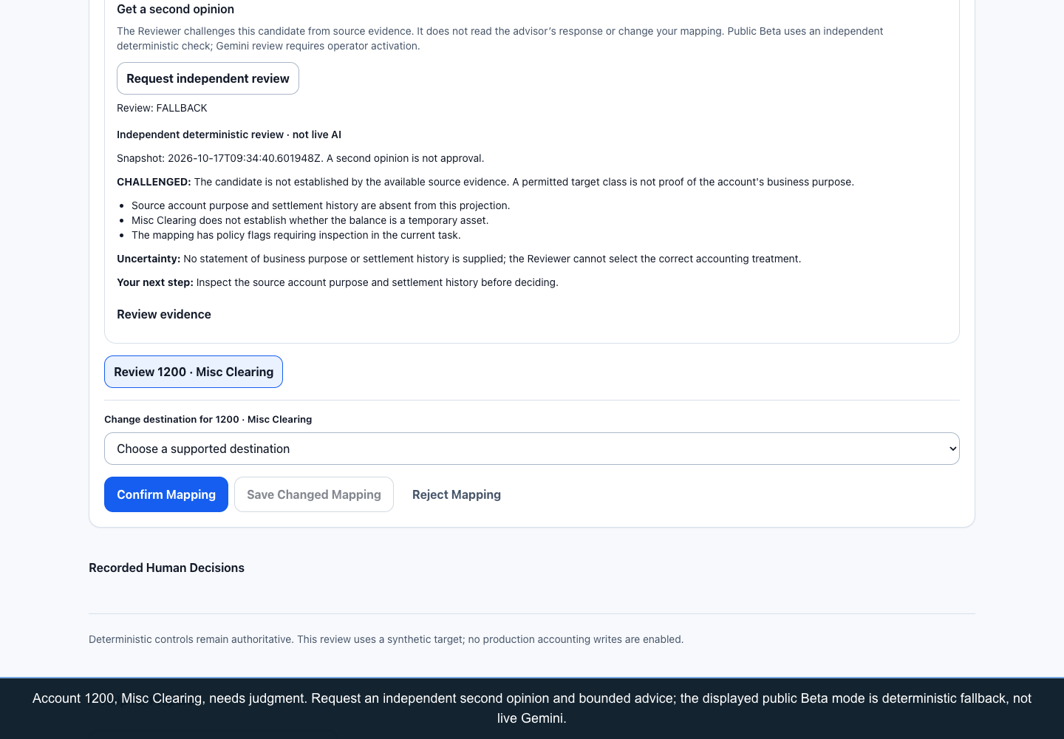
Wireframes/Mock diagrams of the proposed solution (optional)
Implemented decision UI
Inspect account 1200.
Request independent review.
See uncertainty and evidence.
Approve, reject or modify.
Authentic local candidate screenshot, not a simulated mockup or deployed-candidate claim.
Notes:
Source: docs/submission/browser-journey/dryrun/prepare-independent-review.png and the preserved crop in assets/plan-local-candidate.png. API1a24a2c full local UI acceptance17/17.

Slide 8
Architecture diagram of the proposed solution
Accountant / UI
Authenticated API
Python workflow
Financial tools
Cloud SQL
Human decisions
Gemini / Reviewer
Advice returns to the accountant. Only authorized deterministic operations change financial state. Cloud SQL remains financial authority.
Notes:
Editable native diagram. Sources: agents/orchestrator; agents/reviewer; services/api/src/movebooks_api/reasoning.py; runtime/persistence.py. Logical roles are deterministic components, not autonomous LLM delegation. Firestore operational state is separate from financial audit.

Slide 9
Technologies to be used in the solution
Application: Next.js / TypeScript UI and FastAPI / Python services, with Firebase Hosting, Cloud Run, Firebase Authentication and Cloud SQL boundaries.
AI source: bounded Vertex AI / Gemini and Google ADK advisory integration. Public API remains deterministic-only; model access/lifecycle and runtime evidence are gated.
Operational source: owner-scoped Firestore reservations and outcome readback. Dormant Singapore database, deny-client rules and index provisioned; both control flags false.
Supporting adapters: private Cloud Storage, allowlisted Secret Manager, sanitized Logging. Source presence does not prove active service use.
Notes:
Sources: architecture/deployment documents; cloud-inspection-2026-10-17.md; current user-approved dormant Phase A evidence. Phase A resource provisioning does not establish application activation, effective runtime IAM, live inference or live owner-isolation acceptance.

Slide 10
Estimated implementation cost (optional)
No measured implementation spend, current workload quote or commercial price is asserted.
Cost model: Cloud Run compute/time, SQL capacity/storage/backups, model input/output tokens, Firestore operations, storage/egress and logs.
Human effort includes financial review, support and recovery. Publish region, pricing date, workload assumptions and observed spend before a numerical estimate.
Controls bound exposure through owner quotas, conservative durable budget reservations and a kill switch. Resource free-tier metadata is not a guarantee of zero cost.
Notes:
Source: Working Backwards internal FAQ and model controls. No invented financial impact or price. Cost model intentionally remains unpriced until verified prices and workload inputs exist.

Slide 11
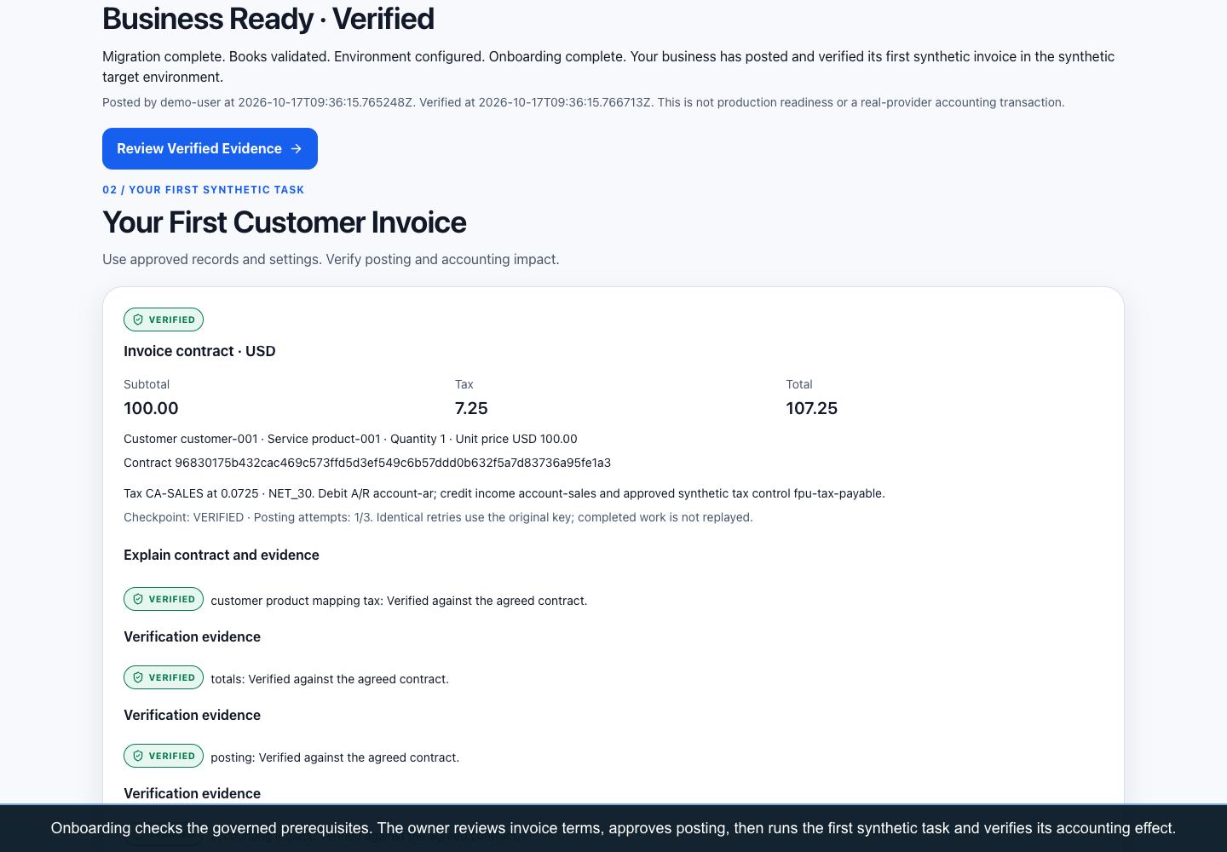
Snapshots of the prototype
Playable office opening mission
Approved invoice and verified FPU
Authentic local candidate captures. The synthetic invoice is USD 107.25 including tax.
Notes:
Source screenshots: browser-play/play-desktop-opening.png; browser-journey/dryrun/start-verified-fpu.png; accepted crops in assets/. Play14/14 checks, full journey17/17 on API1a24a2c. No real provider accounting effect claimed.

Slide 12
Prototype Performance report/Benchmarking
628 backend passed
674 frontend passed
71 skipped; source 6575004
51 files; lint/types/build passed
Full backend suite: 628 passed / 71 skipped in 28.95 seconds. The 58 original optional/external checks remain unverified.
The 13 emulator skips passed separately in 3.04 seconds, plus 8 actual Firebase Web SDK denial checks. These are local, not cloud/IAM tests.
UI acceptance 17/17 belongs to 1a24a2c; video API fffd14c remains separate. Judge: 18 offline contract cases, not model-accuracy results.
Notes:
Current local backend source6575004: docs/submission/evidence/backend-phase-b-tests.txt, 628 passed /71 skipped in28.95seconds. Of71skips,13emulator tests passed separately13/13in3.04seconds;58original optional/external checks remain unverified.8actualFirebaseWebSDKdeny checks passed locally. Frontend674/51files unchanged. FullUI17/17is historical1a24a2c; video runtimefffd14c. Judge18offline contract cases are not accuracy. No cloud/IAM/inference claim.

Slide 13
Additional Details/Future Development (if any)
Now: complete the official-template package, complete the pending contact field, retain accepted synthetic journeys and finish local Phase B integration tests.
Next, release-gated: verify the operational runtime and model lifecycle/access, then obtain explicit deployment/publication authorization.
Hosted uploads require their independent parser-isolation, malware, identity/tenant, retention, abuse and negative-test gate. Local validation stays available.
Later: supported provider adapters, reviewed real-data handling, delegated roles and observed customer outcomes. No current real-provider migration is offered.
Notes:
Sources: product roadmap; release-authorization-plan.md. Hypothetical mature PR/FAQ never authorizes current cloud, upload or financial activation.

Slide 14
Provide links to your:
GitHub Public Repository
https://github.com/JEMathew/movers-and-ledgers
Demo Video Link
Public URL pending authorized publication. Accepted local file: working-product-demo.webm (3:51.88).
Final Product Link
https://movebooks-si.web.app
Reachable public Beta. This does not prove the submission candidate is deployed.
Notes:
URLs verified public/reachable on17 October2026 by integration owner. Candidate publication and deployment remain separate. Accepted video API runtimefffd14c; full latest-source local acceptance1a24a2c recorded separately. Official template itself labels video3Minutes; user-provided portal requirement is3–4minutes, met by3:51.88.

Slide 15
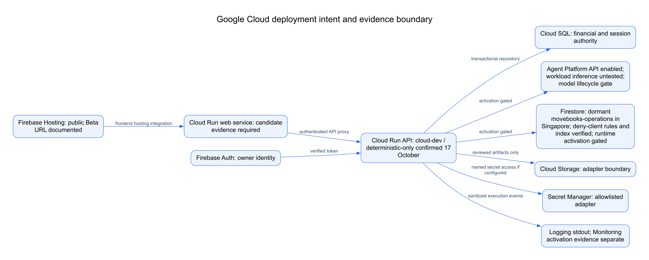
Google Cloud implementation and release gates
Dormant operations resources are provisioned. Both control flags remain false. Application activation, live inference and candidate deployment require separate evidence and authorization.
Notes:
Exact current root-rendered architecture PNG reused. Editable source: docs/architecture-experience/source/google-cloud-deployment.mmd and SVG export. Cloud SQL remains financial authority; operational readback is not financial audit or model-success proof.

Slide 16


