Slide 1
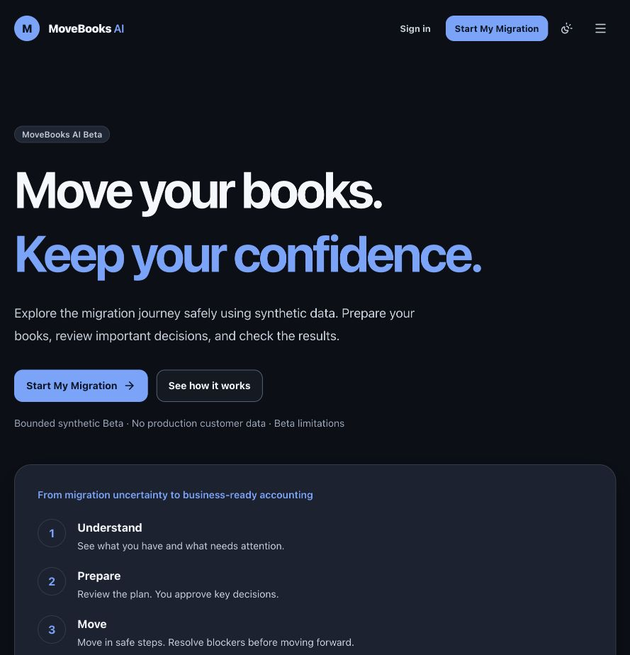
MoveBooks AI
Move your books.
Keep your confidence.
Movers & Ledgers
Accounting migration, from understanding
to verified first productive use
MOVEBOOKS AI / BOUNDED SYNTHETIC BETA
01
Notes:
Source: docs/PRODUCT_CONSTITUTION.md; docs/working-backwards/product-press-release.md. Draft content deck. Exact prescribed template missing and compliance unresolved.

Slide 2
Team and delivery scope
Movers & Ledgers develops MoveBooks AI as an independent product concept.
The submission candidate combines product, engineering, financial systems, AI evaluation and release responsibilities.
Team names, roles and contact details await the submission owner.
MOVEBOOKS AI / BOUNDED SYNTHETIC BETA
02
Notes:
Team roster/contact not provided in source material. Do not infer named contributors from role titles.

Slide 3
The accounting handover problem
A completed import does not show whether the books are ready for work.
Accountants need to understand unsupported records, ambiguous mappings and financial differences.
The proposed outcome is an informed, approved and verified first productive task.
BFSI fit: trustworthy financial migration and onboarding. Exact selected challenge statement pending.
MOVEBOOKS AI / BOUNDED SYNTHETIC BETA
03
Notes:
Source: product directive; docs/PRODUCT_CONSTITUTION.md. Problem needs are strategy hypotheses, not completed customer research. Exact official BFSI challenge wording pending.

Slide 4
The product idea
One governed journey
Understand and prepare with evidence before making consequential decisions.
Move supported synthetic information with checkpoints and safe recovery.
Verify financial correctness, configure the environment and complete an approved first invoice.
MOVEBOOKS AI / BOUNDED SYNTHETIC BETA
04
Notes:
Source: docs/product-management/blueprint.md; feature-contracts.md. Current scope bounded synthetic Beta.

Slide 5
Differentiation
Continuity from learning and readiness to financial verification and productive adoption.
A human accountant controls consequential choices. Gemini explains. A separate Reviewer challenges.
Deterministic tools establish financial truth, while internal Judges evaluate quality outside the execution path.
MOVEBOOKS AI / BOUNDED SYNTHETIC BETA
05
Notes:
Source: docs/working-backwards/internal-faq.md. Differentiation is a positioning hypothesis. No measured competitor superiority claimed.

Slide 6
Three entry experiences
Play
Explore Demo
Try Your Data
A playable office mission for learning migration concepts.
A complete Harbor Light Books synthetic migration rehearsal.
Validation of permitted test packages. Hosted uploads remain separately gated.
All paths preserve the same financial and approval boundaries.
MOVEBOOKS AI / BOUNDED SYNTHETIC BETA
06
Notes:
Source: docs/product-management/feature-contracts.md. New Play and browser-local intake candidate acceptance pending.

Slide 7
Migration process
01
02
03
04
05
Understand
Prepare
Move
Verify
Start
Discover and assess
Plan, map and approve
Migrate and resolve
Reconcile and configure
Onboard and verified FPU
Progress follows evidence and valid state transitions. Financial discrepancies stop the journey.
MOVEBOOKS AI / BOUNDED SYNTHETIC BETA
07
Notes:
Source: docs/architecture-experience/source/customer-journey.mmd; docs/PRODUCT_CONSTITUTION.md.

Slide 8
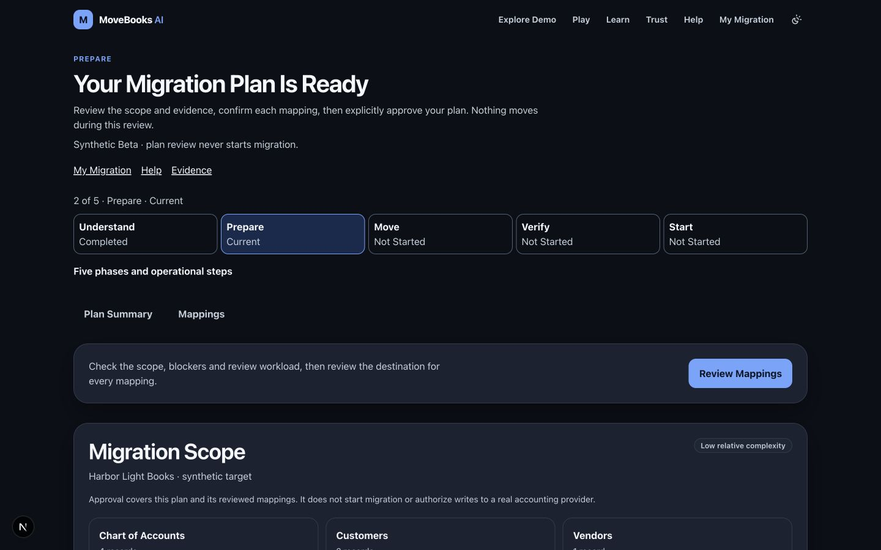
Decision experience and wireframes
Evidence first
What is happening?
Why is it happening?
What happens next?
Historical implemented UI evidence; final candidate capture pending.
MOVEBOOKS AI / BOUNDED SYNTHETIC BETA
08
Notes:
Source: docs/ux-v2/pr05/after-prepare-1440.jpg. Authentic historical candidate screenshot, not a wireframe or proof of this sprint deployment.

Slide 9
Technical architecture
Accountant and UI
Authenticated API
Deterministic workflow
Human decisions
Gemini / Reviewer
Financial tools / SQL
Advisory output returns to the accountant. Only authorized deterministic operations change financial state.
MOVEBOOKS AI / BOUNDED SYNTHETIC BETA
09
Notes:
Source: docs/architecture/beta-v1-agent-architecture.md; google-native-runtime.md. Diagram depicts implementation boundaries; cloud activation evidence is separate.

Slide 10
Google Cloud technologies
Firebase Hosting, Firebase Authentication and Cloud Run form the application and identity boundaries.
Cloud SQL / PostgreSQL retains financial and transactional authority. Cloud Storage and Secret Manager have scoped adapter boundaries.
Vertex AI / Gemini and Google ADK supply bounded advisory integration. Firestore operational controls remain separately activation-gated.
Last known public mode: deterministic-only. Vertex API enablement alone does not prove inference access.
MOVEBOOKS AI / BOUNDED SYNTHETIC BETA
10
Notes:
Source: docs/deployment/public-beta.md; docs/architecture/google-native-runtime.md; user last-known infrastructure facts. No new live verification claimed.

Slide 11
Implementation cost model
A bounded cost model precedes activation
Compute and database: runtime seconds, memory, SQL capacity, storage and backups.
AI and operations: model tokens, Firestore operations, logs, storage and egress.
Service effort: support, financial review and recovery. Owner quotas, durable budgets and a kill switch bound exposure.
Estimate status: unpriced. Publish currency, region, pricing date, workload assumptions and observed spend before asserting cost.
MOVEBOOKS AI / BOUNDED SYNTHETIC BETA
11
Notes:
Source: docs/working-backwards/internal-faq.md. No measured spend, current price quote, workload volumes or commercial price available.

Slide 12
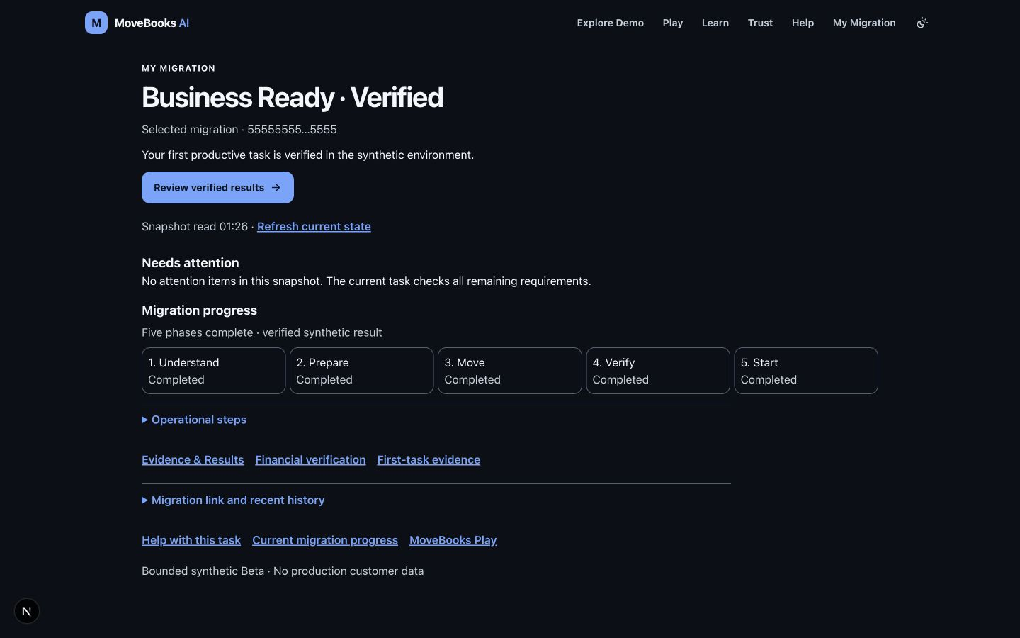
Financial verification and first productive use
Verified outcome
Required controls pass.
The owner approves a synthetic invoice.
A deterministic receipt verifies its effect.
MOVEBOOKS AI / BOUNDED SYNTHETIC BETA
12
Notes:
Source: docs/ux-v2/pr04/after-verified-1440.jpg; agents/orchestrator/onboard_fpu.py; tests/test_onboard_fpu.py. Historical authentic screenshot.

Slide 13
Benchmarking and validation
Baseline backend tests
What the evidence covers
521 passed
Owner/approval boundaries
State transitions and replay
Recovery and reconciliation
Synthetic FPU
58 skipped
Historical local baseline, not candidate acceptance or user impact. No external provider benchmark or model accuracy claim.
MOVEBOOKS AI / BOUNDED SYNTHETIC BETA
13
Notes:
Source: root integration-owner report baseline local backend521 passed58 skipped,17 October2026; named tests. Candidate run and external benchmarking pending.

Slide 14
Future roadmap
Now: accept the synthetic journey, Play mission, local intake, mapping review, offline evaluation and submission evidence.
Next, gated: verify live Gemini and Firestore operations; complete independent hosted-upload safety and operating controls.
Later: reviewed provider adapters, real-data handling, delegated roles and observed customer outcomes.
MOVEBOOKS AI / BOUNDED SYNTHETIC BETA
14
Notes:
Source: docs/product-management/blueprint.md section10. Planned work is not credited as deployed.

Slide 15
Submission links and evidence
Working Beta
https://movebooks-si.web.app
Public source
github.com/JEMathew/movers-and-ledgers
Evidence package
Working Backwards, PM blueprint, editable diagrams and candidate acceptance manifest
Release completion requires the official template, portal checks, accepted candidate evidence and an authentic 3–4 minute video.
MOVEBOOKS AI / BOUNDED SYNTHETIC BETA
15
Notes:
Source URLs: README.md and docs/deployment/public-beta.md. Current permissions/version to be verified by release owner. Exact official template and final working-video link still missing.

