Slide 1
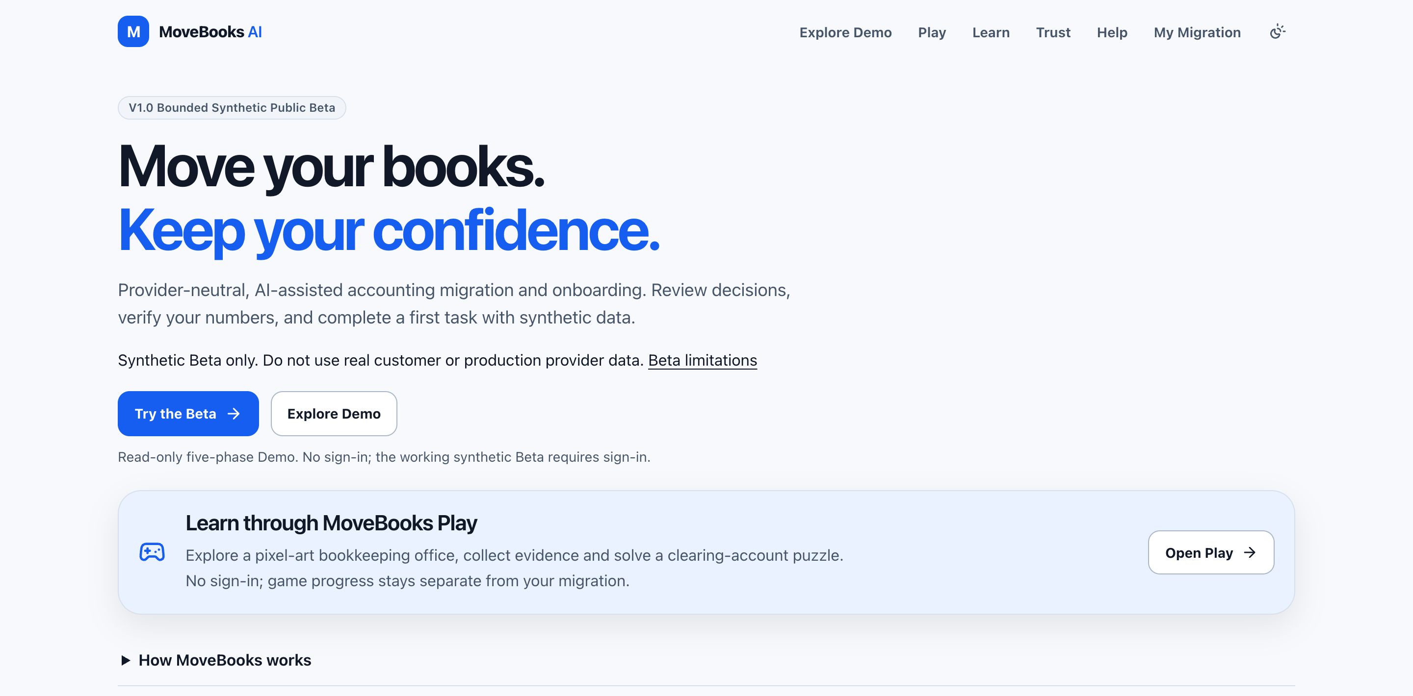
01 Product landing
MoveBooks AI / Actual local UI / Synthetic Beta / Gemini runtime unverified
A bounded synthetic Beta with a clear route into the product.
Notes:
Real application rendering captured 2026-10-18T13:07:43.444Z. Source worktree delivery/submission-integration at aacd3a50409bb2ea3e95329405e3871669cb7572. Route /. Browser viewport 1440×800, device scale factor 2. Viewport cropped to 1440×710 to exclude conceptual vision media. Existing local development preview and local memory API. Source commit is the inspected working tree, not an attestation of an immutable server binary. No mocked responses or fabricated UI. Only the Next.js development indicator was hidden. All workflow records, account names, invoices, identifiers and approvals are synthetic. UI labels such as Agent refer to the implementation's bounded deterministic workflow, not verified model-driven execution. External browser requests and reasoning endpoints were blocked. No live inference or production provider calls were triggered. Screenshot SHA-256 a6bc5d3d963d9f4f9a59743895232abf018cfd5fa0f3cd56d784a5f8592720f7. Image objects can be repositioned/resized/replaced in PowerPoint. Titles, maturity labels and captions are editable native text. Screenshot UI pixels are not editable controls. No production accounting integration, hosted file processing or cloud acceptance claim. 7 headings rendered; zero browser runtime errors. Full safe endpoint-status evidence in screenshot-manifest.json.

Slide 2
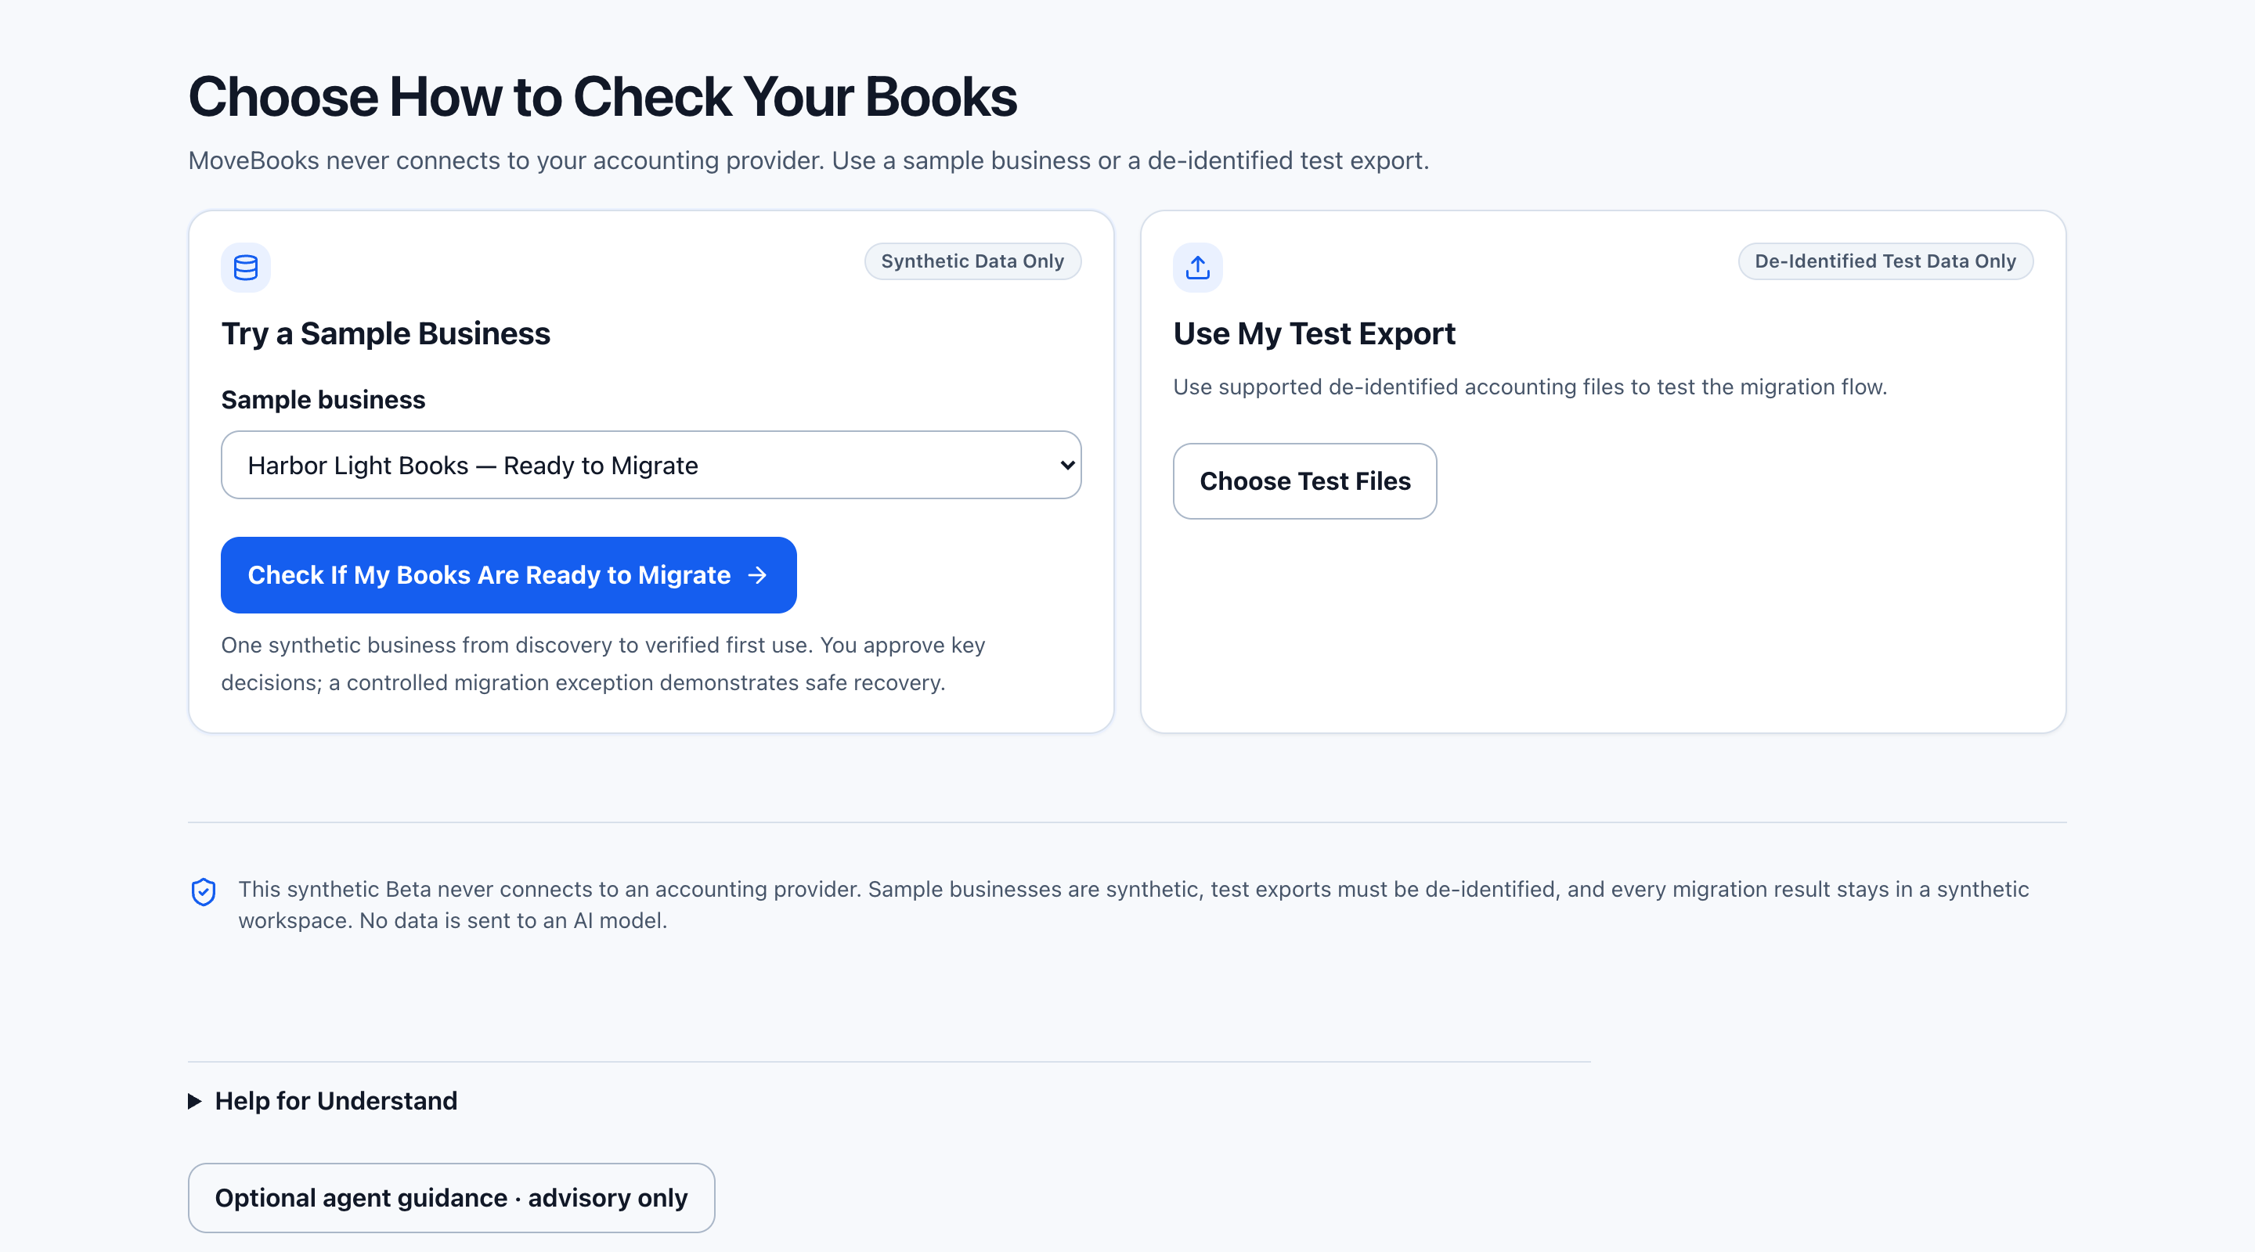
02 Discovery journey
MoveBooks AI / Actual local UI / Synthetic Beta / Gemini runtime unverified
Select a synthetic source business and capture migration context.
Notes:
Real application rendering captured 2026-10-18T13:07:43.444Z. Source worktree delivery/submission-integration at aacd3a50409bb2ea3e95329405e3871669cb7572. Route /assess?sample=harbor-light-migrate-demo. Browser viewport 1440×800, device scale factor 2. Uncropped 1440×800 viewport. Existing local development preview and local memory API. Source commit is the inspected working tree, not an attestation of an immutable server binary. No mocked responses or fabricated UI. Only the Next.js development indicator was hidden. All workflow records, account names, invoices, identifiers and approvals are synthetic. UI labels such as Agent refer to the implementation's bounded deterministic workflow, not verified model-driven execution. External browser requests and reasoning endpoints were blocked. No live inference or production provider calls were triggered. Screenshot SHA-256 01c02caa7b35b59087638d65344990b9a03d82d3f4dda0a162021a2ef4641775. Image objects can be repositioned/resized/replaced in PowerPoint. Titles, maturity labels and captions are editable native text. Screenshot UI pixels are not editable controls. No production accounting integration, hosted file processing or cloud acceptance claim. 4 headings rendered; zero browser runtime errors. Full safe endpoint-status evidence in screenshot-manifest.json.

Slide 3
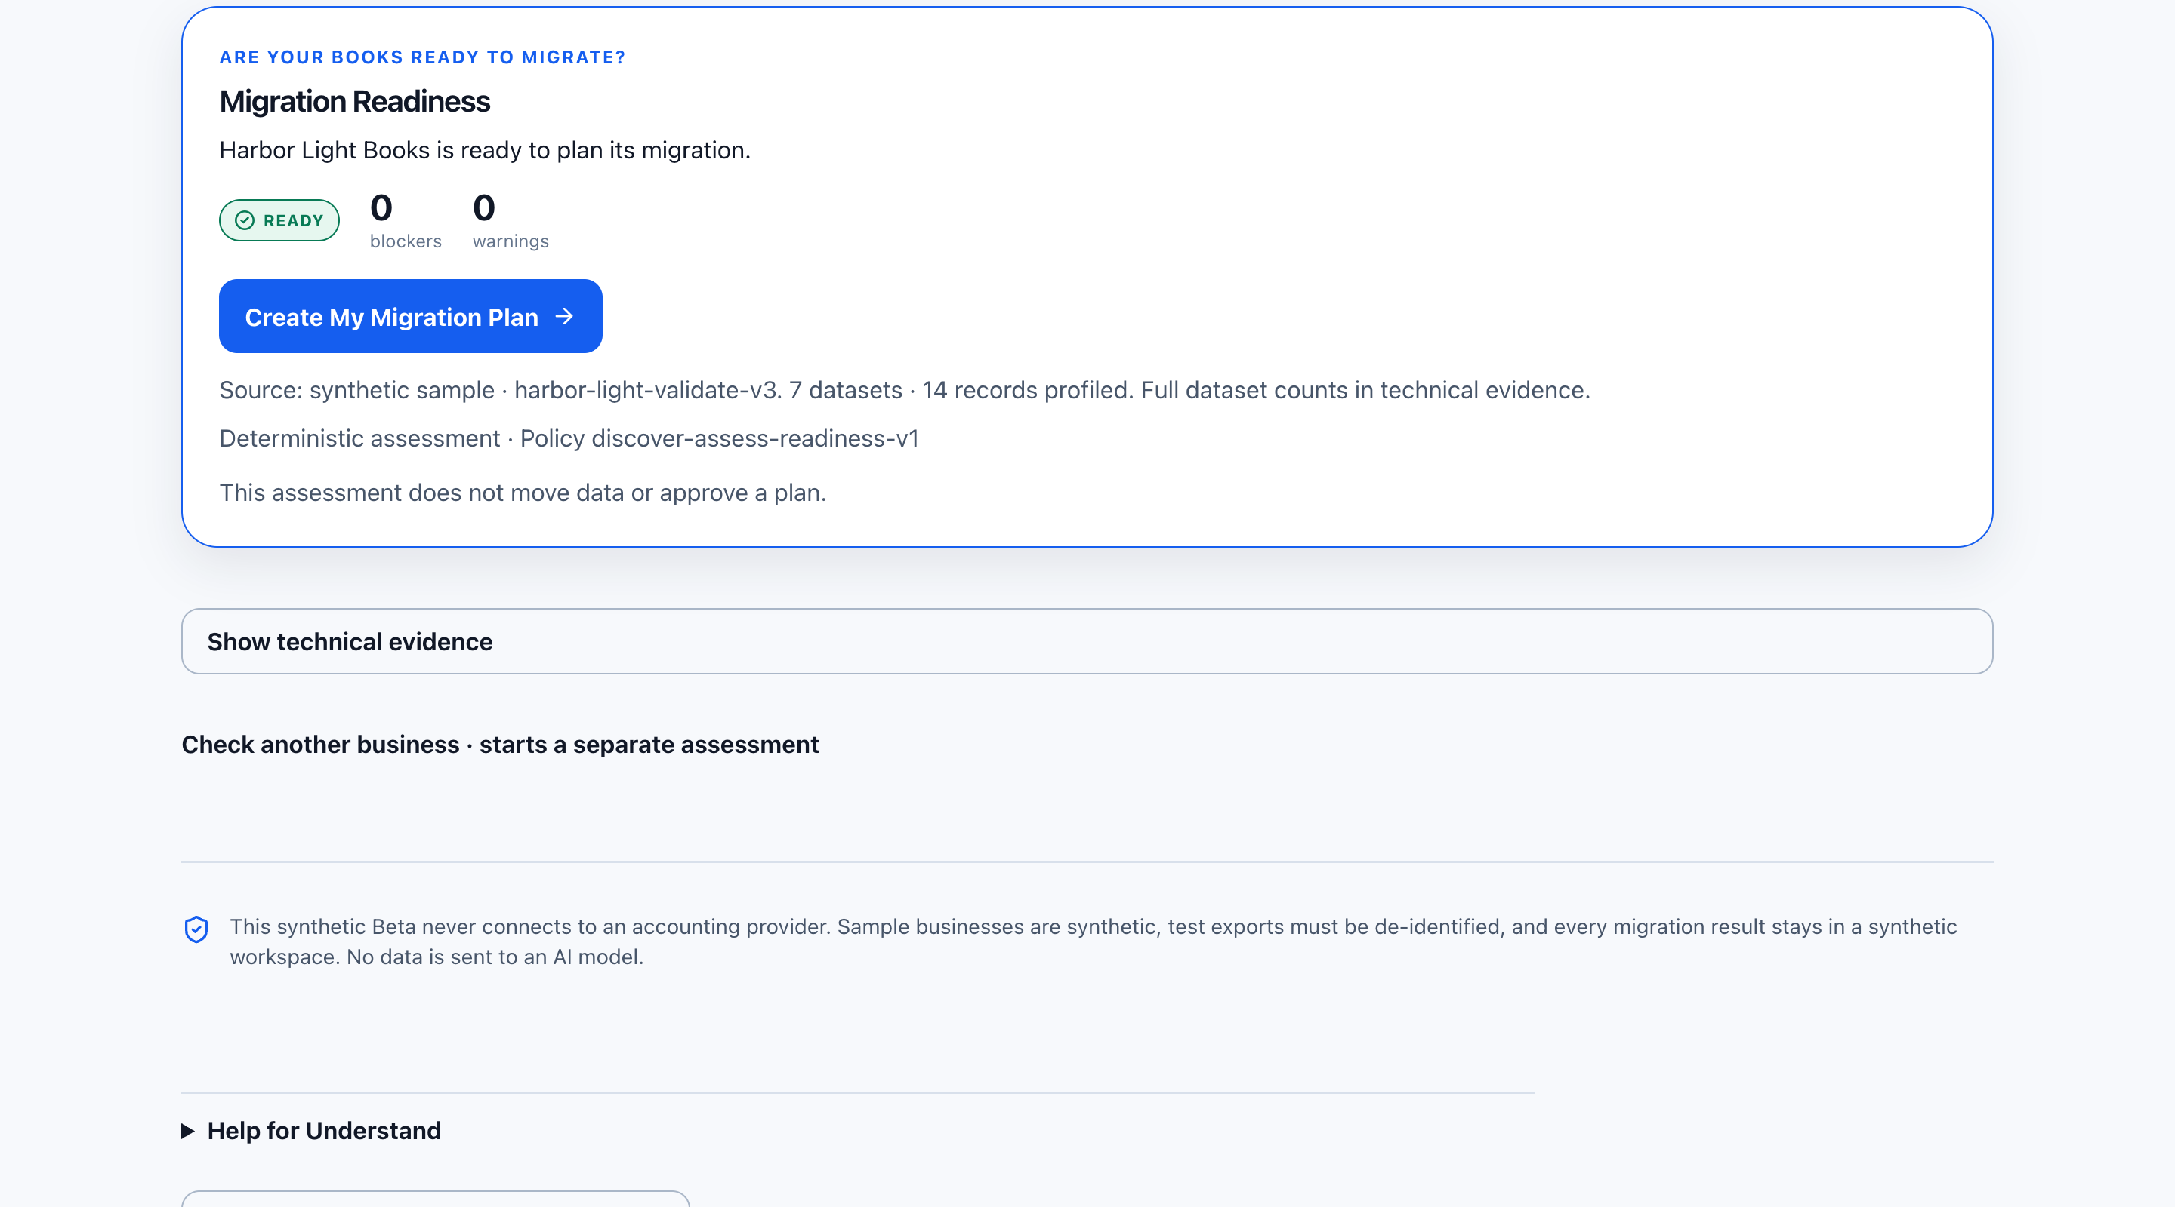
03 Assessment and readiness
MoveBooks AI / Actual local UI / Synthetic Beta / Gemini runtime unverified
Understand readiness findings before preparing a migration plan.
Notes:
Real application rendering captured 2026-10-18T13:07:43.444Z. Source worktree delivery/submission-integration at aacd3a50409bb2ea3e95329405e3871669cb7572. Route /assess?session=<synthetic-session>. Browser viewport 1440×800, device scale factor 2. Uncropped 1440×800 viewport. Existing local development preview and local memory API. Source commit is the inspected working tree, not an attestation of an immutable server binary. No mocked responses or fabricated UI. Only the Next.js development indicator was hidden. All workflow records, account names, invoices, identifiers and approvals are synthetic. UI labels such as Agent refer to the implementation's bounded deterministic workflow, not verified model-driven execution. External browser requests and reasoning endpoints were blocked. No live inference or production provider calls were triggered. Screenshot SHA-256 b39dc56b29bdb83d6f993db895cfa2770f95df6853f8c394b5131e6014cd827e. Image objects can be repositioned/resized/replaced in PowerPoint. Titles, maturity labels and captions are editable native text. Screenshot UI pixels are not editable controls. No production accounting integration, hosted file processing or cloud acceptance claim. 2 headings rendered; zero browser runtime errors. Full safe endpoint-status evidence in screenshot-manifest.json.

Slide 4
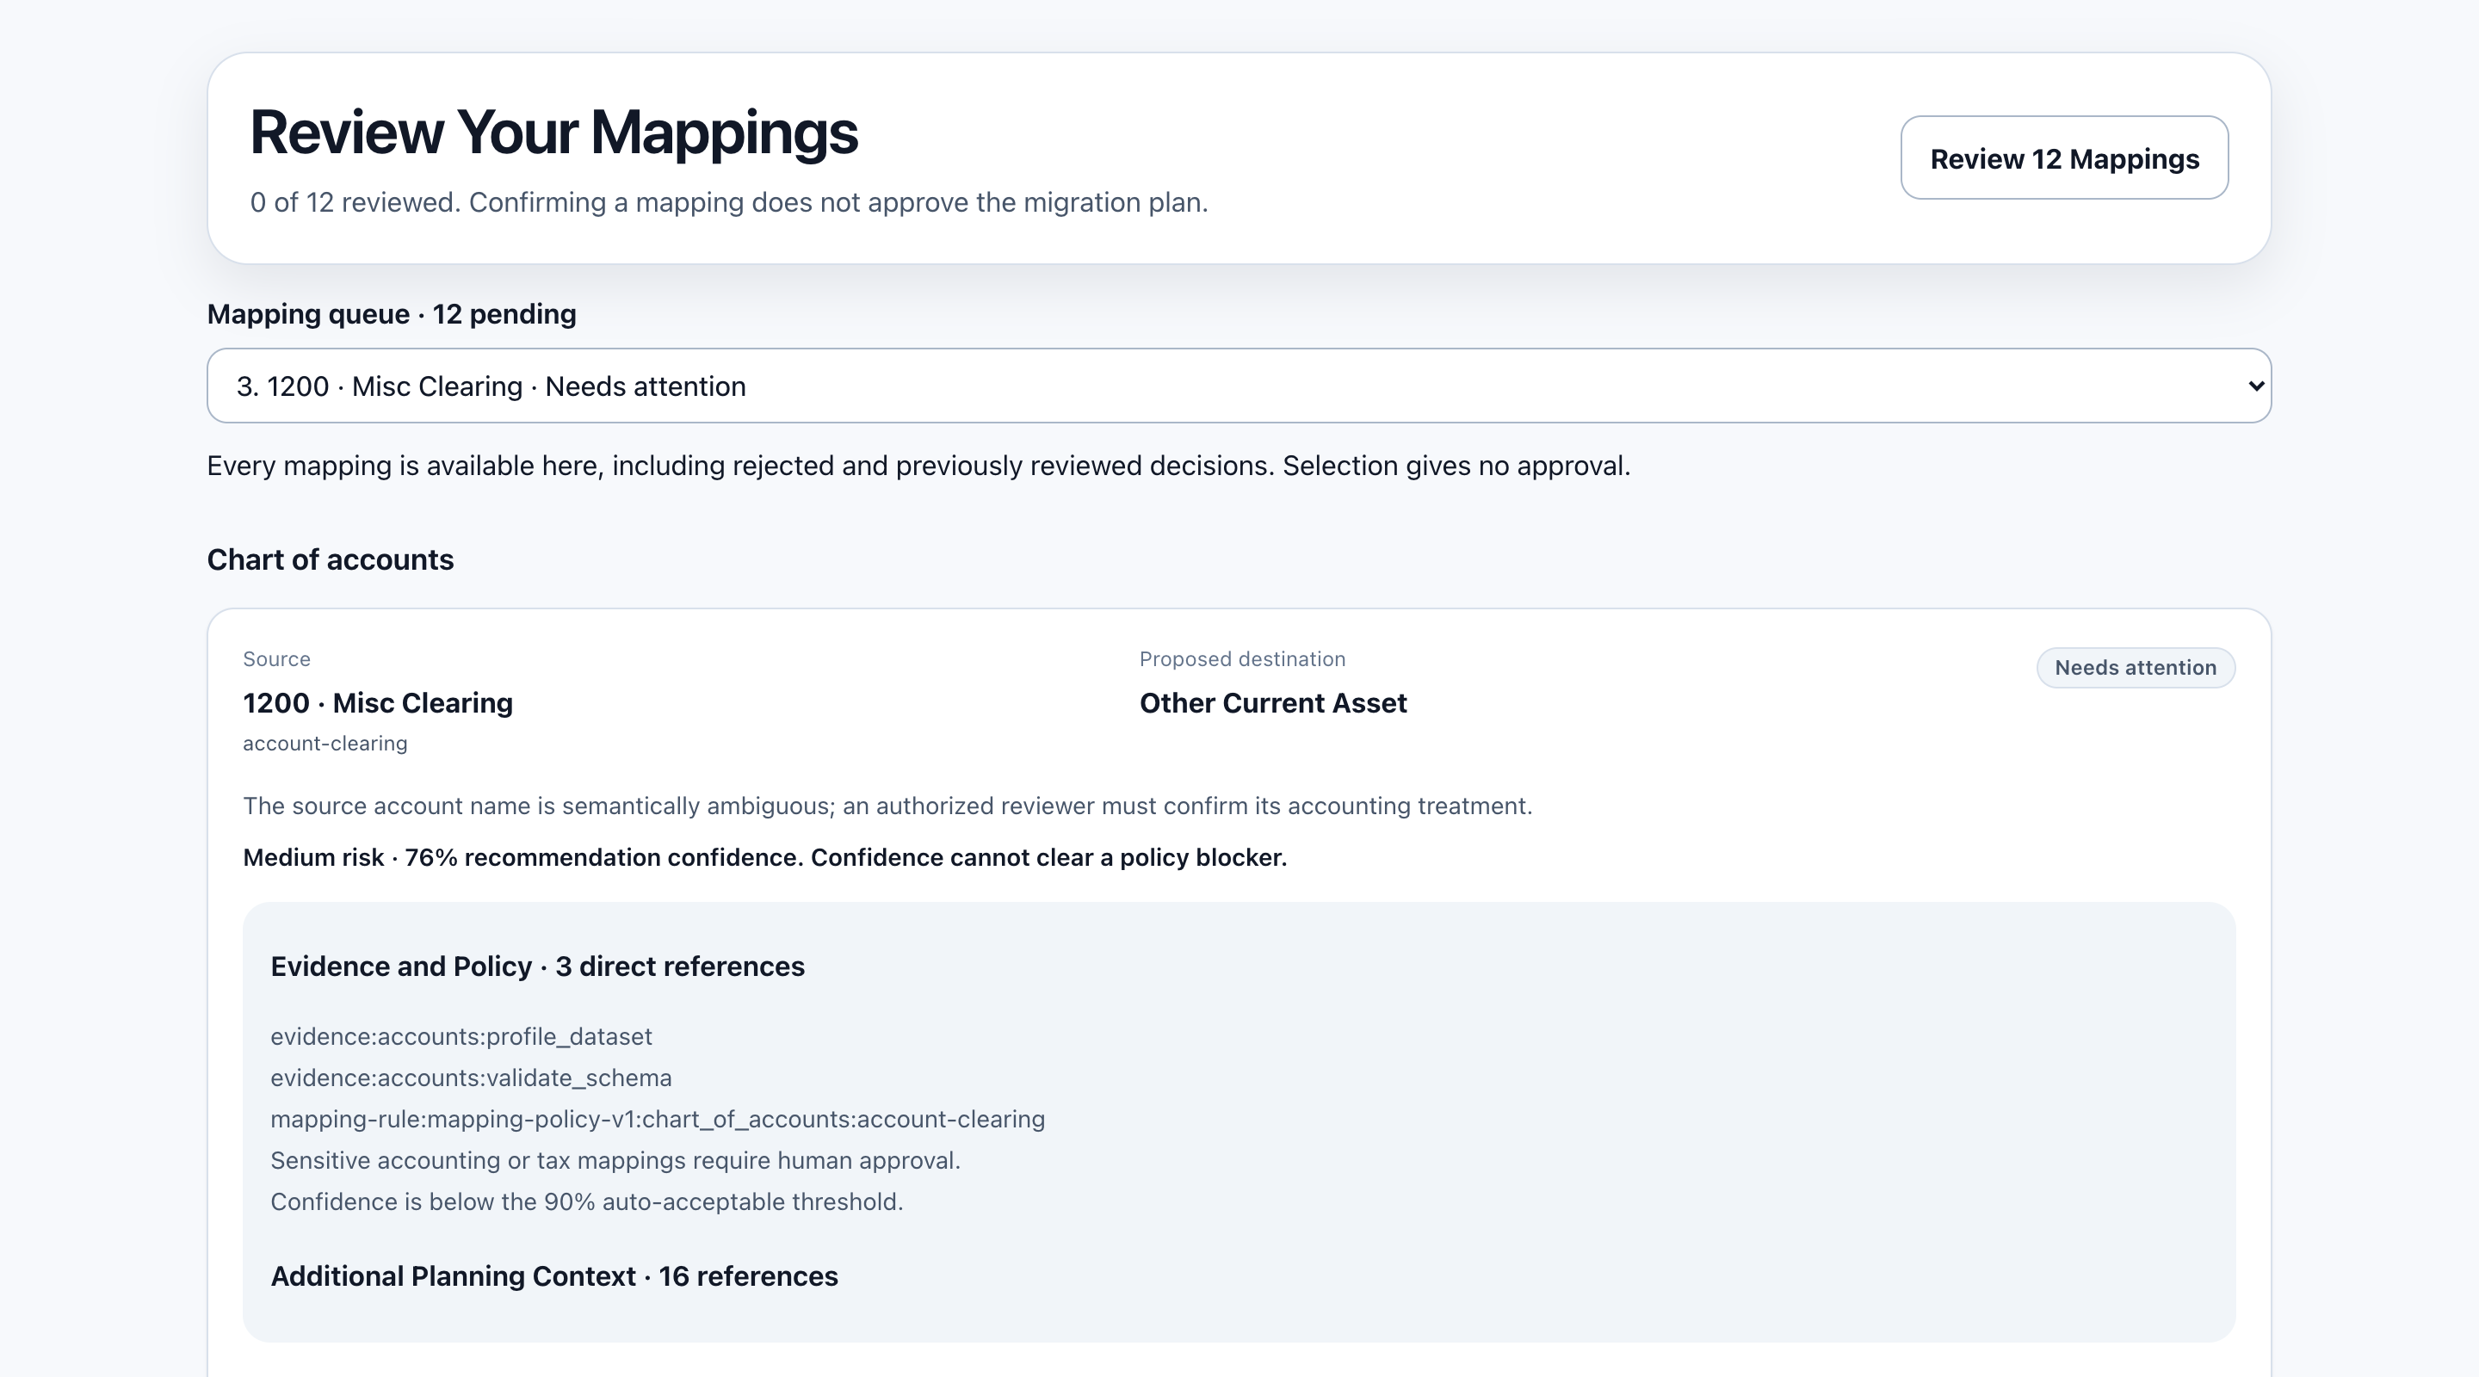
04 Planning and mapping
MoveBooks AI / Actual local UI / Synthetic Beta / Gemini runtime unverified
Inspect ambiguous mappings before explicit human approval.
Notes:
Real application rendering captured 2026-10-18T13:07:43.444Z. Source worktree delivery/submission-integration at aacd3a50409bb2ea3e95329405e3871669cb7572. Route /plan-map-approve?session=<synthetic-session>. Browser viewport 1440×800, device scale factor 2. Uncropped 1440×800 viewport. Existing local development preview and local memory API. Source commit is the inspected working tree, not an attestation of an immutable server binary. No mocked responses or fabricated UI. Only the Next.js development indicator was hidden. All workflow records, account names, invoices, identifiers and approvals are synthetic. UI labels such as Agent refer to the implementation's bounded deterministic workflow, not verified model-driven execution. External browser requests and reasoning endpoints were blocked. No live inference or production provider calls were triggered. Screenshot SHA-256 79704cb5f9f932a0c73d01fd5f51404edc49c350fa9884a987dbdd2f0d7a3735. Image objects can be repositioned/resized/replaced in PowerPoint. Titles, maturity labels and captions are editable native text. Screenshot UI pixels are not editable controls. No production accounting integration, hosted file processing or cloud acceptance claim. 5 headings rendered; zero browser runtime errors. Full safe endpoint-status evidence in screenshot-manifest.json.

Slide 5
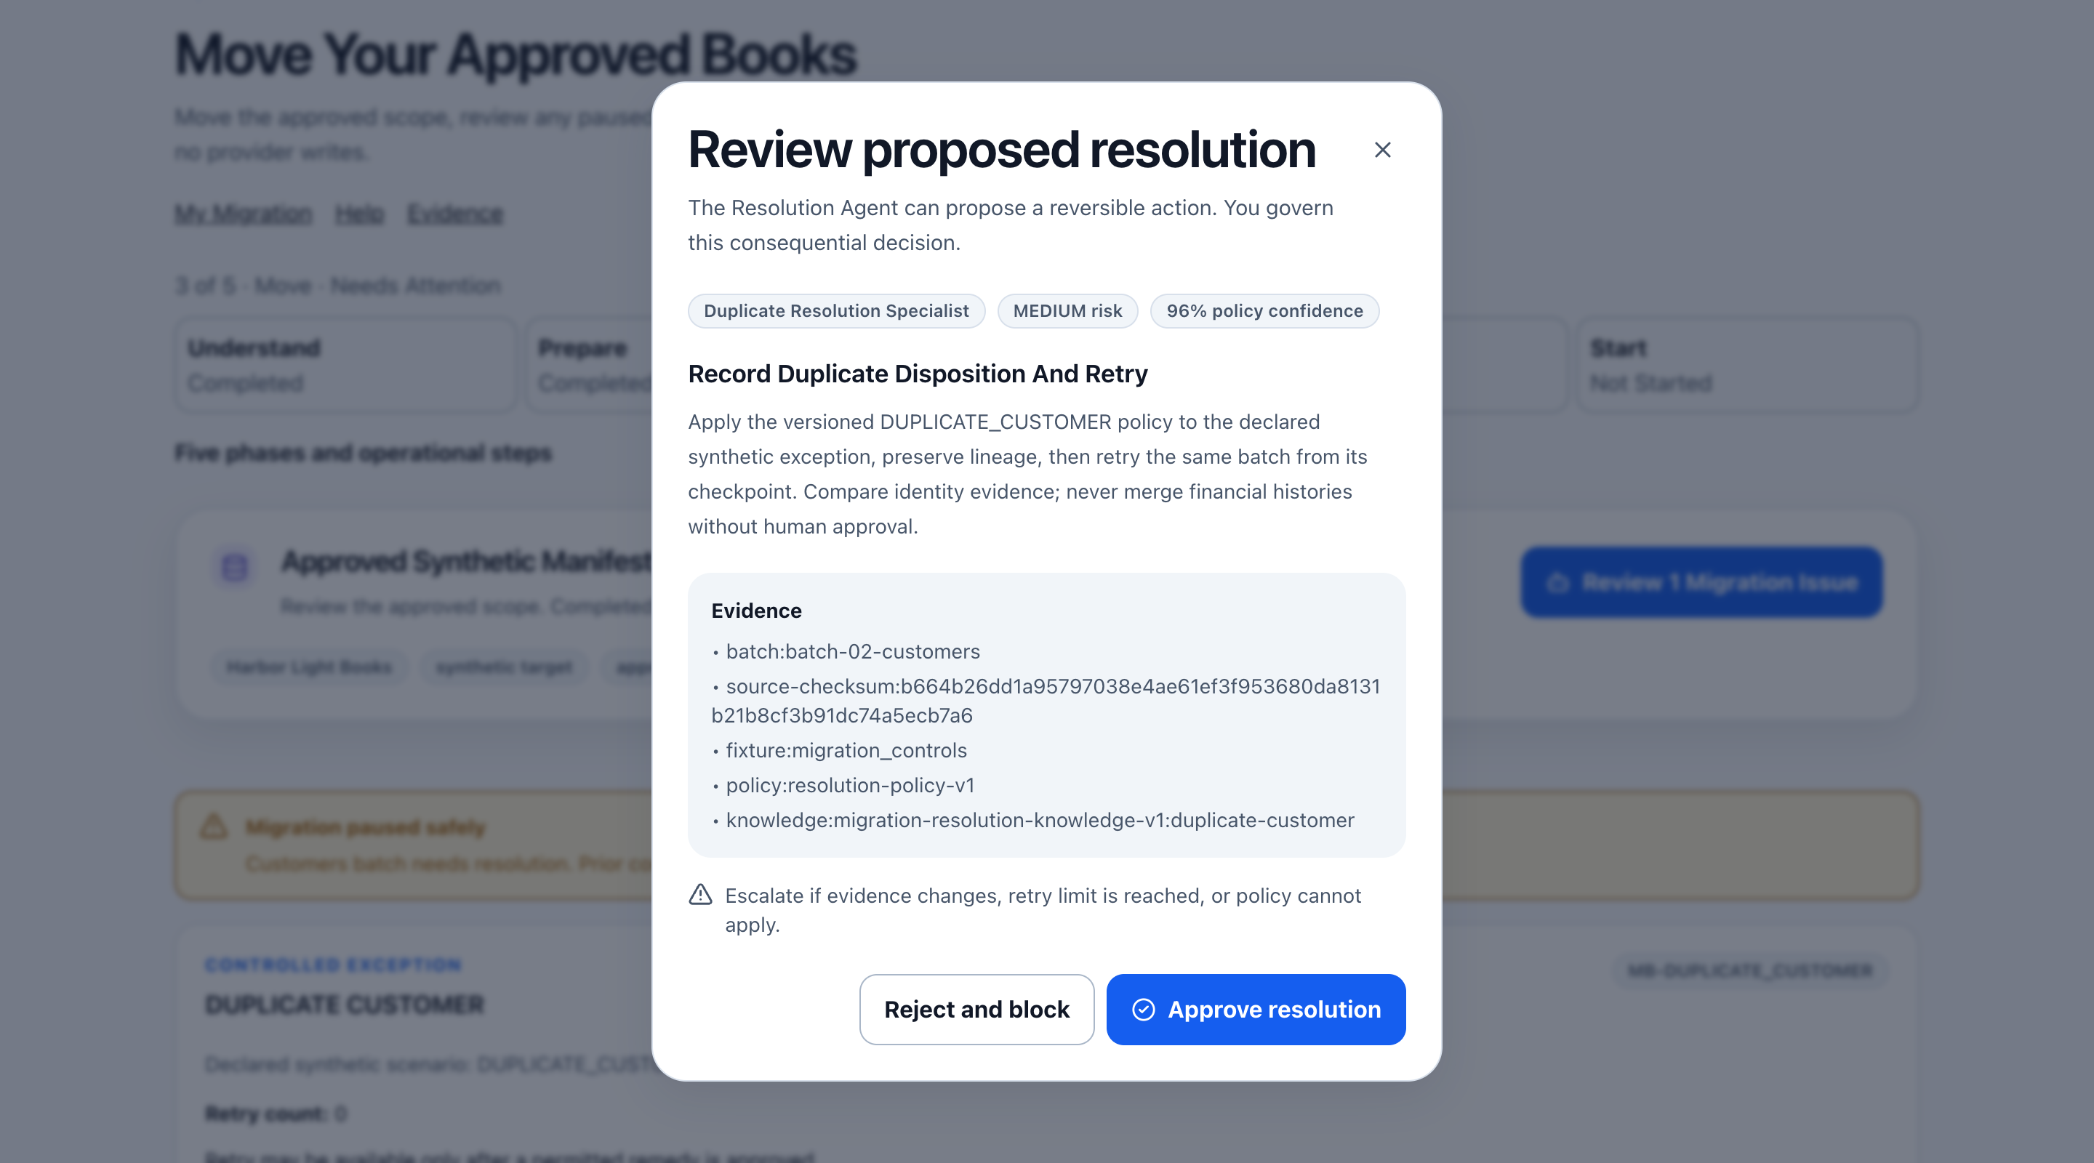
05 Migration and exception resolution
MoveBooks AI / Actual local UI / Synthetic Beta / Gemini runtime unverified
Review the duplicate remedy before retrying a failed synthetic batch.
Notes:
Real application rendering captured 2026-10-18T13:07:43.444Z. Source worktree delivery/submission-integration at aacd3a50409bb2ea3e95329405e3871669cb7572. Route /migrate-resolve?session=<synthetic-session>. Browser viewport 1440×800, device scale factor 2. Uncropped 1440×800 viewport. Existing local development preview and local memory API. Source commit is the inspected working tree, not an attestation of an immutable server binary. No mocked responses or fabricated UI. Only the Next.js development indicator was hidden. All workflow records, account names, invoices, identifiers and approvals are synthetic. UI labels such as Agent refer to the implementation's bounded deterministic workflow, not verified model-driven execution. External browser requests and reasoning endpoints were blocked. No live inference or production provider calls were triggered. Screenshot SHA-256 e03d60b8db250bb6665138fd99a1a022459f1e5bf4044edfdc09970e6d751528. Image objects can be repositioned/resized/replaced in PowerPoint. Titles, maturity labels and captions are editable native text. Screenshot UI pixels are not editable controls. No production accounting integration, hosted file processing or cloud acceptance claim. 6 headings rendered; zero browser runtime errors. Full safe endpoint-status evidence in screenshot-manifest.json.

Slide 6
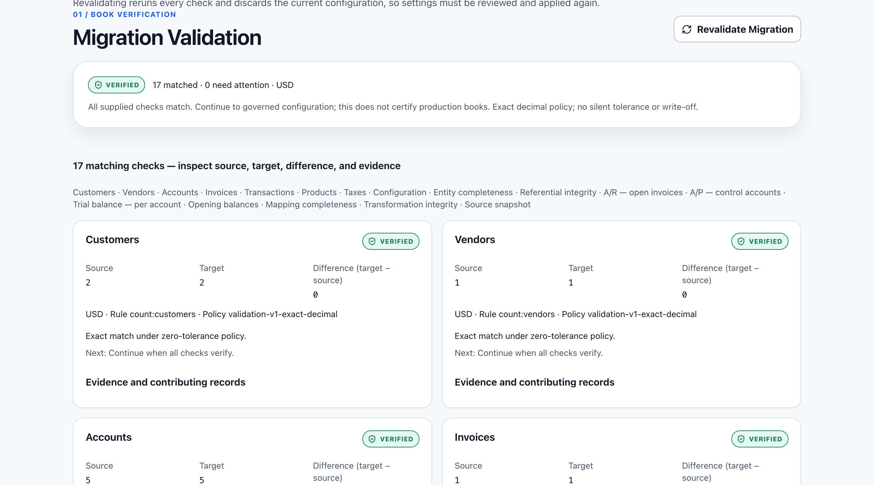
06 Financial validation
MoveBooks AI / Actual local UI / Synthetic Beta / Gemini runtime unverified
Inspect deterministic reconciliation before configuration.
Notes:
Real application rendering captured 2026-10-18T13:07:43.444Z. Source worktree delivery/submission-integration at aacd3a50409bb2ea3e95329405e3871669cb7572. Route /validate-configure?session=<synthetic-session>. Browser viewport 1440×800, device scale factor 2. Uncropped 1440×800 viewport. Existing local development preview and local memory API. Source commit is the inspected working tree, not an attestation of an immutable server binary. No mocked responses or fabricated UI. Only the Next.js development indicator was hidden. All workflow records, account names, invoices, identifiers and approvals are synthetic. UI labels such as Agent refer to the implementation's bounded deterministic workflow, not verified model-driven execution. External browser requests and reasoning endpoints were blocked. No live inference or production provider calls were triggered. Screenshot SHA-256 53806b5c33496c5e466d13ff9b46dc88a41cd67bf92c1b5aa0e8cba8cc90828f. Image objects can be repositioned/resized/replaced in PowerPoint. Titles, maturity labels and captions are editable native text. Screenshot UI pixels are not editable controls. No production accounting integration, hosted file processing or cloud acceptance claim. 21 headings rendered; zero browser runtime errors. Full safe endpoint-status evidence in screenshot-manifest.json.

Slide 7
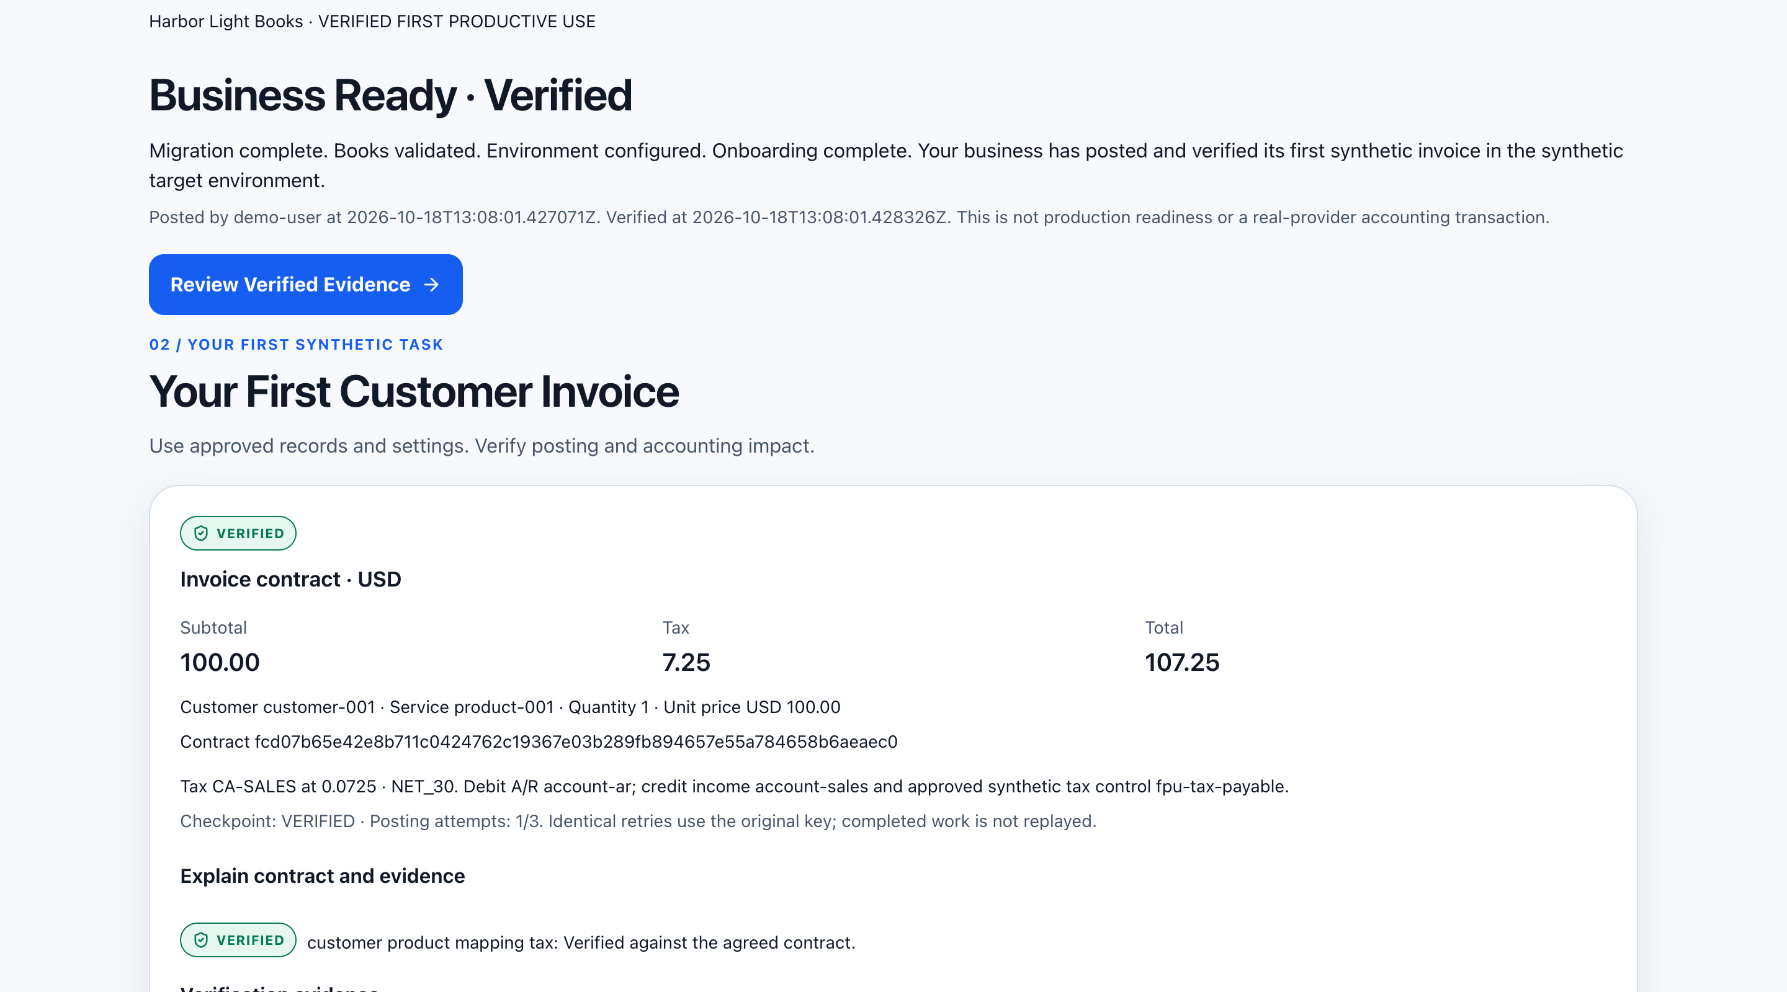
07 Onboarding and First Productive Use
MoveBooks AI / Actual local UI / Synthetic Beta / Gemini runtime unverified
Verify the first approved synthetic invoice and its accounting effect.
Notes:
Real application rendering captured 2026-10-18T13:07:43.444Z. Source worktree delivery/submission-integration at aacd3a50409bb2ea3e95329405e3871669cb7572. Route /onboard-fpu?session=<synthetic-session>. Browser viewport 1440×800, device scale factor 2. Uncropped 1440×800 viewport. Existing local development preview and local memory API. Source commit is the inspected working tree, not an attestation of an immutable server binary. No mocked responses or fabricated UI. Only the Next.js development indicator was hidden. All workflow records, account names, invoices, identifiers and approvals are synthetic. UI labels such as Agent refer to the implementation's bounded deterministic workflow, not verified model-driven execution. External browser requests and reasoning endpoints were blocked. No live inference or production provider calls were triggered. Screenshot SHA-256 bcb9ffef963be985da88f19c6f6c959c61eea7c5df759b015137b6199fa91d46. Image objects can be repositioned/resized/replaced in PowerPoint. Titles, maturity labels and captions are editable native text. Screenshot UI pixels are not editable controls. No production accounting integration, hosted file processing or cloud acceptance claim. 4 headings rendered; zero browser runtime errors. Full safe endpoint-status evidence in screenshot-manifest.json.

Slide 8
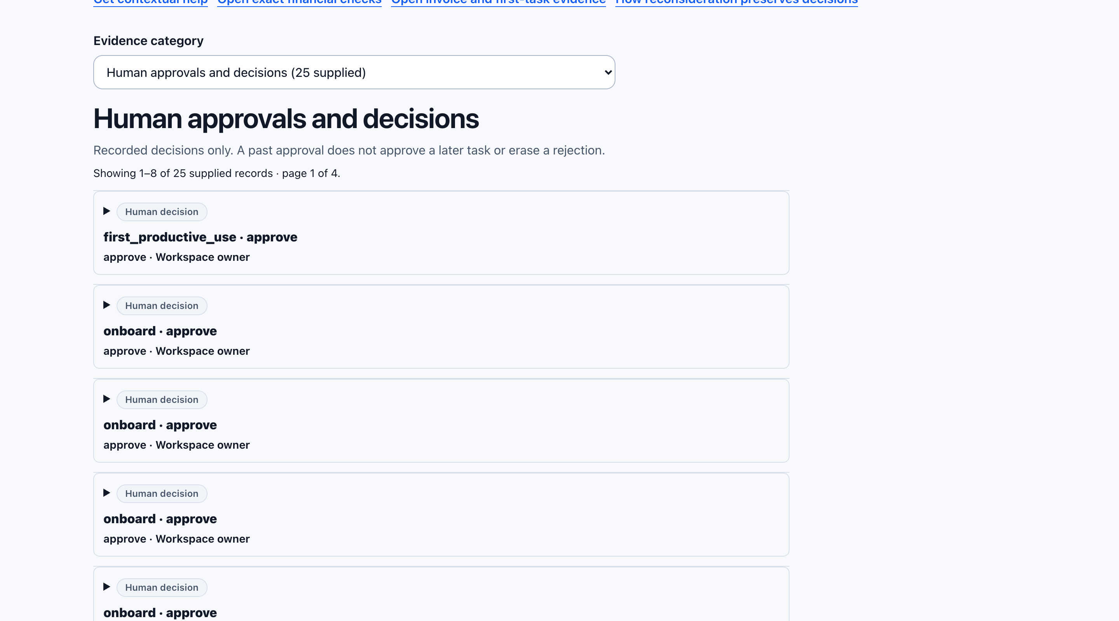
08 Evidence and trust
MoveBooks AI / Actual local UI / Synthetic Beta / Gemini runtime unverified
Inspect workflow evidence and recorded approval decisions.
Notes:
Real application rendering captured 2026-10-18T13:07:43.444Z. Source worktree delivery/submission-integration at aacd3a50409bb2ea3e95329405e3871669cb7572. Route /trust?view=evidence&session=<synthetic-session>. Browser viewport 1440×800, device scale factor 2. Uncropped 1440×800 viewport. Existing local development preview and local memory API. Source commit is the inspected working tree, not an attestation of an immutable server binary. No mocked responses or fabricated UI. Only the Next.js development indicator was hidden. All workflow records, account names, invoices, identifiers and approvals are synthetic. UI labels such as Agent refer to the implementation's bounded deterministic workflow, not verified model-driven execution. External browser requests and reasoning endpoints were blocked. No live inference or production provider calls were triggered. Screenshot SHA-256 259e9c168c91a2d3add4b287b412cc533bbb41476559eca547fefba5f8282e09. Image objects can be repositioned/resized/replaced in PowerPoint. Titles, maturity labels and captions are editable native text. Screenshot UI pixels are not editable controls. No production accounting integration, hosted file processing or cloud acceptance claim. 5 headings rendered; zero browser runtime errors. Full safe endpoint-status evidence in screenshot-manifest.json.

