Slide 1
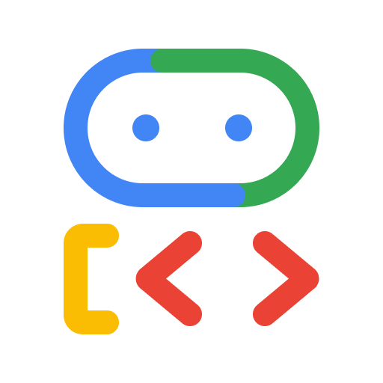
M
MoveBooks AI | Technology Stack
A deterministic accounting core with bounded AI assistance and managed cloud foundations
I
Implemented: recorded cloud baseline
L
Locally Demonstrated: candidate
P
Proposed: future activation
Experience
L
Next.js / React
L
TypeScript / Tailwind
L
Browser-local parsers
Public site and governed workspace
Typed UI, Lucide icons and themes
Supported file checks stay on device
API & access
L
Python / FastAPI / Pydantic
I
Firebase Authentication
L
Owner checks / IAM proxy
Typed contracts and bounded API calls
Google sign-in / owner isolation
Human approval and service identity
Workflow & AI
L
Python workflow / tools
L
Google ADK + google.genai
L
Gemini 3.5 Flash-Lite
State gates and deterministic execution
Read-only Advisor / Reviewer
Offline compatibility / live unverified
Data & finance
I
Cloud SQL / PostgreSQL
I
Firestore: dormant
L
Decimal / synthetic adapters
Financial authority / SQLAlchemy
[L] Quotas, reservations and kill switch
Exact reconciliation and verified FPU
Cloud operations
I
Cloud Run / Hosting
I
Cloud Storage
I
Cloud Logging
Web and API containers / public entry
Private evidence / hosted intake gated
Sanitized logs
[L] Secret Manager adapter
Quality
L
pytest / Vitest / PostgreSQL contracts / emulator / offline Judge / Grype CI gate
P
Proposed
Vertex AI Agent Engine / Cloud Monitoring / BigQuery / Vertex AI Search
Build the financial safeguards. Use managed infrastructure. Keep AI advisory.
Source aacd3a5 / dated 17 Oct cloud evidence / latest candidate cloud acceptance unverified / global inference may leave Singapore
Notes:
Technology inventory prepared 18 October 2026 from delivery/submission-integration commit aacd3a50409bb2ea3e95329405e3871669cb7572. I means implemented recorded cloud baseline/resource, not current candidate deployment acceptance. L means locally demonstrated candidate source with dated local/offline/synthetic evidence. P means future proposed activation/integration. The diagram is a technology overview, not a deployment or trust-boundary flow. All text, layer dividers, status labels and role/tool glyphs are native editable PowerPoint elements. Official brand artwork is embedded as separate SVG/PNG image objects.
Experience and API evidence: apps/web/package.json and package-lock.json; apps/web/next.config.ts; services/api/Dockerfile; apps/web/Dockerfile; pyproject.toml; services/api/src/movebooks_api/settings.py and auth.py; apps/web/lib/server/private-api-proxy.ts and proxy-auth.ts. Browser CSV/JSON/package checks run locally and do not imply hosted file processing. Lucide is a product dependency; the slide role/tool cues are native geometry, not a claim that Lucide authors the slide. Firebase owner is the current authorization role; delegated roles remain proposed.
Workflow and model evidence: agents/orchestrator/workflow.py, migrate_resolve.py, validate_configure.py, onboard_fpu.py; agents/reasoning/adk.py, projection.py, provider.py; agents/reviewer/agent.py; tools/validation/checks.py; tools/activation/invoice.py. The workflow/specialists are deterministic Python implementations. ADK 1.39.1 and google.genai support bounded read-only advice and a separate Reviewer output contract. No agent has unrestricted financial tools or independent approval authority. Decimal checks, deterministic validation and human approvals establish progression, not a model opinion.
Model qualification: docs/security/model-replacement-gate.md records gemini-3.5-flash-lite, explicit global location, https://aiplatform.googleapis.com, 2048 output tokens, LOW thinking and omitted temperature/top-p/top-k, with 67 targeted offline passes at that earlier source. Current exact-model live workload, cost/latency/usefulness and reservations are unverified. Singapore remains the application setting default but this model requires explicit global. Global processing can occur outside Singapore. September historical gemini-2.5-flash dev evidence exists in docs/architecture/live-gemini-adk.md and docs/reviews/live-gemini-adk-2026-09-29-evidence.md. It is not proof for the replacement/current candidate. Public baseline remains recorded deterministic-only.
Data and cloud evidence: services/api/src/movebooks_api/runtime/persistence.py, storage.py, model_controls.py, migration_activity.py, secrets.py and observability.py; docs/architecture/google-native-runtime.md; docs/submission/cloud-inspection-2026-10-17.md; docs/reviews/google-cloud-validation.md; docs/submission/firestore-phase-a-evidence.md; docs/submission/firestore-phase-b-local.md. SQL is the only cloud financial/session authority. Firestore I means the accepted dormant named database, active rules source, Ready index and false seed flags, while the quotas/reservations/kill-switch adapters are L emulator/offline evidence. No active financial workload or complete cloud phase stream is implied. GCS is private and historically probed, not hosted intake. Cloud Logging has bounded historical samples. Secret Manager is a local allowlisted adapter with active successful application reads unverified.
Evidence precedence: the later docs/submission/final-experience/RELEASE-HANDOFF.md reports owner-supplied image builds/scans/publication, SQL backup, IAM and no-traffic candidate progress and explicitly says it was not re-verified. Do not erase that report with the older claim that nothing was deployed, or promote it to exact-current-source verified acceptance. No new cloud access was performed for this artifact. docs/submission/technology-stack/technology-decision-matrix.md provides detailed status, rationale, comparisons, dependency resolutions and limitations.
Assurance and future evidence: .github/workflows/ci.yml, apps/web/vitest.config.ts, tests/test_postgres_runtime.py, tests/test_firestore_emulator_integration.py, scripts/agent_quality_judge.py, scripts/live_reasoning_eval.py, docs/submission/browser-journey/accept-and-record.cjs. Configured CI is not a new passed run. Playwright is bundled workspace tooling rather than an application dependency. Vertex AI Agent Engine is not used by the current ephemeral ADK runner; Cloud Monitoring alerts, BigQuery exporter and Vertex AI Search retrieval remain proposed. agents/knowledge/README.md and runtime/contracts.py define the narrower current catalog/disabled analytics contracts. No Document AI implementation or selected proposal was found in the targeted evidence.
Brand assets: https://cloud.google.com/icons core-products-icons.zip (Cloud Run, Cloud SQL, Cloud Storage, Vertex AI), google-cloud-legacy-icons.zip (distinct Firestore, Logging and Secret Manager product marks); https://firebase.google.com/brand-guidelines official Firebase assets (Authentication, Hosting); https://google.github.io/adk-docs/assets/agent-development-kit.png (official ADK). SVG class color declarations are resolved to equivalent attributes to preserve the official colors in the renderer. No logo distortion/recoloring and no endorsement or activation claim.

