Slide 1
Transport Layer Optimization for Real-Time Healthcare Telemetry in Congested Wireless Networks
A priority- and deadline-aware transport framework, evaluated by simulation
[Presenter name] | [Department, institution] | October 2026
Notes:
Introduce the problem: patient monitors send small deadline-bound messages over wireless networks that are shared with bulk traffic. This talk covers a transport design for that setting and a simulation-based evaluation. All results are from simulation, not from a clinical network.

Slide 2
Clinical telemetry is small, periodic and deadline-bound
150 ms
300 ms
1 s
Alarm / event
ECG waveform
Vital signs
60 B payload, Poisson arrivals
200 B every 40 ms per patient
80 B every second per patient
A message that arrives after its deadline has little clinical value, even if it is eventually delivered correctly. Deadlines are design assumptions of this study, not clinical standards.
Notes:
Three telemetry classes with their delivery deadlines. The key idea is that the deadline, not reliability in the abstract, is what has to be protected. The numbers are assumptions made for the study.

Slide 3
Default transports and shared queues miss those deadlines
1
TCP
2
UDP
3
Shared access point
Head-of-line blocking: one loss delays every later message
200 ms minimum retransmission timer
Loss-based congestion control keeps buffers full
No recovery at all
Every wireless loss is a missing sample or a missed alarm
No protection from queueing delay
Bulk flows fill a deep buffer
A 200 kB buffer takes about 200 ms to drain, longer than the 150 ms alarm deadline
Notes:
Why the usual choices fail: TCP couples all messages on a connection and backs off slowly; UDP gives up on repairs; and both sit behind whatever queue the bulk flows have built at the access point.

Slide 4
What this work contributes
1
Deadline-classified messages
Alarm, ECG and vitals streams, each with its own deadline, plus best-effort bulk
2
Deadline-aware retransmission
Short measured timer; retransmit only if the repair can still arrive in time
3
Gated redundancy
Loss-adaptive FEC and alarm copies, switched off when delay shows queueing, not loss
4
Priority queue with deadline drop
Telemetry bypasses bulk traffic; expired packets are dropped, not sent
5
Reproducible, validated model
Python replica checked against ns-3; demo app; 1,168 runs over congestion, patients, loss, buffer, delay
Notes:
Five contributions. The first four are the design; the fifth is the evaluation, including ablations that separate what each mechanism contributes.

Slide 5
System model: four traffic classes, one shared bottleneck
Class | Stream | Payload | Rate per patient | Deadline | Priority
0 | Alarm / event | 60 B | Poisson, mean 5 s | 150 ms | Highest
1 | ECG waveform | 200 B | 1 per 40 ms | 300 ms | High
2 | Vital signs | 80 B | 1 per 1 s | 1000 ms | Medium
3 | Bulk (cross traffic) | 1500 B | Greedy TCP | none | Lowest
Network
N devices share one access-point queue and a bursty wireless link (8 / 4.8 Mbit/s, 25% bad-state loss). K bulk TCP flows compete in the same queue.
Primary metric
Timely delivery ratio (TDR): share of messages delivered by their deadline. Undelivered counts as missed. Also: p99 latency, overhead, bulk goodput.
Notes:
The network is deliberately simple: one shared bottleneck with Gilbert-Elliott channel states. The metric is the share of messages that meet their deadline, with undelivered messages counted as misses.

Slide 6
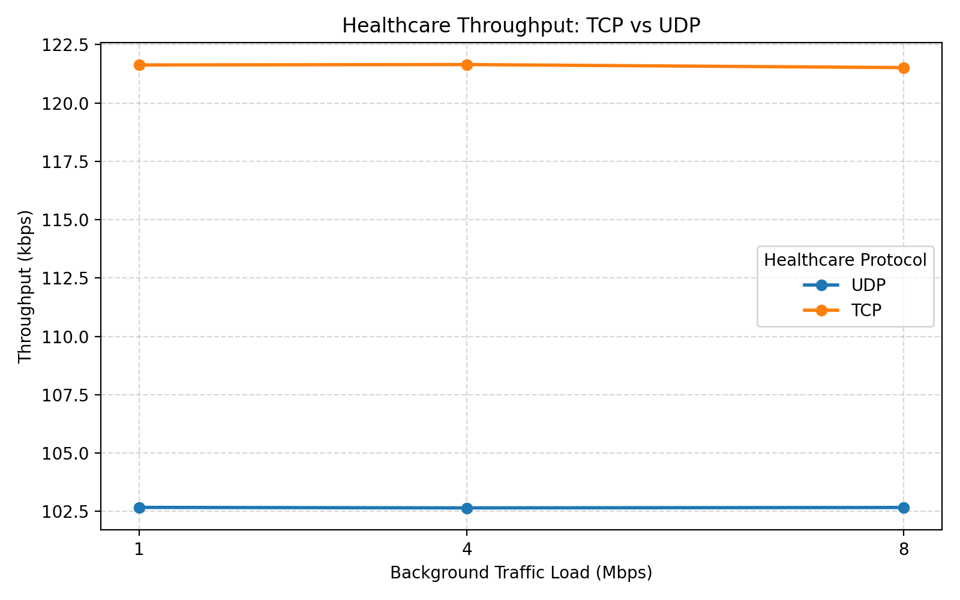
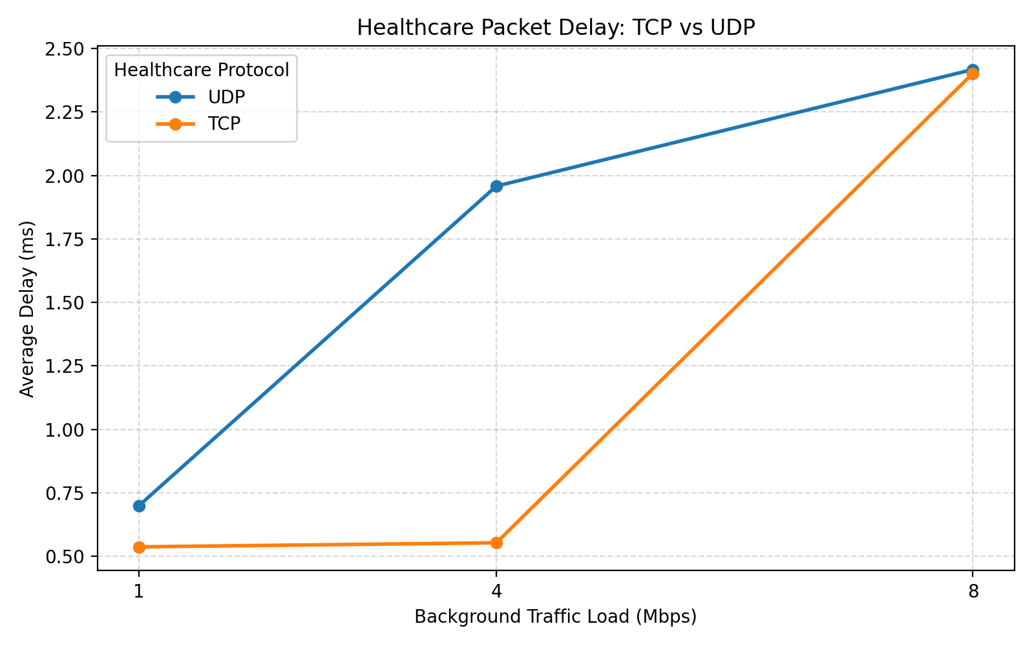
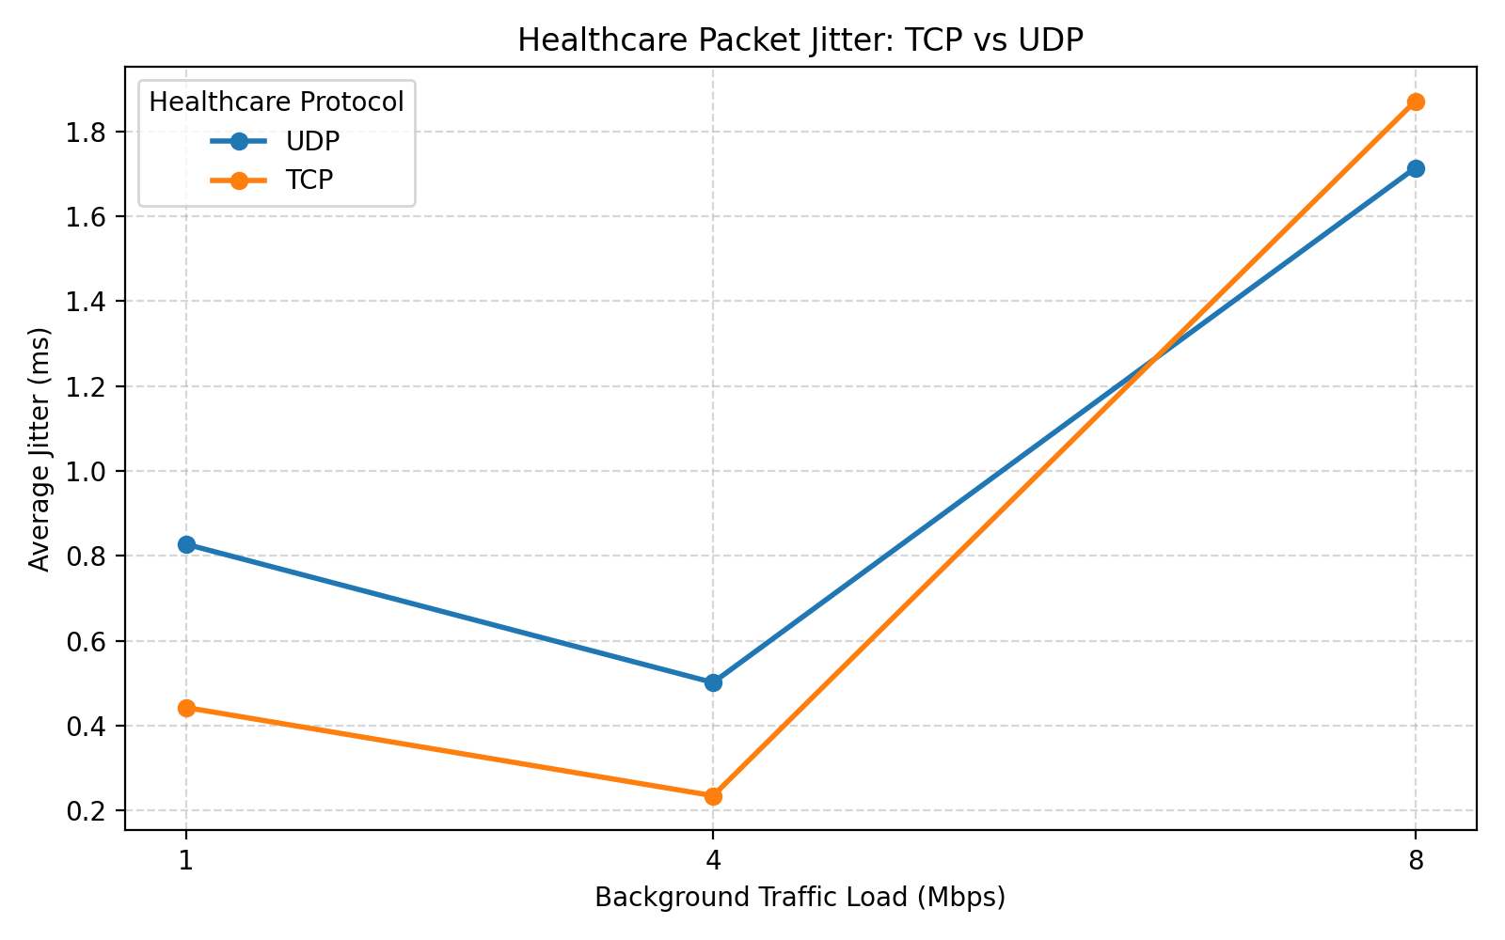
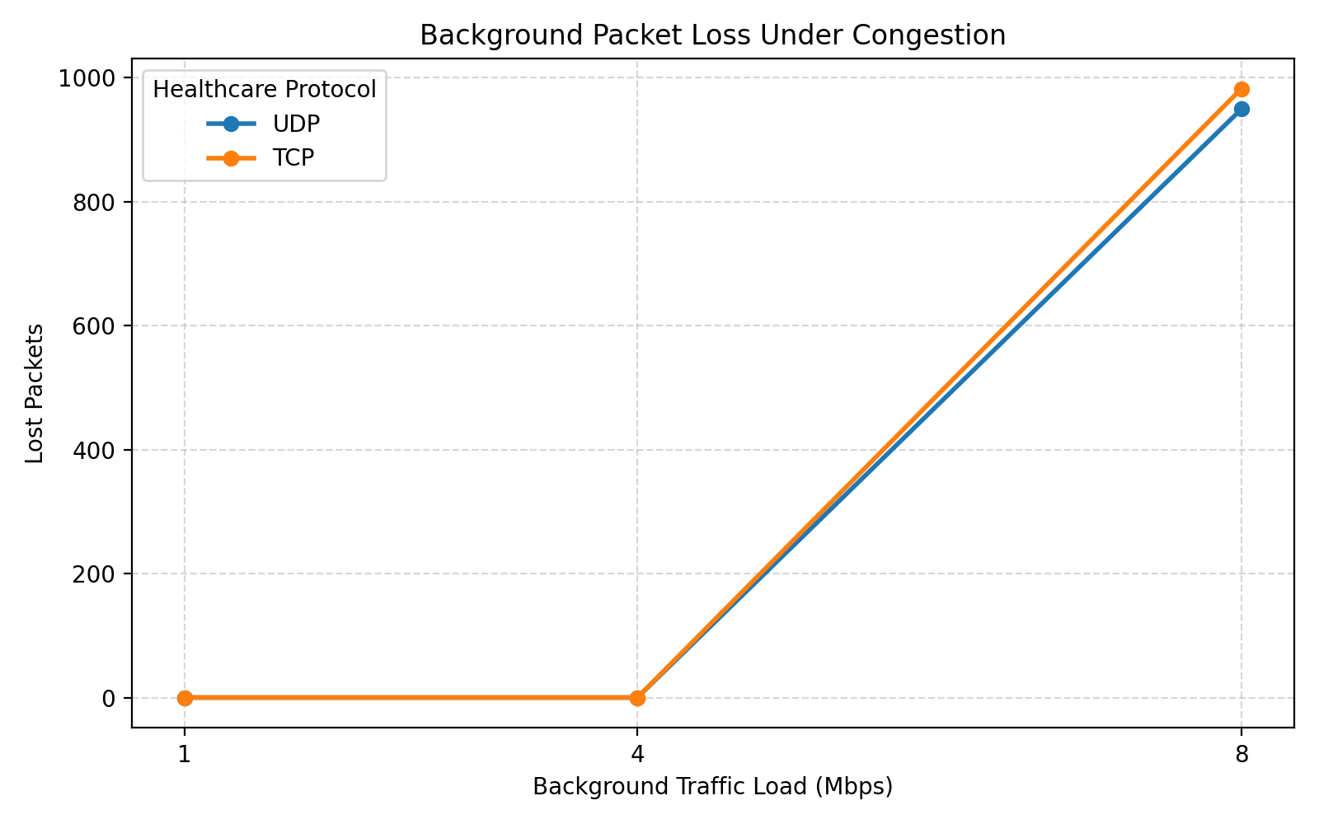
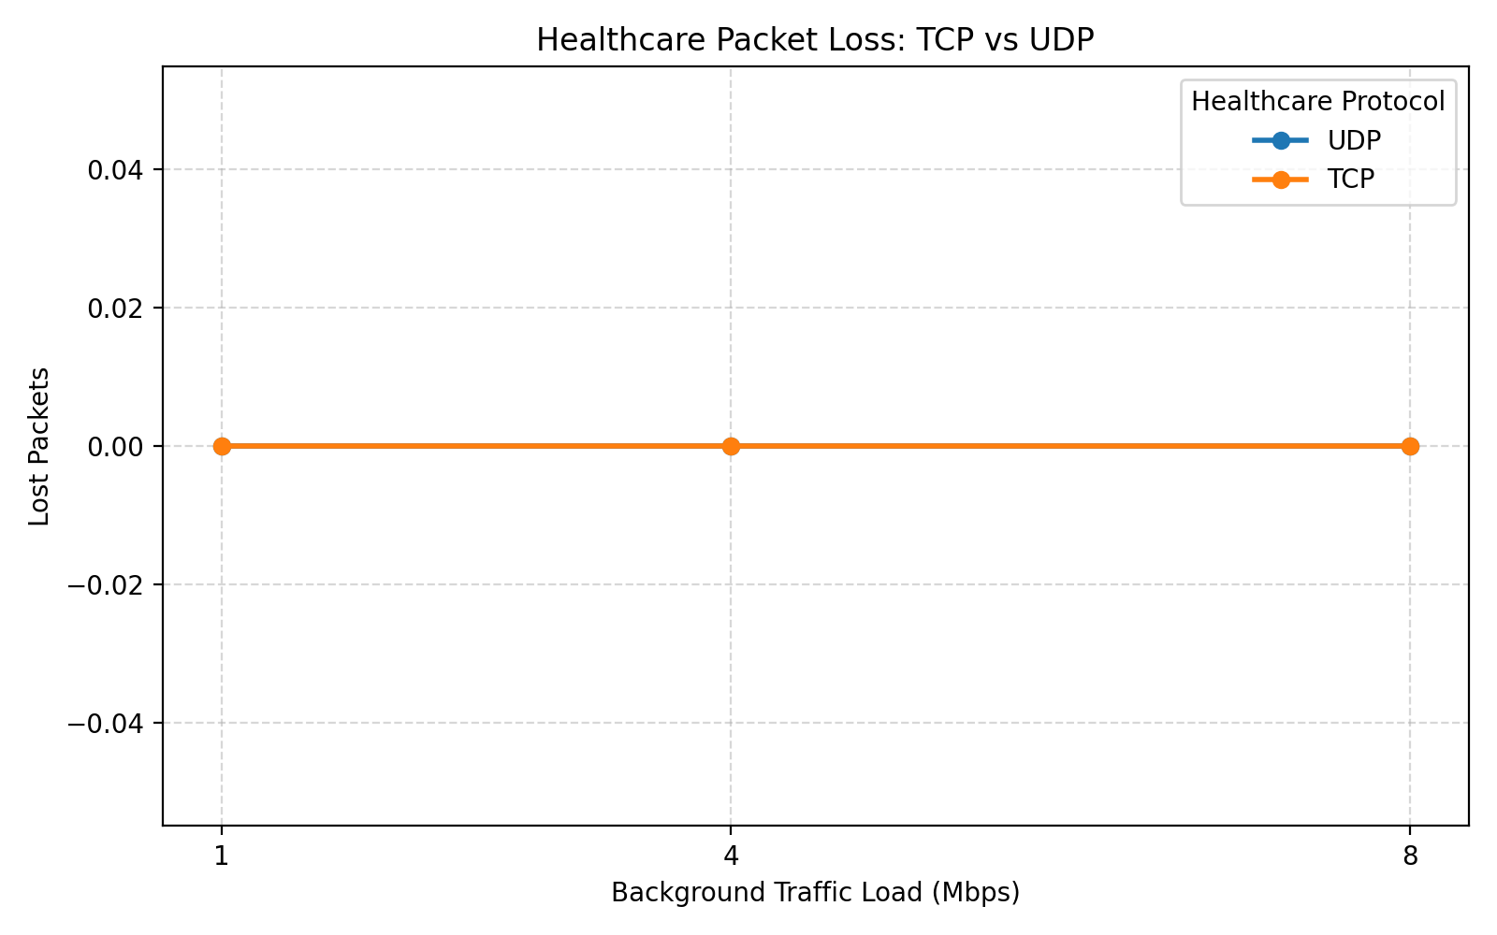
Starting point: the ns-3 baseline, TCP vs UDP
Baseline results
Zero healthcare loss at 1, 4 and 8 Mbit/s. Delay 0.5 to 2.4 ms. TCP's extra kbit/s is header overhead.
ns-3.47, 802.11g at 6 Mbit/s; one healthcare station, one background station (repository results, one run per point).
Notes:
These are the five graphs from the base repository. They show TCP and UDP behave almost identically for the healthcare flow in this topology. The next slide explains why.

Slide 7
Why the baseline cannot separate TCP from UDP
0
2.4 ms
464 ms
healthcare packets lost, every load and both protocols
worst mean healthcare delay (8 Mbit/s background)
background flow's own delay at 8 Mbit/s
Congestion stays in the sender that causes it
The healthcare and background flows have separate station queues. Under 802.11 contention a light flow waits for at most one frame in flight (about 1.5 ms at 6 Mbit/s) plus a short backoff.
TCP's higher throughput is header arithmetic
100 packets/s x 128 B (UDP) x 8 = 102.4 kbit/s; x 152 B (TCP) = 121.6 kbit/s.
Limits: one run per point, lossless channel, one device, three loads. So the proposed framework is tested where telemetry shares a bottleneck queue.
Notes:
This is the honest reading of the baseline. It is a valid measurement, but it does not stress the transport layer, so it cannot show a benefit for optimisation. The stress scenario later in the talk puts telemetry and bulk traffic in the same queue.

Slide 8
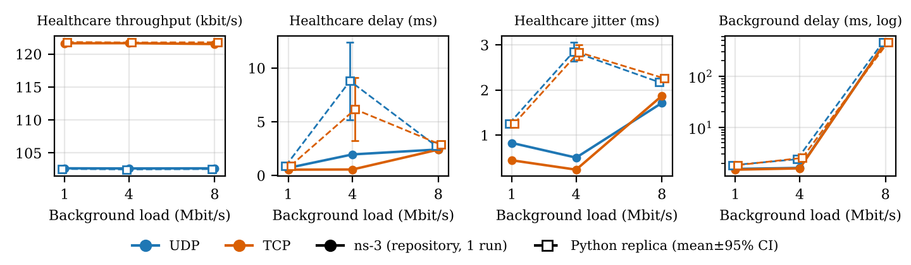
Validation: Python replica vs ns-3
Throughput within 0.6% for both flows; saturated background delay within 0.7%.
Healthcare delay at 8 Mbit/s is 14 to 19% high (2.8 vs 2.4 ms).
At 1 and 4 Mbit/s the replica overestimates delay; ns-3 is one deterministic run, so this gap is approximate.
Notes:
The replica is a slot-level 802.11g DCF model: backoff, collisions, MAC acknowledgements, a 500 packet queue. Open markers are the replica with 95 percent intervals over 30 runs; filled markers are the single ns-3 run from the repository. Be clear that healthcare delay and jitter are only approximately validated.

Slide 9
The working model: run it, change it, reproduce it
Interactive demo
One-command results
streamlit run app.py: sliders for patients, bulk flows, loss, buffer; five schemes side by side
python run_all.py regenerates every number and figure in the paper
Validated baseline
Open data
Python 802.11g replica checked against the repository's ns-3 results
Per-run CSVs, summary.json and all source code ship with the paper
Notes:
This is the slide to switch to the live demo. Start with the default scenario, then raise the number of bulk flows and show TCP's alarm delivery falling while the proposed scheme holds.

Slide 10
Architecture: a chain of cooperating modules
Bulk TCP cross traffic
Telemetry sources
Class marker
Reliability engine
AP priority queue
Wireless channel
Receiver
Alarm, ECG, vitals
Class tag, deadline, sequence no.
ARQ, FEC, alarm copies, gate
Strict priority, deadline drop
Bursty loss, shared capacity
Out-of-order delivery, FEC decode, ACK
Feedback: ACK, RTT, loss estimate
Notes:
Messages are tagged with class, sequence number and absolute deadline, protected by the reliability engine, and queued by class at the access point. The receiver delivers immediately without reordering and feeds ACKs back, from which the sender estimates RTT and loss.

Slide 11
Deadline-aware retransmission: repair only what can still arrive
Timer
RTO = max(30 ms, srtt + 4 rttvar)
Retransmit only if
r < 3 and t + srtt / 2 ≤ deadline
Otherwise abandon the message and free capacity for fresher data. RTT is sampled from first transmissions only (Karn's rule); timers back off by 1.5 per retry.
30 ms
timer floor in the proposed design
200 ms
minimum retransmission timer in common TCP implementations
Notes:
With a 30 ms floor a repair can arrive inside the 150 ms alarm deadline. TCP's 200 ms minimum timer alone exceeds it. The deadline check avoids sending repairs that would arrive late anyway.

Slide 12
Redundancy, switched off when queueing is the cause
Loss-adaptive FEC for ECG
Congestion gate
Parity and copies are disabled while the ECG stream's smoothed RTT exceeds 1.5 × (2d + 4 ms) = 36 ms.
Without the gate, extra traffic deepens overload: at 120 patients vitals on time fall to 0.0% (with gate: 85.8%).
Loss estimate | XOR group size | Extra traffic
< 1% | no FEC | 0%
1% to 6% | 4 packets | 25%
≥ 6% | 2 packets | 50%
Alarms: a second copy is sent 10 ms after the first when the loss estimate exceeds 1%.
Notes:
Redundancy repairs channel loss but cannot repair delay. When RTT inflation reveals a standing queue, adding parity only adds load. The gate was added after an earlier version collapsed at high patient counts.

Slide 13
Priority queue with deadline-aware dropping
Alarm
10 kB
Strict priority
Bulk cannot take telemetry buffer space.
Deadline drop
Drop a telemetry packet at dequeue if t + d > deadline.
ECG
30 kB
Wireless link
Vitals
10 kB
Bulk
200 kB
Assumes the access point supports class-based priority (for example DiffServ marking and 802.11e access categories). Real 802.11 priority is statistical, not strict.
Notes:
Telemetry has its own queues so it never waits behind bulk traffic. Packets that can no longer arrive in time are dropped at dequeue rather than consuming capacity. This is the part that most depends on network support.

Slide 14
Five configurations form an ablation ladder
Configuration | Recovery | Order | Priority queue | Deadline drop | FEC / copies
TCP | TCP ARQ | in-order | - | - | -
UDP | none | none | - | - | -
UDP+Prio | none | none | ✓ | - | -
Transport-only | deadline-aware ARQ | none | - | - | ✓
Proposed | deadline-aware ARQ | none | ✓ | ✓ | ✓
Default scenario: 40 patients, 8 bulk flows, 200 kB buffer, one-way delay 10 ms, ACKs also lossy. 8 seeds per setting, 95% confidence intervals. Custom discrete-time simulator (1 ms steps); same message schedule for every configuration within a seed.
Notes:
TCP models MQTT over TCP with one connection per patient. Each later configuration adds one ingredient, so comparing neighbours isolates what that ingredient contributes.

Slide 15
Under congestion, only the full design meets deadlines
20.1%
alarms on time with TCP
100.0%
alarms on time, proposed
-11%
bulk goodput vs UDP+Prio
Notes:
Default scenario: 40 patients and 8 bulk flows. UDP+Prio reaches about 98% for every class but cannot repair channel loss. Transport-only fixes ECG and vitals but not alarms, because queueing delay alone exceeds 150 ms. The proposed design delivers essentially all messages on time; the cost is lower bulk goodput.

Slide 16
TCP fades as background flows grow; the design does not
TCP
UDP
UDP+Prio
Transport-only
Proposed
Notes:
Without background traffic TCP is fine: 99.2% of alarms on time. At 16 bulk flows it delivers 0.7% of alarms and 24.1% of ECG. UDP and Transport-only keep ECG but lose alarms; UDP+Prio is flat near 98%; the proposed design stays near 100%. Category axis is not to scale. Means of 8 runs; confidence intervals are in the paper.

Slide 17
Tail latency: a bounded 20 to 40 ms instead of seconds
Deadlines
Alarm 150 ms, ECG 300 ms
FIFO baselines
UDP and Transport-only sit near 230 ms, the queue drain time; TCP reaches about 1 s.
Proposed
Path delay plus at most one repair.
Notes:
Latency of delivered messages only; undelivered messages are counted in the timely delivery ratio instead. The 10 ms floor is the assumed path delay. The proposed design's 20 ms and 40 ms tails correspond to one retransmission.

Slide 18
Scaling to 100 patients, and why the gate matters
Up to 100 patients
Proposed keeps every class at or above 99.9%.
At 120 patients
Alarms 100.0%, but vitals fall to 85.8% and bulk goodput to 0.08 Mbit/s: strict priority starves the rest. Without the gate, vitals reach 0.0%.
Notes:
Vitals have the lowest telemetry priority, so they show overload first. The gated design degrades gracefully; the ungated one collapses because redundancy adds load exactly when the link is full. A deployment would need a rate cap or weighted scheduling for telemetry.

Slide 19
Short buffers shrink the baselines' penalty
Honest caveat
With a 25 kB buffer, TCP delivers 96.2% of alarms on time and UDP 98.1%.
At 400 kB TCP falls to 16.7%.
Active queue management is a real alternative or complement when priority is not available.
Notes:
Much of the baselines' loss comes from deep buffers. The proposed design is insensitive to buffer depth because telemetry has its own queues, but short buffers or AQM would help every configuration.

Slide 20
Redundancy pays off when the round trip nears the deadline
1.04 vs 1.28
overhead at 10 ms: ARQ only vs full
1.02 vs 1.49
overhead at 120 ms: ARQ only vs full
Axis starts at 96%. At 10 ms ARQ alone already reaches 100%, so FEC and copies add traffic for no timeliness gain. At 120 ms they lift alarms from 98.0% to 99.6%.
Notes:
Axis is truncated at 96% to show the differences; the gains are modest in absolute terms. Redundancy should be enabled on the ratio of round-trip time to deadline rather than on the loss estimate alone. At intermediate delays the retransmission timer margin is too small and spurious retransmissions raise overhead; that is a known limitation.

Slide 21
What it costs, and what this study does not show
Costs
Overhead ratio 1.28 at default settings
11% less bulk goodput than UDP+Prio
Strict priority can starve bulk and vitals at overload
Spurious retransmissions at mid-range delays
Limits
Simulation, not measurement
One shared channel state; no MAC contention
Strict priority assumed at the AP
TCP baseline untuned; no QUIC or BBR
No security overhead; deadlines assumed
Notes:
Be explicit about scope. Results compare mechanisms under controlled assumptions and should not be read as predicted performance of a hospital network.

Slide 22
Conclusions and next steps
Findings
Next steps
Baseline ns-3: no healthcare loss, ms-scale delay; TCP's extra throughput is headers
Shared queues make TCP and UDP miss alarm deadlines
Priority removes queueing delay; deadline-aware ARQ repairs loss; both are needed
Redundancy helps mainly when RTT nears the deadline, and needs a congestion gate
Protection costs bulk goodput
Validate in a packet-level simulator with 802.11 EDCA, then on a testbed
Compare with tuned TCP (CUBIC, RACK-TLP) and QUIC
RTT-proportional timer margin; redundancy on RTT-to-deadline ratio
Security overhead, energy cost, clinical deadlines
Notes:
Close with the scope reminder: simulation-based, strict priority assumed. Invite questions on the ablation results and the limits.

Slide 23
Selected references (1 of 2)
Base repository: N. Samson, healthcare-telemetry-ns3, GitHub, Oct. 2026 https://github.com/nikhilsamsonsuresh-sketch/healthcare-telemetry-ns3
W. Eddy (Ed.), "Transmission Control Protocol (TCP)," RFC 9293, 2022 https://www.rfc-editor.org/rfc/rfc9293
J. Iyengar, M. Thomson (Eds.), "QUIC," RFC 9000, 2021 https://www.rfc-editor.org/rfc/rfc9000
J. Iyengar, I. Swett (Eds.), "QUIC loss detection and congestion control," RFC 9002, 2021 https://www.rfc-editor.org/rfc/rfc9002
Y. Cheng et al., "The RACK-TLP loss detection algorithm for TCP," RFC 8985, 2021 https://www.rfc-editor.org/rfc/rfc8985
L. Xu et al., "CUBIC for fast and long-distance networks," RFC 9438, 2023 https://www.rfc-editor.org/rfc/rfc9438
B. Briscoe (Ed.) et al., "L4S Internet service: Architecture," RFC 9330, 2023 https://www.rfc-editor.org/rfc/rfc9330
D. Borsatti et al., "From IoT to cloud: Applications and performance of the MQTT protocol," ICTON 2020 https://research.chalmers.se/en/publication/523631
Notes:
All sources are dated 2019 or later and each link was opened while writing the paper. The paper has the full reference list.

Slide 24
Selected references (2 of 2)
I. Ahmad et al., "Adaptive lightweight security for performance efficiency in critical healthcare monitoring," arXiv:2406.03786, 2024 https://arxiv.org/abs/2406.03786
J. Zhou, Y. Sun, C. Tellambura, IoMT wireless communication survey, arXiv:2504.02446, 2025 https://arxiv.org/abs/2504.02446
N. Nomikos et al., "Deadline-constrained traffic and the number of allowed retransmissions," Entropy 26(8), 2024 https://www.mdpi.com/1099-4300/26/8/655
J. Livingood, "Improving latency with AQM during COVID-19," arXiv:2107.13968, 2021 https://arxiv.org/abs/2107.13968
S. Aoyagi et al., "Evaluation of AQM and TCP congestion control in WiFi networks," MITA 2022 https://www.s-lab.nd.chiba-u.jp/achievements/abst.php?paper=683
V. Sitaram A. et al., "QoS provisioning ability of IEEE 802.11e WLAN," arXiv:2112.07170, 2021 https://arxiv.org/abs/2112.07170
Memoona, S. W. Kim, "Performance and simulation analysis of 802.11ax OFDMA," PeerJ CS 11:e2687, 2025 https://peerj.com/articles/cs-2687
ns-3 network simulator (release 3.47 used for the baseline) https://www.nsnam.org/
Notes:
All sources are dated 2019 or later and each link was opened while writing the paper. The paper has the full reference list.

