Slide 1










Slide 2


















Slide 3





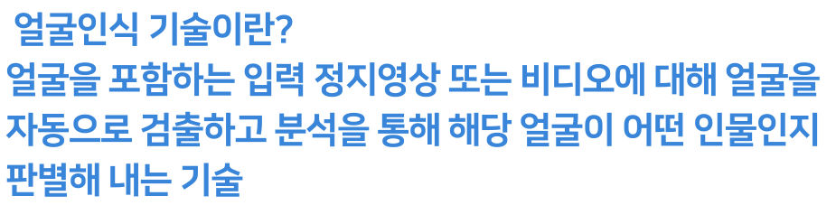


Slide 4













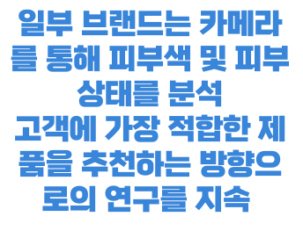
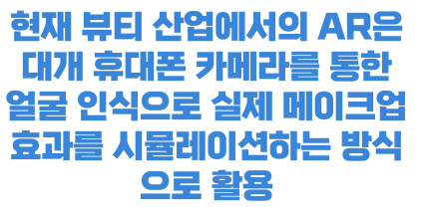
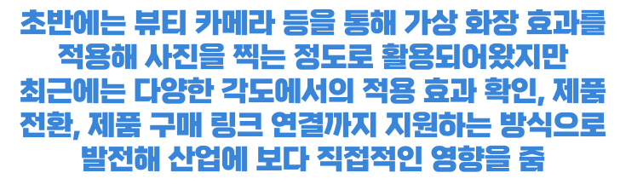
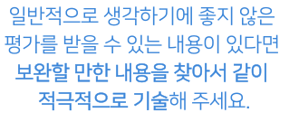
https://www.beautynury.com/news/view/94575/cat/10

Slide 5



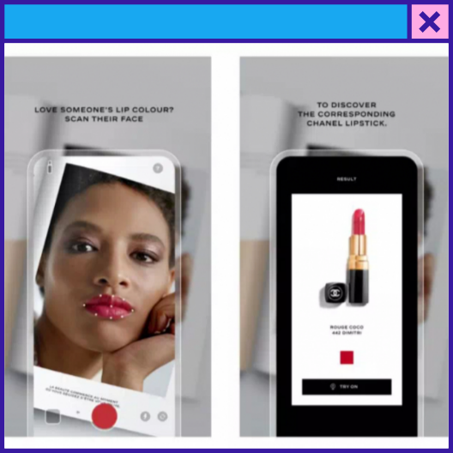

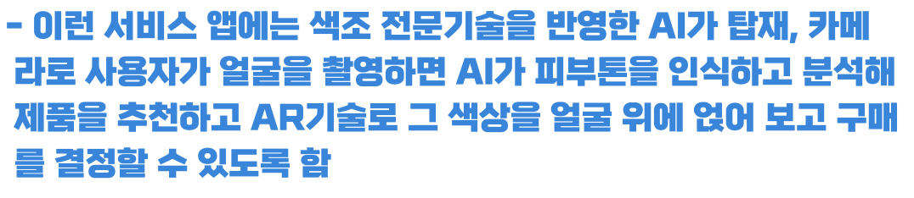

https://www.enewstoday.co.kr/news/articleView.html?idxno=1512612

Slide 6










Slide 7










Slide 8

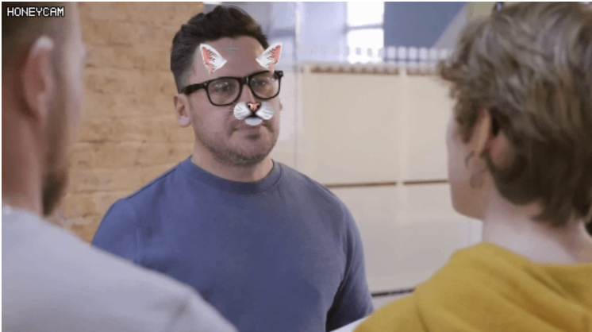





Slide 9


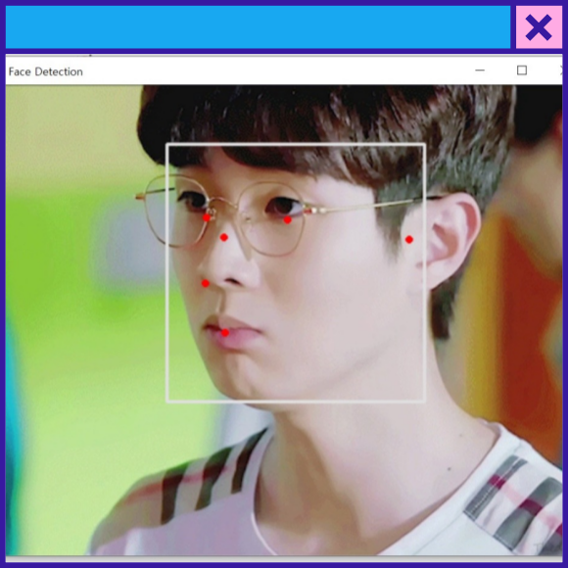




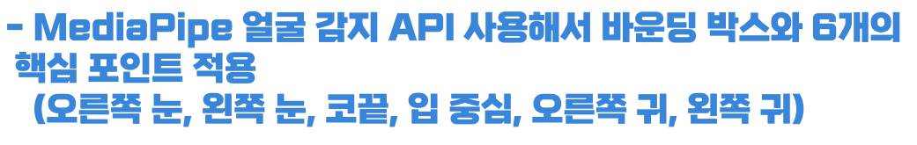

https://google.github.io/mediapipe/solutions/face_detection#python-solution-api

Slide 10




https://google.github.io/mediapipe/solutions/face_detection#python-solution-api

Slide 11







