Slide 1
Mod 4

Slide 2
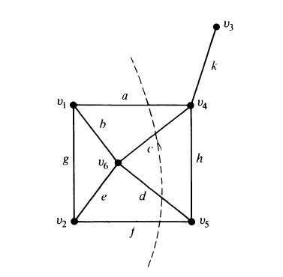
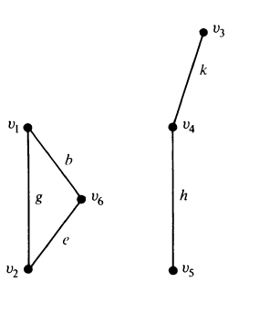
Cut Sets
In a connected graph G, a cut-set is a set of edges whose removal from G leaves G disconnected.
Cut sets - {a, c, d, f}, {a, b, g}, {k}, {a, b, e, f}, {d, h, f}

Slide 3
Cut set also called minimal cut set, proper cut set, cocycle or simple cut set.
Cut set always cuts a graph into two.
So cut set can also be defined as minimal set of edges in a connected graph whose removal reduces the rank of the graph by one.
Application: Telephone & transportation networks

Slide 4
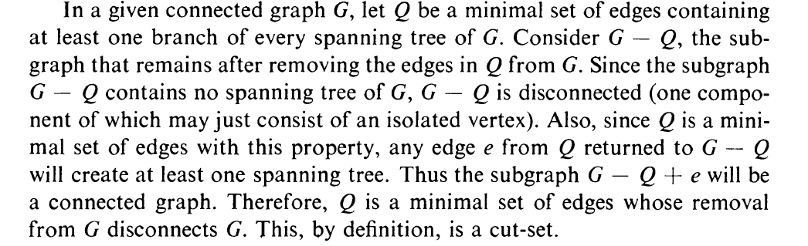
Properties of cut set
I. Theorem 1
Every cut set in a connected graph G must contain at least one branch of every spanning tree of G.
Proof:

Slide 5
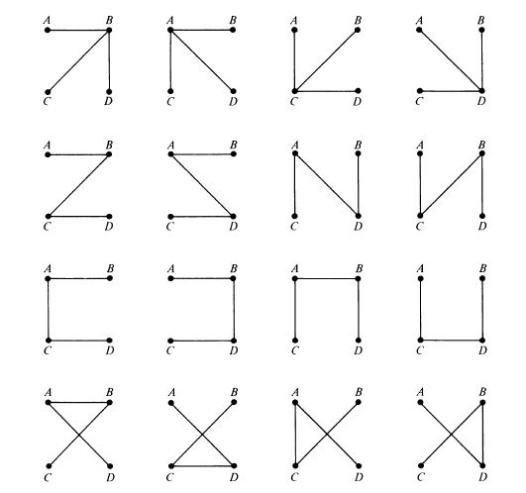

Slide 6
II. Theorem 2
In a connected graph G, any minimal set of edges containing at least one branch of every spanning tree of G is a cut set.
Proof:

Slide 7
III. Theorem 3
Every circuit has even number of edges in common with any cut set
Proof: Consider cut set S in G. Let removal of S partitions the vertices set in G into two disjoint sets v1 & v2. Consider a circuit Ƭ in G. If all vertices in Ƭ are with in v1(or v2), the number of edges common to S and Ƭ is zero.
On other hand, if some vertices in Ƭ are in v1 and others in v2, because of the closed nature of circuit, the number of edges traverse between v1 and v2 must be even. And since every edge in S has one end in v1 and other in v2. Since number of edges common to S and Ƭ must be even.

Slide 8
Fundamental Cut Sets / Basic cut set
A fundamental cut set w.r.t. that tree is a cut set that only contains one branch of the tree.
Consider spanning tree T of connected graph G.
Take a branch b from T.
Since {b} partitions all vertices into two disjoint sets.
Consider the same partition of vertices in G & cut set S in G that corresponds to this partition.
S will contain only one branch b and rest edges in S will be the chords with respect to T.
Such a cut set S which contains exactly one branch of T is called fundamental cut set w.r.t T.

Slide 9
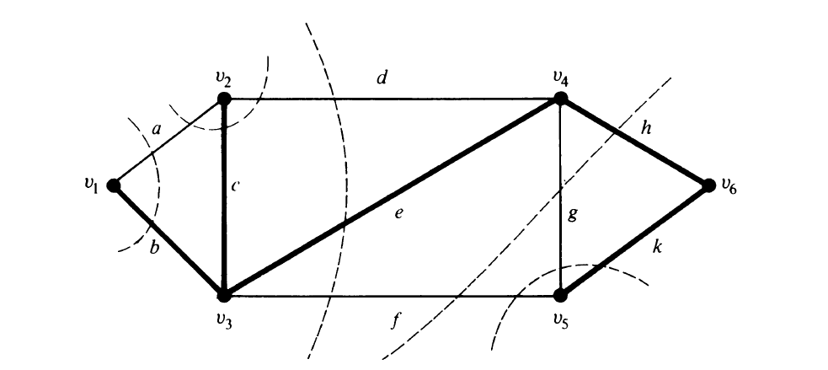

Slide 10
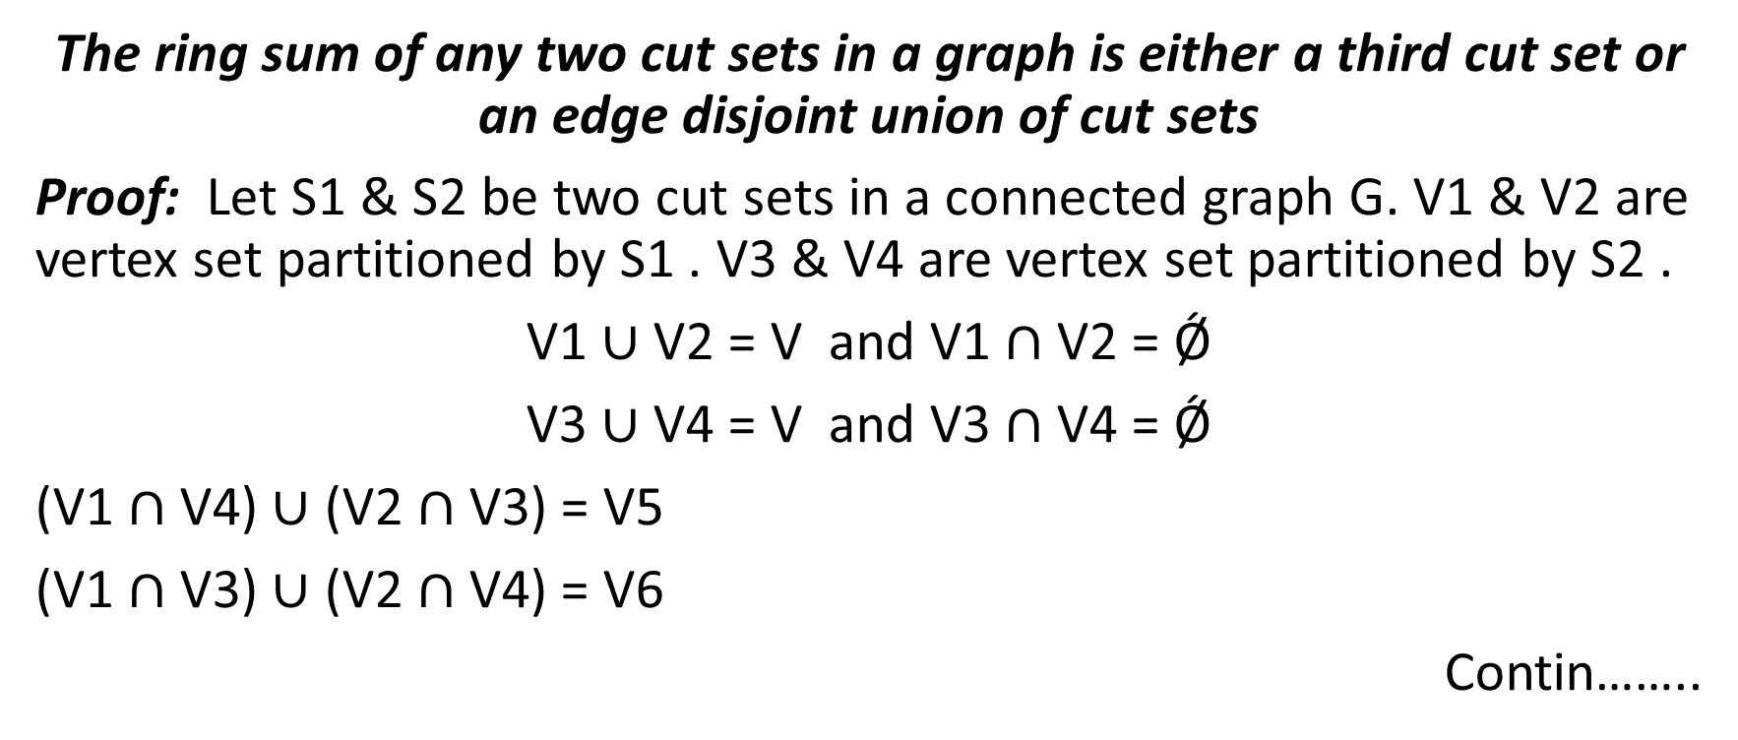
Theorem
The ring sum of any two cut sets in a graph is either a third cut set or an edge disjoint union of cut sets
Proof: Let S1 & S2 be two cut sets in a connected graph G. V1 & V2 are vertex set partitioned by S1 . V3 & V4 are vertex set partitioned by S2 .
V1 $∪$ V2 = V and V1 $∩$V2 = Ǿ
V3 $∪$ V4 = V and V3 $∩$V4 = Ǿ
(V1 $∩$V4) $∪$ (V2 $∩$V3) = V5
(V1 $∩$V3) $∪$ (V2 $∩$V4) = V6
Contin……..

Slide 11

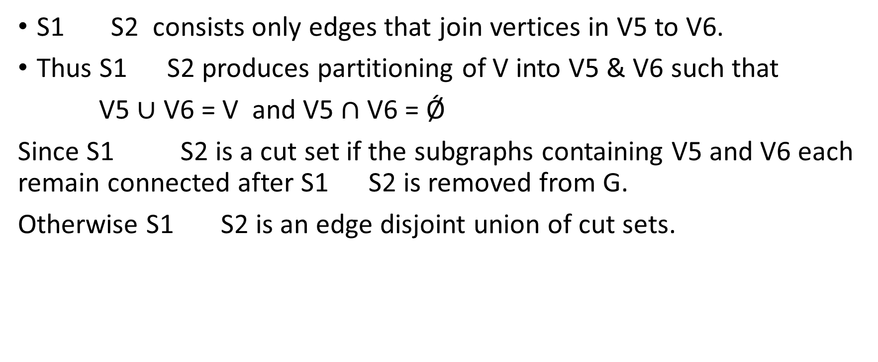
S1 S2 consists only edges that join vertices in V5 to V6.
Thus S1 S2 produces partitioning of V into V5 & V6 such that
V5 $∪$ V6 = V and V5 $∩$V6 = Ǿ
Since S1 S2 is a cut set if the subgraphs containing V5 and V6 each remain connected after S1 S2 is removed from G.
Otherwise S1 S2 is an edge disjoint union of cut sets.

Slide 12
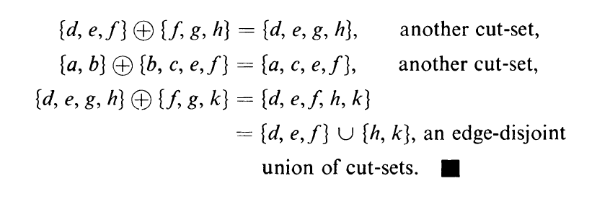
Example

Slide 13
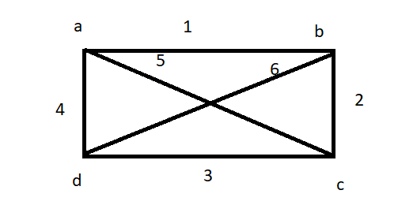
Fundamental circuits and cut sets
Theorem:
With respect to a given spanning tree T, chord c_{i} that determines a fundamental circuit Ƭ occurs in every fundamental cut set associated with the branches in Ƭ and in no other.
Proof:

Slide 14
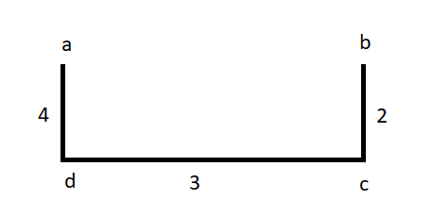
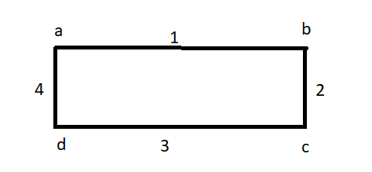
Spanning tree T:
Fundamental Circuit Ƭ formed by adding chord {1}
Ƭ={branches}+{chord}
={2,3,4}+{1}={1,2,3,4}

Slide 15
Fundamental cut set w.r.t branch {2}→{1,2,5}
Fundamental cut set w.r.t branch {3}→{1,3,5,6}
Fundamental cut set w.r.t branch {4}→{1,6,4}
The chord {1} is present in all fundamental cut set of every branches.
Hence proved.

Slide 16
Theorem
With respect to a given spanning tree T, a branch b_{i} that determines a fundamental cut set S is contained in every fundamental circuit associated with the chords in S and in no others.
Proof: Fundamental cut set S = {b_{i} ,c₁, c₂,……..c_{p} }
Fundamental circuit Ƭ formed by chord c_{i}
Ƭ = {c₁,b₁,b₂,…b_{q}}

Slide 17
Let fundamental circuit S w.r.t b→{1,6,2}
where {2 } is branch & {1,6} are chords w.r.t T
The b_{i} in S will be present in all fundamental circuits formed by chords in S w.r.t given T.
Here {2} is branch & {1,6} are chords w.r.t T .
Fundamental circuits that can be formed using edges {1,6} are {5,4,3,2} & {1,2,3,4}
As per theorem {5,4,3,2} & {1,2,3,4} fundamental circuits contains {2} which is a branch in S.
Hence proved.

Slide 18
Edge connectivity
The cut sets in a connected graph G consists of certain number of edges.
The number of edges in cut sets with fewer number of edges is known as edge connectivity of G.
It can also be defined as the minimum number of edges, whose removal reduces the rank of the graph by one.
Edge connectivity of tree is always one.

Slide 19
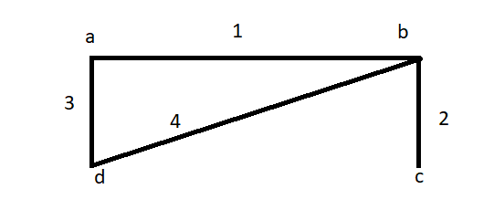
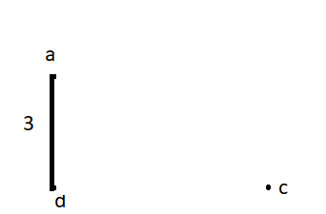
Vertex connectivity
It is defined as the minimum number of vertices, whose removal from G leaves the remaining graph disconnected.
Vertex connectivity of tree is always one
Remove vertex b from G
Here vertex connectivity is one

Slide 20
Separable graph
A graph G is said to be separable if its vertex connectivity is one.
Graphs with vertex connectivity more than one are non separable graphs.
In a separable graph, a vertex whose removal disconnects the graph G is known as cut vertex, cut node or anticulation point.

Slide 21
Theorem
A vertex v in a connected graph G is a cut vertex iff there exist two vertices x and y in G such that every path between x and y passes through v
Proof:
Here b is the cut vertex. For every path between a & c it passes through b. Hence proved.
Application: Suppose n stations are to be connected using e lines, which is less vulnerable to destruction of individual stations & individual lines. Then The network should have maximum edge a& vertex connectivity.

Slide 22
Theorem
The edge connectivity of a graph G cannot exceed the degree of the vertex with the smallest degree in G
Proof: Let v_{i} be vertex with smallest degree in G. By deleting the edges incident on this v_{i} can make the G disconnected. Hence proved.
Ex: Here c is the vertex with smallest
Degree. So by deleting edges incident
on c can make G disconnected.
Ie, by deleting edge{2} can make
G disconnected. So edge connectivity in this G is 1.

Slide 23
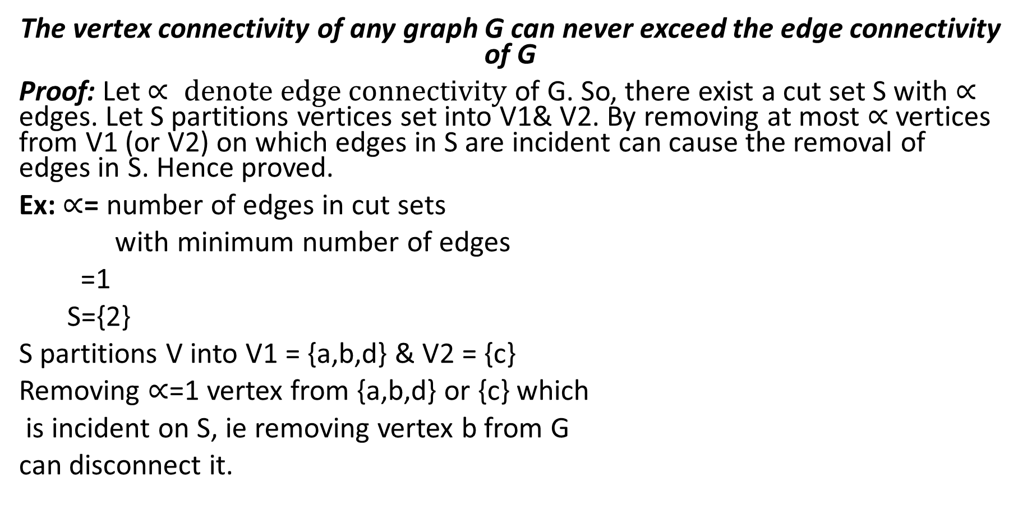
Theorem
The vertex connectivity of any graph G can never exceed the edge connectivity of G
Proof: Let $∝ denote edge connectivity$ of G. So, there exist a cut set S with $∝$ edges. Let S partitions vertices set into V1& V2. By removing at most $∝$ vertices from V1 (or V2) on which edges in S are incident can cause the removal of edges in S. Hence proved.
Ex: $∝$= number of edges in cut sets
with minimum number of edges
=1
S={2}
S partitions V into V1 = {a,b,d} & V2 = {c}
Removing $∝$=1 vertex from {a,b,d} or {c} which
is incident on S, ie removing vertex b from G
can disconnect it.

