Slide 1
JERO FRANCIS S
B.TECH
AI & DS
AU211521243077
3/21/2024 Annual Review

Slide 2
TITLE
LANE DETECTION WHILE DRIVING USING AI
3/21/2024 Annual Review

Slide 3


AGENDA
Introduction
Project Overview
Implementation Details
Additional Processes
Demonstration
Conclusion & Discussion
3/21/2024 Annual Review

Slide 4

PROBLEM STATEMENT
Accurate lane detection is crucial for navigation and safety in both manual and autonomous driving. Traditional computer vision techniques often struggle in varying lighting conditions, weather, and road types, leading to unreliable lane detection that can compromise safety.
3/21/2024 Annual Review

Slide 5

PROJECT OVERVIEW
This project focuses on creating a robust lane detection system using deep learning, specifically Convolutional Neural Networks (CNNs), to process video frames from car-mounted cameras. The system will identify and track lane markings under various environmental conditions, providing critical information for driver assistance systems and autonomous vehicles.
3/21/2024 Annual Review

Slide 6

WHO ARE THE END USERS?
The primary users are automotive manufacturers and autonomous vehicle technology companies. Secondary users include developers of driver-assistance systems and researchers in vehicular automation.
3/21/2024 Annual Review

Slide 7

YOUR SOLUTION AND ITS VALUE PROPOSITION
Implement a CNN-based model that processes frames from video streams to detect lane lines. The model will use edge detection and feature extraction techniques to identify lane boundaries and predict their trajectories. The system will be designed to adapt to different lighting conditions, road surfaces, and occlusions, ensuring reliable lane detection in real-time.
3/21/2024 Annual Review

Slide 8

THE WOW IN YOUR SOLUTION
The system's ability to perform real-time lane detection accurately under various challenging conditions, such as rain, snow, nighttime, and roads without clear lane markings, will be its wow factor. This capability is crucial for the advancement of autonomous driving technologies and the enhancement of road safety.
3/21/2024 Annual Review

Slide 9
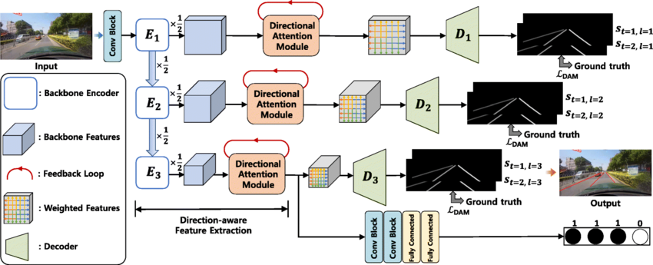
MODELLING
3/21/2024 Annual Review

Slide 10
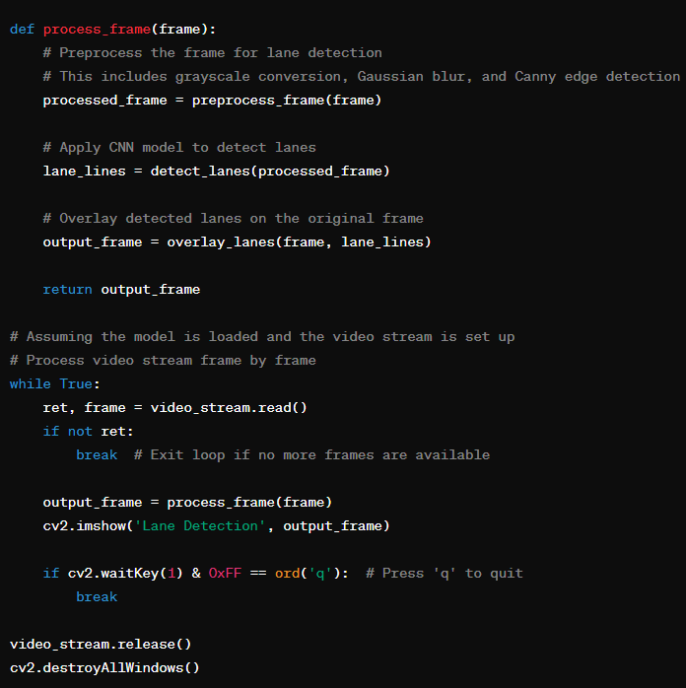
RESULTS
Demo Link
3/21/2024 Annual Review

