Slide 1
Optical Quantum Effects
Candidate number: 1025496
Supervisor: Prof. Alex Lvovsky

Slide 2
Background - spontaneous parametric down-conversion (SPDC)
Quantum information
Single photon source
SPDC
Modern research
Quantum cryptography
Entangled photon pairs
Quantum computation

Slide 3
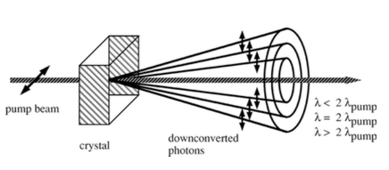
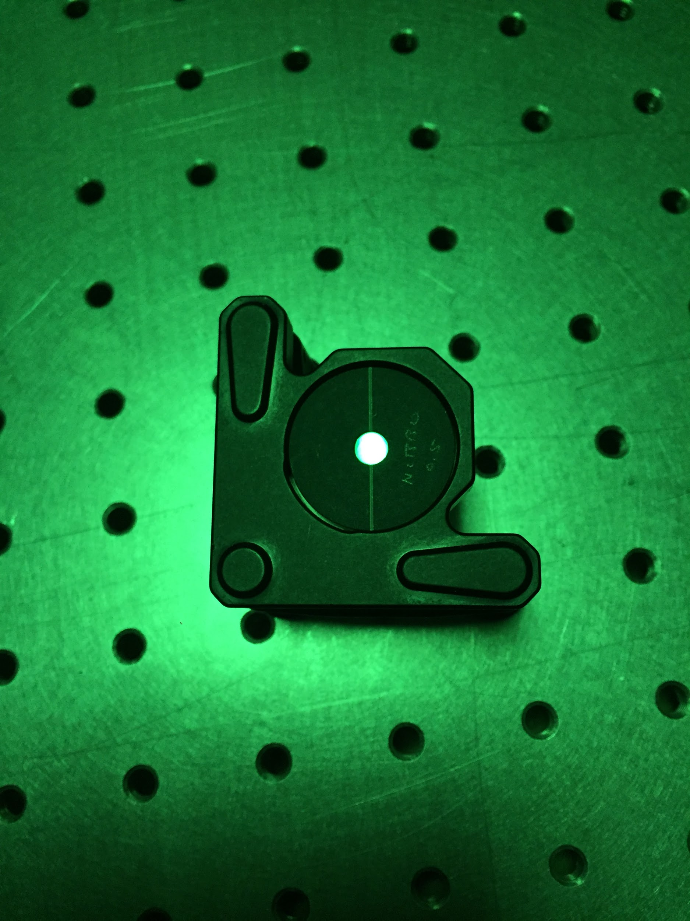
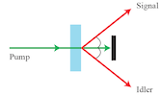
Introduction of SPDC
Type 1 BBO crystal

Slide 4
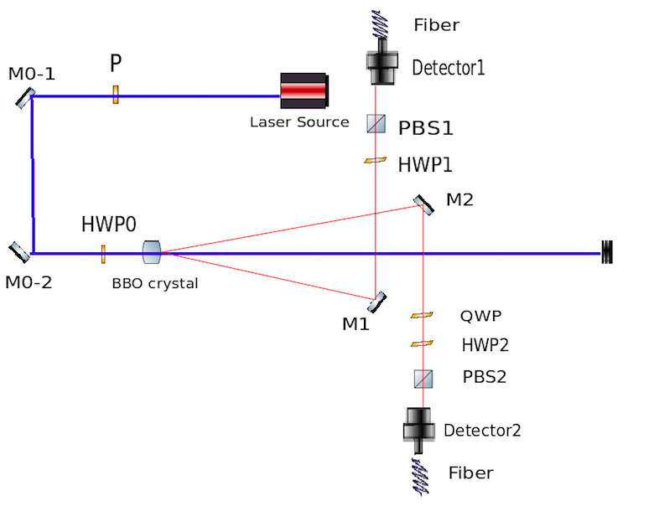
Experimental setup
HWP: half-wave plate
QWP: quarter-wave plate
P: polarizer
PBS: polarizing beam splitters
M: mirror

Slide 5
Key step - alignment
Precise adjustments
Back alignments
Results:
Single photon count ~ 40kHz
Coincidence count ~ 10kHz
1kHz for Bell’s inequality

Slide 6
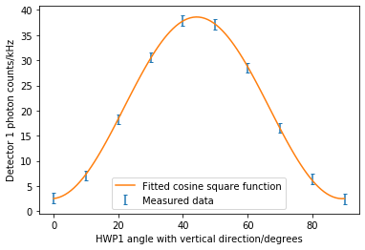


Polarization measurements
HWP
Detector
PBS

Slide 7
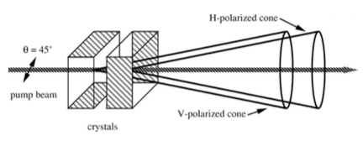
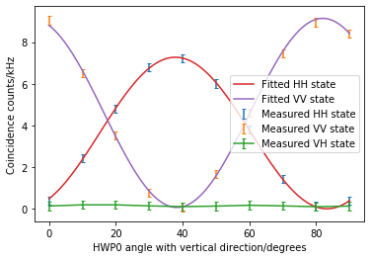
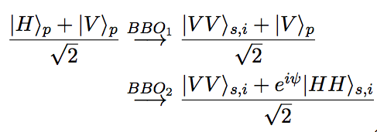
Phenomenon - entanglement

Slide 8
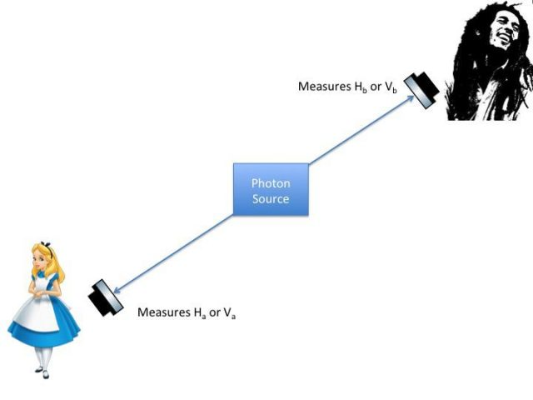
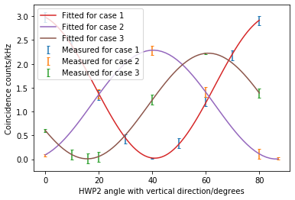
Phenomenon - remote state preparation
 | QWP/degrees | HWP1/degrees
Case 1 | 292 | 0.0
Case 2 | 246 | 22.5
Case 3 | 23 | 45

Slide 9
Next Steps
Bell’s inequality
Photon interference: Hong-Ou-Mandel and Mach-Zehnder interferometer

Slide 10
Conclusions
High coincidence vs single photon count ratio: 3%.
Around 3 times higher than literatures.
Demonstration of maximally entangled state and remote state preparation.
Well-documented for teaching purposes.

Slide 11
Thanks for listening!

