Slide 1

Aquatic Life Identification
A
John Schulz
Project
Department
of
Electrical Engineering

Slide 2
Abstract
Provide a practical and efficient solution for controlling aquatic populations.
Utilize video data captured from the systems destination environment to create the machine learning database.
Restricted Boltzmann Machine (RBM) deep feed forward neural network implemented.
Targeting deployable high end embedded systems.

Slide 3
Prediction/Hypothesis
Need 15-30 Minutes of VGA quality per species 🙃
Reach Accuracy between 60% and 80%.
Considerable amount of time training ✅
Accuracy will depend on 3 key points
Amount of learning data collected.
Environments the subject is in.
Training Time 😑🙏

Slide 4
Video and Images
Captured Video Quality: VGA (640 x 480) to HD (1240 x 720)
Capture Codec: .m4v
Image Processing
Video Frames split into individual Images, then downscaled.
Images Quality: QVGA (240 x 320)
Images Type: PNG
Image Codec: AdobeRGB 8-bit

Slide 5
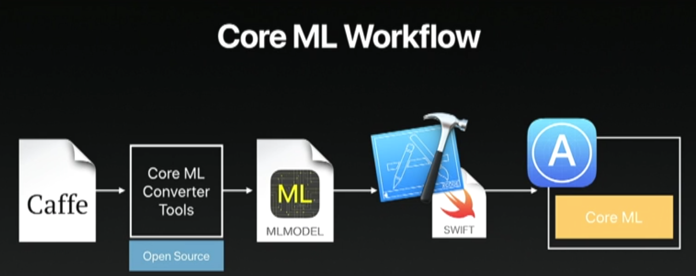
Software
4 Operating Systems
3 Languages
4 API’s
MacOS 10.11 Sierra
MacOS 10.12 High Sierra
Windows 10 Pro
iOS 11
Python 3.6
Matlab Script
Swift 4.0
Image Processing Toolbox
Keras 2.1.4
coremltools converter
CoreML 0.8
Vision
Keras
Source: “State of the Union 2016”, Apple WWDC, 2016.

Slide 6
Hardware
Imaging Device 1: Canon 70D 20 MP 18-55 STM f/3.5-5.6 IS STM
Imaging Device 2: iPhone X 12 MP f/1.8 or f/2.4
Machine 1: 2016 MacBook Pro 15”
Intel i7-6820HQ 4-cores @ 2.6 GHz, AMD 460, 16 GB RAM
Machine 2: 2018 Alienware 13 R3
Intel i7-7700HQ 4-cores @ 2.8 GHz, Nvidia GTX 1060, 32 GB RAM
Machine 3: 2017 iPhone X
A11 Bionic 6-cores @ 2.4 GHz, Co-Processor Neural Engine 1.0, 3 GB RAM

Slide 7
Database
Total Features: 5
Unique Features: 3
Total # Unique Species: 5611
Total # of Images: 8088

Slide 8
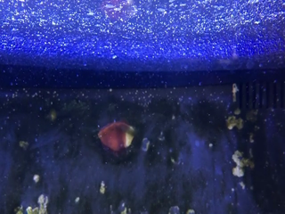
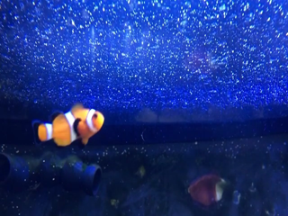
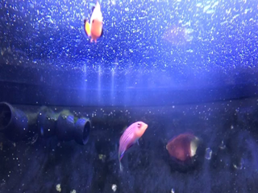
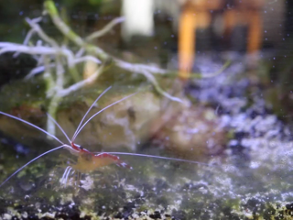
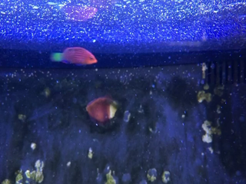
Sample Features
Empty
Orange Clownfish
Mixed
Shrimp
Wrasse

Slide 9
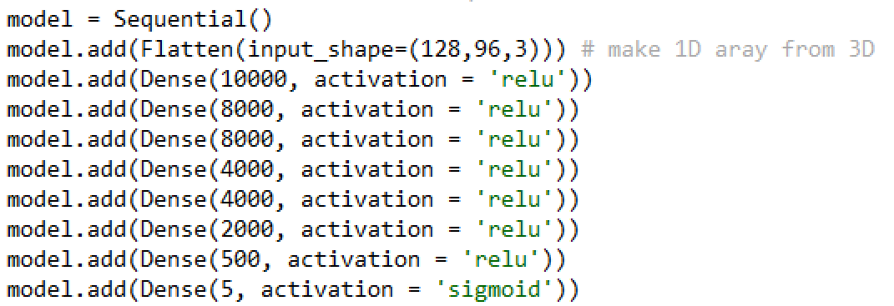
Architecture
Keras Sequential Model
Feed Type: Direct PNG
Lack of Dropout Support on Embedded Systems for .h5
Batch Size = 100
Micro-Batch Size = 10
Batch Queue = 1

Slide 10
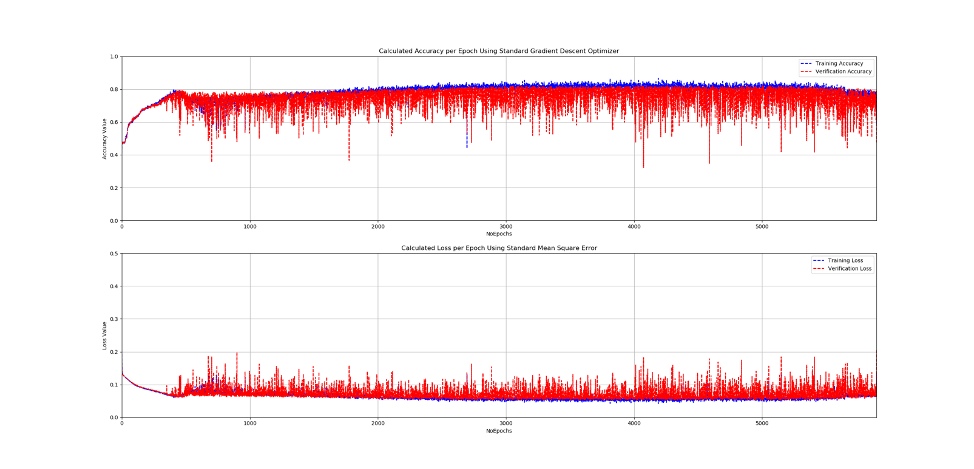
Training Results
9[s] per epoch

Slide 11
12 Stages of Design
Collect Imagery Data
Convert
Video2PNG.m
Manually Sort Images
Process Images
FormatPNG.m
Split Data 70/20/10
PreBatcher.m
Convert Images into Text Files for Archiving
img_list2array.py
Create Randomized Batches of Data Saved as Text Files
Custom_Batching.py
Train In Keras
NN_New_Sequential.py
Export Keras Model
Fish_Imaging_Model.h5
Use coremltools to convert model to CoreML
Keras_to_coreML_OSX.py
Import CoreML Model into XCode
Run on iPhone X
90% of Code Written For Cross-Platform Use

Slide 12

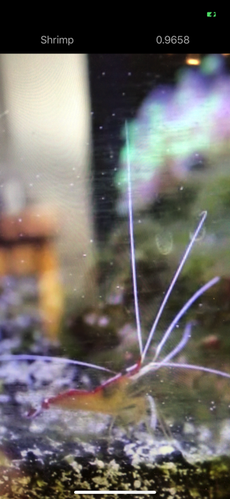
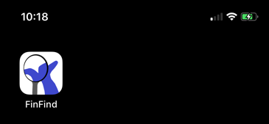
FinFind
Real Time Identification
Full Resolution of Camera App
No Image Delay
2-3 Predictions a Seconds
CoreML = CPU+GPU+Neural Engine
Vision Change In Frame Detection for Optimal Battery Life
Guards Stops Crashes Against nil

Slide 13
Demo
https://youtu.be/6SYRssdz97I

Slide 14
Conclusion
The Goals
✅ Design
✅ Identify
✅ Embed
✅ Hypothesize

Slide 15
Questions

