Slide 1
EasyID
By: Taryn Chovan Jesus Cantu Joseph Lombardi

Slide 2

Proposal
We propose a web-interaced tool that identifies what a piece of data is. Given any string of data, or a file full of strings of data, it will output what those string(s) are likely to be, and any corresponding additional details about them.
Situation
➤ You come across an unknown, benign or perhaps malicious, piece of data.
➤ Instead of long google searches and unsure guesses, you want immediate identification of the string.
➤ Examples:
1. That mysterious string "0x52908400098527886E0F7030069857D2E4169EE7" in your sketchy email is in fact an Ethereum wallet address.
2. That nine-digit number 580655723 floating around a public forum happens to be your brother's social.
3. That text from your friend directing you to "dQw4w9WgXcQ" is just a youtube video ID.

Slide 3
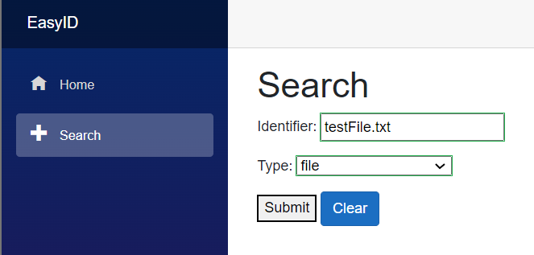
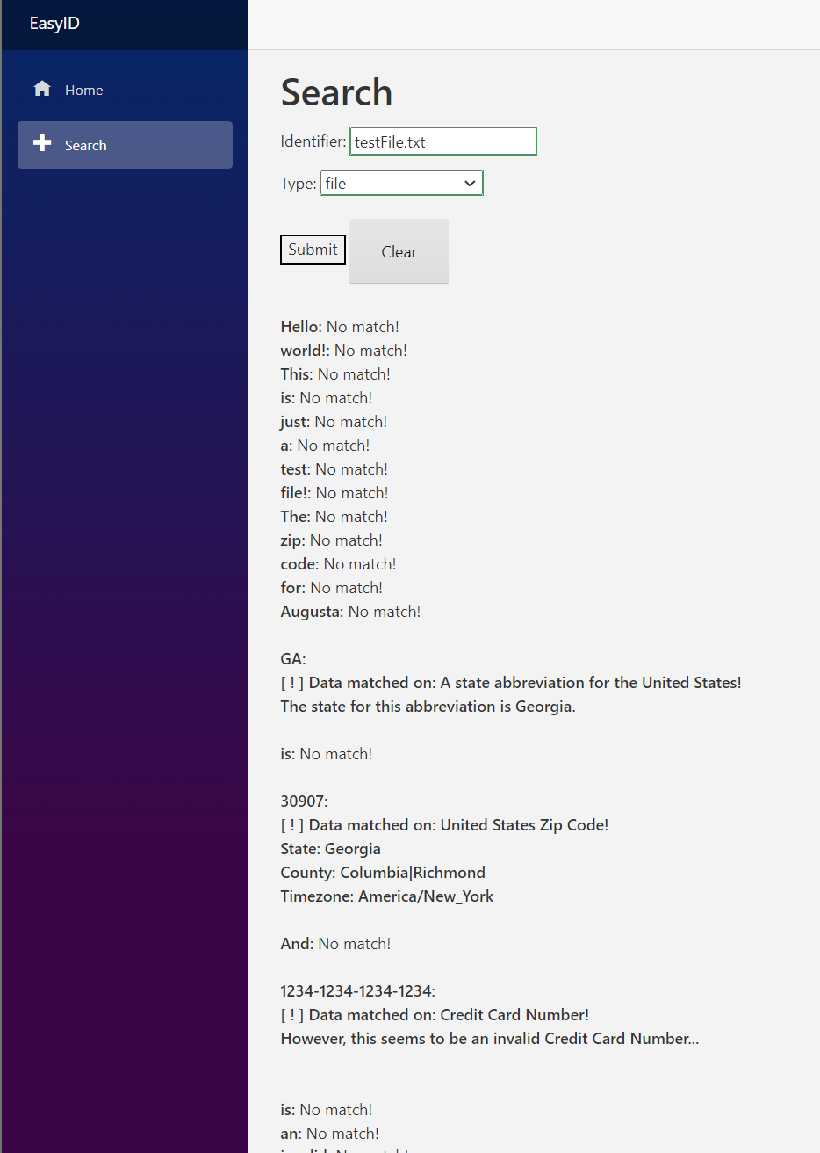
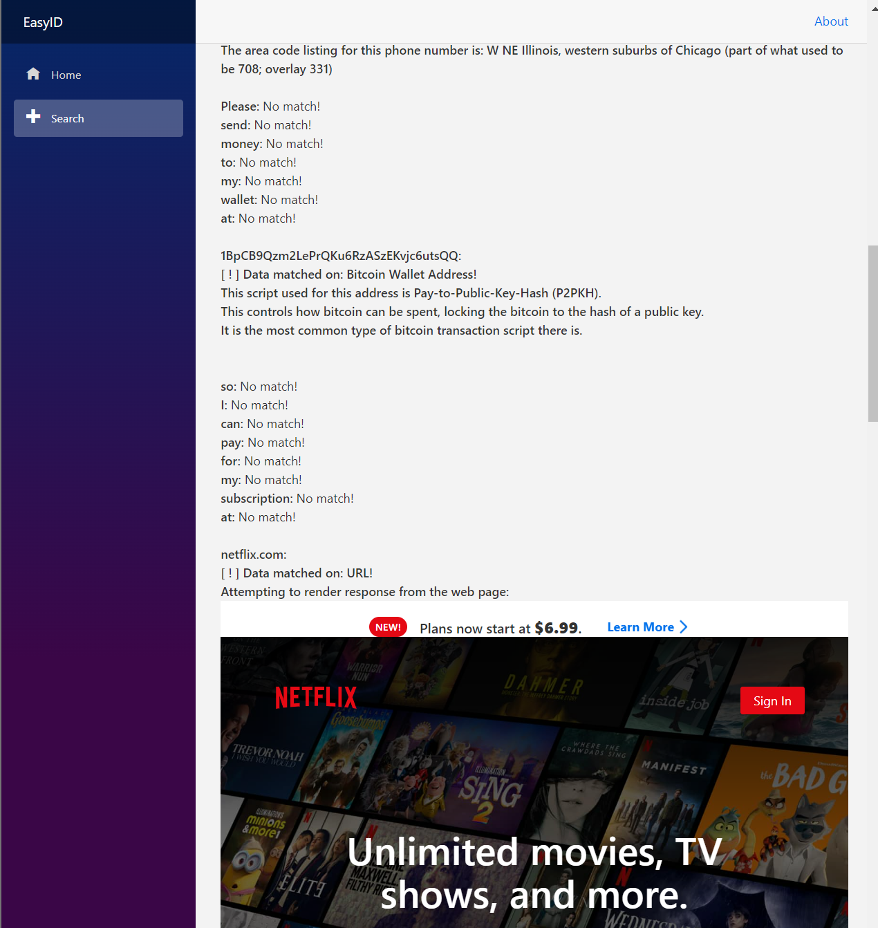
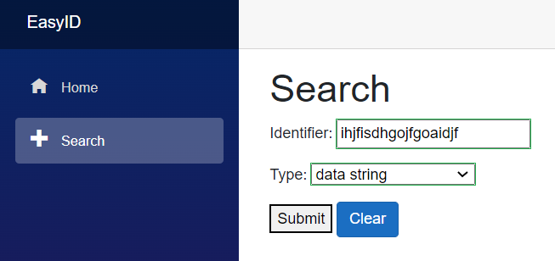
Web Interface
Input
Output

Slide 4
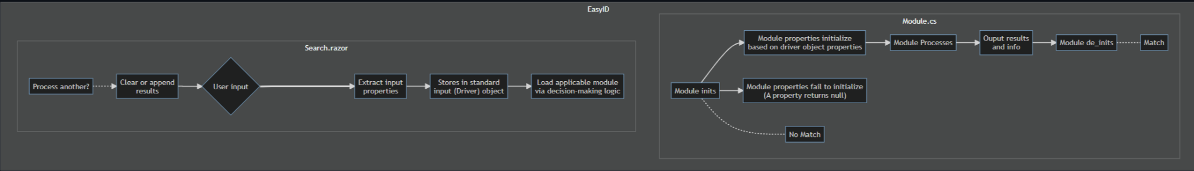


Software Design: code flow

Slide 5
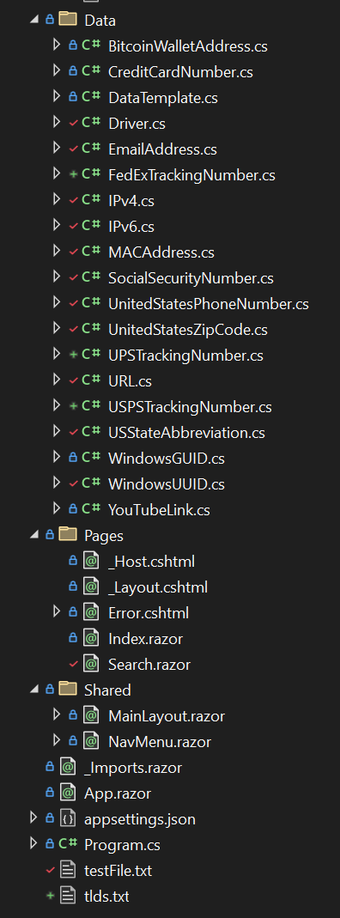
Software Design: code hierarchy
Shared objects
Data Modules
Base class
Driver objects
Initializes web app
Inherited classes
Shared files
Page Layouts
Creates a Driver, Searches modules

Slide 6
Bugs
Current version has an XSS or HTML injection vulnerability
Limitations
Needs more modules (data strings to test for)
Module selection algorithm - slows down program
Needs better handling for matching on multiple modules, such as a percent likelihood. (i.e: A singular nine-digit numeric string string will match on both UPS Tracking Number and Social Security Number with no way of differentiating between the two).
Needs more fuzzing and test cases to identify bugs and inaccuracies

Slide 7
Future work
Module selection via HashMap O(1)
More modules
More API calls and interesting details
Another navigation tab on the web page for another feature?

Slide 8
Demo

Slide 9
Questions?

