Slide 1
“DermApp”

Slide 2
Definición del problema
Here you have a list of items
And some text
But remember not to overload your slides with content
Your audience will listen to you or read the content, but won’t do both.

Slide 3
1.
Descripción

Slide 4
Escenario de uso

Slide 5
Casos de Uso

Slide 6
Bosquejo de Clases

Slide 7
2. Métodos y Herramientas

Slide 8
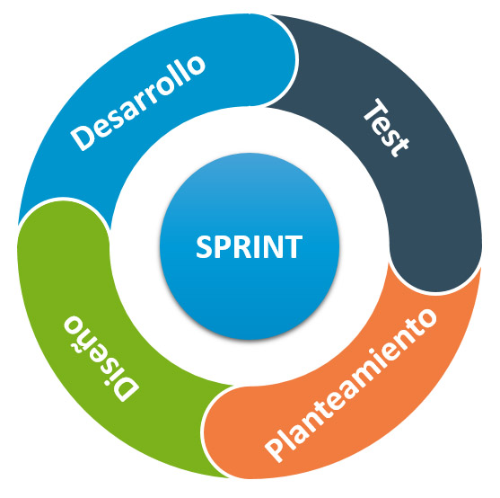
Metodología Ágil
Todos los integrantes scrum users.
Un scrum master.

Slide 9



Herramientas de comunicación

Slide 10
Bitácora
Fecha | Objetivo | Duración
03/10/19 | Definir formalmente el proyecto. Dividir tareas de primera entrega | 30 min
…. | … | …
… | … | …

Slide 11
2.1
Métrica

Slide 12
Funcionalidad
Tareas
División
División del sistema
Conversión a tareas
‘Equitativamente’

Slide 13
Maps
our office

Slide 14
89,526,124
Whoa! That’s a big number, aren’t you proud?

Slide 15
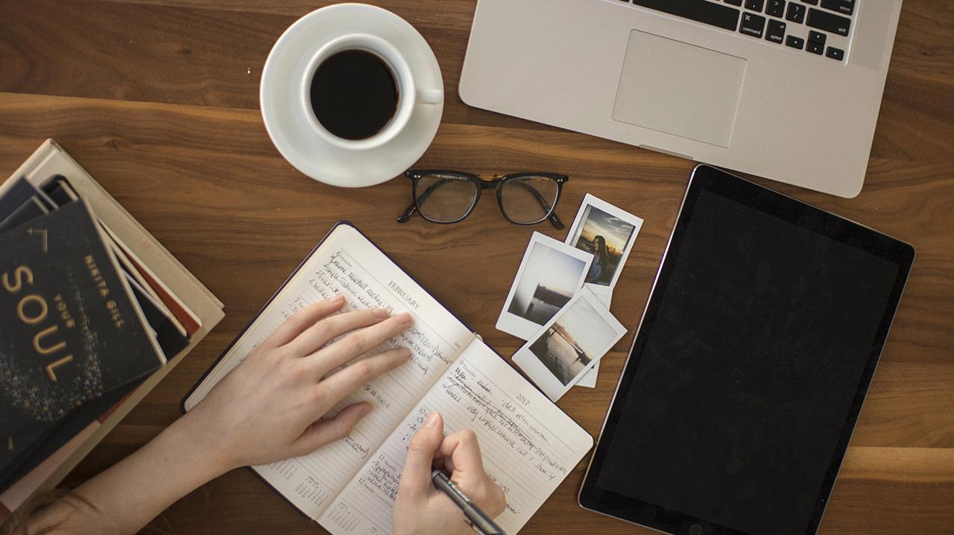
Want big impact?
Use big image.

Slide 16
Our process is easy
first
second
last

Slide 17
Let’s review some concepts
Yellow
Is the color of gold, butter and ripe lemons. In the spectrum of visible light, yellow is found between green and orange.
Blue
Is the colour of the clear sky and the deep sea. It is located between violet and green on the optical spectrum.
Red
Is the color of blood, and because of this it has historically been associated with sacrifice, danger and courage.
Yellow
Is the color of gold, butter and ripe lemons. In the spectrum of visible light, yellow is found between green and orange.
Blue
Is the colour of the clear sky and the deep sea. It is located between violet and green on the optical spectrum.
Red
Is the color of blood, and because of this it has historically been associated with sacrifice, danger and courage.

Slide 18
GRACIAS!
Repositorio: https://github.com/alextorrer/OOP

