Slide 1
“DermApp”

Slide 2
Definición del problema
Here you have a list of items
And some text
But remember not to overload your slides with content
Your audience will listen to you or read the content, but won’t do both.

Slide 3
1.
Descripción del Proyecto

Slide 4
Requerimientos
Funcionales
Is the color of milk and fresh snow, the color produced by the combination of all the colors of the visible spectrum.
No Funcionales
Is the color of coal, ebony, and of outer space. It is the darkest color, the result of the absence of or complete absorption of light.

Slide 5
Escenario de uso

Slide 6
Casos de Uso

Slide 7
Bosquejo de Clases

Slide 8
2. Métodos y Herramientas

Slide 9
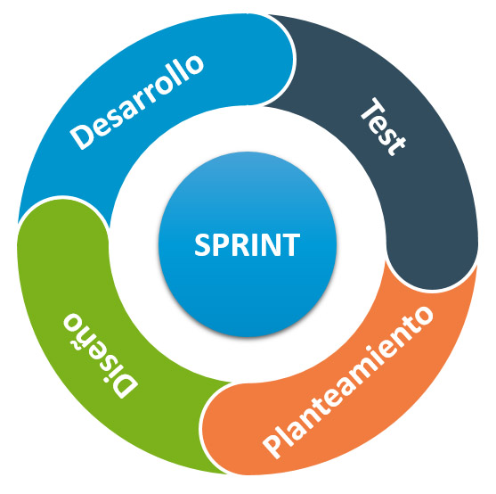
Metodología Ágil
Todos los integrantes scrum users.
Un scrum master.

Slide 10



Herramientas de comunicación

Slide 11
Bitácora
Fecha | Objetivo | Duración
03/10/19 | Definir formalmente el proyecto. Dividir tareas de primera entrega | 30 min
…. | … | …
… | … | …

Slide 12
Maps
our office

Slide 13
89,526,124
Whoa! That’s a big number, aren’t you proud?

Slide 14
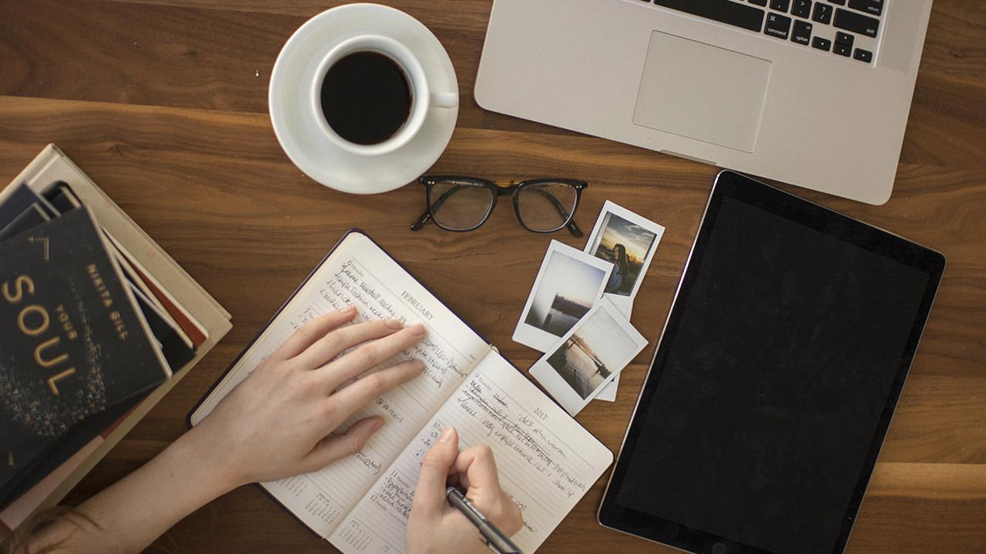
Want big impact?
Use big image.

Slide 15
89,526,124$
185,244 users
100%
That’s a lot of money
And a lot of users
Total success!

Slide 16
Our process is easy
first
second
last

Slide 17
Let’s review some concepts
Yellow
Is the color of gold, butter and ripe lemons. In the spectrum of visible light, yellow is found between green and orange.
Blue
Is the colour of the clear sky and the deep sea. It is located between violet and green on the optical spectrum.
Red
Is the color of blood, and because of this it has historically been associated with sacrifice, danger and courage.
Yellow
Is the color of gold, butter and ripe lemons. In the spectrum of visible light, yellow is found between green and orange.
Blue
Is the colour of the clear sky and the deep sea. It is located between violet and green on the optical spectrum.
Red
Is the color of blood, and because of this it has historically been associated with sacrifice, danger and courage.

Slide 18
Android project
Show and explain your web, app or software projects using these gadget templates.
Place your screenshot here

Slide 19
iPhone project
Show and explain your web, app or software projects using these gadget templates.
Place your screenshot here

Slide 20
Tablet project
Show and explain your web, app or software projects using these gadget templates.
Place your screenshot here

Slide 21
Desktop project
Show and explain your web, app or software projects using these gadget templates.
Place your screenshot here

Slide 22
GRACIAS!
Repositorio: https://github.com/alextorrer/OOP

Slide 23
Credits
Special thanks to all the people who made and released these awesome resources for free:
Presentation template by SlidesCarnival
Photographs by Unsplash

Slide 24
Presentation design
This presentation uses the following typographies and colors:
Titles: Roboto Slab Light
Body copy: Lato Light
You can download the fonts on these pages:
http://www.latofonts.com/lato-free-fonts/
https://www.fontsquirrel.com/fonts/roboto-slab
Aqua #02bdc7 · Yellow #ffb600 · Magenta #fc4067
You don’t need to keep this slide in your presentation. It’s only here to serve you as a design guide if you need to create new slides or download the fonts to edit the presentation in PowerPoint®

Slide 25
SlidesCarnival icons are editable shapes.
This means that you can:
Resize them without losing quality.
Change line color, width and style.
Isn’t that nice? :)
Examples:

Slide 26
😉
Now you can use any emoji as an icon!
And of course it resizes without losing quality and you can change the color.
How? Follow Google instructions https://twitter.com/googledocs/status/730087240156643328
✋👆👉👍👤👦👧👨👩👪💃🏃💑❤😂😉😋😒😭👶😸🐟🍒🍔💣📌📖🔨🎃🎈🎨🏈🏰🌏🔌🔑 and many more...

